Slide 1



Military Sociology:
Past, Present, Future
Patricia M. Shields, PhD
Texas State University
Presented at
Norwegian Institute for Defence Studies
September 24, 2013

Slide 2

Organization
Short Scholarly Biography
Definitions of Military Sociology
History and Leading Military Sociologists
Theoretical perspectives
Contemporary Dimensions of Military Sociology
Future of Military Sociology

Slide 3
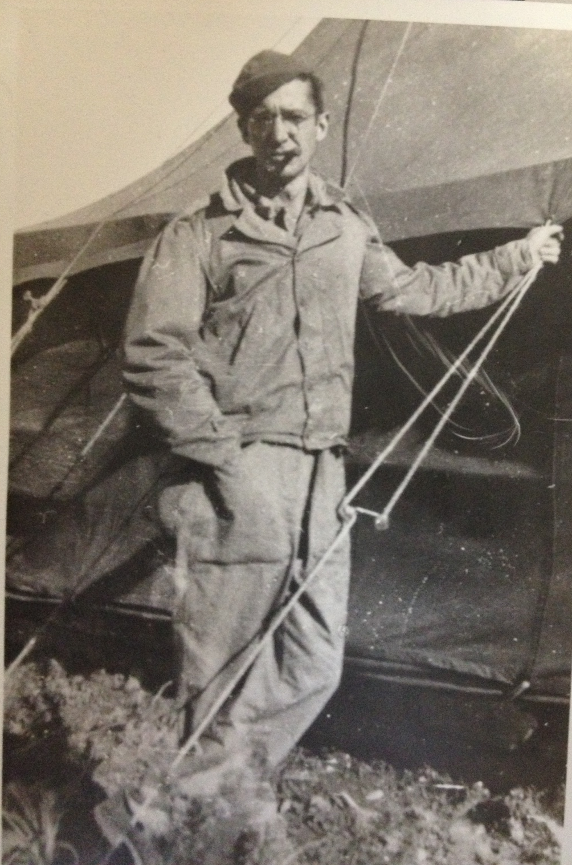
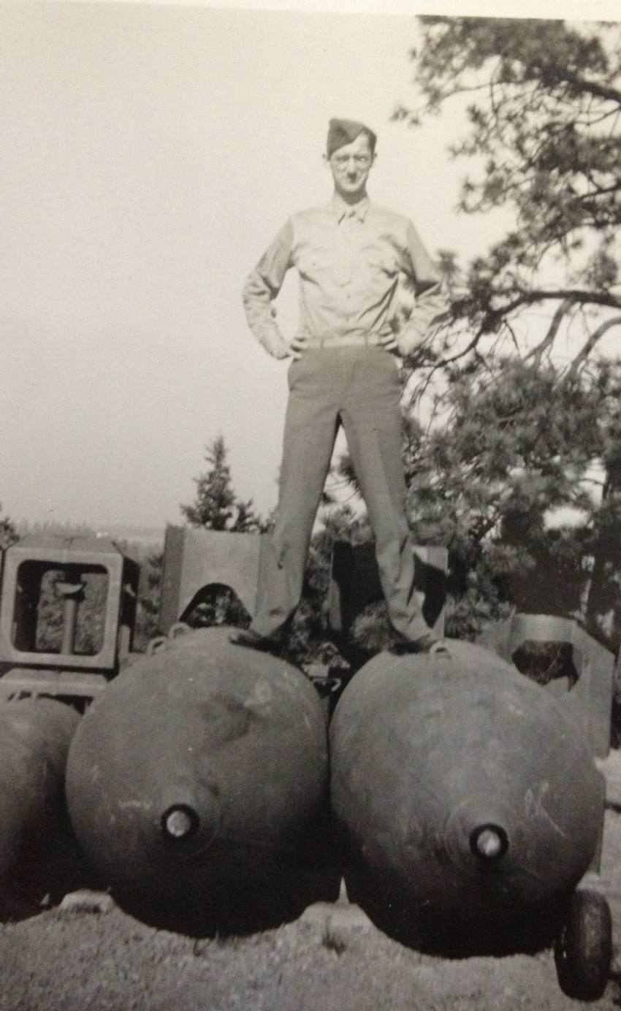
Short Scholarly Biography
J. G. Shields 1914 - 2002

Slide 4
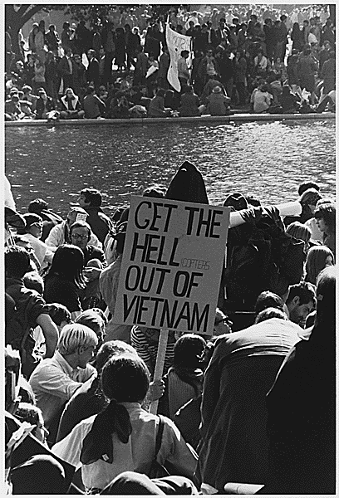
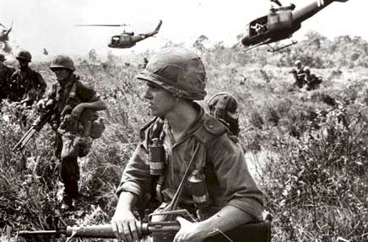
College Years
1969 – Vietnam War
1977 – Dissertation “The Determinants of Service in the Armed Forces during the Vietnam Era”

Slide 5
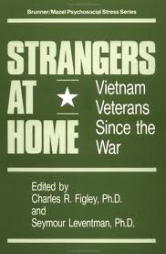
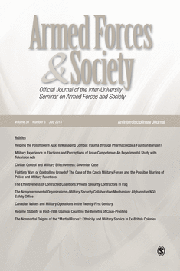
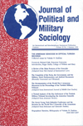
Early Publications
1980 – “Determinants & Consequence of
Service in Vietnam” (Veterans focus)
“Enlistment during the Vietnam
Era and the ‘Representation’ Issue of the All Volunteer Force
1981 – “The Burden of the Draft: The
Vietnam Years” Journal of Political
and Military Sociology

Slide 6
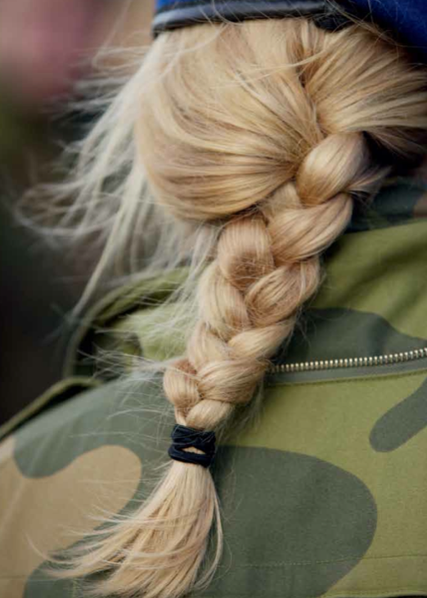
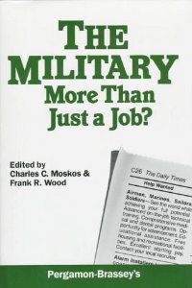
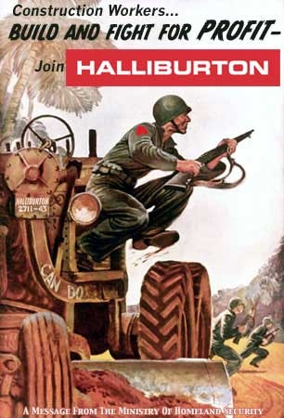
1988 Women in the Military “Sex Roles in the Military” The Military More than a Job (Moskos & Wood)
1989 Military Privatization “Consequence of Privatization” The Bureaucrat
Shift to All-Volunteer military

Slide 7
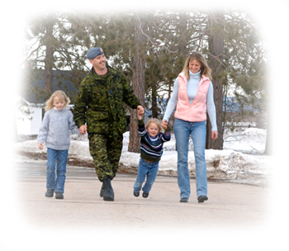
1993 – Socioeconomics
“A New Paradigm for Military Policy:
Socioeconomics”
1996 - Family Demographics
“Changing Family Demographics” in Future Soldier and the Quality Imperative
Volunteer military

Slide 8
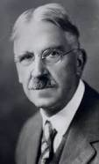
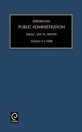
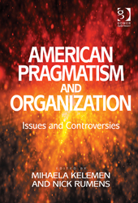




Applied Pragmatism
1996 - 2013
Public Administration
Research Methods
Decision-making
John Dewey
(12)

Slide 9
2001-Present
Operates in the broad intellectual and policy spheres where society and the military meet.

Slide 10
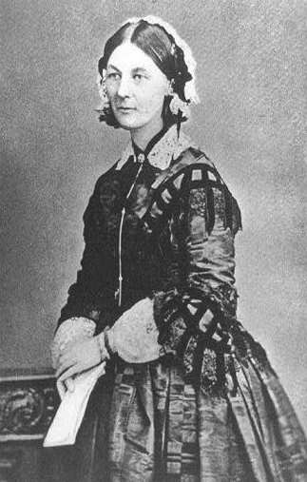

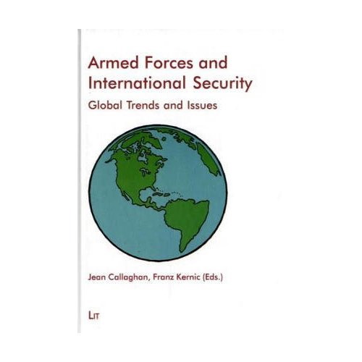
2003
The Bureaucracy in Military Sociology
Florence Nightingale
2009
Women’s Contribution to Military and Societal Transformation

Slide 11

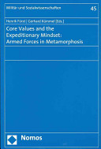
Expeditionary
Mindset (2011)
2013
Post Cold War – War on Terror
Pragmatism & Peacekeeping

Slide 12

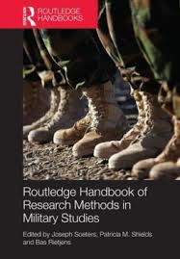
Research Methods
2013
2014

Slide 13
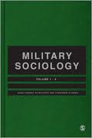
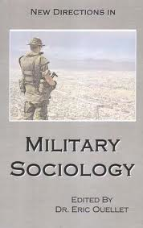
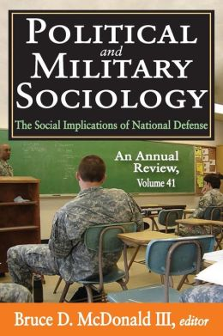
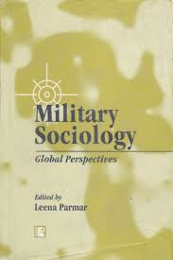
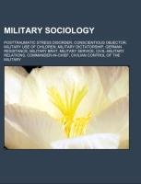
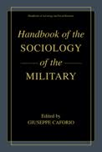
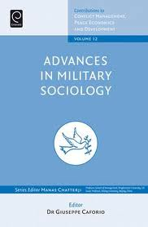

Slide 14
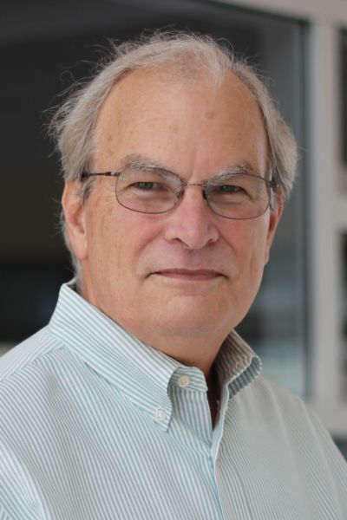
Military sociology is a subfield of the study of armed forces and society that is focused more narrowly
on the relationships
between military
oganizations and the larger society.
James Burk

Slide 15
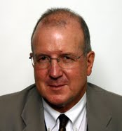
Military sociology is a broad term
to describe
the academic field that
studies the individual within
the military institution,
and the military profession
within its wider society.
BG Nick Jans

Slide 16
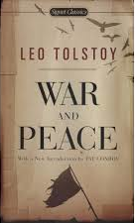
‘In warfare the force of armies is
the product of mass multiplied
but something else,
an unknown x.’
‘X is the spirit of the Army’

Slide 17
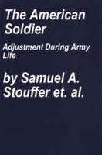
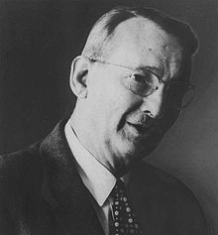
Understand X – develop policies
Opinion polling
500,000+
Research Arm of Army
1900 - 1960
Self aware field

Slide 18
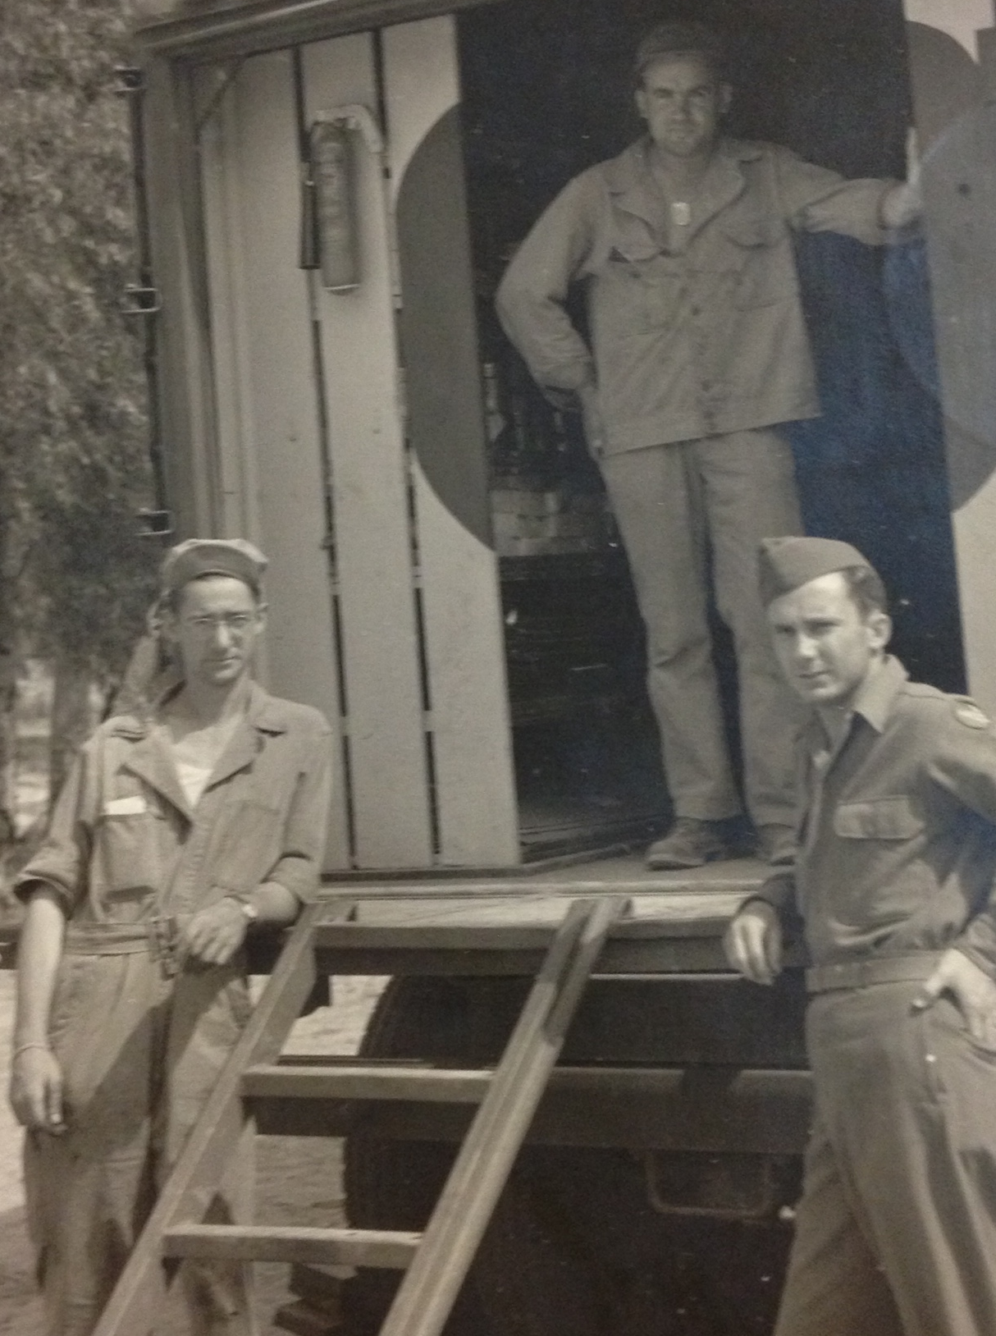
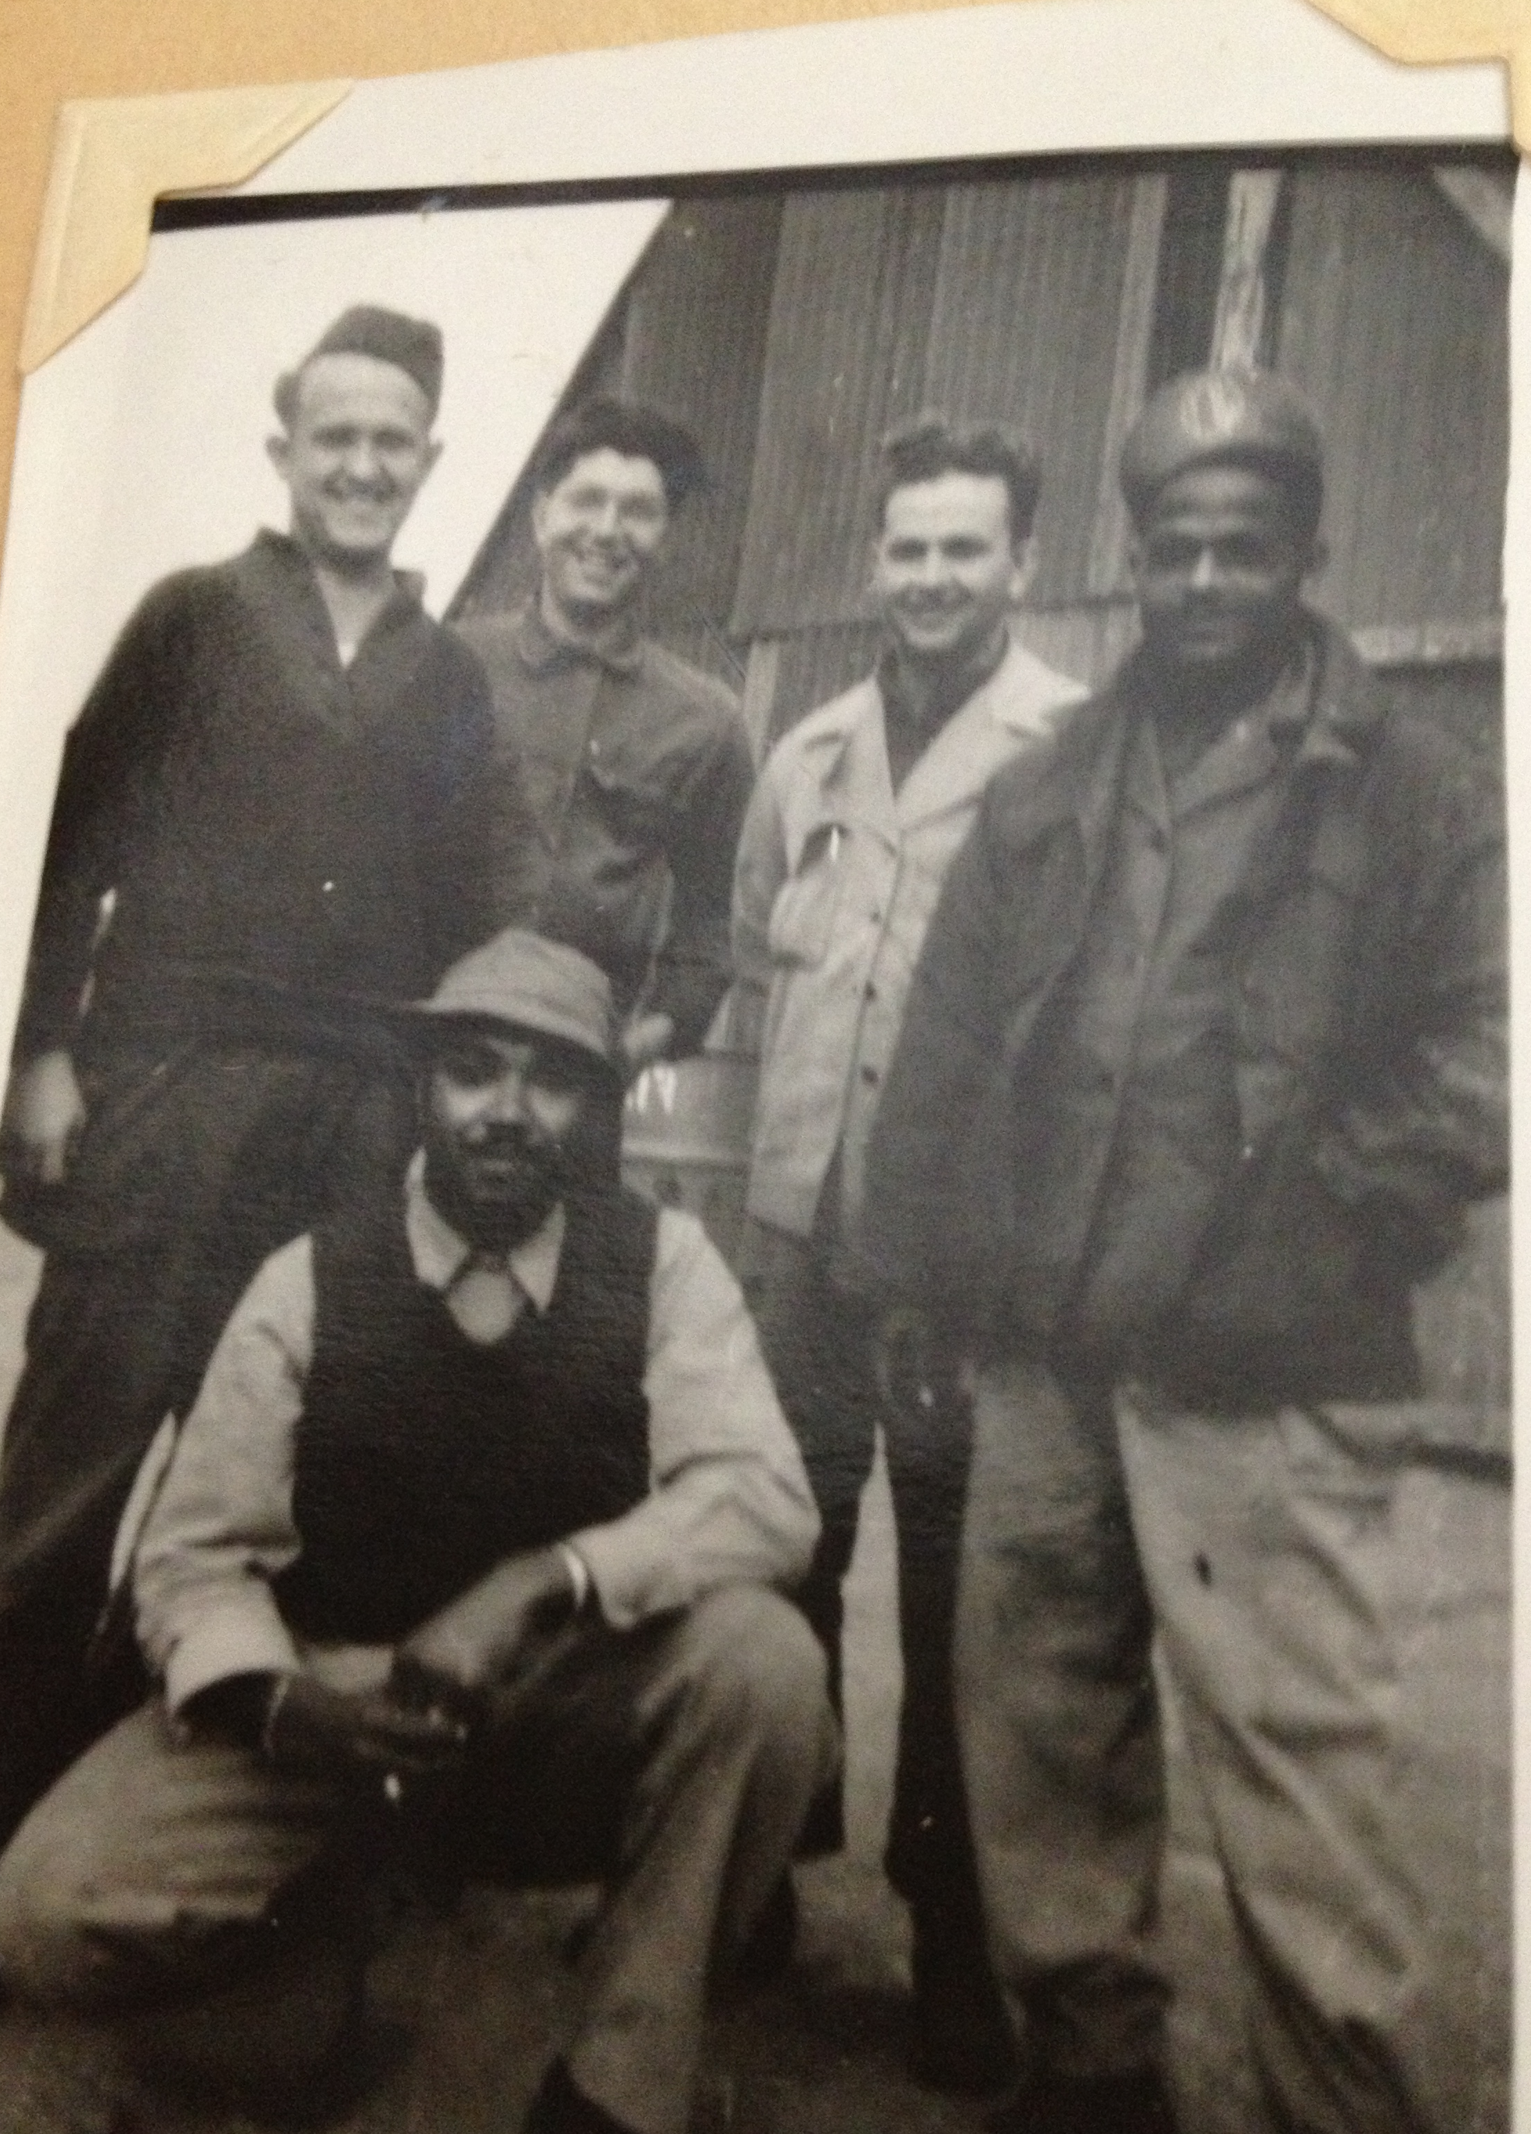
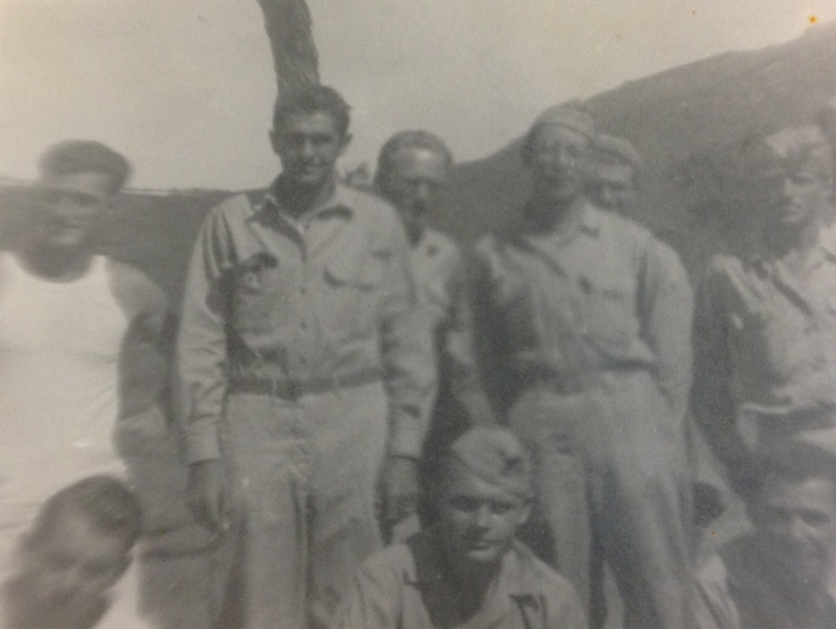
practical
Morale
Integration (contact Hypothesis)
Demobilization (point system)

Slide 19
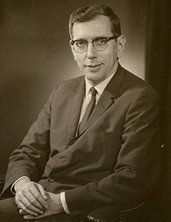
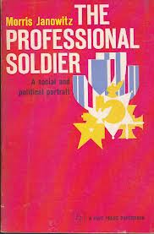
1919-1988
Standing Army and shift focus Officer
1960
Cold War
(Shift from absolutist to pragmatist)

Slide 20
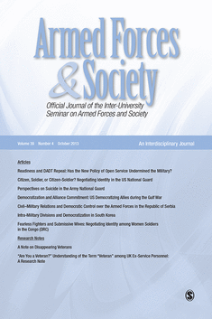
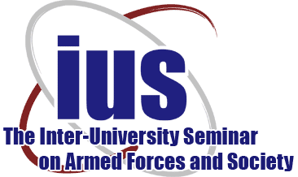
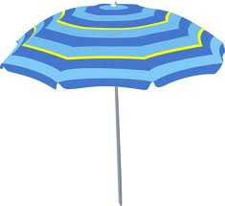
sociology
Political science
Social
Psychology
X

Slide 21
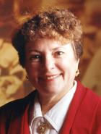
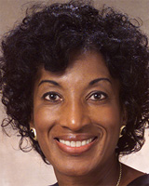
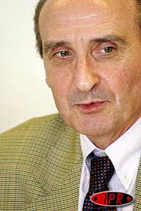
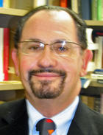
Mady Segal
Brenda Moore
James Burk
Bernard Boëne
David Segal

Slide 22
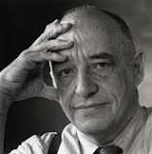
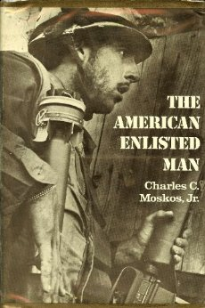

1934-2008
1988
1971
Post Vietnam – volunteer military/Post Cold War

Slide 23
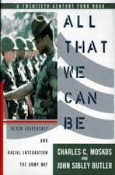
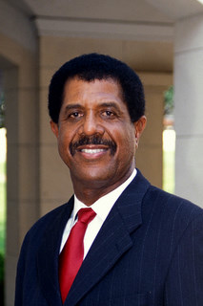
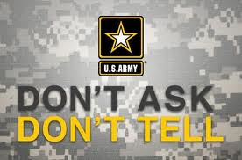
1996
John Butler
1993

Slide 24

‘Military sociology … should be
understood in a broad, generic way
– cluster of disciplines’ (Boëne, 2000)
Bernard Boëne
European Journal of Military Studies

Slide 25
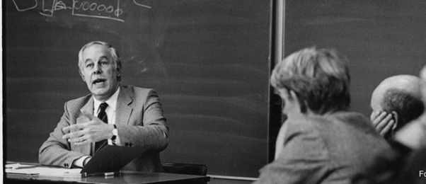
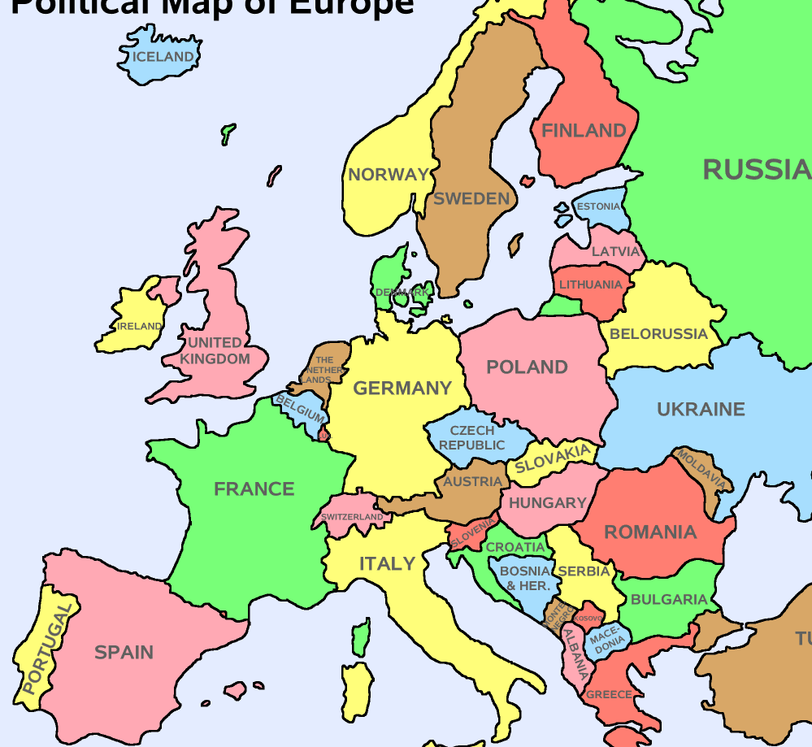
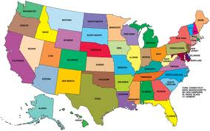
Shift in Center of
gravity from
US to Europe
Jacques van Doorn
1925 - 2008
Decline of Mass Army

Slide 26


Christopher Dandeker
Health/mental health of troops
Veterans
Strategic concerns

Slide 27

Giuseppe Caforio

Slide 28




Reuvan Gal
Yagil Levy

Slide 29
Civil Military Relations
Theories
Huntington
Democratic Control
(Hobbes – Political Science)
Janowitz
Citizen Soldier
(Aristotle/Dewey - Sociology)
Civil Military Relations
Theoretical
Perspectives
Notes:
Huntington --Protect rights and liberties of individual citizens.
Social Contract - State as sovereign power whose laws were obeyed in exchange
for protection of its citizens.
Janowitz - inspired by Aristotle, Polybius, and Cicero inspired by the governmental forms and writings
of classical antiquity. After a gaping centuries-long
period of neglect due to unique arrangements of medieval feudalism, its main ideas were recovered
and went on to flourish during the Renaissance and Enlightenment. In the classical itself the
term republicanism did not exist, however the term res publica, which translates literally as
"things public," was in usage. There were a number of theorists who wrote on political philosophy
during this period such as Aristotle, Polybius, and Cicero, and their ideas became the essential
core of classical republicanism.
The ideology of republicanism blossomed during the Italian Renaissance, most notably in Florence,
when a number of authors looked back to the classical period and used its examples to formulate
ideas about ideal governance. Most prominent among these was Niccol� Machiavelli (1469-1527).

Slide 30

Samuel Huntington
Political Science
Security Studies
Liberal theory of democratic state
Problematique -military strong enough to defend the state can threaten the polity
Objective Control - regime
loyalty/Professional autonomy
Effectiveness
Soldier and the State

Slide 31

Morris Janowitz
Sociology
Civic republicanism theory of democracy
Citizen Soldier – service & fairness
Functional Imperative (meet changing threat environment – constabulary force)
Pragmatic professionalism (focus policy problems )
The Professional Soldier
Notes:
How do civil military relations sustain and protect democratic values. Burk p. 8

Slide 32

Huntington/Janowitz View of International Relations
Absolutist View Huntington | Pragmatist View Janowitz
War basis of IR | War a tool of IR
Total victory | More than Victory/Defeat
End of War given | Adjustment between ends and means
Punitive objective | Political objective
States Role in IR – protect own interest | Reinforce commitments to a system of international alliances
Burk 2005 p. 156-157

Slide 33
Constabulary Force revisited
Definition: “continuously prepared to act, [was] committed to the minimum use of force, and [sought] viable international relations rather than [military] victory” (Janowitz, 1971, 418)
Approach to the use of force
Does not specify a unique structure

Slide 34
Implications for force structure
Pragmatist View of IR | Constabulary Force
War a tool of IR | tool of IR
More than victory/defeat | Success/effectiveness
Adjustment between ends and means | Fluidity between ends and means as context changes
Political objective | Emphasize political objectives
Reinforce commitments to a system of international alliances | Manage commitments to an international system of alliances

Slide 35
Democracy
Logic of Inquiry
Philosophy
Pragmatism
Institution Building
Social Organization
Social Control
Social Science
Sociology
Applied Fields
Applied to problems in military realm
Brendel, 2006
Categories useful distinctions, they interpenetrate, process connects them

Slide 36
TRENDS
Institutional/Occupational
Hypothesis
Constabulary Force
Mass Army
WWII
Cold War
All volunteer force

Slide 37

Post Modern
Military
Institutional/Occupational
Hypothesis
Cold War Ends
911
Afghanistan
Iraq
21st Century

Slide 38


Institutional Occupational
Traditional values
Market mechanisms
Moskos 1977

Slide 39


Post Modern military
Decline of Mass Army
Expeditionary Model
Strategic Private

Slide 40



Post Modern military
Small forces w/Global Outreach
Torunn Haaland
Reform after cold war
Olav Bogen
Anders Sookermany – New Skills

Slide 41



Topics in Military Sociology
Overlapping and interpenetrating
Useful distinctions

Slide 42
Working Groups
Morale, Cohesion, Leadership
Women and gender issues
Military Family
Military Profession
Warriors in Peacekeeping
Recruitment/Retention
Blurring of Military and Police Roles
Veterans
Civilian Control of Armed Forces
Public Opinion – Mass media & Military

Slide 43


Morale, Cohesion, Leadership
Samuel
Stouffer
Diversity in the Ranks
Gays
Racial/ethnic
Women
Transgender
Post modern context
Charles Moskos

Slide 44


Women and gender issues
Diversity broadly defined
Brenda Moore
Mady Segal

Slide 45

Military Family
Both are Greedy
Institutions
Mady Segal
David Segal

Slide 46
Military Profession
Janowitz
Giuseppe Caforio

Slide 47
Warriors in Peacekeeping
Postmodern
Military
Christopher Dandeker
David Segal

Slide 48
Recruitment/Retention
Moskos
Motivation
David Segal
Butler

Slide 49

Blurring of Military and
Police Roles
Constabulary Force

Slide 50



Veterans
Christopher Dandeker
Vidar Falck

Slide 51
Civilian Control of the
Armed Forces
Christopher Dandeker
Overlap Political Science
James Burk

Slide 52

Public Opinion
– Mass Media & Military

Slide 53
Future
New or different X-factor
Multi-Polar World – Small Wars
Climate Change – AF “rescuer”
Technology Weapons, Drones, Robots
Nature of communication
Wealth polarization
Veterans

Slide 54


Multi-Polar World – Small Wars
Decision-making pushed down chain

Slide 55





Climate Change
Military as “rescuer”

Slide 56




Technology Weapons, Drones, Robots

Slide 57




Nature of communication

Slide 58


Communication During WWII

Slide 59

Wealth polarization
Who will serve?
Place of military in society?
Bridging environment.

Slide 60

Veterans
1861-1864
PTSD
Health issues
Homelessness
Unemployment
Last Civil War Widow
2004

Slide 61


