Slide 1
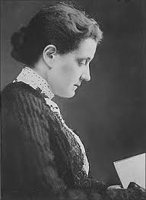
Promoting Peace: Overcoming the Dominance of Negative
Peace – Jane Addams’s Peaceweaving
Patricia M. Shields
Political Science
Texas State University
ps07@txstat.edu
Presented at
Promoting Peace: An Interdisciplinary Panel
Texas State Philosophy Dialogue Series
February 28, 2017 @ 12:30
Jane Addams

Slide 2
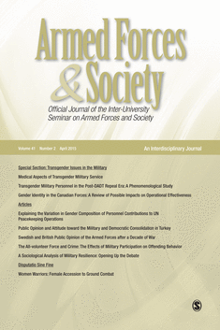

Background
Expeditionary Mindset
Sweden
Shields, Patricia. (2011). An American Perspective on 21st Century Expeditionary Mindset and Core Values:
A Review of the Literature. In (Eds) Jurst, H and Kummel, F. Core values and the Expeditionary Mindset:
Armed Forces in Metamorphosis. Germany: Nolos.

Slide 3
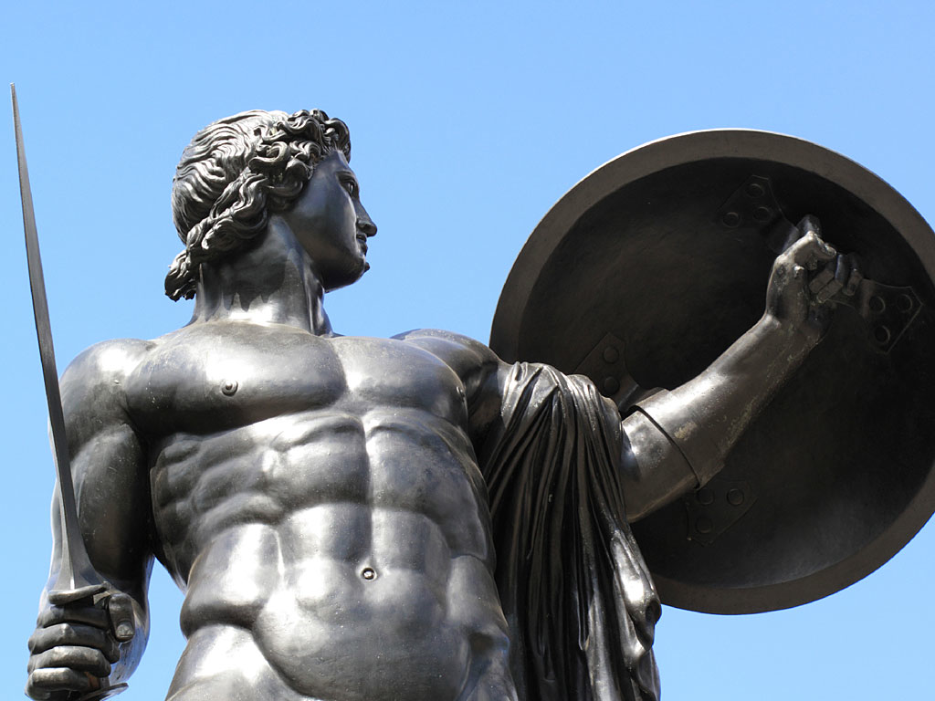
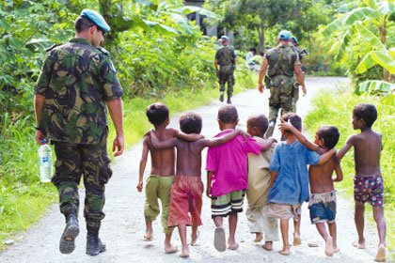
Warrior
Peacekeeper
Shields & Soeters, 2013

Slide 4
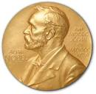
Expeditionary mindset/
Peacekeeping
Pragmatism/
Public Administration

Slide 5
Hull House
Ideas emerged from
This experience
Immigrant Community
Lab – conflict resolution
Democracy

Slide 6
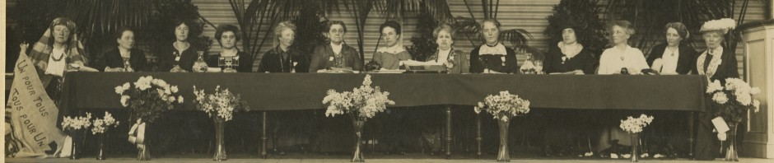
International Peace Congress of Women at the Hague
April 1915

Slide 7


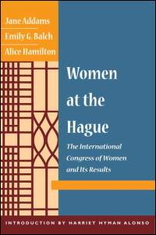
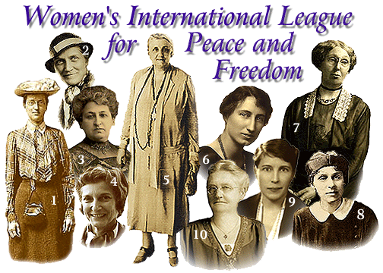
Nobel Peace Prize
1931
Faculty
Development
Leave
What was her idea
Of Peace?
Could it be applied
To Peacekeeping?

Slide 8
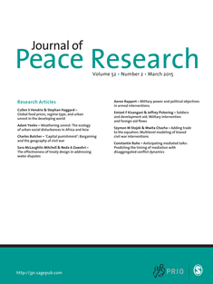
“Peace Research:
Just the Study of War”*
Negative Definition of Peace
* Gleditsch, N. Nordkvelle, J & Strand, H. (2014) Peace Research Just the Study of War.
Journal of Peace Research, 51(2), 145-158.

Slide 9
Problems with Negative Definition
Shifts focus of inquiry from peace to violence.
Focuses on a short run end state.
Divorced from the dynamics of relationships.
Shifts attention away from underlying
dynamics or causes of violence.

Slide 10
Positive Peace
Nonviolent and creative conflict transformation.
Uneven long run focus.
The fabric of the kind of society to which we aspire.
Integrity, wholeness and well-being that
arise from justice.
Humanity toward others.

Slide 11
Addams – Positive Peace

Slide 12
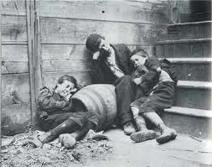
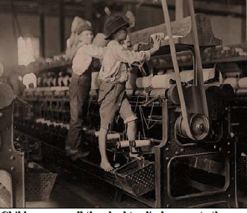
1889
Worked for social justice
Feminine Standpoint

Slide 13
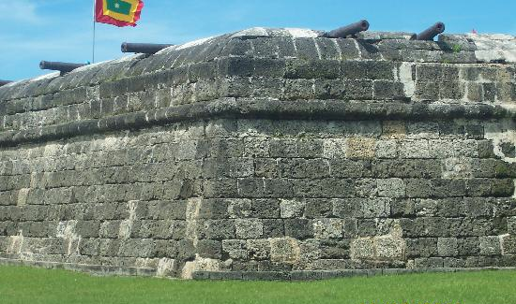
1907
Civic Housekeeping
“Survival of Militarism in City Government”
“Failure to Utilize Immigrants in City Government
“Utilization of Women in City Government”
City as Citadel – soldiers valued
City as Household – ????

Slide 14
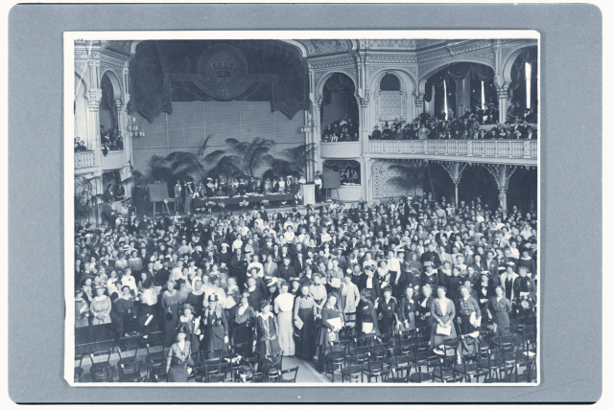
1915

Slide 15
Peace - Courage

Slide 16

Feminine sensibility
PeaceWeaving
1. Relationships

Slide 17
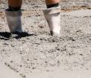

2. Avoid Rigid Moralisms
Friend/enemy
good/evil
Courage

Slide 18

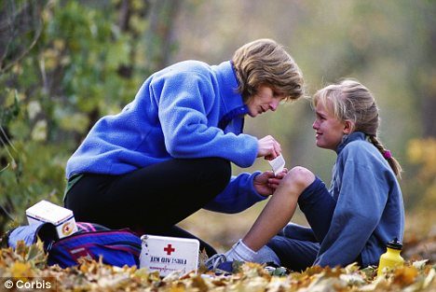
3. Sympathetic Understanding
How build
relationship

Slide 19
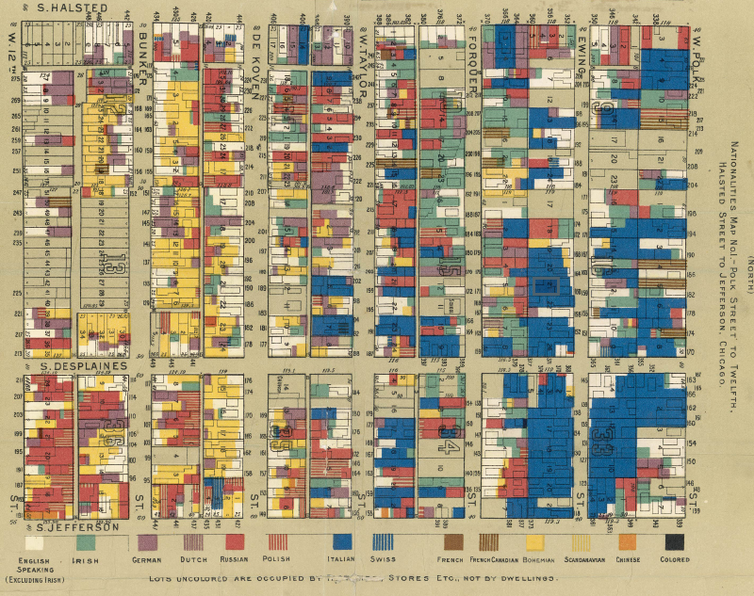

4. Community of Inquiry
Practical Problems
Scientific Attitude
Participatory Democracy

Slide 20
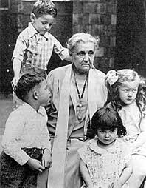
5. Lateral Progress

Slide 21

PeaceWeaving
– building the fabric of peace by emphasizing relationships. These positive relationships are built by working on practical problems, engaging people widely with sympathetic understanding while recognizing that progress is measure by the welfare of the vulnerable. (Shields & Soeters, 2015)

