Slide 1
What She Said:
How Jane Addams Informs Public Administration
Patricia M. Shields
Texas State University
Mary Ellen Guy
University of Colorado, Denver
Feb. 21, 2019

Slide 2
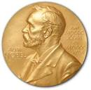
Part of Springer Series
Pioneers in Arts, Humanities,
Science, Engineering and Practice
*
Intellectual, biography --
Make the case -- pioneer (4)
Bibliography of her works (20 pages)
Jane Addams works (14 chapters)
“What She Said”
Notes:
Background and overview of the book. It is part of a series on pioneers in arts, humanities…. Features the pioneers written contributions.
Special series within the larger series on Nobel Prize winners.

Slide 3
Today
Find Missing Voices of Our Past
Who is Jane Addams
Addams Accomplishments
Show how her ideas and example have
applications for contemporary PA

Slide 4
Woodrow Wilson
1856-1924
Dwight Waldo
1913-2000
Louis Brownlow
1879-1963
Mary Follett
1868-1933
Frederick Taylor
1856-1915
Max Weber
1864-1920
Herbert Simon
1916 - 2001
Luther Gulick
1892-1993
Lyndall Urwick
1891-1983
Frank Goodnow
1859 - 1939
Henri Fayol
1841-1925
Notes:
This slide gives pictures, and dates to some of the most prominent founders/leaders of PA. Supposed to make the point that with the exception of Mary Parker Follett, all men. Find the lost voices.

Slide 5
Reconstruct our Past and Find Missing Voices
Florence Kelley
Alain Locke
Grace Abbott
S. Breckinridge
Julia Lathrop
Help us understand Today and Shape Tomorrow
Notes:
One of my professional goals. Find missing voices from past and integrate their ideas into our historical legacy. Focus of the talk is Jane Addams. – Stivers led the way with Bureau Men and Settlement women. Settlement women are a great place to start.

Slide 6
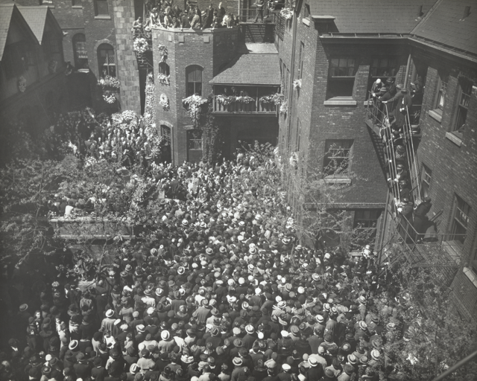
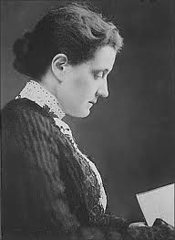
1860 - 1935
Jane Addams’s Funeral
Steps of Hull House
1.

Slide 7
Who was Jane Addams??
Leader of a large, innovative non-profit organization
Author and speaker
Leader Suffrage
Nobel Peace Prize Winner
Founder of Social Work
Activist Social Reformer
Garbage inspector
Feminist
Philosopher

Slide 8

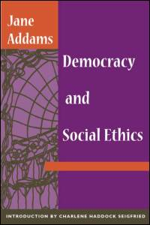
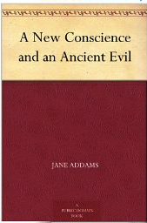








Noted Speaker - Author

Slide 9
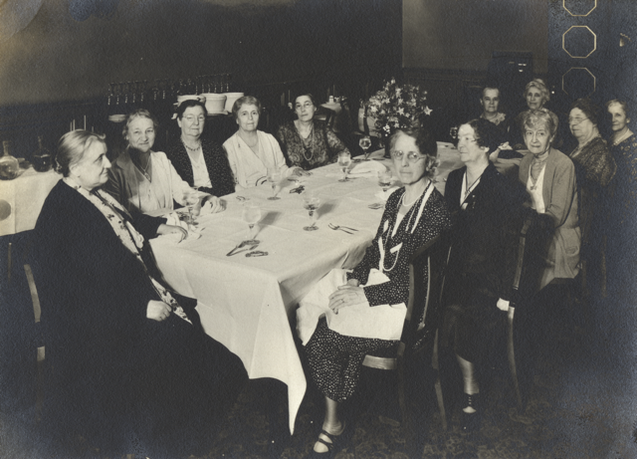
Rockford Female
Seminary
Valedictorian
Editor Newspaper
President Debate Club
President of Class
Notes:
Jane Addams was among the first wave of women who went to college. Here she had experiences that shaped her future. Clear that she thrived in a residential setting with women.

Slide 10
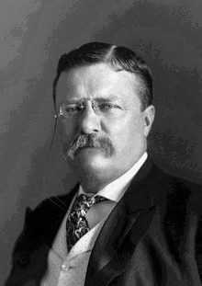
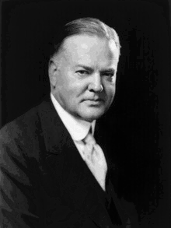
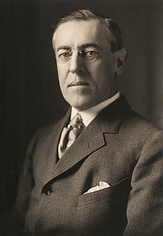
31st President
She and Hoover worked
on post
WWI humanitarian efforts
26th President
28th President
She nominated Progressive
party presidential
candidate.
Wilson nominated her for
Nobel prize

Slide 11

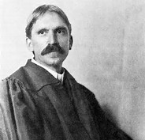
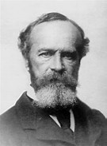
Founder Classical American Pragmatism
Du Bois
Peirce
Addams
Dewey
James
Mead
Feminist Pragmatism
Public Philosopher
Recover - Woman of Ideas

Slide 12
Leader Settlement Movement
1880s – 1920s
Problems of
Industrialization & Urbanization
Poverty
Health – Sanitation
Health – Industrial accidents
Education
Inspired by trip to
England’s Toynbee Hall
Top Down model of reform

Slide 13
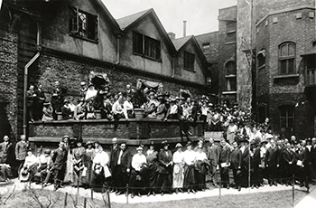
Hull House (Chicago)
Immigrant Community
Lab – conflict resolution
Hull House –
Settlement Workers gathering
1920
Bottoms up model of reform

Slide 14
Hull House
Ideas emerged from
This feminine experience
Feminist Pragmatism
Democracy /ethics/peace
Immigrant Community
Labor/management disputes
Lab – conflict resolution

Slide 15
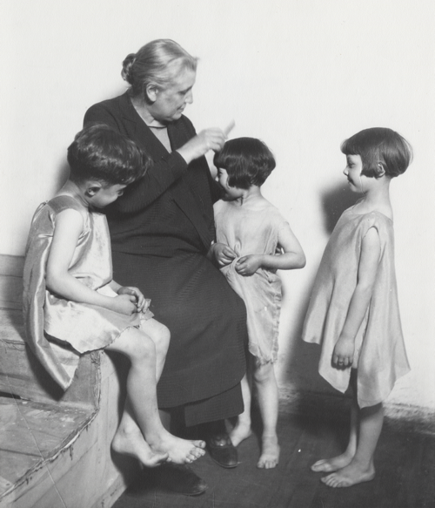
Hull House Activities
drama classes,
day care programs,
coffee house/theater,
art and labor museum,
Sunday concerts,
choir,
over 25 clubs,
meeting rooms for organized labor,
cooperative apartments for young women
College Extension courses
Voter Registration
Speaker series….
first in Chicago to establish a public
bath,
gymnasium,
kitchen,
playground,
swimming pool.

Slide 16
Hull House Charter
To provide a center for a higher civic and social life;
To institute and maintain educational and
philanthropic enterprises
To investigate and improve the conditions in the
industrial districts of Chicago
To be --- tangible expression of democratic ideal
(Addams, 1910, p. 112)

Slide 17

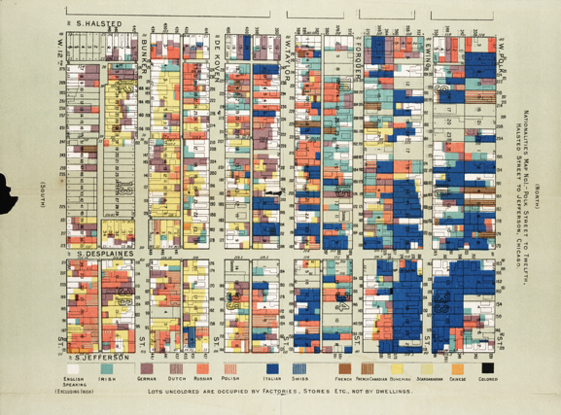
“The Settlement, then is an experimental effort to aid in the solution of the social
and industrial problems which are engendered by modern conditions of life in a great city.” (Addams, 1910, p. 125)

Slide 18
Bubble up from the bottom
Poorhouse vacation
Daycare
Notes:
Examples of how programs came to be. Daycare – Mothers working in the factories left babies and young kids with siblings and sometimes just alone in the apartment. During the hot summer some escaped and found their way to the steps of Hull House. Eventually there was one cottage devoted to a day nursery. Where possible, parents paid something.
Poor house two week vacation. Many older women could not afford to live by themselves and had not relatives so went to the poorhouse for lodging. Hull House had a 2 week vacation plan for the women. They stay used Hull House as a kind of hub and perhaps stayed with a friend, enjoyed meals at Hull House and drank tea at the coffee house.
See the community’s need by being part of the community and letting the problems emerge organically.

Slide 19
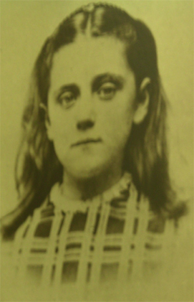
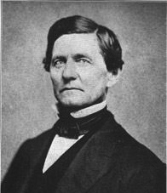
Paternalism
ç
Duty
Moral Absolutism
Man of integrity

Slide 20

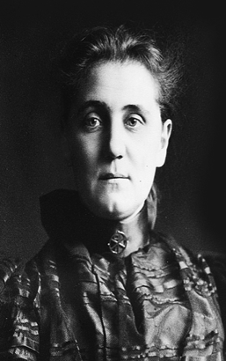
Social Claim
Sympathetic Understanding
Notes:
Break out of the narrow private or family claim and serve the larger community. The ability to make the move is in part dependent on sympathetic understanding or the ability to put oneself in another persons shoes.

Slide 21
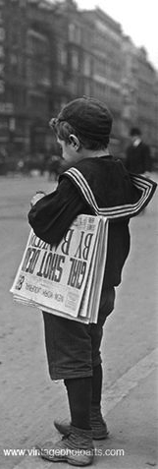
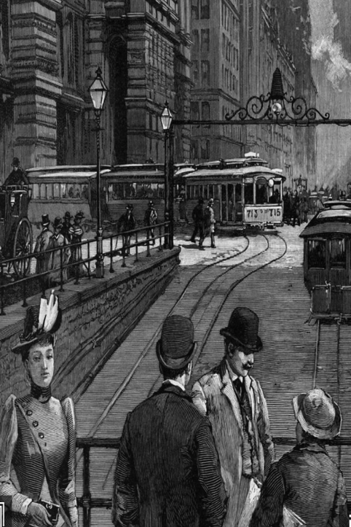
Notes:
Illustrate the social claim/social ethic using story of a paperboy. Business man, philanthropist, laborer each had an ethical response to the boy. Businessman rewarded his initiative, philanthropist vowed to develop schools for paperboys, laborer vowed to work for child labor laws. (most advanced social ethic).
Clearly, 20th and 21st Century Public Administration is informed by this social ethic and the need to negotiate between multiple ethics that shape policy.

Slide 22

Criticized Two Models of City Government
City as Citadel
City as Efficient Business/Industry
Valued soldiers
Devalued Children
No concern for health and safety
Criticized outmoded model
of city governance
Lack of care for children

Slide 23
Different Model
Clean Streets
Clean Water
Safe Meat/Food
Safe Clothing
Safe Children
Function of City – care for citizens
Specialty of Women

Slide 24
Municipal Housekeeping
Women’s
experience
Argued in favor of a
more caring model of
city government.
Take women’s skills into a new sphere
Embrace a social claim
Lateral Progress

Slide 25
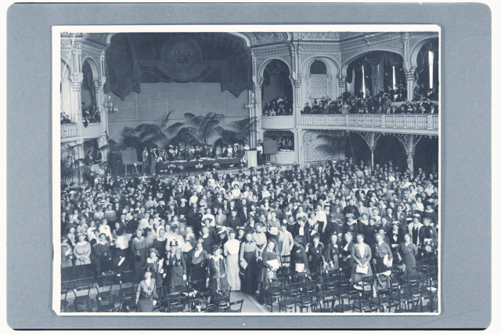
Leader of the Peace Movement
Social Claim
April 1915
International Peace Congress of Women at the Hague

Slide 26
Begin peace negotiations
immediately
Organization “Society of Nations”
Acknowledge women’s suffering
during war
Give women right to vote
Women participation in Peace
Processes
14

Slide 27
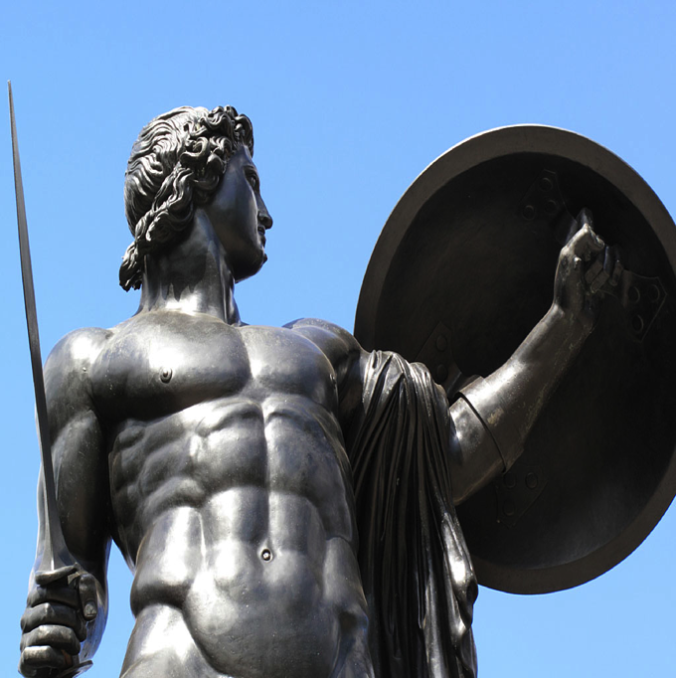

Warrior
Peacekeeper
Shields & Soeters, 2013
Notes:
Sabbatical explore Addams ideas of peace to see if there were applications to Peacekeeping --

Slide 28
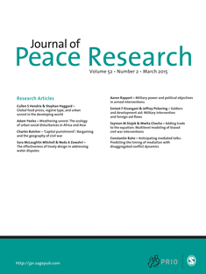
“Peace Research:
Just the Study of War”*
Negative Definition of Peace
* Gleditsch, N. Nordkvelle, J & Strand, H. (2014)
Notes:
Sabbatical explore Addams ideas of peace to see if there were applications to Peacekeeping --

Slide 29
Problems with
Negative Definition
Shifts focus from peace to violence.
Focuses on a short run end state.
Divorced from the dynamics of relationships.
Shifts attention away from underlying
causes of violent conflict.

Slide 30
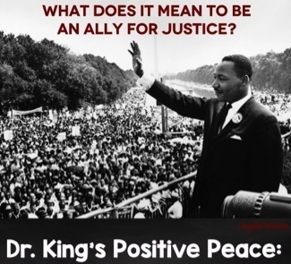
Positive Peace
Nonviolent and creative
conflict transformation.
Uneven long run focus.
The fabric of the kind of society to which
we aspire.
Integrity, wholeness and well-being that
arise from justice.
Humanity toward others.
Openness to a widely conceived social claim.
Notes:
Public Administrators should be part of the fabric of positive peace inside a society.

Slide 31

PeaceWeaving
– building the fabric of peace by emphasizing relationships. These positive relationships are built by working on practical problems, engaging people widely with sympathetic understanding while recognizing that progress is measure by the welfare of the vulnerable. (Shields & Soeters, 2015)
Public Administrators as
Peaceweavers.
Notes:
I culled her writings on positive peace and coined a term to capture her definition of positive peace – Peaceweaving.
Positive Peace Concept that should be part of PA’s ethical core. Positive peace is a logical extension of social justice.

Slide 32
Commentary
Mary Guy

Slide 33
Selected Bibliography
Addams, J. (1990). Twenty years at Hull House. Champaign, IL: University of Illinois Press. (Original work published 1910)
Addams, J. (2002). Democracy and social ethics. Champaign, IL: University of Illinois Press. (Original work published 1902)
Addams, J. (2002). A New Conscience and an Ancient Evil Chicago, IL: University of Chicago Press (Original work published 1912)
Addams, J. (2002). Peace and bread in time of war. Champaign, IL: University of Illinois Press. (Original work published 1922)
Addams, J. (2002). A modern Lear. In J. B. Elshtain (ed) The Jane Addams Reader (pp. 163-234). New York: Basic Books. (Original work published in 1912)
Addams, J. (2003). Women and internationalism. In J. Addams, E. G. Balch, & A. Hamilton (Eds.), Women at The Hague: the international congress of women and its results (pp. 107-115). Champaign, IL: University of Illinois Press. (Original work published 1915)
Addams, J. (2007). Newer ideals of peace. Champaign, IL: University of Illinois Press. (Original work published 1907).
Shields, P. (2003). The community of inquiry: Classical pragmatism and public administration Administration & Society 35 (5), 510-538.
Shields, P. (2006). Democracy and the social ethics of Jane Addams: A vision for public administration. Administrative Theory and Praxis 28(3), 418-443.
Shields, P. (2008). Rediscovering the Taproot: Is Classical Pragmatism the Route to Renew Public Administration. Public Administration Review 68(2), 205-221.
Shields, P. & Rangarajan, N. (2011). Public Service Professionals: The Legacy of Florence Nightingale, Mary Livermore and Jane Addams. In Menzel, D. & White, H. (Eds.) The State of Public Administration: Issues, Challenges and Opportunity. 36-53. New York: M.E. Sharpe.

Slide 34
Shields, P. & Soeters, J. (2013). Pragmatism, peacekeeping and the constabulary force. In Ralston (Ed.) A Bold New World: Essays on Philosophical Pragmatism and International Relations. 87-110. New York: Lexington Books.
Shields, P & Soeters, J. (2017). Peaceweaving: Jane Addams, Positive Peace and Public Administration. American Review of Public Administration
Shields, P. (2017). Jane Addams: Progressive Pioneer of Peace, Philosophy, Sociology, Social Work and Public Administration. New York, Springer
Stivers, C. (2000). Bureau Men, Settlement Women: Constructing Public Administration in the Progressive Era. Lawrence, KA, University Press of Kansas.
Skocpol, T. (1995). Protecting soldiers and mothers: The political origins of social policy in the United States. Cambridge, MA: Harvard University Press.

