Slide 1
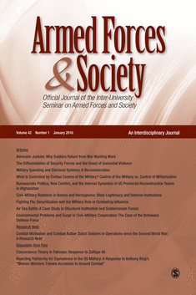

Academic Publishing in Military Studies:
Insight and Tips from an Experienced Editor
Patricia M. Shields
Texas State University
ps07@txstate.edu
Editor-in-Chief
Armed Forces & Society
Presented at the Bi-annual IUS Conference
Reston VA, Oct. 13 – 15, 2023

Slide 2

Presentation Overview
Manuscript Review Process
Editors Perspective
Tips for article acceptance in AF&S
Book Reviews (Don Travis)
General Tips (content quality)
To Do -- Before submit
To Do – R&R
Keys to Success (personal)

Slide 3


Double Blind
Peer Review
Promotes Fairness in Process

Slide 4
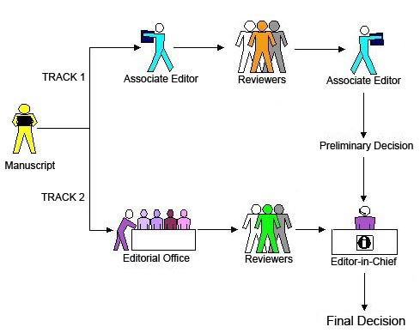
Editorial Process
(submission - publication)

Slide 5
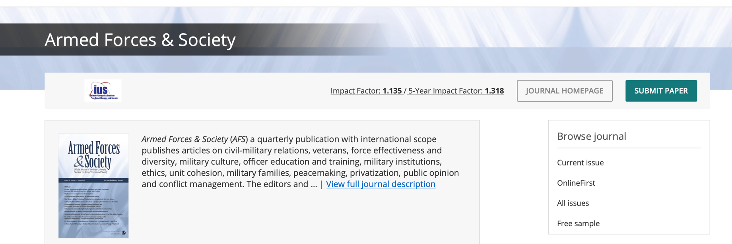
Stage 0 (Before submission)
Getting the Manuscript Ready for Review
Follow manuscript guidelines

Slide 6

A few basics
APA 7.0 Style. (examples)
Endnotes
Anonymize
Figures/tables at end of paper
If far outside guidelines
Return to Author to Fix

Slide 7


Stage 1
Manuscript arrives
Managing Editor Review
Editor’s Review
Reject 40- 60%
Find Reviewers

Slide 8

Stage 2
Send out for review
2-4 reviewers
Reviews in
Reviewers’ assessment

Slide 9

Stage 3
First Round Decision
Accept Very rare (1 in 500)
Reject
Revise and Resubmit

Slide 10

Stage 4 +++
R&R decision, comments sent to author
Revised Manuscript and letter with explanation arrives
Re-review Re-review (could be 2 - 4 rounds)
Decision - Accept/Reject
Sent to publisher for processing

Slide 11
Stage 5
Copyediting by SAGE
Author queries – Clarification/approval
Onlinefirst. (5-7 weeks)
Assigned to an
Issue (12 – 18 months)

Slide 12

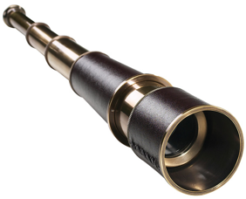


Editors Perspective
Scholar’s perspective

Slide 13


Steward or
Caretaker Role

Slide 14



Editor as Coach and Cop
Improve the manuscript
Make sure poor material gets caught

Slide 15


Most Precious Asset
Reviewer time
More challenging to find reviewers

Slide 16

What is the citation potential?
Impact Factor
Index used to rank and rate journals
1.4. 2-year
1.6 5-year

Slide 17


Tips Article Acceptance
Getting past the
Editors Desk

Slide 18


POOR FIT
Outside scope or mission of the journal

Slide 19
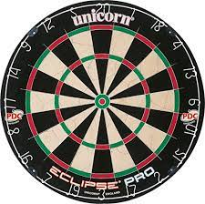
Bulls eye topics
civil-military relations
professionalism/leadership
veterans & reserves
military families
recruitment/retention
public opinion/popular culture
gender/race issues
peacekeeping
domestic use of military
civil/military cooperation
health/mental health
contracting
police/military interface
cohesion/readiness
society
military

Slide 20
Not Bullseye topic (far end of dartboard)
Need to make the case – fits the mission (implicit or explicit)
Look for new topics. Forest changes
“Dynamic intersection of Military & Society”
https://link.springer.com/referenceworkentry/10.1007/978-3-030-02866-4_31-1
Handbook of Military Science

Slide 21
Audience --
Scholars/Policy Makers
International & Interdisciplinary
Military scholars
AVOID
Purely Military topics (strategy, tactics)
Purely International Relations Topics
If audience is military leadership of a particular country
Narrowly tailored for a specific discipline
Lots of country or discipline specific acronyms

Slide 22

Strong Abstract
Gateway to reviewers
Gateway to readers and citations

Slide 23
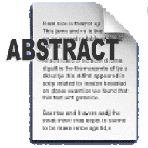
Include (empirical)
Purpose
Method
Key findings
Take-away
Research Purpose
Method to achieve purpose
Key findings
Take-Away
Strong Writing
Avoid
Acronyms
Convoluted sentences
Obvious conclusion
(more research needed)

Slide 24

Strong/Interesting Title
Not too long
Not too short
keywords
Limit acronyms
Title
Abstract

Slide 25
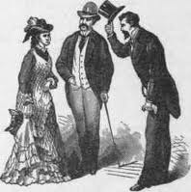

Introduction
Do not repeat abstract
Present big picture
Compelling case for research purpose/question
Clear statement of aims/purpose of pa
Big Picture
State purpose or aim early
Compelling Case for research question
Strongest Writing

Slide 26


Bibliography
Overall Quality of references
Cites to journal submitting to
Find Reviewers

Slide 27


Easy to Navigate
Clear logical subheadings
Tables – Stand alone quality
Easy productive skim

Slide 28
Discipline Specific Orientation
Do not Consider AF&S Audience (Interdisciplinary,
international military scholars)
Use of jargon and write for discipline specific audience
(Psychology & Medicine)
Lots of discipline specific acronyms
Lots of general workforce references (literature review)
The military is not just another job.

Slide 29



















Inadequate sample size
(7 interviews, 2 focus groups @
university Y, systematic review 5 articles)

Slide 30

More like a book chapter than an article.
adds to knowledge
argues a position using
reasons/evidence
analytical or explanatory
methodology section
analyzes existing knowledge
synthesizes knowledge
descriptive
Bib filled with books

Slide 31
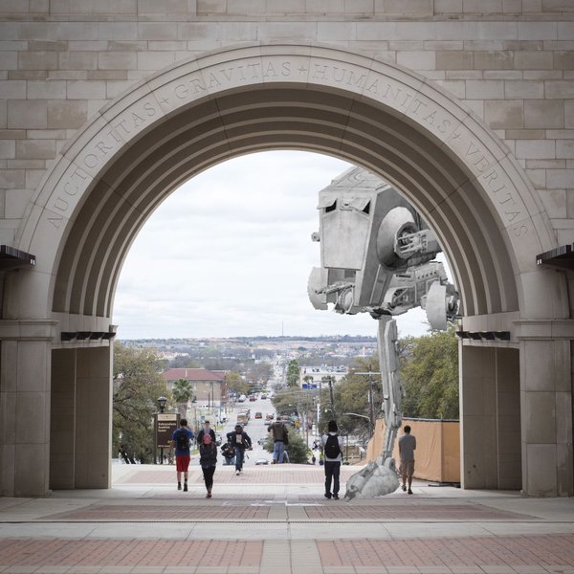

Quality Threshold
Poor Writing
Tired ideas
Lacks Coherence
Limited generalizability
Will it give a reviewer a
headache?

Slide 32
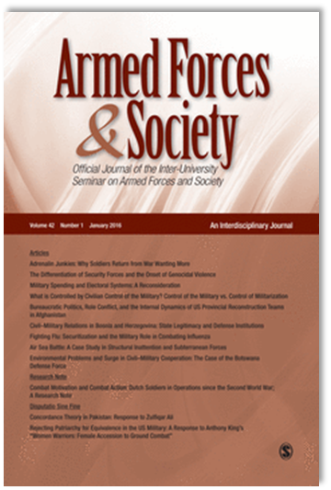
Book Reviews
So what? Why bother with a book review?
What kind of books? Books related to the intersection of Armed Forces and Society, such as:
  Civil-Military Relations
  Military Organizations
  Conflict Resolution
  Logic and Consequences of War
  Terrorism
  Military Leadership & Professionalism
  Cohesion
  Peacekeeping
  Recruitment and Retention
  Reserve Forces and Veterans
  Representation Issues
  Military Family and Health Issues
  Military History
Donald S. Travis, PhD
afsjournal@iusafs.org
dontravis752@yahoo.com
Managing Editor
Book Review Editor
Armed Forces & Society
Notes:
So what?
Books are published that relate to the inter-section of Armed Forces & Society: military scholars have a place to review these books
Book reviews can draw public attention to Armed Forces & Society
Book reviews are a relatively quick way for authors to gain exposure as an author

Slide 33
Book Reviews
Three phases…
We identify a book:
  A book is brought to our attention by an individual
  We independently gain awareness of a book
  An author submits a review
We seek out a reviewer:
  Who is qualified to review the book?
  Solicitation or recommendations: finding the right author
  Authors, as reviewers, submit their reviews
C. Submission of the review, then review of the manuscript

Slide 34
Book Reviews
Book Review Submission Guidelines
Book reviews must be submitted electronically via http://mc.manuscriptcentral.com/afs; authors must establish an online account on the SageTrack system powered by ScholarOne. Manuscripts are not accepted by e-mail nor are they ‘pre-reviewed’ by editorial staff for suitability.
Book reviews should adhere to all submission guidelines and should be approximately 1500 words and will not exceed 2000 words.
Manuscript Quality: Rating Criteria
Appropriateness of book
Readability/writing style
Relevance/ interest to readership

Slide 35
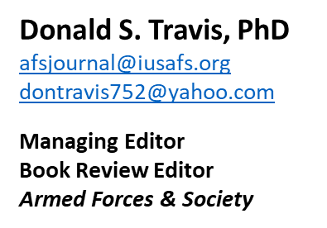
Book Reviews
Questions?
Contact the journal’s editorial staff at afsjournal@iusafs.org if you have any questions or concerns about submitting a book review that are not addressed here.

Slide 36



To ensure meets quality threshold

Slide 37

Strong
External Validity
Broadly Defined
Survey Research
Case Studies multiple countries
Theoretical analytical generalizability

Slide 38

Missing Methodology Section
Most often with Case Study

Slide 39

Enough Information
Imagine how to Replicate

Slide 40

Is Hypotheses stated in testable form?
Is operationalization easy to find/judge?
Does Hypothesis connect to research purpose/question?
Does the evidence test the hypothesis?

Slide 41

Do Data and Claims match?
Inappropriate generalization (qualitative research)
Recognize Alternative Hypotheses

Slide 42


Before you send it out

Slide 43


Strategize the best fit journals
Find journal description, does it fit?
What is journal’s quality threshold?
Have they published articles on similar topics?
Preferred Methodology?
End with a plan and a
ranking of journals
DO YOUR HOMEWORK

Slide 44


Send to journals you cite!

Slide 45


Revise & Resubmit Decision

Slide 46


Get control of emotions

Slide 47


Open minded Creative Thinking

Slide 48


Revise & Resubmit
Explanation Letter
Organized
Thoughtful (not superficial)
Disagree OK
– good reason

Slide 49


Additional

Slide 50


Don’t take it personally (key test how you deal with first rejection)
Try again (use comments from reviewers)

Slide 51


Share your work widely – present at conferences
Conference Papers/Syllabi on Academia.edu, Institutional Repository, Research Gate

Slide 52

Cultivate Collaborators
No downside to “Good” co-author(s)

Slide 53


Two Personal Rules for
Successful Scholarship
The only good dissertation
is a completed dissertation.
2. Better in a library than a file cabinet.

Slide 54
Become an Active Reviewer
Familiar with behind the scenes
Hone critical review skills – apply to own work
Respect of the editor
Get a sense of what is a strong/weak paper
Active member of scholarly community

Slide 55
Shed the insider perspective
Consciously write for a larger audience
Limit unnecessary acronyms
Stand alone tables – easy skim
International & Interdisciplinary

Slide 56


Discoverability
Optimizing Article For Search Engines
EXTRA ATTENTION
Key Words
Abstract
Title

Slide 57

Questions??

Slide 58
References and Additional Resources
Casula, M., Rangarajan, N., & Shields, P. (2021). The potential of working hypotheses for deductive exploratory
research. Quality & Quantity, 55(5), 1703-1725. https://link.springer.com/article/10.1007/s11135-020-01072-9
Hall, J. L., Hatcher, W., McDonald III, B. D., Shields, P., & Sowa, J. E. (2019). The art of peer reviewing:
Toward an effective developmental process. Journal of Public Affairs Education, 25(3), 296-313.
Shields, P.M. (2020). Dynamic Intersection of Military and Society. In: Sookermany, A. (eds)
Handbook of Military Sciences. Springer, Cham. https://doi.org/10.1007/978-3-030-02866-4_31-1
Shields, P. M. and Whetsell, T. (2014). Doing Practical Research and Publishing in Military Studies. In
Soeters, J., Shields, P. M., & Rietjens, S. J. H. (Eds.) Routledge handbook of research methods in military studies. pp. 310-325. London: Routledge.
Shields, P. Rangarajan, N. & Stewart, L. (2012) Open Access Digital Repository: Sharing Student
Research with the World, Journal of Public Affairs Education, 18:1, 157-181, DOI: 10.1080/15236803.2012.12001676
Soeters, J., Shields, P. M., & Rietjens, S. J. H. (Eds.). (2014). Routledge handbook of research methods in military studies. London: Routledge.

