Slide 1
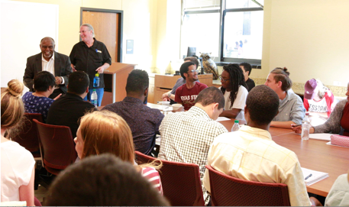
Peaceweaving and Positive Peace
Patricia M. Shields
Political Science
Texas State University
ps07@txstate.edu
Texas State
Philosophy Dialogue Series
Oct. 5, 2022
3:30 PM
City of San Marcos Library

Slide 2
Peaceweaving
– building the fabric of peace by emphasizing relationships. These positive relationships are built by working on practical problems, avoiding rigid moralisms, embracing perplexity, engaging people widely with sympathetic understanding while recognizing that progress is measured by the welfare of the vulnerable. (Shields & Soeters, 2015)

Slide 3
Making and Doing

Slide 4


Missing a philosophical stance
(public service, efficiency)
Lacked Rigor
Politics
Steeped in Utilitarianism
Rigorous theory and methods
Market

Slide 5
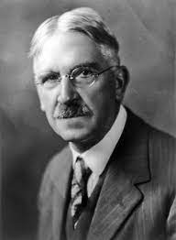
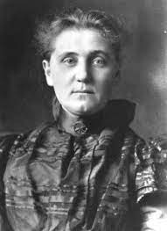
Discovered Pragmatism
John Dewey
Jane Addams
Example – intertwined road to peaceweaving
Public Administration deals with the stewardship
and implementation of the products of a
living democracy

Slide 6
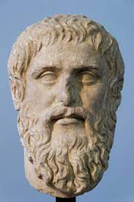
Theory, Practice, Production
theoria
praxis
poiesis
Philosopher
Fixed Forms/truth
Ranking ways of knowing
Artisan/architect
Plato
Builder

Slide 7
production
practice
theory
Stresses
Doing and Making
World of practical
problems
John Dewey
Problems with Greek
Failed to stimulate
experimental inquiry
Questioned fixed truth
Fight over fixed truth

Slide 8
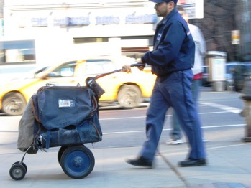
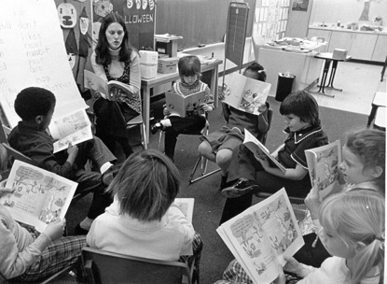

Public Administration -- implementation
Doing and Making
production
practice
theory
Implement (designing, build, production)
Involved with the making and doing
of public policy
Ways of knowing
Experience
Inquiry logical part of implementation

Slide 9
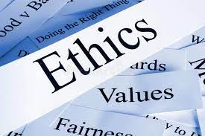
Public Administration -- stewardship
Concerned with Values
Efficient, ethical use of resources
  Finance
  Human resources
production
practice
theory
Democratic Values
  Liberty
  Equality
  Justice
  Rule of law
  Peace
constitution

Slide 10
Public Administration – Products of living democracy
What are the products of a living democracy?
production
practice
theory
Items that are produced or constructed
bridges mail delivery
space ships safety regulations
food safety education
laws road maintenance foster care sewer system
police force Covid vaccines
courts elections

Slide 11
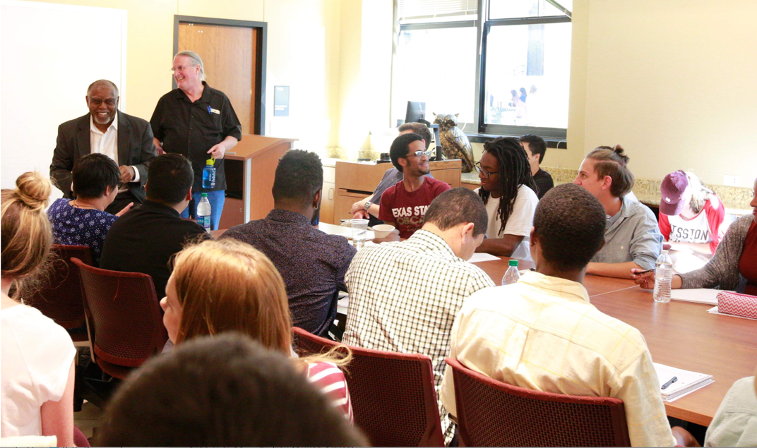
Dialogue Series --- Product of living democracy

Slide 12
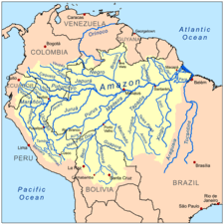


Public Adm reaches out into the experiences of everyday life
influence making and doing around products of democracy
Context for millions of problematic situations - inquiry

Slide 13
Public Administration – Products of living democracy and imperfect
Democracy that is organic, living, evolving, doing, making
connected to political systems and manifest through creativity, participation
“Democracy is a way of life”
Dewey, Creative Experience, 1939
Peace is a way of life
John Dewey
Jane Addams
It is most difficult to hold to our political democracy and to make it in any sense a social expression and not a mere governmental contrivance, unless we take pains to keep common ground in our human experiences.
Addams Democracy and Social Ethics 1902

Slide 14
Who was Jane Addams??
Leader of a large, innovative non-profit organization
Author and speaker
Democratic Theorist
Leader Suffrage movement
Nobel Peace Prize Winner
Founder of Social Work
Founder NAACP and ACLU
Activist Social Reformer
Garbage inspector
Feminist Pragmatist
Public Philosopher
Notes:
These give examples of the depth and breadth of Addams’s activities

Slide 15
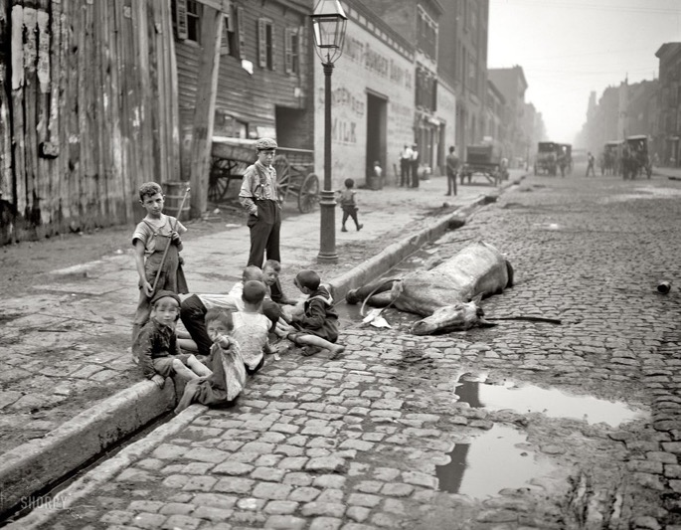
Industrialization
Urbanization
A world desperately in need of reform
1880s – 1930s

Slide 16
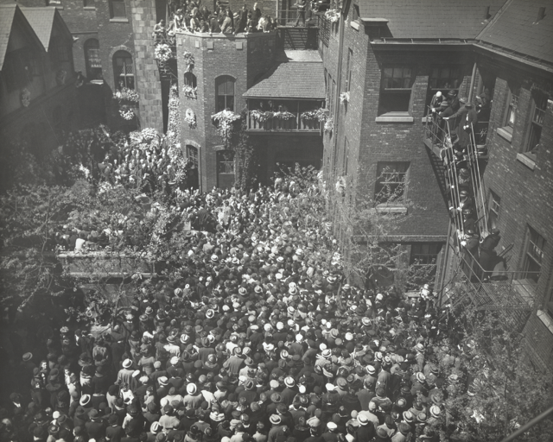
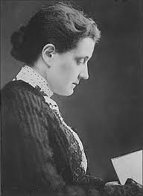
1860 - 1935
Jane Addams’s Funeral
Steps of Hull House
1.
Notes:
This picture of her funeral demonstrates visually just how beloved and important she was.

Slide 17
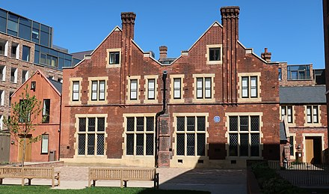
Leader Settlement Movement
1880s – 1920s
Residential reform initiative
Inspired by trip to England’s Toynbee Hall
Male University students help
solve problems
Settlement House
theory
Practice
Product
Problems of
Industrialization & Urbanization
Top Down model of reform

Slide 18
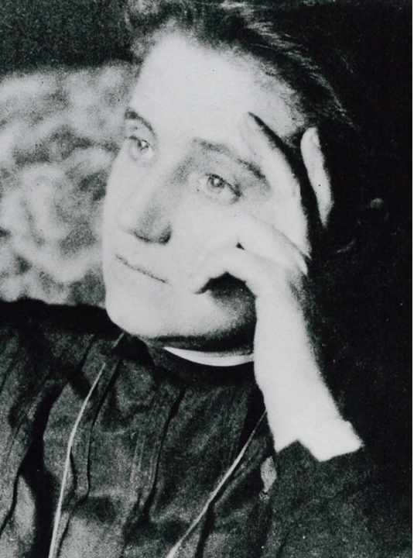
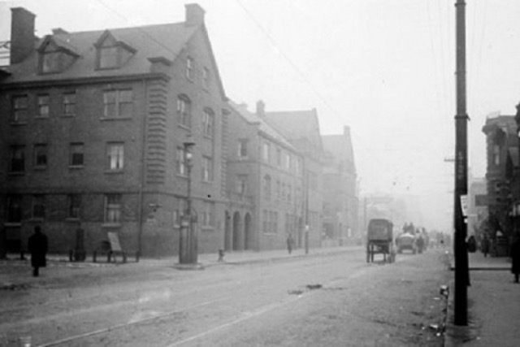
Adapt for US – Place for Women to Serve
Find Women a respectable place to live
Worked with networks of women’s clubs.
Visited Churches
Hull House
Found Large Home Industrial/Slums of Chicago

Slide 19
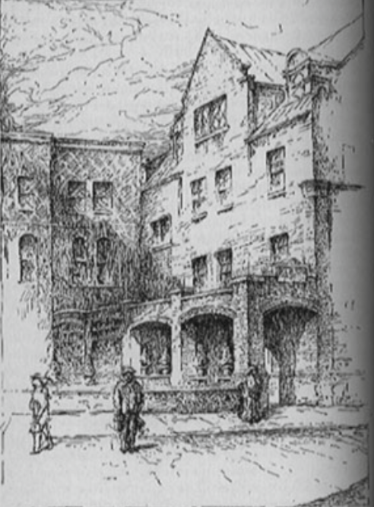
Hull House Charter
To provide a center for a higher civic
and social life;
To institute and maintain educational
and philanthropic enterprises
To investigate and improve the conditions in the
industrial districts of Chicago
Addams, Twenty years at Hull House, 1910
To be --- tangible expression of democratic ideal
Addams, Subjective Necessity of the Settlement, 1892

Slide 20
Hull House (Chicago)
Residential Community Center
Primarily Young Women
Feminine Standpoint
Bottoms up model of reform
Immigrant Community
Labor/management disputes
Lab – conflict resolution
product
practice
theory
Participatory democracy

Slide 21
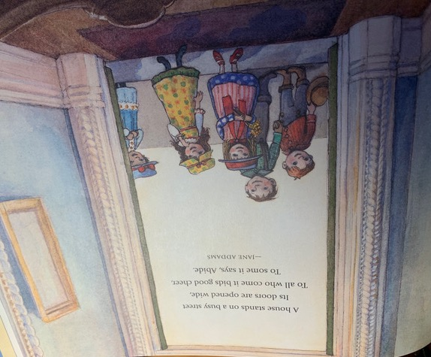
Welcoming place for
immigrant neighbors

Slide 22
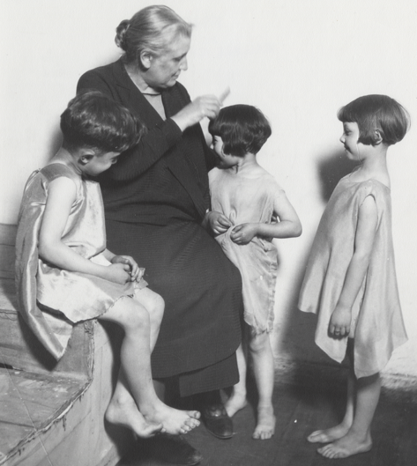
Hull House Activities
drama classes,
day care programs,
coffee house/theater,
art and labor museum,
Sunday concerts/choir,
over 25 clubs,
meeting rooms for organized labor,
cooperative apartments for young women
College Extension courses
Voter Registration
Speaker series….
“the identification with the common lot which is the essential idea of
Democracy becomes the source and expression of social ethics.” Democracy and Social Ethics, 1902

Slide 23
Bottoms up incubator of democracy
Clubs
Organizing meeting
Running a meeting
Programing
Succession
Democratic processes
Planning
Maintaining records
Civil/productive discourse
Problematic Situations/
inquiry
Greek Mother’s Club
Making and Doing

Slide 24
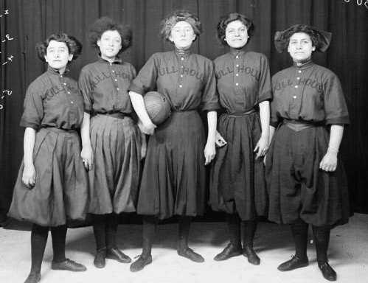
First in Chicago to establish a public
bath
gymnasium
kitchen
playground
swimming pool
Democracy is belief in the ability of human experience
to generate the aims and methods by which
further experience will grow in ordered richness.
John Dewey (1939) Creative Democracy
Making and Doing

Slide 25
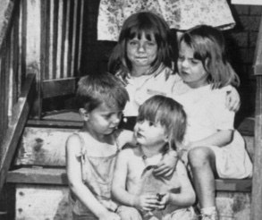
Bubble up from the bottom
Daycare
Poorhouse vacation
The task of democracy is forever that of creation of a freer and
more humane experience in which all share and to which all contribute. Dewey, Creative Democracy, 1939
Notes:
Examples of how programs came to be. Daycare – Mothers working in the factories left babies and young kids with siblings and sometimes just alone in the apartment. During the hot summer some escaped and found their way to the steps of Hull House. Eventually there was one cottage devoted to a day nursery. Where possible, parents paid something.
Poor house two week vacation. Many older women could not afford to live by themselves and had not relatives so went to the poorhouse for lodging. Hull House had a 2 week vacation plan for the women. They stay used Hull House as a kind of hub and perhaps stayed with a friend, enjoyed meals at Hull House and drank tea at the coffee house.
See the community’s need by being part of the community and letting the problems emerge organically.

Slide 26
Hull House
Incubator of ideas
Feminine Standpoint
Ideas emerged from
This feminine experience
Feminist Pragmatism
Put pragmatism to work

Slide 27
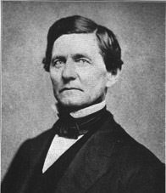
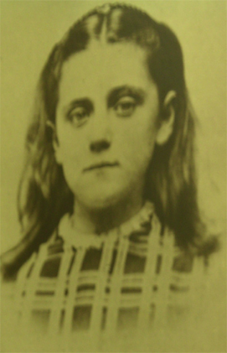
Ethics
Paternalism
ç
Family Claim
John Huy Addams
Duty
Moral Absolutism
Man of integrity strong Individual Ethic
Paternalism is NOT democratic

Slide 28
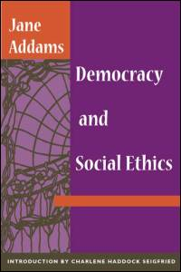

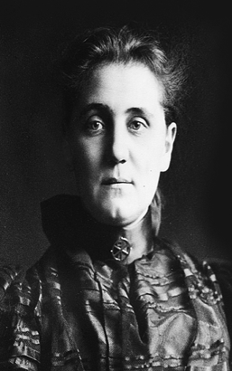
Social Claim
1902
Sympathetic Understanding
Notes:
Break out of the narrow private or family claim and serve the larger community. The ability to make the move is in part dependent on sympathetic understanding or the ability to put oneself in another persons shoes.

Slide 29
Balance the two
Problem of Poverty
Friendly visitor job to reinforce
individual ethic
Thrift, cleanliness, avoid vices,
Avoid Laziness, save.
Social Justice – move outside private sphere
recognize problems with the system - REFORM

Slide 30
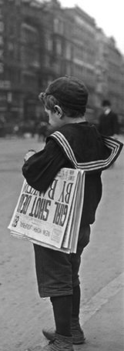
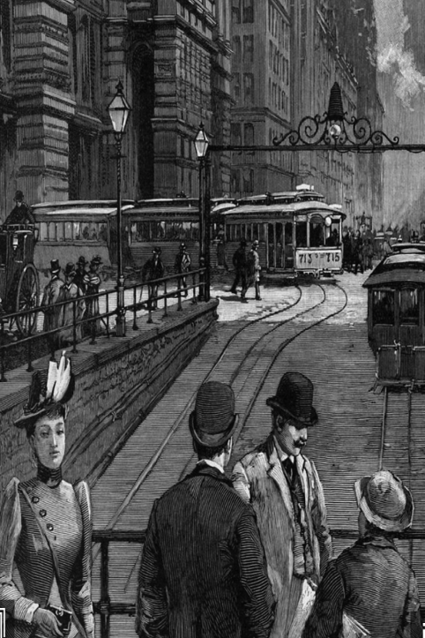
Notes:
Illustrate the social claim/social ethic using story of a paperboy. Business man, philanthropist, laborer each had an ethical response to the boy. Businessman rewarded his initiative, philanthropist vowed to develop schools for paperboys, laborer vowed to work for child labor laws. (most advanced social ethic).
Clearly, 20th and 21st Century Public Administration is informed by this social ethic and the need to negotiate between multiple ethics that shape policy.

Slide 31
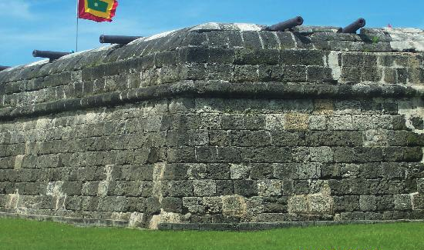
Criticized Two Models of City Government
City as Citadel
City as Efficient Business/Industry
Valued soldiers
Devalued Women & Children
No concern for health and safety
Lack of care for children
Social Darwinism

Slide 32
Municipal Housekeeping
Take women’s skills into a new sphere
Embrace a social claim
Argued in favor of a
more caring model of
city government.
Lateral Progress

Slide 33

Use model of home instead
Municipal Housekeeping
Clean Streets
Clean Water
Safe Meat/Food
Safe Clothing
Safe Children
Care for Indigent
Making and doing
Care vs. efficiency/protection

Slide 34
Peace in the here and now – city government
Chapters
Survival of Militarism in City Government
Protection of Children
Utilization of Women in City Government
Passing of the War Virtues – Courage
(international implications)
1907

Slide 35



Peace Movement (1890s – WWI)
Establish International Law and Order
Peace good for Business
Peace Organizations (Elite)
Social conservative
National political figures
Important Businessmen
Presidents (Taft, Wilson)
Secretaries of State (5)
Andrew Carnegie

Slide 36
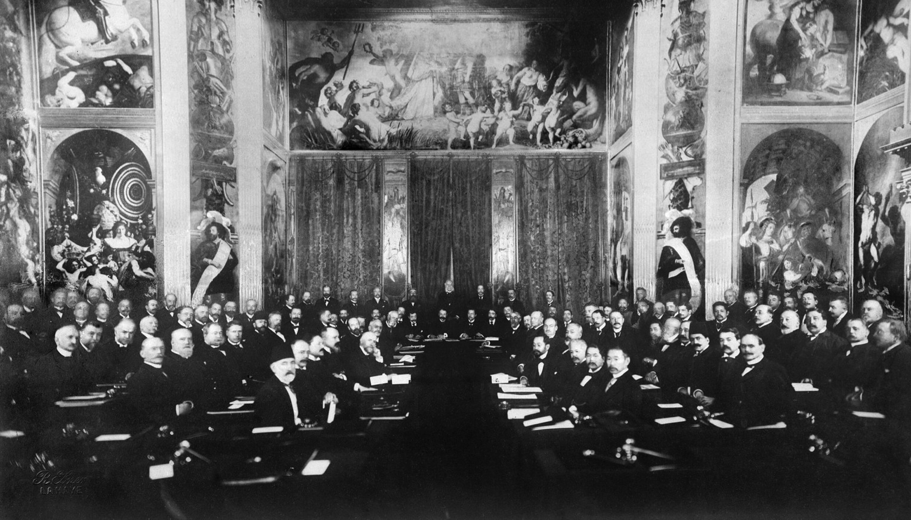
1899 Hague Peace Conference
(1907)
Legal Framework for Peaceful settlement of disputes

Slide 37
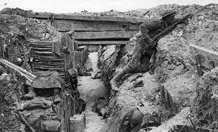
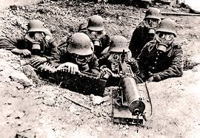
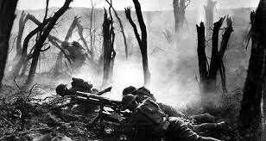
WWI and expanding social claim
1914 - 1918

Slide 38
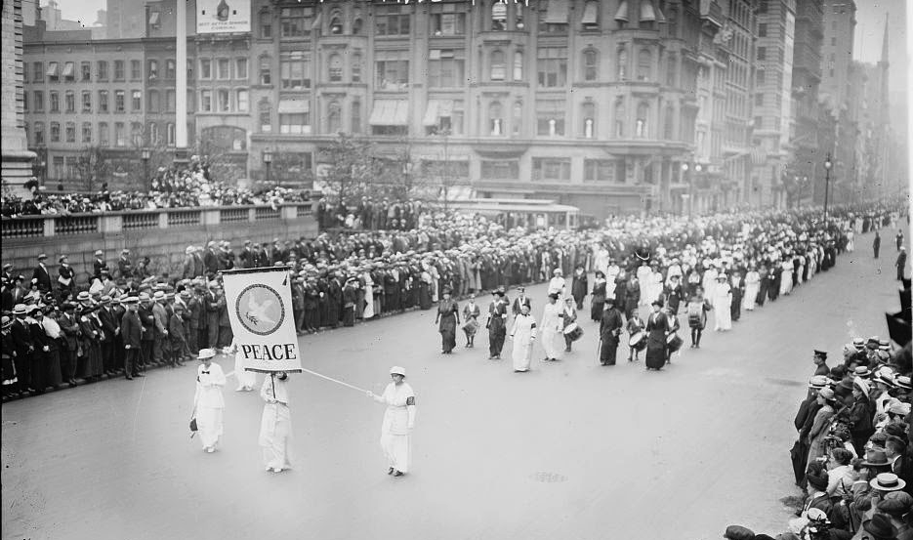
Woman’s Peace Party established – Jane Addams Leader

Slide 39
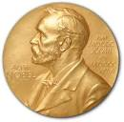
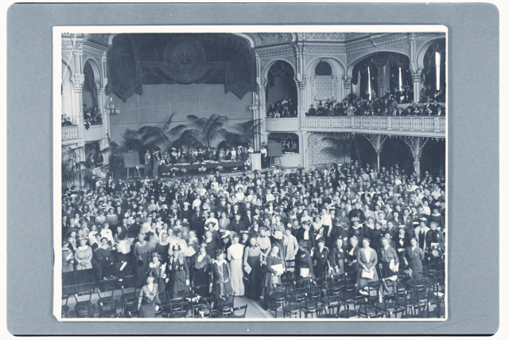
Leader of the Peace Movement
Social Claim
April 1915
International Peace Congress of Women at the Hague

Slide 40
Begin peace negotiations
immediately
Organization “Society of Nations”
Acknowledge women’s suffering
during war
Give women right to vote
Women participation in Peace
Processes
14

Slide 41
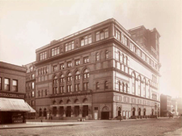
Jane Addams Public Timeline
Lost Historical Memory
1889
1915
Demeaned
Traitor
Communist
Silly old woman
1935
Celebrated
Work on
Peace lost
DOJ Surveillance

Slide 42
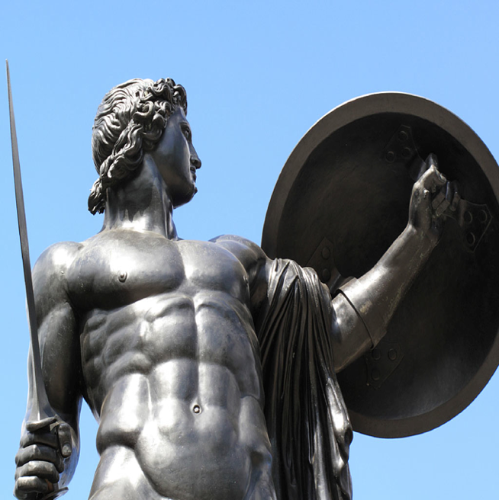

Warrior
Peacekeeping Missions
Peacekeeper
Notes:
Sabbatical explore Addams ideas of peace to see if there were applications to Peacekeeping --

Slide 43


Investigate her
work on Peace
What was her concept of peace?
Sabatical

Slide 44
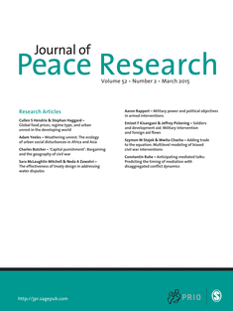
“Peace Research:
Just the Study of War”*
Negative Definition of Peace
* Gleditsch, N. Nordkvelle, J & Strand, H. (2014)
Notes:
Sabbatical explore Addams ideas of peace to see if there were applications to Peacekeeping --

Slide 45
Problems with
Negative Definition
Shifts focus from peace to violence.
Focuses on a short run end state.
Divorced from the dynamics of relationships.
Shifts attention away from underlying
causes of violent conflict.

Slide 46
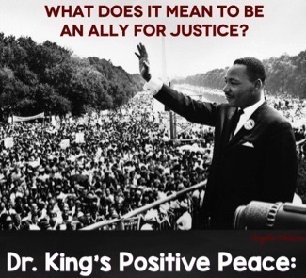
Positive Peace
Nonviolent and creative
conflict transformation.
Uneven long run focus.
The fabric of the kind of society to which
we aspire.
Integrity, wholeness and well-being that
arise from justice.
Humanity toward others.
Openness to a widely conceived social claim.
Notes:
Public Administrators should be part of the fabric of positive peace inside a society.

Slide 47
Where does Addams Fit?
Spoke of a Positive Peace
Manifestation of her Social Ethics
Apply to peacebuilding
Apply to Public Administration

Slide 48

Feminine sensibility
PeaceWeaving
1. Relationships
Making and Doing
Transform enemies into friends

Slide 49
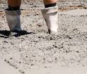

2. Avoid Rigid Moralisms
Friend/enemy
good/evil
Victory/Defeat
Good/Bad

Slide 50
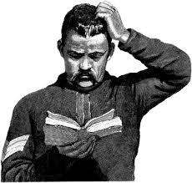
3. Embrace Perplexity
Pause & Reflect
Willingness to entertain new ideas
opposite of rigid moralisms

Slide 51

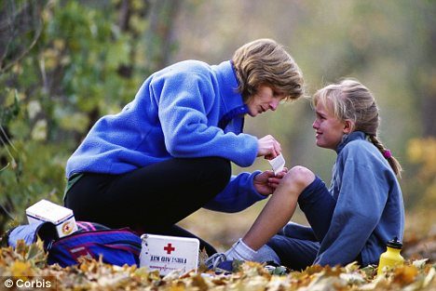

4. Sympathetic Understanding
How build
relationship
Openness to Perplexity
Listening

Slide 52
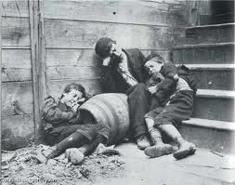
5. Community of Inquiry
Practical Problems
Scientific Attitude
Participatory Democracy

Slide 53
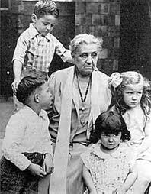
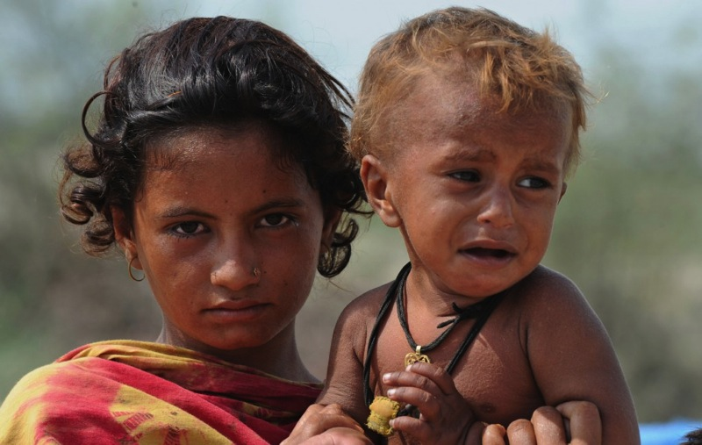
6. Lateral Progress
Duty toward the less fortunate – Social claim

Slide 54
PeaceWeaving
– building the fabric of peace by emphasizing relationships. These positive relationships are built by working on practical problems, avoiding rigid moralisms, embracing perplexity, engaging people widely with sympathetic understanding while recognizing that progress is measured by the welfare of the vulnerable. (Shields & Soeters, 2015)
People as
Peaceweavers
Notes:
I culled her writings on positive peace and coined a term to capture her definition of positive peace – Peaceweaving.
Positive Peace Concept that should be part of PA’s ethical core. Positive peace is a logical extension of social justice.

Slide 55
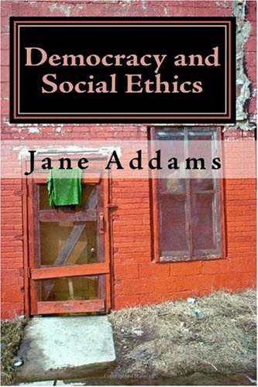
Peaceweaving
Ethics and Democracy
Importance of Making and Doing
“Building fabric of peace”
“built by working on practical problems”
generates ongoing experience
and inquiry
Democracy as a way of life

Slide 56
Peaceweaving
Relationships
Room Flexible belief systems
Sympathetic Understanding
Work on Practical Problems (COI)
Care about welfare of Students,
Lecturers, staff,
Dialogue Series --- Product of living democracy

Slide 57

Peaceweavers reach out into the experiences of everyday life
Peaceweaving throughout the system
Fractal design
family-neighborhood-community-state-nation-world

Slide 58
Commentary and Dialogue
How can you be a peaceweaver?
How can San Marcos promote peaceweaving?
Making and doing?

Slide 59
Selected Bibliography
Addams, J. (1990). Twenty years at Hull House. Champaign, IL: University of Illinois Press. (Original work published 1910)
Addams, J. (2002). Democracy and social ethics. Champaign, IL: University of Illinois Press. (Original work published 1902)
Addams, J. (2002). A New Conscience and an Ancient Evil Chicago, IL: University of Chicago Press (Original work published 1912)
Addams, J. (2002). Peace and bread in time of war. Champaign, IL: University of Illinois Press. (Original work published 1922)
Addams, J. (2002). A modern Lear. In J. B. Elshtain (ed) The Jane Addams Reader (pp. 163-234). New York: Basic Books. (Original work published in 1912)
Addams, J. (2003). Women and internationalism. In J. Addams, E. G. Balch, & A. Hamilton (Eds.), Women at The Hague: the international congress of women and its results (pp. 107-115). Champaign, IL: University of Illinois Press. (Original work published 1915)
Addams, J. (2007). Newer ideals of peace. Champaign, IL: University of Illinois Press. (Original work published 1907).
Burnier, D. (2022). The long road of administrative memory: Jane Addams, Frances Perkins and care-centered administration. In Handbook on Gender and Public Administration. Edward Elgar Publishing.
Dewey, J. (1929). The quest for certainty: A study of the relation of knowledge and action. New York: Minton Blach & Co.
Dewey, J. (1938). Logic: The theory of inquiry. New York: Holt, Rinehart and Winston.
Dewey, J. (1948). Reconstruction in philosophy (enlarged ed.). Boston: Beacon Press. (Orig- inal work published 1920)
Dewey, J. (1954). The public and its problem. Chicago: Swallow Press. (Original work published 1927)
Dewey, J. (1998). Creative democracy: The task before us. In L. Hickman & T. Alexander (Eds.), The essential Dewey: Volume I. Pragmatism, education, democracy (pp. 340-
344). Bloomington: Indiana University Press. (Original work published 1938)
Diehl, P. (2016). Exploring Peace: Looking beyond war and negative peace. International Studies Quarterly 60(1), 1-10
Diehl, P. (2016a). Thinking about peace: Negative terms versus positive outcomes. Strategic Studies Quarterly 10(1), 3 – 9.
Fenton, J. K. (2022). Gender in administrative ethics: Jane Addams’s feminist pragmatist conception of democracy as social ethics. In Handbook on Gender and Public Administration. Edward Elgar Publishing.
Fischer, M. (2009).“The Conceptual Scaffolding of Newer Ideals of Peace,” in Jane Addams and the Practice of Democracy, ed. Marilyn Fischer, Carol Nackenoff, and Wendy Chmielewski (Urbana, IL: University of Illinois Press)

Slide 60
Fenton, J. K. (2022). Gender in administrative ethics: Jane Addams’s feminist pragmatist conception of democracy as social ethics. In Handbook on Gender and Public Administration. Edward Elgar Publishing.
Fischer, M. (2009).“The Conceptual Scaffolding of Newer Ideals of Peace,” in Jane Addams and the Practice of Democracy, ed. Marilyn Fischer, Carol Nackenoff, and Wendy Chmielewski (Urbana, IL: University of Illinois Press)
Galtung, J., (1996). Peace by Peaceful Means: Peace and Conflict, Development and Civilization. Thousand Oaks, CA: Sage Publications.
Gleditsch, N.P., Nordkvelle J., & Strand, H. (2014). Peace research-Just the study of war? Journal of Peace Research, 51, 145-158.
Goertz, g., Diehl, P. and Balas, A. (2016). The Puzzle of Peace: The Evolution of Peace in the International System. New York: Oxford University Press.
Hickman, L. A. (1990). John Dewey's pragmatic technology. Indiana University Press.
Hickman, L. A. (2001). Philosophical tools for technological culture: Putting pragmatism to work. Indiana University Press.
Hamington, M. (2009). The Social Philosophy of Jane Addams. Urbana: University of Illinois Press.
Ralston, S. J. (2022). Jane Addams and John Dewey. In Shields, P., Hamington, M. & Soeters, J. The Oxford Handbook of Jane Addams. Oxford University Press
Rissler, G. & Shields, P. (2018) Positive Peace – A Necessary Touchstone for Public Administration. Administrative Theory & Praxis
Seigfried, C. (1996). Pragmatism and Feminism: Reweaving the Social Fabric. Chicago, University of Chicago Press.
Shields, P. (2003). The community of inquiry: Classical pragmatism and public administration Administration & Society 35 (5), 510-538.
Shields, P. M. (2017). The limits of negative peace, faces of positive peace. Parameters 47(4):5-12.
Shields, P. M. (2005). Classical Pragmatism: Roots and promise for a PA feminist Theory. Administrative Theory & Praxis 27(2): 370-376.

Slide 61
Shields, P. (2006). Democracy and the social ethics of Jane Addams: A vision for public administration. Administrative Theory and Praxis 28(3), 418-443.
Shields, P. (2008). Rediscovering the Taproot: Is Classical Pragmatism the Route to Renew Public Administration. Public Administration Review 68(2), 205-221.
Shields, P. (2022). Jane Addams and Public Administration: Clarifying Industrial Citizenship. In Shields, P., Hamington, M. & Soeters, J. (Eds), The Oxford Handbook of Jane Addams, Oxford University Press DOI: 10.1093/oxfordhb/9780197544518.013.3
Shields, P. & Rangarajan, N. (2011). Public Service Professionals: The Legacy of Florence Nightingale, Mary Livermore and Jane Addams. In Menzel, D. & White, H. (Eds.) The State of Public Administration: Issues, Challenges and Opportunity. 36-53. New York: M.E. Sharpe.
Shields, P. & Soeters, J. (2013). Pragmatism, peacekeeping and the constabulary force. In Ralston (Ed.) A Bold New World: Essays on Philosophical Pragmatism and International Relations. 87-110. New York: Lexington Books.
Shields P. (2022).The origins of the settlement model of public administration . In Shields, P. & Elias, N. Handbook on Gender and Public Administration. Edward Elgar Publishing. pp. 35-52 ISBN: 978 1 78990 472 7
Shields, P. & Elias, N. Introduction to the Handbook of Gender and Public Administration, In Shields, P. & Elias, N. Handbook on Gender and Public Administration. Edward Elgar Publishing. pp. 1-19. https://www.elgaronline.com/view/edcoll/9781789904727/9781789904727.00008.xml
Shields, P. & Soeters, J. (2022). Jane Addams and the Noble Art of Peaceweaving. In Shields, P., Hamington, M. & Soeters, J. (Eds), The Oxford Handbook of Jane Addams, Oxford University Press DOI: 10.1093/oxfordhb/9780197544518.013.8
Shields, P & Soeters, J. (2017). Peaceweaving: Jane Addams, Positive Peace and Public Administration. American Review of Public Administration47(3), 323-339.

Slide 62
Shields, P., Hamington, M. & Soeters, J. (Eds.)(2023), The Oxford Handbook of Jane Addams, Oxford University Press (https://www.oxfordhandbooks.com/view/10.1093/oxfordhb/9780197544518.001.0001/oxfordhb-9780197544518)
Shields, P. (2017). Jane Addams: Progressive Pioneer of Peace, Philosophy, Sociology, Social Work and Public Administration. New York, Springer
Shields, P. M., & Rissler, G. E. (2016). Positive Peace: Exploring its Roots and Potential for Public Administration. Global Virtue Ethics Review, 7(3), 1-13.
Stivers, C. (2000). Bureau Men, Settlement Women: Constructing Public Administration in the Progressive Era. Lawrence, KA, University Press of Kansas.
Skocpol, T. (1995). Protecting soldiers and mothers: The political origins of social policy in the United States. Cambridge, MA: Harvard University Press.
Westbrook, R. (1991). John Dewey and American democracy. Ithaca, NY: Cornell University Press.

