Slide 1
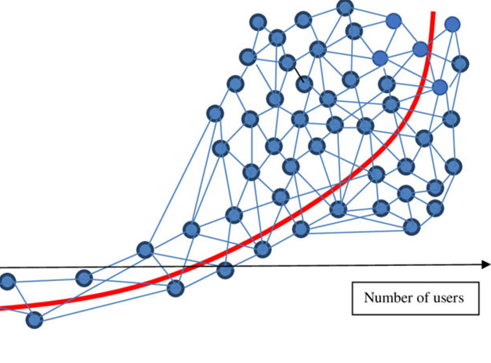
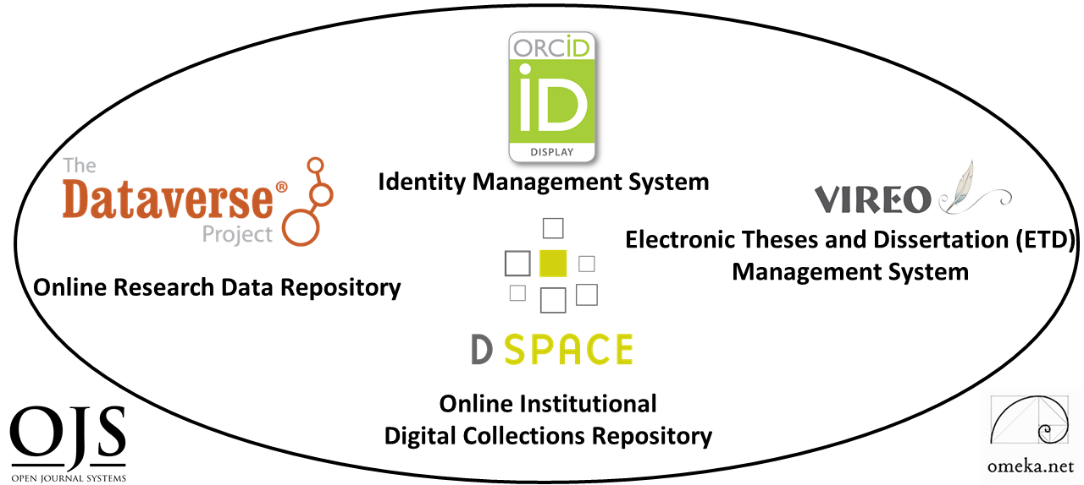
Developing a
Digital Scholarship
Research Ecosystem
Ray Uzwyshyn, Ph.D. MBA MLIS
http://rayuzwyshyn.net , R_U@txstate.edu
Director, Collections and Digital Services
Texas State University Libraries
Presented for ICEIT2020
St. Anne’s College, Oxford University Oxford, United Kingdom
February 12, 2020

Slide 2

What is a Digital Scholarly Research Ecosystem?
Network of Several Software Components to Enable Faculty and Student Research
and Raise Research Profiles
Notes:
Ecosystem Metaphor Look at Relationships in the Digital Environment
Specifically Focuses Upon the Discrete Component Relationships with the Networked Digital Environment

Slide 3
General Characteristics of This
Digital Scholarly Research Ecosystem
Open Source Software
Customizable Components
Active Developer Communities

Slide 4

Digital Ecosystem Consists of Six Main Software Components
Digital Collections Repository (Dspace)
Research Data Repository (Dataverse)
Identity Management System (ORCID)
ETD Management System (VIREO)
User Interface Software (OMEKA)
Open Journal Software (OJS3)
Hardware: Digitization Lab

Slide 5
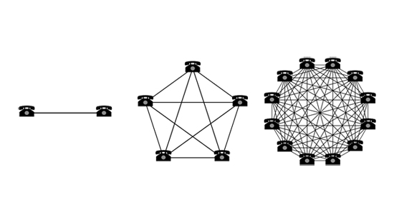
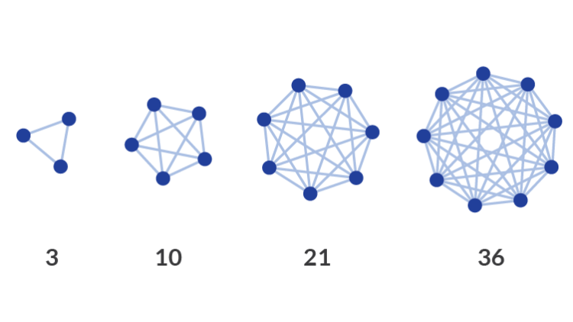
Collocating Open Source Digital Components in a Networked Research Ecosystem Enables Larger Connections and/or Network Effects
Ecosystem Metaphor Looks at Component Relationships
Simple Larger Idea
Notes:
Ecosystem Metaphor Look at Relationships in the Digital Environment
Specifically Focuses Upon the Discrete Component Relationships with the Networked Digital Environment

Slide 6
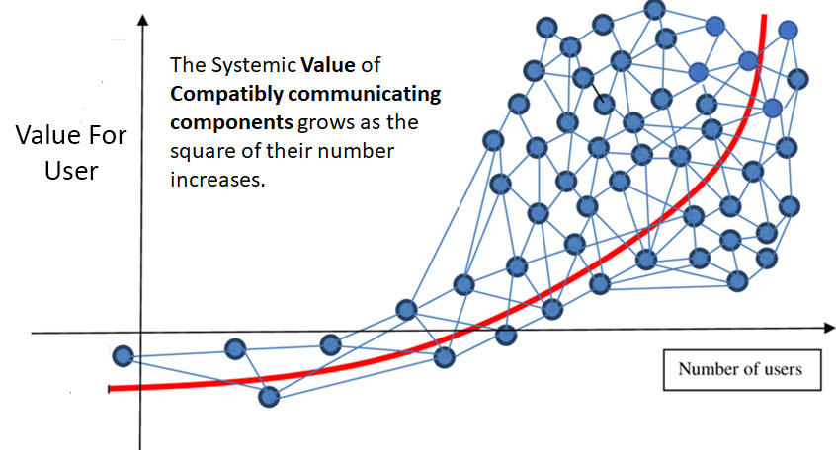
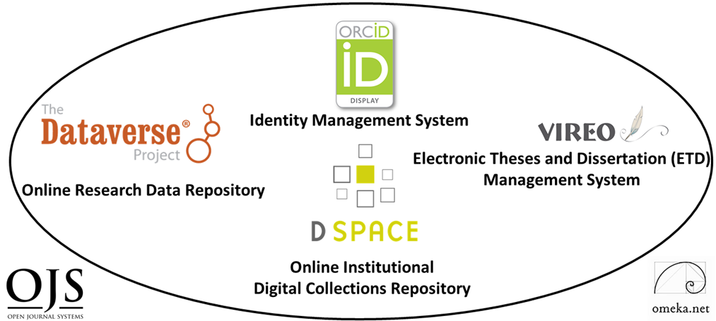
Network Effects: Metcalfe’s Law
Component Networks may be Internal and/or External
Notes:
Early Telecommunications Law for Ethernet (1993)

Slide 7
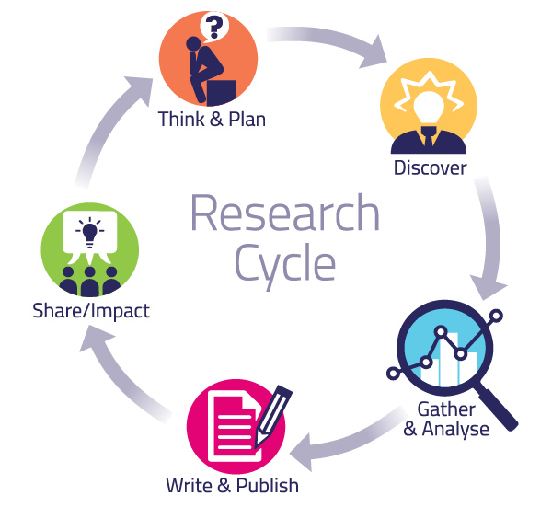
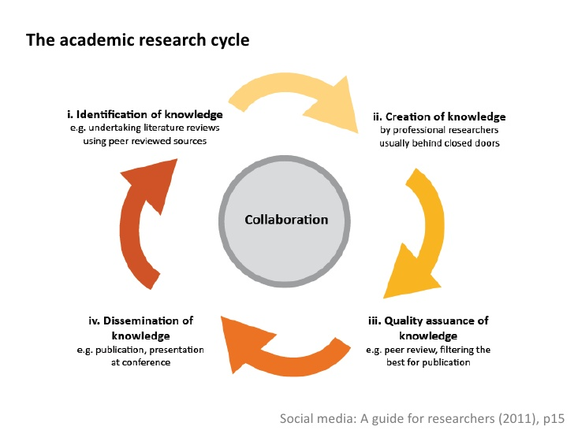
Together, These Digital Ecosystem Components Enable
Various Parts of the Academic Research Cycle
Pragmatic Levels
Abstract Levels

Slide 8


Texas State University
Libraries
Digital Scholarly Research Ecosystem
Primary Components

Slide 9
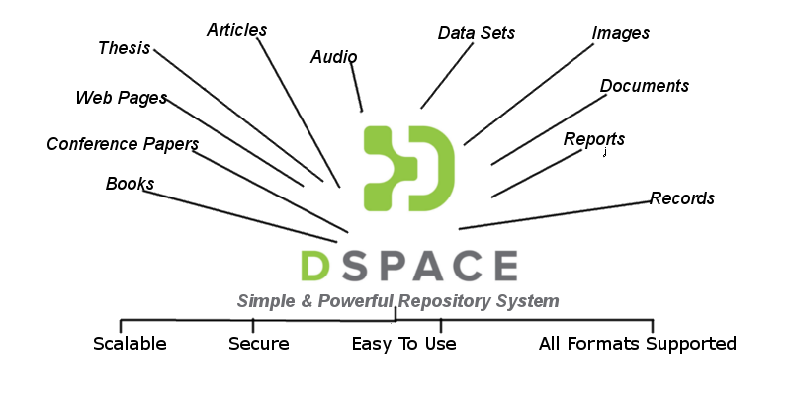
Institutional Digital Collections Repository (Dspace)
Organizes, centralizes and makes accessible
research and knowledge generated by the institution’s research community (Faculty and Graduate Students):
Pre-prints
Faculty Publications
White Papers
Conference Presentations
Graduate Student Theses
and Dissertations

Slide 10
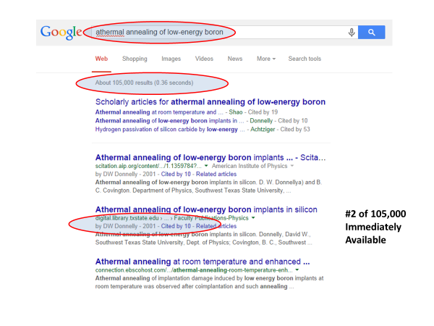
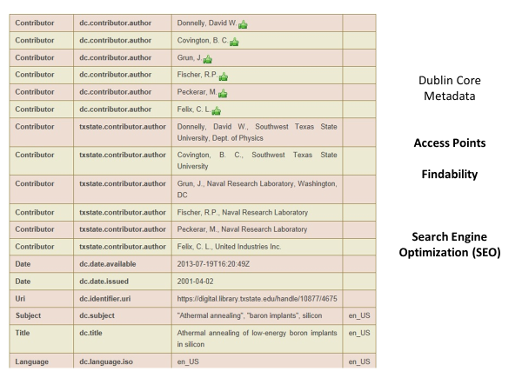


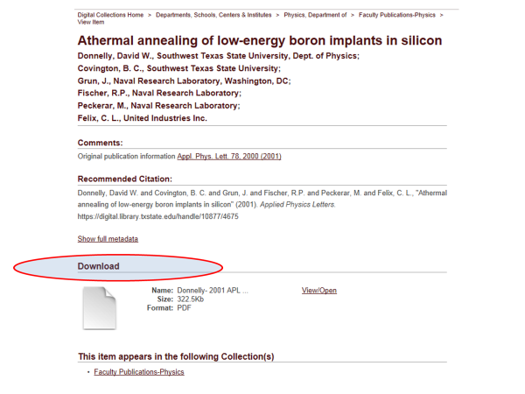
Primary Use Case Value
Application of Structured Metadata Schema for Search Engine Optimization

Slide 11
https://digital.library.txstate.edu/

Slide 12
Application of Structured Metadata Schema for Search Engine Optimization
Leads to Accessibility and Multiple Points of Access

Slide 13
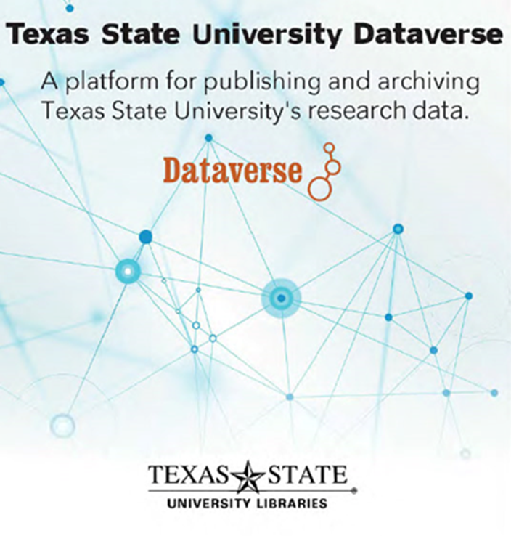
Research Data Repository
https://dataverse.tdl.org/dataverse/txstate

Slide 14
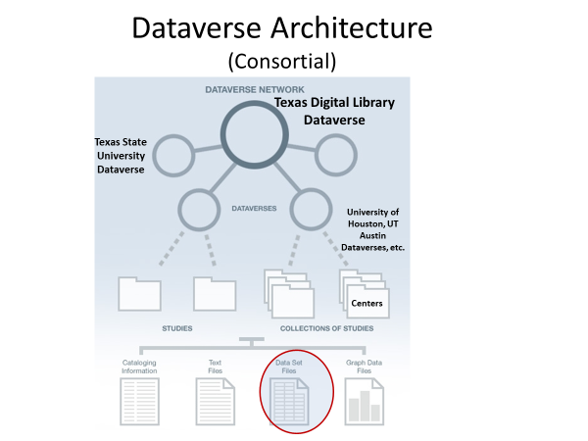
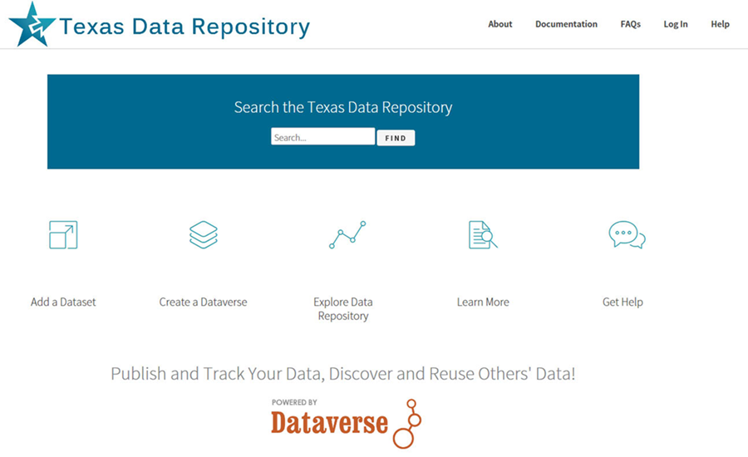
The Dataverse can be configured as a single Instance or as a Consortial Model
(Texas Aggregates
22 Individual Instances, through the Texas
Digital Library)
https://dataverse.tdl.org/

Slide 15
Digital Scholarly
Research Ecosystem
Secondary Components
(Dependent on Primary Digital
Repositories for Content and Data)

Slide 16

Vireo
Electronic Thesis and Dissertation Management System
Addresses Intermediary steps in the ETD Process
Connects with Both the Collections Repository And Data Repository so students can publish and link their theses dissertations and data
Bridges Student Thesis/Dissertation Submission with Graduate School Review, Online Publication and ETD Preservation

Slide 17
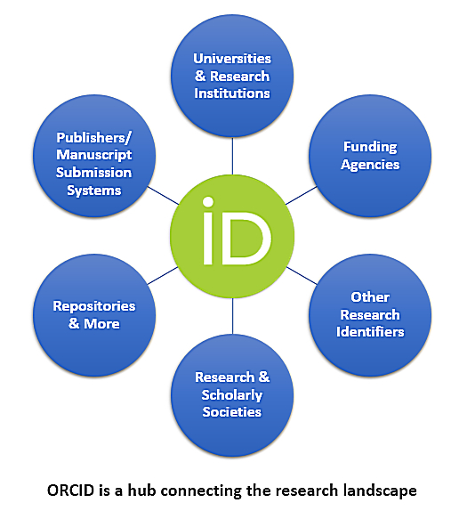

Researcher Identity Management System
Gives Researchers Unique Number (ORCID ID) Connecting and Disambiguate Scholars names
Maria Hernandez, Biochemist
Maria Hernandez, M.D. or Astrophysicist
Allows publications from a researcher to be found, linked and aggregated across multiple information Systems.
Allows Papers in the collections repository and datasets in data repository can be associated with ORCID ID’s for aggregation of research profiles.
Orcid can act as a Network Hub aggregating from several sources and connecting to other internal and external networks

Slide 18
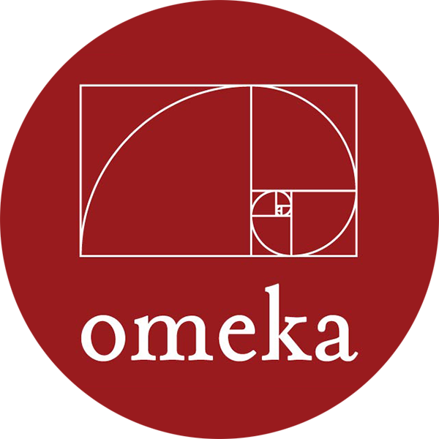

Omeka and OJS
Open Source User Interface Software
Allows an elegant portal/gateway entrance for larger scholarly research projects, digital collections and data repositories - linking text, image media and datasets and acting as a front end for connecting components and component networks.
Open Access Academic Journal Software for refereed journal online publishing, workflow and connections with background research and datasets etc. through Dataverse/Dspace connections

Slide 19
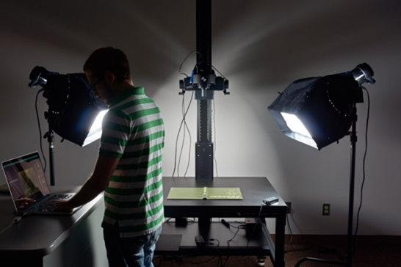

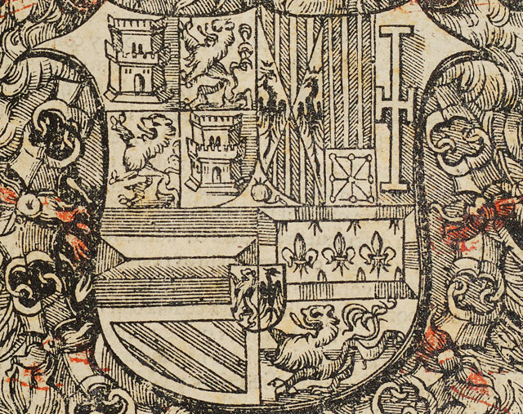
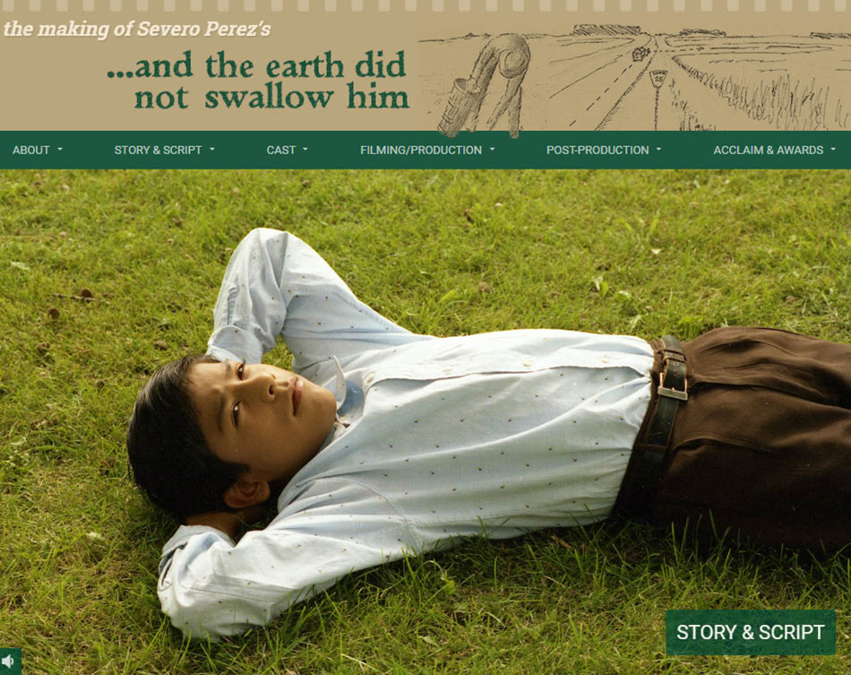
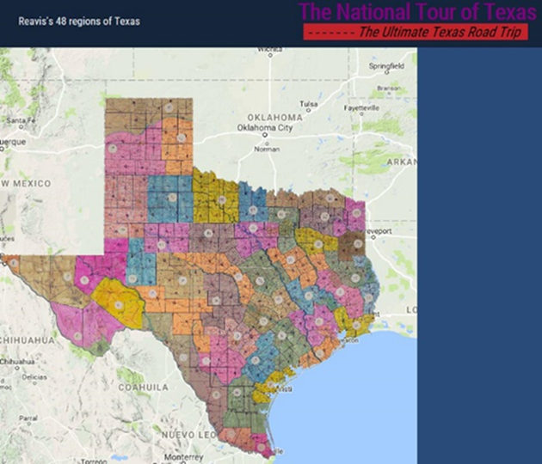
The Digitization Lab
Expands Possibilities for Faculty Research Projects
Possibilities range from OCR, image, book, manuscript & journal digitization to 3D objects, audiovisual material, GIS and visualization technologies (IIIF etc)
(i.e. Digitization Lab’s IIIF Framework can create internal or globally distributed Image Libraries.

Slide 20
Combining Research Ecosystem Components
Opens Amazing Possibilities For Digital Scholarship & Collaboration Opportunities
Cognitive Cartography/Multimedia Archives
(Video, Text, GIS, Images, Field Notes)
Dick Reavis: National Tour of Texas
Multimedia, Digital Archives/Retrospective ETD Projects
(Digital video, online exhibit images, text, digital archives)
Severo Perez: And the Earth Did not Swallow Them
Online Exhibits/Digital Archives/ Online Academic Journals
(images and text, Omeka front end/Database back end, IIIF)
Cabeza de Vaca La Relacion Digitization
Santiago Tafolla: Mexican Amer. Confederate Soldier
Interactive Image Archives/Data & Research Projects
(Image libraries, Interactive Commenting/Metadata)
Texas State Flickr Commons
Digital Libraries Archiving & Documentation Projects
(Text, Metadata, OCR, Search, Zoom ability, Page Turning)
Pedagogs University Yearbooks
Faculty Digitization Proposals/Partnerships
Projects,Prototypes Grant Partnerships
Complexity

Slide 21


Human Resources and
Implementation Paths
System Administrator/Programmer
server infrastructure set-up/maintenance/basic customization
Digital Collections Librarian/Specialist
Software Administration, Marketing, User Support
(Further Expansion Possibilities: Web Developer, Programmer Project Manager, Metadata Librarian, Digitization Specialist, GIS Specialist, Data Visualization Specialist, AI Specialist/Post-Doc)
Timelines, 1-5 Years (Many Roads to Rome)
Year 1 : Digital Collection Repository and Digitization Lab
Year 2: User Interface Software (OMEKA), Identity Management System, ORCID
Year 3: Data Repository
Year 4: ETD Middleware (VIREO) and OJS Software
Year 5 Complex Digitization Projects, IIIF Server, Faculty Grant Projects etc.
Notes:
Metadata Librarian: Dublin Core, Specialized Schema
Web Developer/Programmer: OMEKA, System Integration
Project Manager/Department Head (PMP Certification)
Digitization Specialist
GIS Specialist/Data Visualization Specialist
AI Specialist/Post-Doc

Slide 22
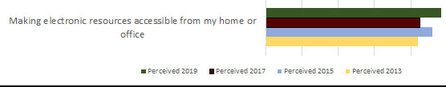
Ecosystem Assessment and Results
Quantitative and Qualitative Measures
Annual Usage Growth
(Downloads, Number of Items, ORCID ID’s
and Hosted Journals)
LibQual Biannual Survey 2013-2019, Faculty and Student System Perceptions, Comments
System | 2015 |  | 2016 | 2017 | 2018 | 2019
Downloads
DSpace | 318,742 | 318,742 | 385,163 | 341,224 | 972,359 | 1,010,349
ETDs | 158,240 | 158,240 | 200,373 | 328,420 | 470,437 | 505,658
Dataverse | n/a | n/a | n/a | 455 | 3,451 | 2,043
Items Added
DSpace | 1,437 | 1,437 | 1,546 | 1,660 | 2,135 | 2,720
ETDs | 1,174 | 1,174 | 1,326 | 1,581 | 1,789 | 2,218
Dataverse | n/a | n/a | n/a | 28 | 33 | 53
ORCID IDs
ORCID | 190 | 190 | 316 | 438 | 545 | 669
Hosted Journals
OJS | 1 | 1 | 2 | 2 | 3 | 4

Slide 23
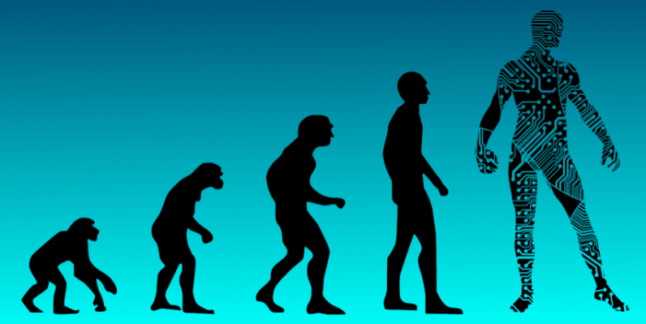
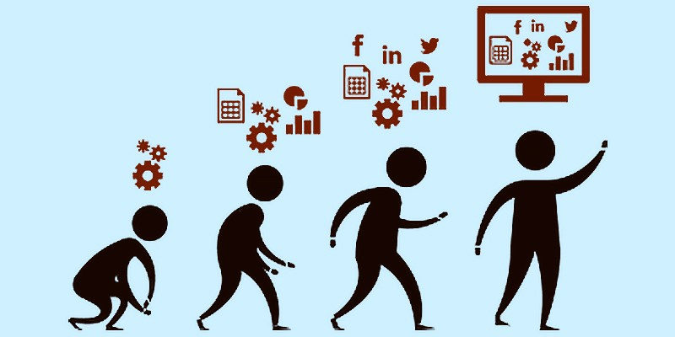
Summary Reflections
Placing Digital Scholarship Components within an Ecosystem Paradigm Enables:
1) Better Guidelines and Roadmaps for Developing Digital Scholarly Components
2) Pathways Forward and Evolutionary Possibilities for Future System Development
3) New Possibilities For Researchers within the academic research cycle

Slide 24

Questions, Comments
Ray Uzwyshyn, Ph.D. MBA MLIS
Director, Collections and Digital Services
Texas State University Libraries
ruzwyshyn@txstate.edu, 512-245-5687
http://rayuzwyshyn.net

Slide 25
Further References
Uzwyshyn, R. 2020 Developing an Open Source Digital Scholarship Ecosystem (Preprint). ICEIT2020. Oxford, UK. https://www.researchgate.net/publication/336923249_Developing_an_Open_Source_Digital_Scholarship_Ecosystem
Texas State University Libraries Website. https://www.library.txstate.edu/
Texas State Digital Collections Repository https://digital.library.txstate.edu/
Texas State Data Research Repository https://dataverse.tdl.org/dataverse/txstate
Texas State Online Research Identity Management System:
https://guides.library.txstate.edu/researcherprofile/orcidTexas State Electronic Thesis and Dissertation Management (VIREO): https://www.tdl.org/etds/
Texas State Digital & Web Services:
https://www.library.txstate.edu/services/faculty-staff/digital-web-services.html

Slide 26
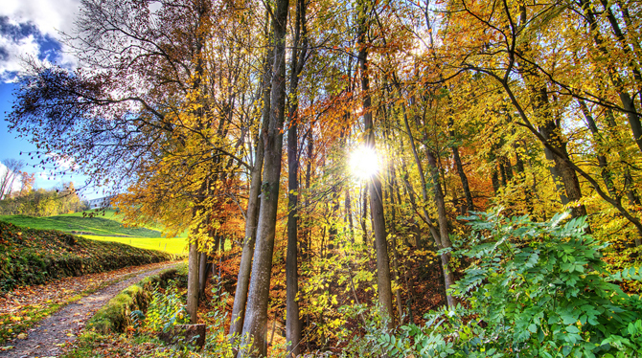
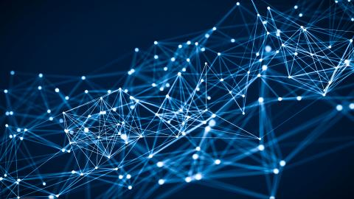

Future
Pathways
Networked Global Scholarly Research Environment

Slide 27


Research Universities and Digital Research Ecosystems
~266-300 Research Institutions US & Canada
Carnegie R1 & R2, Very High or High Research Activity
~1000-1250 Research Universities Worldwide
QS Rankings and Times Higher Education Supplement. (40% Europe, 26.5% Asia Pacific, US/Canada 18%, Latin America 9% and Middle East/Africa.
Enable Top 2-3% Research Institutions Globally, 1000 Institutions beyond the US and Canada.
(This represents the other 90% of Research Libraries Globally)

Slide 28





One Server Per Research Institution
2020-2025
Empower 1000 Research University Institutions/Research Libraries Globally
Gift each Research University One Configured Server Ecosystem with 6 Open Source Scholarly Research Software Components,
< $1000.00 US/Server or set up Fractional Server Space with Mirror Sites Globally (SAAS)
Set Up brief weeklong training over five continents
Connect Networks
Measure the Effects

Slide 29

Can we Enable Scholarly Research Network Ecosystem Possibilities on Global Levels?
Is it Desirable or Time to Begin Thinking About Empowering a Global Research University Community ?

Slide 30


Brainstorming Models
One Laptop Per Child
Dreamed up mid-late 90’s, Launched 2005
Nicholas Negroponte, MIT Media Lab Founding Director
Noble Initiative/Grand Ambitions
Vision: Give each child in world access to a laptop with open source software for less than 100.00 $US/laptop
Gage Effects For Education Globally
Can We do the same thing for academic research globally?

Slide 31
Research Universities and Digital Research Ecosystems
~266-300 Research Institutions US & Canada,
Carnegie R1 & R2, Very High or High Research Activity, 124 ARL Libraries
~1000-1250 Research Universities Worldwide
QS Rankings and Times Higher Education Supplement. (40% Europe, 26.5% Asia Pacific, US/Canada 18%, Latin America 9% and Middle East/Africa.
26,000-40,000 Universities Globally. Research Universities 2.7% - 4.2% of all universities worldwide. Highest by Country: US 156, UK 76, Germany 45, Japan 44.
Other Top 2-3% Research Institution Academic Libraries Globally, 1000 Institutions beyond the US and Canada. This represents the other 90% of Research Libraries Globally

Slide 32
Research Universities and Digital Research Ecosystems
124 ARL Research Libraries (US and Canada)
131 US Research Universities (Carnegie R1, Very High Research Activity)
135 Doctoral Universities (Carnegie R2, High Research Activity, US), ~266-300 Research Institutions US & Canada
1011 Research Universities Worldwide (40% Europe, 26.5% Asia Pacific, US/Canada 18%, Latin America 9% and Middle East/Africa.
QS Rankings
1250 Research Universities Worldwide, Times Higher Education Supplement (2.7% - 4.2% of all universities worldwide)
By Country: US 156, UK 76, Germany 45, Japan 44
Global Estimates of General University #’s 26,000-40,000
Empower Other Top 2-3% Research Institution Libraries Globally,
1000 Institutions, the other 90% of Research Libraries Globally

Slide 33
Larger Digital Scholarly Research Projects
Can Act as Qualitative/Quantitative Benchmarks
Cognitive Cartography/Multimedia Archives
(Video, Text, GIS, Images, Field Notes)
Dick Reavis: National Tour of Texas
Multimedia, Digital Archives/Retrospective ETD Projects
(Digital video, online exhibit images, text, digital archives)
Severo Perez: And the Earth Did not Swallow Them
Online Exhibits/Digital Archives/ Online Academic Journals
(images and text, Omeka front end/Database back end, IIIF)
Cabeza de Vaca La Relacion Digitization
Santiago Tafolla: Mexican Amer. Confederate Soldier
Interactive Image Archives/Data & Research Projects
(Image libraries, Interactive Commenting/Metadata)
Texas State Flickr Commons
Digital Libraries Archiving & Documentation Projects
(Text, Metadata, OCR, Search, Zoom ability, Page Turning)
Pedagogs University Yearbooks
Faculty Digitization Proposals/Partnerships
Complexity
1) Project Completion
(Milestones)
2) Usage Statistics
Projects,Prototypes Grant Partnerships

Slide 34



Combining Components
System Synergies
Digital Scholarly Research Ecosystem

Slide 35
Network Effects
Both In and Between Individual Components and In and Among Component Networks
ORCID Aggregates from Several Sources and Networks and Connects to Other Networks, Internal and External
OMEKA can act as a middleware front end connecting several components and component networks internally.
3) Digitization Lab’s IIIF Framework can create internal or globally distributed Image Libraries.
4) Dataverse can be configured as a single Instance or as a Consortial Model (Texas 22 Individual Instances, TDL)

Slide 36
Assessment and Results
Quantitative and Qualitative Measures
Annual Usage Growth
(Downloads, Number of Items, ORCID ID’s
and Hosted Journals)
LibQual Biannual Survey 2013-2019, Faculty and Student System Perceptions, Comments
Ecosystem Implemented in Stages, 2014-2019
System | 2014 | 2015 | 2016 | 2017 | 2018 | 2019
Downloads
DSpace | 326,762 | 318,742 | 385,163 | 341,224 | 972,359 | 1,010,349
ETDs | 136,985 | 158,240 | 200,373 | 328,420 | 470,437 | 505,658
Dataverse | n/a | n/a | n/a | 455 | 3,451 | 2,043
Number of Items
DSpace | 1,340 | 1,437 | 1,546 | 1,660 | 2,135 | 2,720
ETDs | 967 | 1,174 | 1,326 | 1,581 | 1,789 | 2,218
Dataverse | n/a | n/a | n/a | 28 | 33 | 53
ORCID IDs
ORCID | 101 | 190 | 316 | 438 | 545 | 669
Hosted Journals
OJS | 1 | 1 | 2 | 2 | 3 | 4

Slide 37

Ecosystem as System
Enables Core Research
Articles, Theses, Dissertations in the collections repository can be associated with datasets in the data repository for reference, verification or reproducibility.
Journal article citation lists can be associated with articles and datasets in the Collections and Data Repositories
Further Desired Connections can also guide developmental paths for both component software and the ecosystem

Slide 38
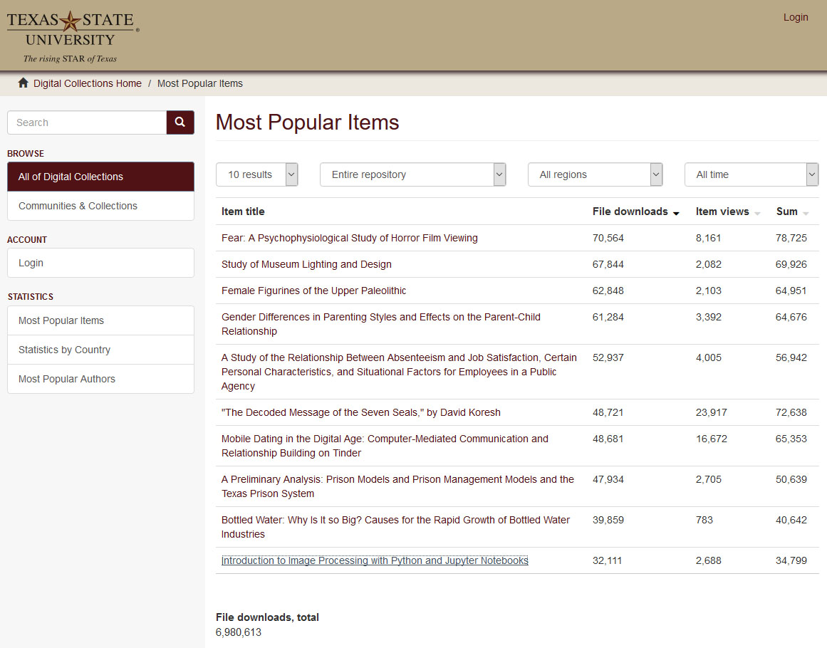
Digital Collection Repositories Gives Insight and another window into Faculty/Student Research (Statistics)

Slide 39
Network Effects Allow Opportunities
Among Research Institutions
Research
Institution A
Research
Institution B
Research
Institution C

Slide 40

Digital Scholarly Ecosystem
Timelines and Implementation Paths
Many Roads To Rome (1-5 Year Paths)
Year 1 : Digital Collection Repository and Digitization Lab
Year 2: User Interface Software (OMEKA), Identity Management System, ORCID
Year 3: Data Repository
Year 4: ETD Middleware (VIREO) and OJS Software
Year 5 Complex Digitization Projects, IIIF Server, Faculty Grant Projects etc.
Ecosystem Implemented in Stages, 2014-2019

Slide 41
Human Resources
System Administrator/Programmer
server infrastructure set-up/maintenance/basic customization
Digital Collections Librarian:
Administration, Marketing, User Support, Collections and Data Repository, OJS/ORCID
Metadata Librarian: Dublin Core, Specialized Schema
Web Developer/Programmer: OMEKA, System Integration
Project Manager/Department Head (PMP Certification)
Digitization Specialist
GIS Specialist/Data Visualization Specialist
AI Specialist/Post-Doc/CLIR Fellow

Slide 42
Percent Increase in Article Citations by Discipline with Open Access Online Availability
(Immediately Available Through Google)
Range = 36%-250%
(Data: Stevan Harnad and Heather Joseph, 2014)

