Slide 1

Jane Addams’s Peaceweaving:
A Feminist Response to Paternalism,
Militarism, and World War I
Patricia M. Shields
Department of Political Science
Texas State University
March 24, 2017
San Marcos, TX

Slide 2
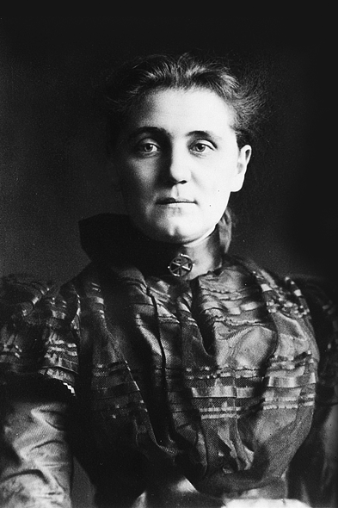
Who is Jane Addams
My Story
Paternalism
Militarism
WWI -- Woman’s Peace Movement
Peaceweaving

Slide 3
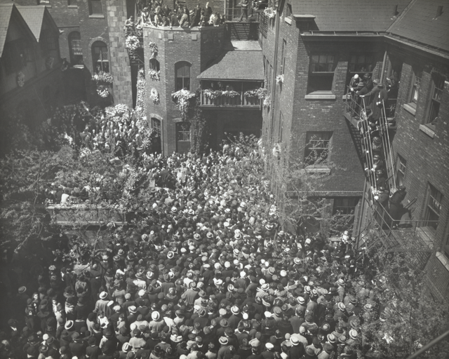
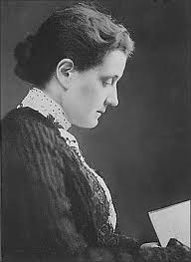
1860 - 1935
Jane Addams’s Funeral
Steps of Hull House

Slide 4
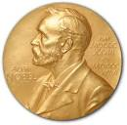


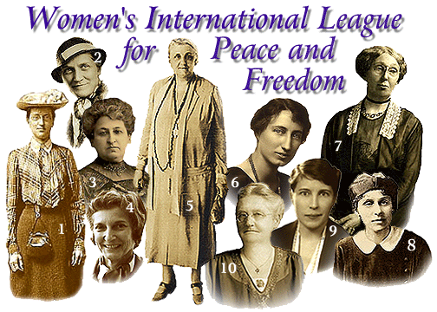

Nobel Peace Prize
1931
Founder

Slide 5
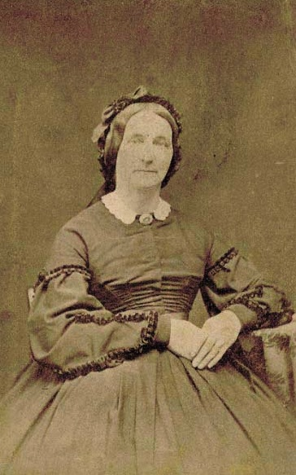
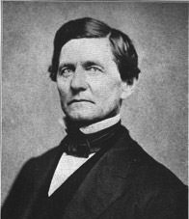
John Huy Addams
Father
Sarah Weber Addams
Mother
Anna Haldeman Addams
Stepmother

Slide 6
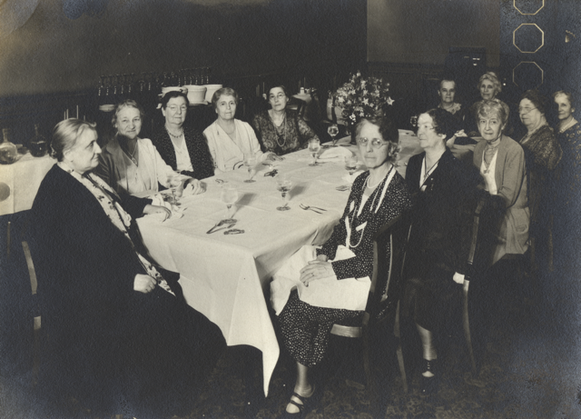
Rockford Female Seminary
Valedictorian
Editor Newspaper
President Debate Club
President of Class

Slide 7
Leader Settlement Movement
1880s – 1920s
Problems of
Industrialization & Urbanization
Poverty
Health – Sanitation
Health – Industrial accidents
Education
Inspired by trip to
England’s Toynbee Hall
Top Down model of reform

Slide 8
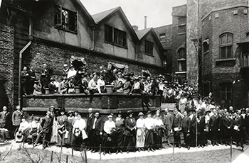
Hull House (Chicago)
Ideas emerged from
This experience
Immigrant Community
Lab – conflict resolution
Bottoms up model of reform
Hull House – Settlement Workers gathering 1920

Slide 9
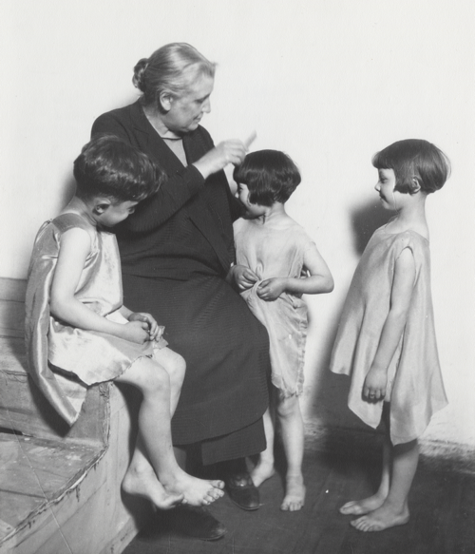
Hull House Activities
drama classes,
day care programs,
coffee house/theater,
art and labor museum,
Sunday concerts,
choir,
over 25 clubs,
meeting rooms for organized labor,
cooperative apartments for young women
College Extension courses
Voter Registration
Speaker series…....
first in Chicago to establish a public
bath,
gymnasium,
kitchen,
playground,
swimming pool.

Slide 10
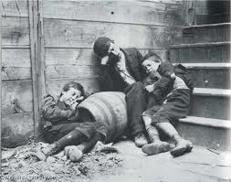
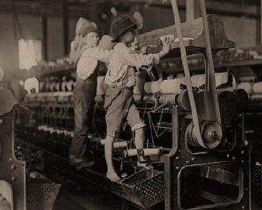
Child labor laws
Playgrounds
Juvenile Courts
NAACP founder
Active social reform
Street Cleaning/garbage
collection
Water/Sewer
Healthier workplace

Slide 11
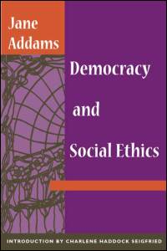
Hull House
Ideas emerged from
This feminine experience
Democracy
Immigrant Community
Labor/management disputes
Lab – conflict resolution

Slide 12
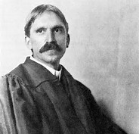
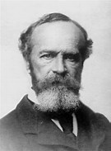

Philosophers (Friends/Associates)
John Dewey
William James
W. E. B. Du Bois
George Herbert
Mead
Co-founded NAACP
Feminine Standpoint

Slide 13
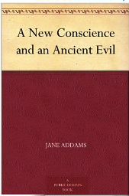







Noted Speaker - Author
1907

Slide 14
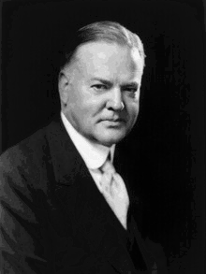
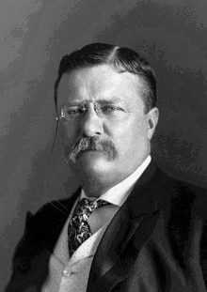
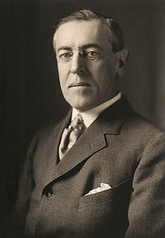
31st President
26th President
28th President
She and Hover worked on post
WWI humanitarian efforts
She nominated Roosevelt for the
Progressive party presidential
candidate.
Wilson nominated her for
Nobel prize

Slide 15
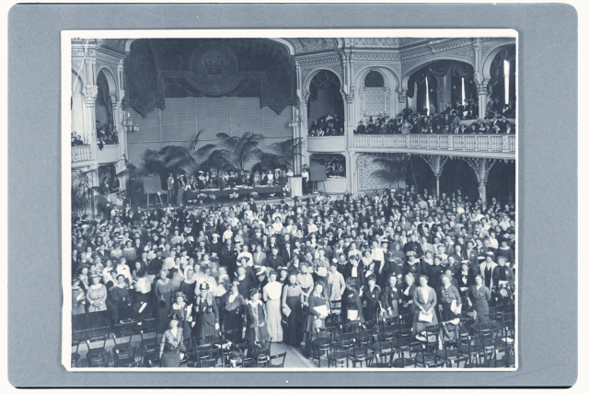
1915 Women’s Peace Conference The Hague

Slide 16
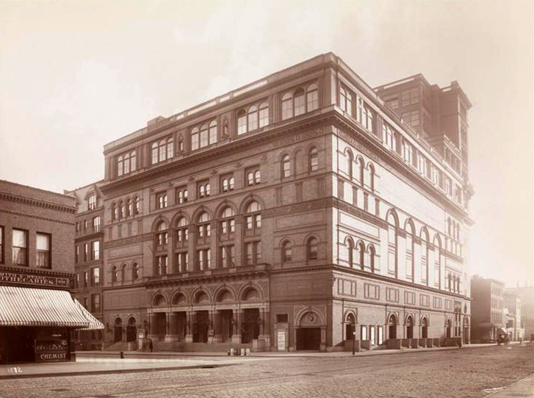
Speech Carnegie Hall

Slide 17
Jane Addams Public Timeline
Lost Historical Memory
1889
1915
Demeaned
Traitor
Communist
Silly old woman
1935
Celebrated
DOJ Surveillance

Slide 18
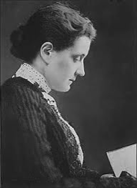
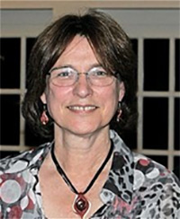
Expeditionary mindset/
Peacekeeping
Pragmatism/
Public Administration

Slide 19
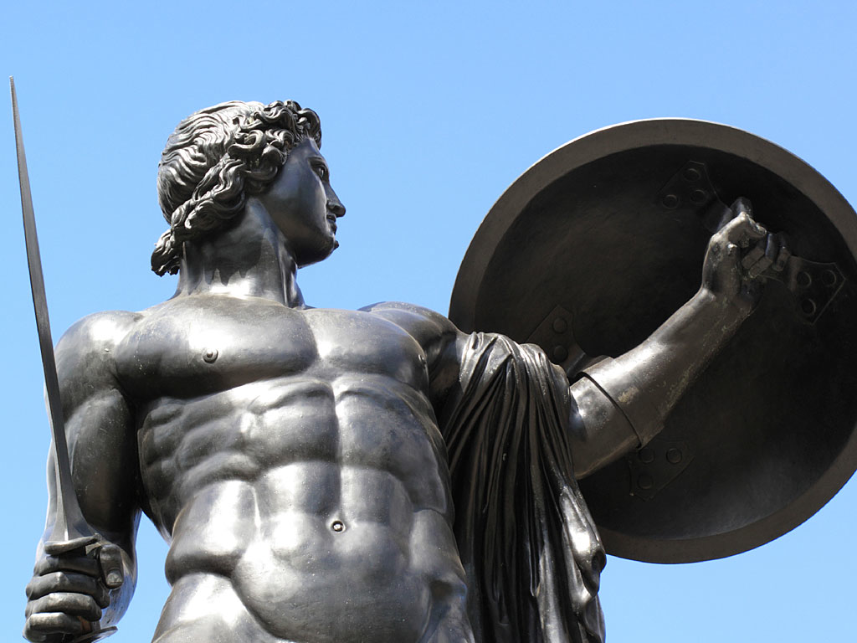

Warrior
Peacekeeper
Shields & Soeters, 2013

Slide 20
Nobel Peace Prize
1931
Faculty
Development
Leave
What was her idea
Of Peace?
Could it be applied
To Peacekeeping?

Slide 21
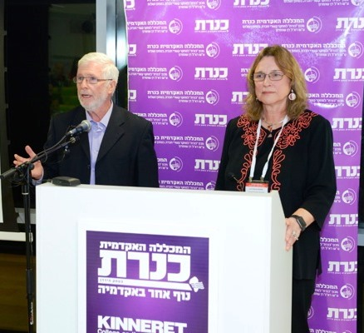

Slide 22
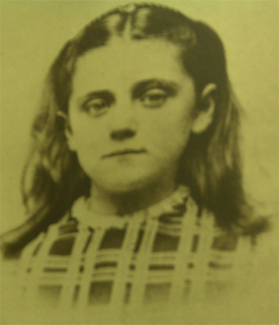
Paternalism
ç
Duty
Moral Absolutism

Slide 23

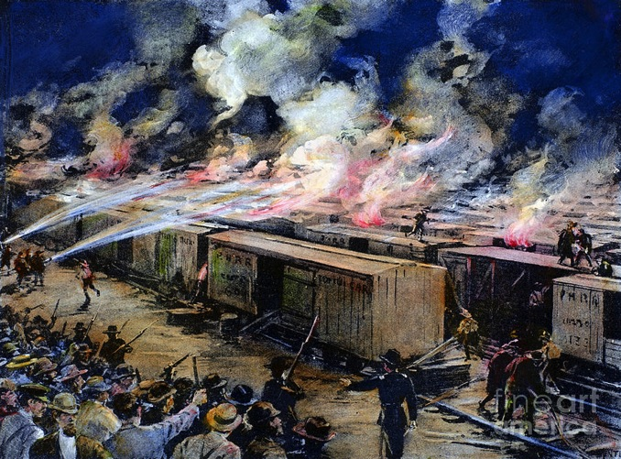
Pullman Strike
King Lear
“Modern Lear”

Slide 24

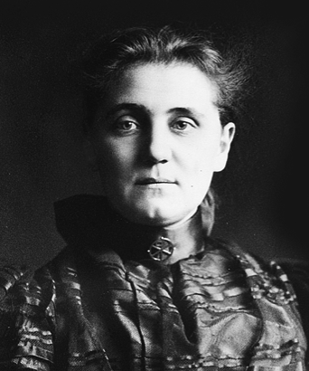
Social Claim

Slide 25
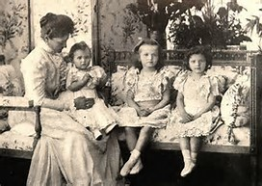

Slide 26
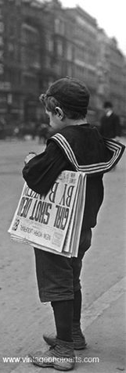
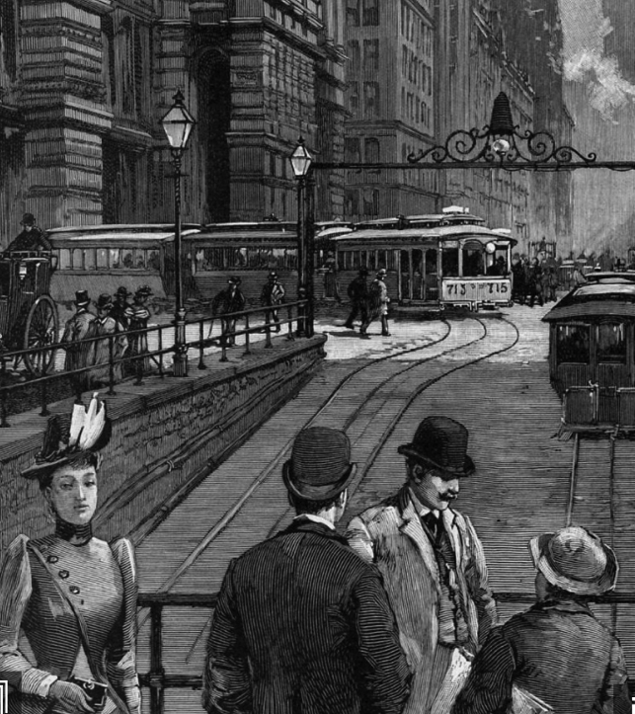

Slide 27
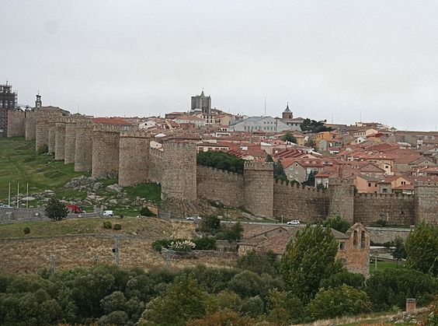
Militarism
Valued Soldiers
De-valued Women & Children

Slide 28

Municipal Housekeeping
City as Citadel
Criticized outmoded model
of city governance
Argued in favor of a
more caring model of
city government

Slide 29
Civic Housekeeping
1907
“Survival of Militarism in City Government” (chapter 1)
“Failure to Utilize Immigrants in City Government
“Utilization of Women in City Government”

Slide 30
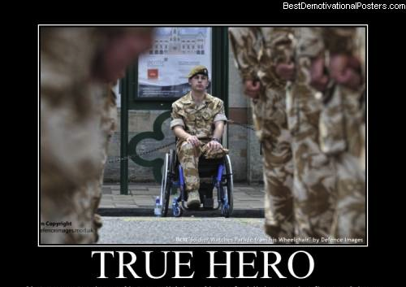
Heroism of War
Newer Ideals of Peace
Valor on Battlefield
Courage
Sacrifice for Country
Problem –supporting peace
feeble and inadequate
goody-goody
Needed a more aggressive – stir the blood
Notion of peace.
New Humanitarianism
Valor in serving the needy

Slide 31
Peace - Courage

Slide 32
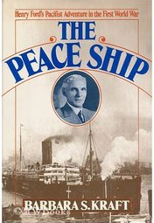

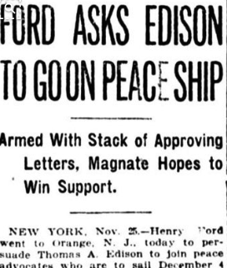
Peace Movement (1890s – WWI)
Establish International Law and Order
Peace good for Business
Peace Organizations (Elite)
Social conservative
National political figures
Important Businessmen
Presidents (Taft, Wilson)
Secretaries of State (5)
Andrew Carnegie

Slide 33
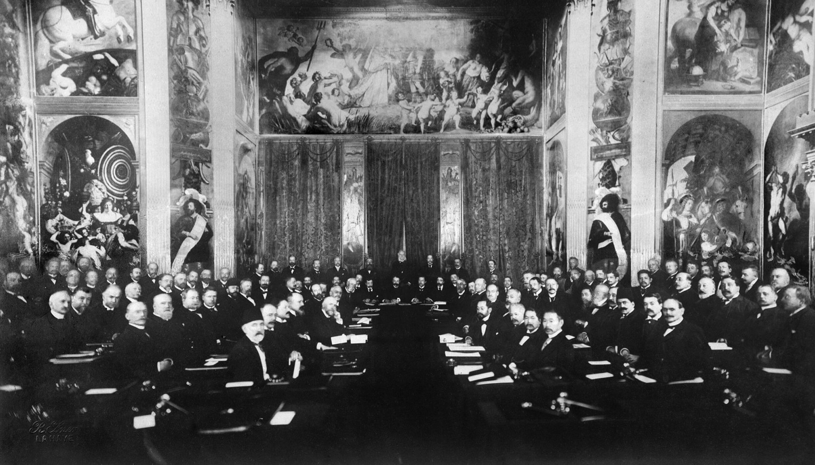
1899 Hague Peace Conference
(1907)
Legal Framework for Peaceful settlement of disputes

Slide 34
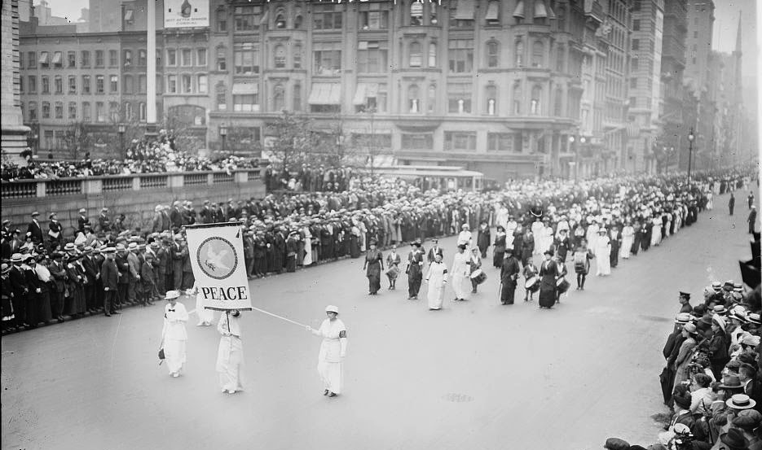
Maternal Instinct
Women have an instinctive and
rational opposition to war
Women & Children suffer but not
at table
Need increase participation of
women in politics.
Linked to Suffrage
Aug. 1914
Woman’s Peace Party established – Jane Addams Leader

Slide 35
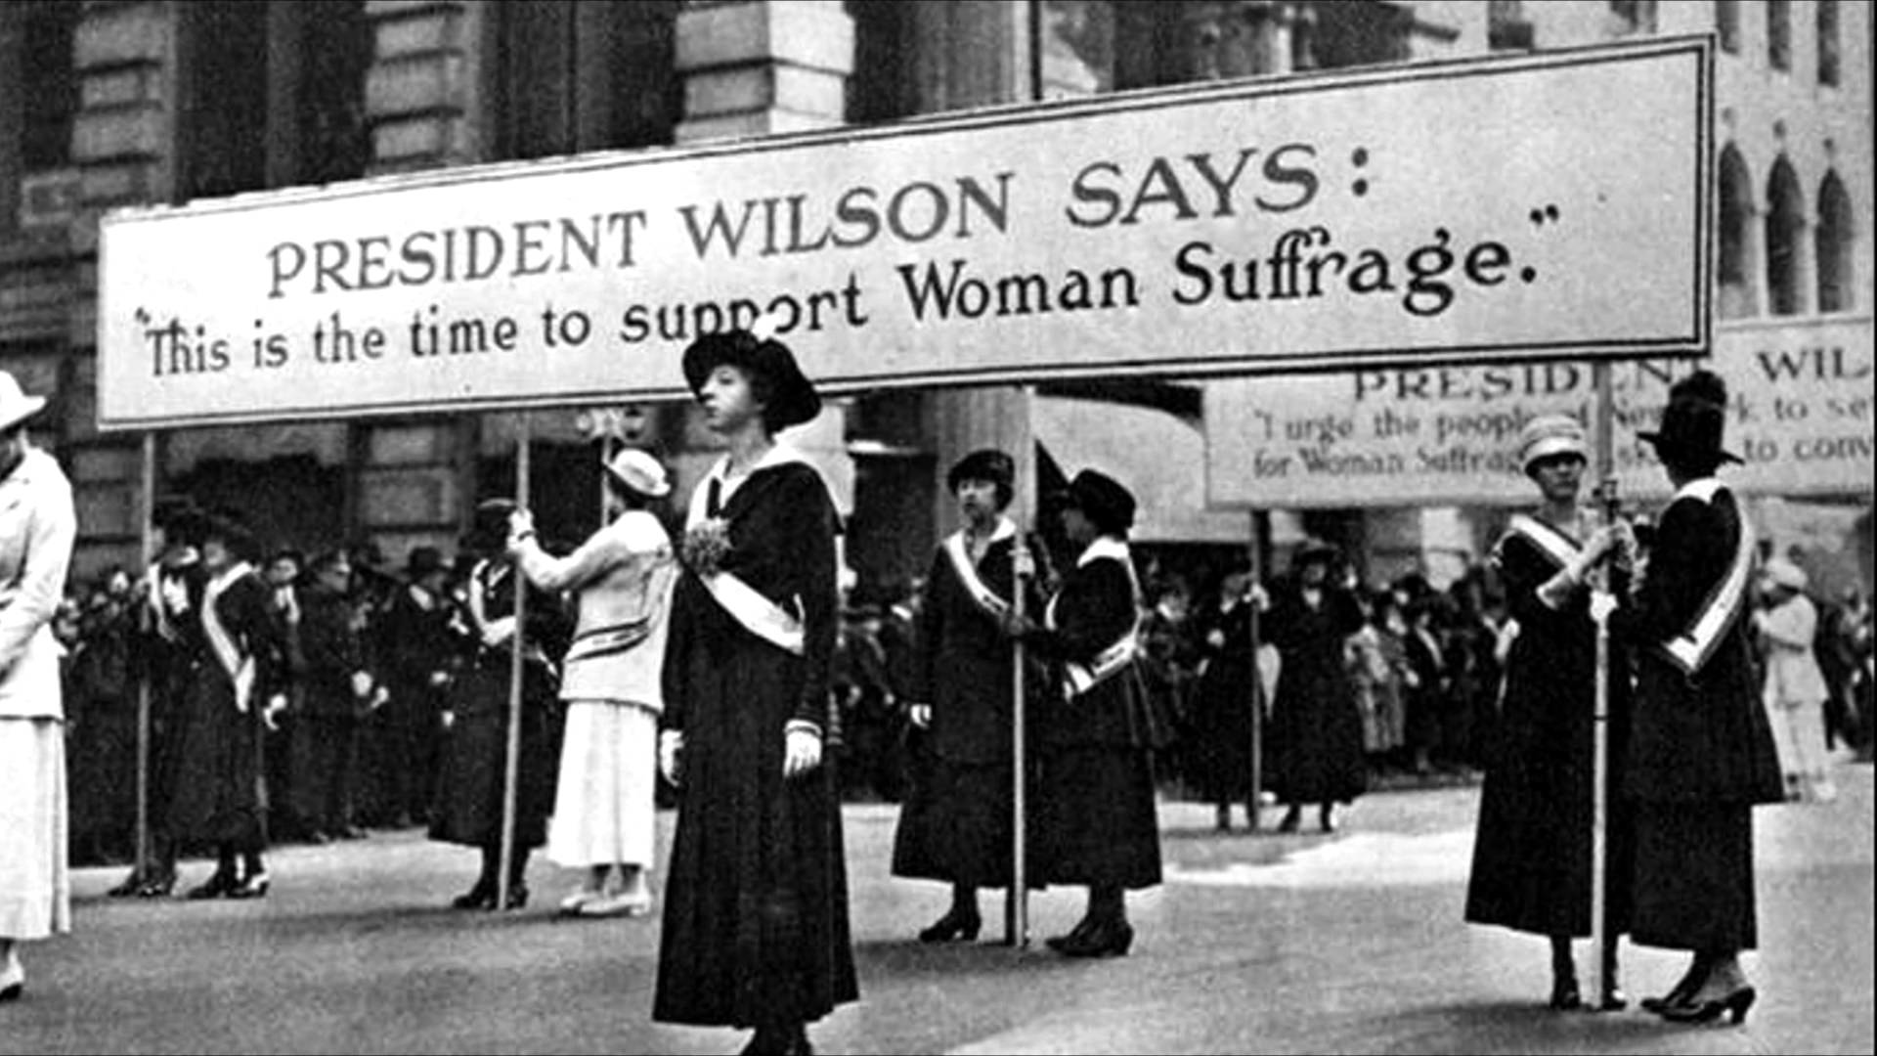

Slide 36
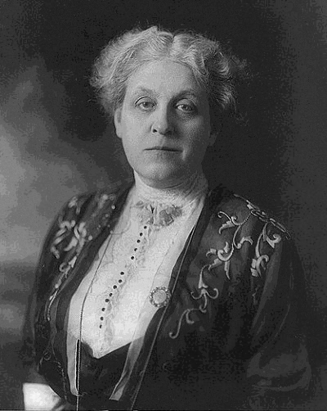
Carrie Chapman Catt

Slide 37
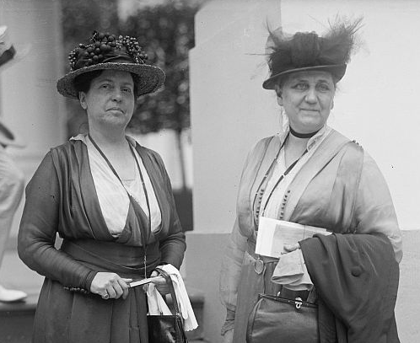
Preserving the Social Fabric
Led by Social Workers
Threat of war to domestic social programs
Importance of conservation of society
SW expertise at Social Relations
- expanded to International Relations
Lillian Wald & Jane Addams
Henry Street Settlement

Slide 38
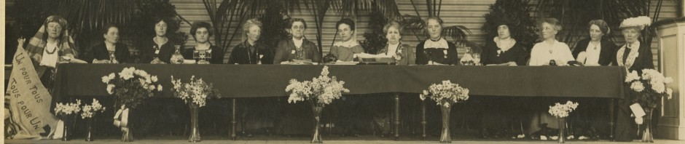
International Peace Congress of Women at the Hague
April 1915

Slide 39
Social Claim
International Committee of Women for Permanent Peace
April 1915

Slide 40
Begin peace negotiations immediately
Conference Neutral Nations
Continuous Mediation
Future disputes – arbitration
Organization “Society of Nations”
Acknowledge women’s suffering
during war
Give women right to vote
Women participation in Peace Processes

Slide 41

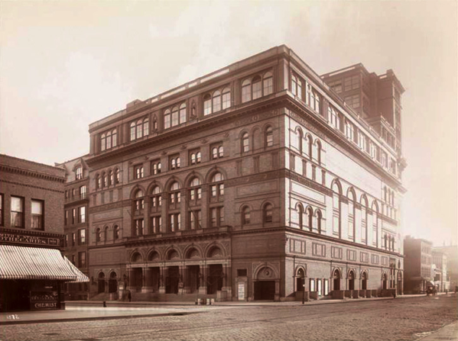
Peace Delegation

Slide 42
During WWI
Suffrage movement – support the war

Slide 43
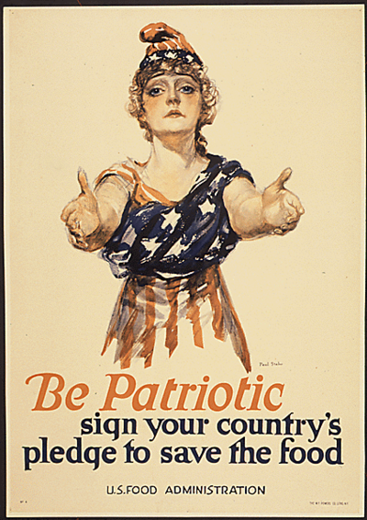
US Food Administration
American Relief
Administration
Addams traveled
Including Texas
4 million tons of supplies
23 countries
Herbert Hover

Slide 44

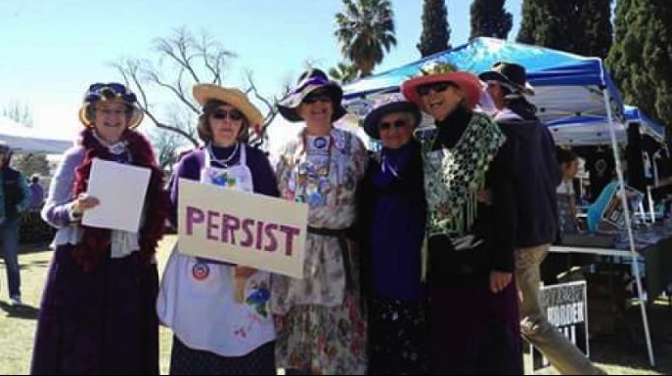
International Committee of Women for Permanent Peace
Becomes Women’s International League of Peace and Freedom

Slide 45
Addams – Peaceweaving

Slide 46
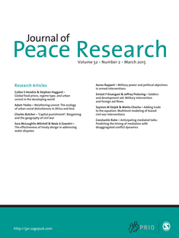
“Peace Research:
Just the Study of War”*
Negative Definition of Peace
* Gleditsch, N. Nordkvelle, J & Strand, H. (2014) Peace Research Just the Study of War.
Journal of Peace Research, 51(2), 145-158.

Slide 47
Problems with Negative Definition
Shifts focus of inquiry from peace to violence.
Focuses on a short run end state.
Divorced from the dynamics of relationships.
Shifts attention away from underlying
dynamics or causes of violence.

Slide 48
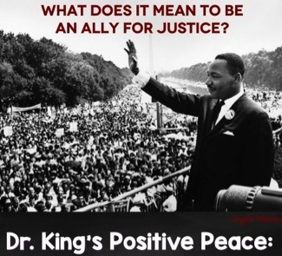
Positive Peace
Nonviolent and creative conflict transformation.
Uneven long run focus.
The fabric of the kind of society to which we aspire.
Integrity, wholeness and well-being that
arise from justice.
Humanity toward others.
Openness to a widely conceived social claim

Slide 49

Feminine sensibility
PeaceWeaving
1. Relationships

Slide 50
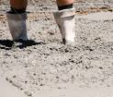

2. Avoid Rigid Moralisms
Friend/enemy
good/evil
Courage

Slide 51

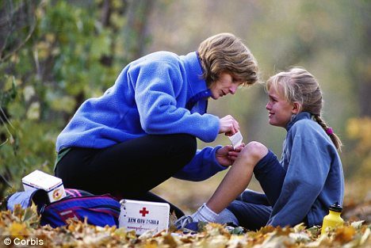
3. Sympathetic Understanding
How build
relationship

Slide 52
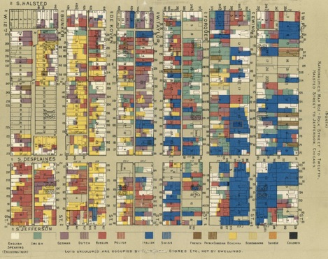

4. Community of Inquiry
Practical Problems
Scientific Attitude
Participatory Democracy

Slide 53
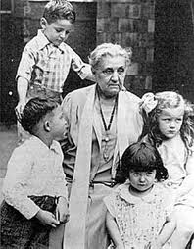

5. Lateral Progress
Duty toward the less fortunate – Social claim

Slide 54

PeaceWeaving
– building the fabric of peace by emphasizing relationships. These positive relationships are built by working on practical problems, engaging people widely with sympathetic understanding while recognizing that progress is measure by the welfare of the vulnerable. (Shields & Soeters, 2015)

