Slide 1
Women’s Peace Movement
Patricia Shields PhD
Texas State University
ps07@txstate.edu
Save Texas History Symposium: Texas and the Great War
University of Texas, September 15 – 16, 2017

Slide 2
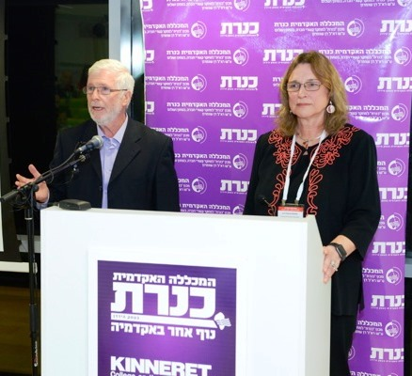
Israel, Sea of Galilee

Slide 3
Samuel Palmer Brooks
President Baylor (1902- 1931)

Slide 5
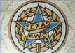
Co-Sponsored by:
Texas Federation of Women’ Clubs
Mrs. Percy V. Pennybacker (Anna)

Slide 6
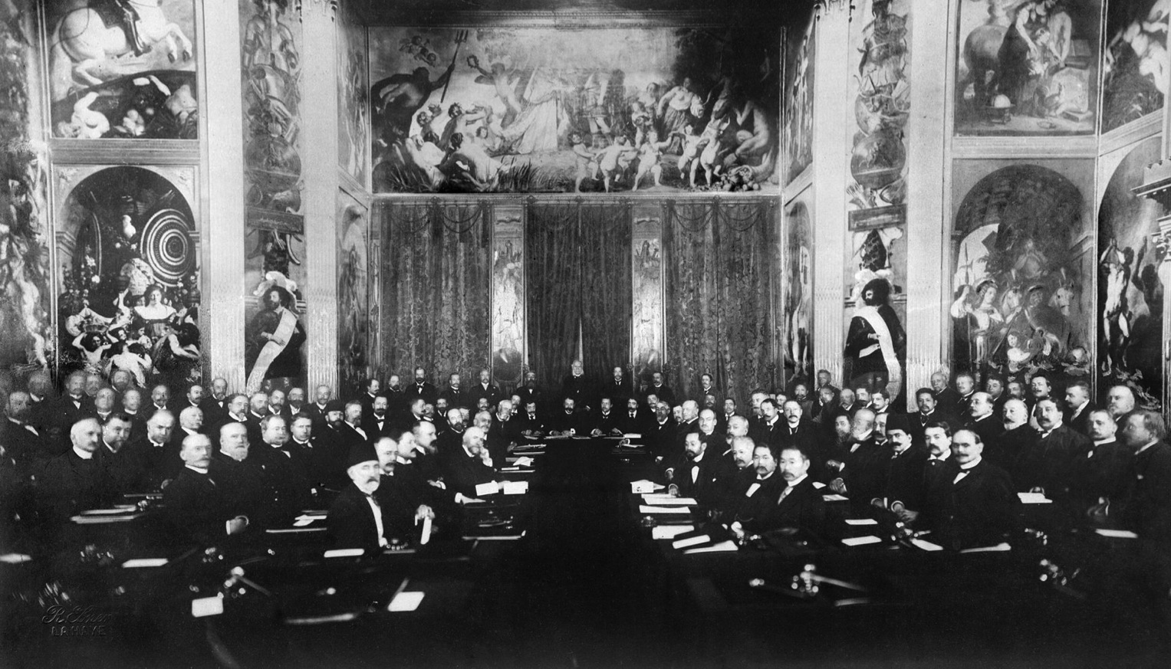
Peace Movement 1899 – 1917: US and Texas
Baylor 1907
The Hague
1899 & 1907
2015

Slide 7
US & Texas Peace Movement

Slide 8

US Peace Movement (1890s – WWI)
Establish International “Law and Order”
Arbitration
US Supreme Court as Model
Peace Good for Business
Christian Values
Women’s social policy agenda
Henry Ford

Slide 9
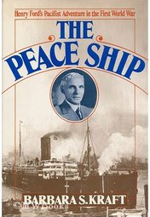
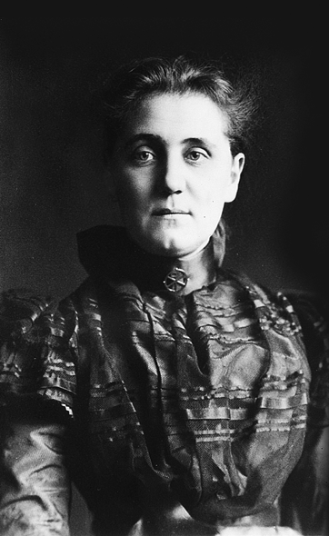
Peace Organizations (Elite)
Social conservative
National political figures
Important Businessmen
Taft
Ford
Wilson
Roosevelt
Carnegie
Addams

Slide 10
International Peace Conference
World leaders actively sought new institutions, legal frameworks and policy tools
multilateral treaties
Permanent Court of Arbitration
1st formal statement laws of war, war crimes
War replaced by a system for the peaceful settlement of disputes among states.
The Hague 1899 & 1907

Slide 11
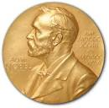
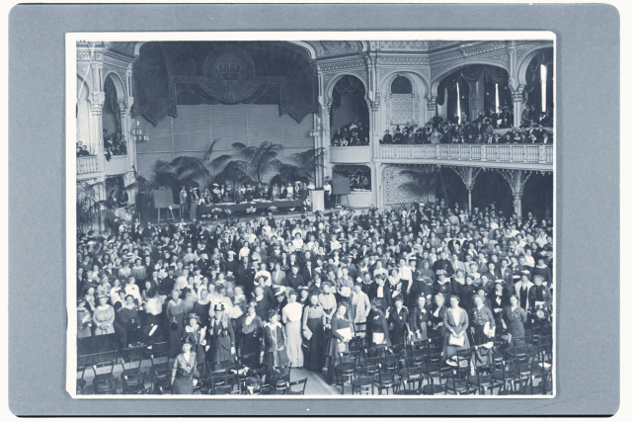
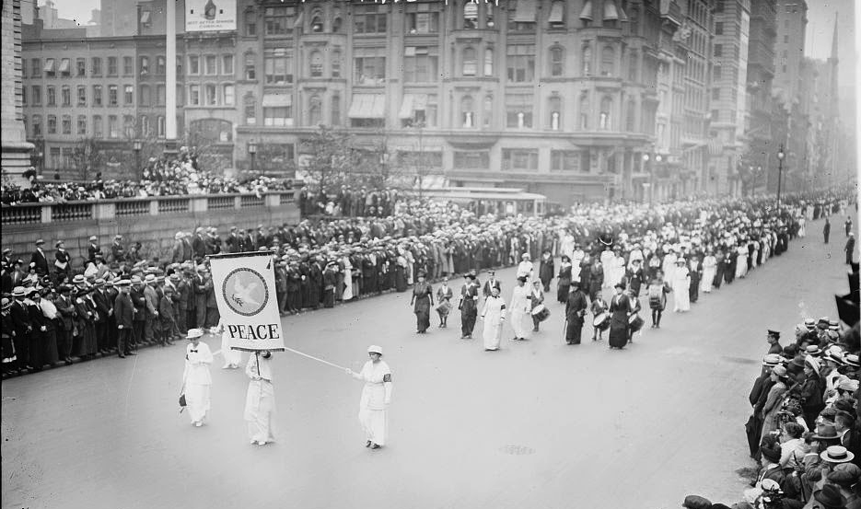
1915
Women’s Peace Conference
The Hague
Delegation visited capitals warring
Nations -- Mediation
1914

Slide 12
Begin peace negotiations
immediately
Organization “Society of Nations”
Acknowledge women’s suffering
during war
Give women right to vote
Women participation in Peace
Processes
14

Slide 14
World War I
Like an extinction event
German sympathizers/traitors
Communist sympathizers
Quick to judge/unsupported claims – press/politicians

Slide 15
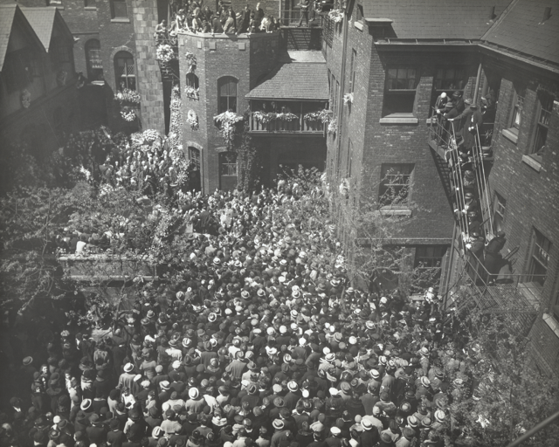
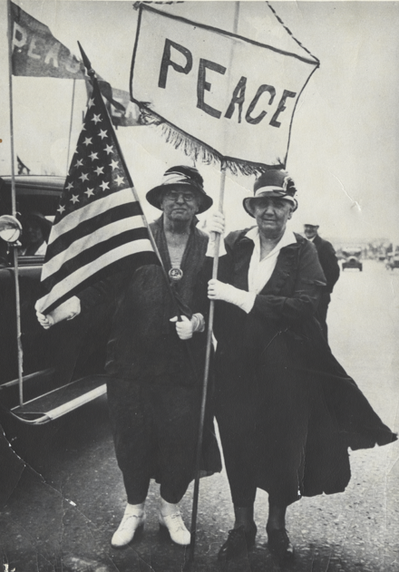
Jane Addams
1860-1935
Funeral
Steps of Hull-House

Slide 16


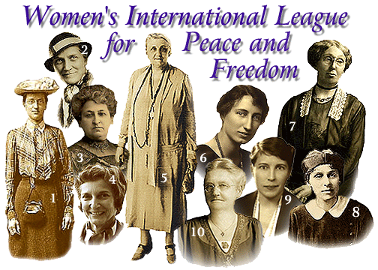

Nobel Peace Prize
1931
Founder

Slide 17
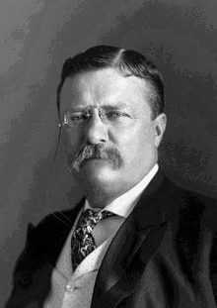
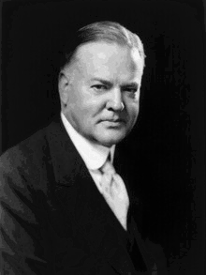
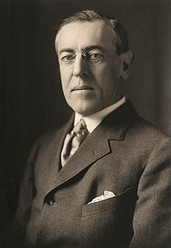
31st President
She and Hoover worked
on post
WWI humanitarian efforts
26th President
28th President
She nominated Progressive
party presidential
candidate.
Wilson nominated her for
Nobel prize

Slide 18
Leader Settlement Movement
1880s – 1920s
Problems of
Industrialization & Urbanization
Poverty
Health – Sanitation
Health – Industrial accidents
Education
Inspired by trip to
England’s Toynbee Hall
Top Down model of reform

Slide 19
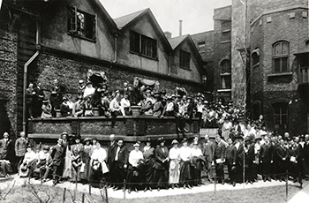
Hull House (Chicago)
Immigrant Community
Lab – conflict resolution
Women’s ideas
Hull House –
Settlement Workers gathering
1920
Bottoms up model of reform

Slide 20
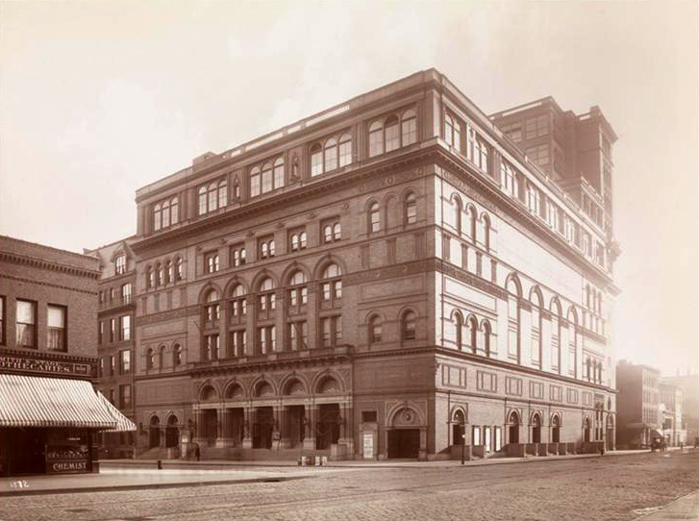
Recovering Jane Addams
1889
1915
Demeaned
Traitor
Communist
Silly old woman
1935
Celebrated
DOJ Surveillance

Slide 21
Roots of Women’s Peace Movement
Women organizing politically
North
South
Abolition
US Sanitary Commission
Women’s Clubs
Settlement movement
Literary Clubs
Women’s Clubs
Moral authority of the Mother

Slide 22
Texas Federation Women’s Clubs
Northern Women
Abolition organization
Sanitary Commission (Civil War)
Urbanization
Immigration
Women’s Club tradition
Settlement movement
Literary Tradition
Urbanization
Focus – rural poverty
Upper class
Volunteerism
White experience

Slide 23
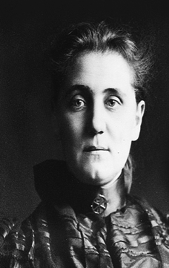
Jane Addams
Anna Pennybacker
1860 - 1935
1861 -1938
Founded Settlement movement
Single (niece/nephew)
Author/Speaker
Non profit administrator
Hull House
Higher Education
Upper Class
President Texas Federation of Women’s Clubs
Widowed – 3 children
Author/speaker
Teacher/ Principal
Higher Education
Upper Class

Slide 24
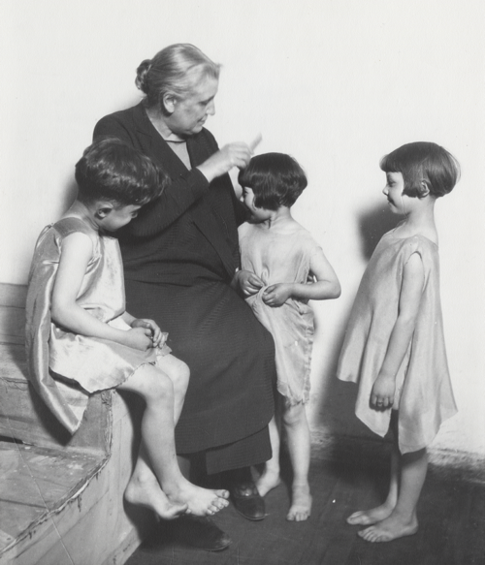
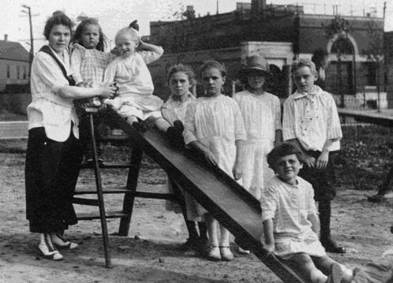
drama classes,
day care programs,
Kindergarten,
coffee house/theater,
art and labor museum,
Sunday concerts,
Speaker Series, choir,
over 25 clubs,
Urban Neighborhood Services
meeting rooms for organized labor,
cooperative apartments for young women
College Extension courses
Voter Registration
First in Chicago to establish a public
bath,
gymnasium,
kitchen,
playground,
swimming pool.
Texas Women’s Clubs
Libraries
School playgrounds
City playgrounds
Traveling Art Exhibits
Literary groups
Civic beautification
“soap & water days”
Concerts
lectures
Hull House Activities

Slide 25
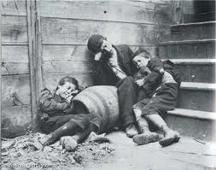
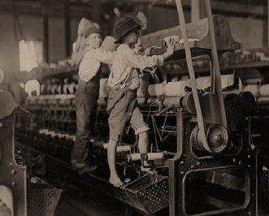
Active social reform
Child labor laws
Playgrounds
Juvenile Courts
Street Cleaning/garbage
collection
Water/Sewer
Healthier workplace

Slide 26
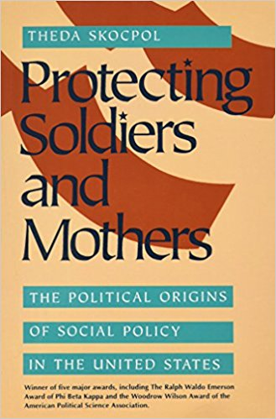
Maternalism-social activism
Moral Authority of Mother
Claim policy areas that
affected women and
children
Peace

Slide 27
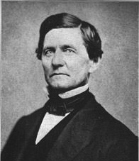
Paternalism
Woman’s sphere
Private Sphere
ç
Public Sphere – male domain
Duty
Moral Absolutism

Slide 28
Municipal Housekeeping
Criticized outmoded model
of city governance
Argued in favor of a
more caring model of
city government.
Women’s
experience
Widen Social
Claim

Slide 29
Civic (Social) Housekeeping
1907
“Survival of Militarism in City Government” (chapter 1)
“Failure to Utilize Immigrants in City Government
“Utilization of Women in City Government”
Social claim linked to Women’s
Experience
Natural Leader of Women’s Peace Movement

Slide 30
Home
Community
World
Expanding Women’s Sphere
Newer Ideals

Slide 31
Women have an instinctive
and rational opposition to war
Women & Children suffer
but not at table
Need increase participation of
women in politics.
Linked to Suffrage Movement

Slide 32
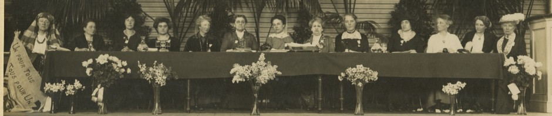
International Peace Congress of Women at the Hague
April 1915

Slide 33
Social Claim
International Committee of Women for Permanent Peace
April 1915

Slide 34
During WWI
Suffrage movement Pro-war

Slide 35
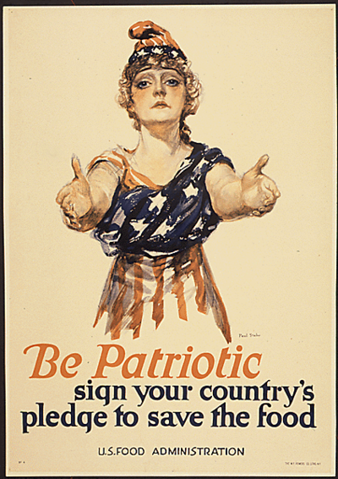
US Food Administration
American Relief
Administration
Addams traveled
Including Texas
4 million tons of supplies
23 countries
Herbert Hoover

Slide 36

PeaceWeaving
– building the fabric of peace by emphasizing relationships. These positive relationships are built by working on practical problems, engaging people widely with sympathetic understanding while recognizing that progress is measure by the welfare of the vulnerable. (Shields & Soeters, 2015)

Slide 37
Sponsored by Baylor and
Texas Federation of Women’s
Clubs

Slide 38
Program
Nov. 19 – Mrs. Pennybacker TFWC
Hallelujah Choir
Nov. 20 –Nat Washer – Grand Master, (Mason) & President Business Men’s Club of SA
W. H. Atwell US District Attorney
Geo. Burgess, Member of Congress
Geo Turett, Pastor, 1st Baptist, Dallas
T. M. Campbell, Governor of Texas
Benjamin Trueblood, Secretary of the American Peace Society, Editor, Advocate for Peace
    J. Kirwin, Rector, St. Mary’s Cathedral
    Clarence Ousley, Editor, Ft. Worth Record

Slide 39
Mrs. Pennybacker (Pres, TFWC)
“What the women of America should do is to believe and make
other people believe that Peace is the best thing for the World,
and that arbitration is the best way in the world to settle all differences.”
Nat Washer (Pres. Businessmen’s Club)
“Peace is already accepted as an ally to industry,
as well as to every other civilizing factor….”
Rev. Truett
“If this nation is to be saved from the doom of the proud nations of the olden
days, we must learn from the Son of God Himself the priceless value of human life.”

Slide 40
“The price of peace, to the shame of modern civilization, is the cost of war.
I do not as a citizen, and I would not under right occasion in war, fail to respond to the needs of my country.
But I appeal to teachers, who study the
history of mankind, and who teach the rising generations … we have reached a time in the development of the race when diplomacy and arbitration are better than war.”
Samuel P. Brooks
“The Price of Peace”
Address to the State Teachers Assoc. 1913
World’s Best Orations Lone Star Edition

Slide 41
Lindley M. Keasbey
UT Professor
Released from UT for
Peace activism (1917)
WWI
Casualties
Eduard Prokosch
UT Professor forced to
Resign from UT for German
Leanings 1919

Slide 42
Legacy of Peace Movement -- Newer Ideals of Peace
Municipal Libraries
Public Parks
Child Labor Laws
School Playground equipment
Sewers
Clean water
Garbage Collection
Sanitary meat markets, restaurants
Etc.
Hidden in Plain Sight
Dinosaurs -- birds

Slide 43
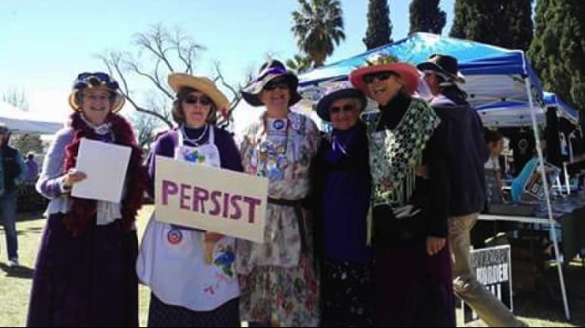

2017
-- Jane Addams
UN Resolution 1325
on Women, Peace and Security
Increased participation of women in decision making
related to, prevention, management and resolution
of armed combat.

Slide 44
2015
Mrs. Pennybacher
Support “Peace” broadly defined by
Targeting family violence

