Slide 1
Pragmatism and Public Administration Research Methodology
Patricia Shields
Texas State University
ps07@txstate.edu
Travis Whetsell
Florida International University
twhetsel@fiu.edu
Presented at the Public Administration Theory Network annual
Conference, Cleveland Ohio, May 31 – June 3, 2018
Notes:
This presentation summarizes much of our 2017 article. “Public Administration Methodology: A Pragmatic Perspective.” This is a chapter in “Foundations of Public Administration:” edited by j. Raadshelders and R. Stillman pp. 75-92, published by Melvin & Leigh. https://www.researchgate.net/publication/311511761_Public_Administration_Methodology_A_Pragmatic_Perspective

Slide 2
We Argue:
Philosophical pragmatism provides a robust
basis for research methodology in PA
Notes:
This presentation summarizes much of our 2017 article. “Public Administration Methodology: A Pragmatic Perspective.” This is a chapter in “Foundations of Public Administration:” edited by j. Raadshelders and R. Stillman pp. 75-92, published by Melvin & Leigh. https://www.researchgate.net/publication/311511761_Public_Administration_Methodology_A_Pragmatic_Perspective

Slide 3
John Dewey
Focus:
Problems of the public
Connection between theory and practice
Logic of Inquiry >>>>> resolution of public problems
C. S. Peirce
Notes:
Pragmatism works for PA (and many applied fields) because……

Slide 4
Simultaneously
objective and subjective
Notes:
Pragmatism is neither the foundational perspective of positivism or the relative perspective of postmodern. It embraces parts of each simultaneously. Flight and perch is a useful metaphor. A perch is a temporary foundation and flight can be a journey of discovery.
“While many scholars hold to the notion of theory-independent observation ad objective truth, others assert that truth itself is a fools quest and all is relative. We argue that neither of these alternatives (positivism or post-modernism) offer a productive philosophical basis for the conduct or inquiry in PA, which demands simultaneous objectivity and subjectivity.” (Shields & Whetsell, 2017, 76).

Slide 5
1980s- 1990s
Dismal status of
dissertation
research in PA
“Courses and textbooks on research
methods deal mostly w/ methodism
And fail to .. Address philosophy of
science”
Missing:
Causal Relationships
Connection to theory
Research design
Clear purpose
PA research “requires a type of
practical reasoning that justifies
the method and purpose.”
J. White (1986)
Notes:
We will show how pragmatism addresses the problems that were identified early on in public administration research and dissertation research in particular. It should be noted that many of these problems have been addressed. Our point is that Pragmatism offers a way to address them. We shall see – it has a “philosophy of science” and uses practical reasoning.

Slide 6
Mindless empiricism
Research question ignored
Missing explicit framework
Theoretical Wasteland
Guy Adams
J. White
1994
Notes:
These summarized some of the criticisms of dissertations in an article by Guy Adams and Jay White. Note there were no pictures of Jay White.
Guy Adams is considered the founder of the PA Theory Network.

Slide 7




NASPAA
Weak
Lit Reviews
Conceptual Frameworks
Mumble, mumble
Admit
-- I did not know the answer
Notes:
Return to the student papers. These insights helped me to answer the question – what is a conceptual framework. There were a lot more purposes and frameworks in PA than hypotheses.
While reading Dewey’s -Logic the Theory of Inquiry- she saw a connection with student research and Dewey’s Logic.

Slide 8
Pragmatism
Problematic Situation – relevancy to practice
Experimental notion of inquiry
– unify logic & experience >> theory
Focus construction of tools resolve conceptual &
empirical issues
Theory and method pluralism
Community of Inquiry
Process of inquiry – surprise, fallible, provisional

Slide 9
Problematic Situation
Public Administrators always facing problems
Independent of scale
Fractal

Slide 10
Inquiry is
the controlled or directed
transformation of an indeterminate situation into
one that is so determinant in its
constituent distinctions and relations to convert
the elements of the original situation
into a unified whole. (Dewey, 1938, 104)
Notes:
Dewey’s classic definition of inquiry.

Slide 11

As scholar confronts the unexpected while doing the reading- confusion-doubt
Equilibrium with greater complexity
Equilibrium with greater complexity
Equilibrium
    Unexpected doubt and reflective thought

Slide 12
Primary Experience
Habits honed to skill
(writing, computer, library
statistical…)
Secondary Experience
Creative insights to use skills
(often overlooked in methods
courses)
Emphasizes
Doing & Making
Notes:
Important distinction between experience which takes into account two types of experience that go together in pragmatic inquiry. Need the habits (includes skills) that enable the study of and communication about. But also need a place to make unexpected connections and have creative insights. Comfortable with confusion – so that insights can happen.
Do the careful work of the literature review so that there will be surprises that one needs to integrate. Ralston (2009) describes this as the ebb and flow of experience.

Slide 13

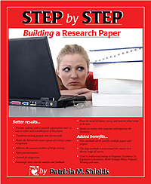
Tools of Inquiry
Transforms writing a paper
into organizing a project
Primary experience
Build:
Organizing skills (stuff & ideas)
Reading comprehension
Writing skills
Critical thinking skills
Organizing
  Materials
  Time
  Ideas
Making and Doing
Notes:
The Step Notebook is an example of a tool of inquiry. It helps to build skills necessary for the strong primary experience/habits, which enable one to do scholarly research.

Slide 14
Notebook is a tool to manage the ‘doubt and confusion’ stage
Equilibrium with greater complexity
Reflective Thought
Mindful analysis
Step notebook is a tool that brings order to the outer world while the inner world changes
Comfortable with
Confusion
Equilibrium
Secondary Experience
– Surprise, connections, reflection
Transformations of Inquiry
Notes:
This slide shows how the pragmatic theory of inquiry can be used as an antidote to “Mindless empiricism” identified by Adams and White (1994).
Step notebook is a tool that encourages reflective thought by giving structure to the things of doing research – enables the mind to be comfortable with confusion, surprise and creates the conditions for light bulb moments.

Slide 15
Theory as tool - Map
Theory pluralism
Theories connected to
Resolving problem
Achieving purpose.
Theory helps
Navigate a problem
Achieve purpose
Notes:
Theory is like a map. A map is not reality but a representation of reality. The key role of the map is to navigate space and get to a destination. Theory helps to navigate the problem and achieve the purpose.
William James noted that theory is like rooms along a hotel corridor. Some may be useful, others not. The one walking the corridor with the problem recognizes the usefulness of the theory to resolve the problem.

Slide 16
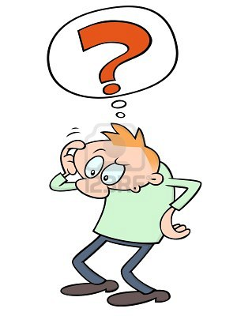
Blinded to their Confusion
Dr. Shields:
What is a
Conceptual Framework ?
Mumble, mumble
Admit
-- I did not know the answer
Notes:
At the same time that the field was wrestling with the quality of PA Dissertations, Pat Shields was wrestling with improving the quality of MPA student capstone papers. NASPAA, our accrediting body, had identified weak literature reviews and non-existent conceptual frameworks as the problem with MPA student papers.

Slide 17

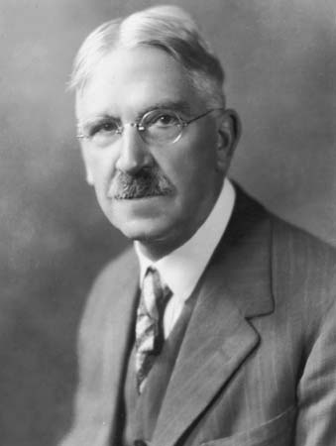
BEGAN
Earl Babbie’s
Practice of Social Research
Three Research Purposes
Exploration
Description
Explanation
Description - Categories
Explanation - Hypotheses
Exploration ?????
John Dewey
Working Hypotheses
Use literature to build frameworks
Notes:
Focus on combining purpose and framework helps guarantee that the research questions will not be ignored and that theory (Frameworks) will be connected.
Dewey mentioned working hypotheses, these seemed well suited for exploratory research.

Slide 18
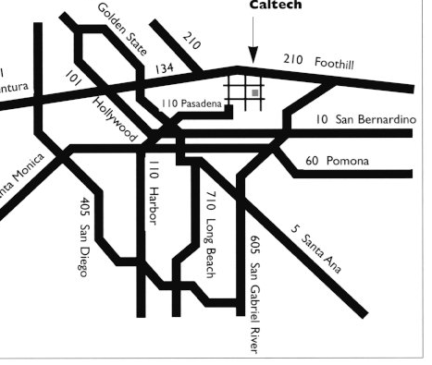
Pairing purpose and framework
Research Purposes
Exploration
Description
Gauging
Decision Making
Explanation/ Prediction
Conceptual Frameworks
Working Hypotheses
Descriptive Categories
Practical Ideal Type
Models of Operations Research
Formal Hypotheses
Notes:
After discovering the working hypothesis and linking it up with exploratory research, two other framework/purpose pairs were discovered – gauging/practical ideal type and decision making/models of operations research. See the pairing used in the Texas State MPA Program.

Slide 19
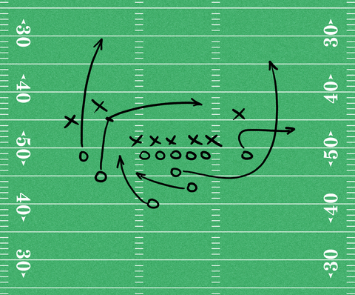
purpose
Long or short yardage
Play
ideas that organize player actions
How men move on ground
Results
Actual yardage gained
Movement of players on ground
Notes:
Conceptual frameworks move beyond the purpose as a connection. They enable connection to the mode of data collection. We use a football play as a metaphor for the role of the framework. It is an abstract representation of what the men on the ground need to do to achieve the purpose (long or short yardage) and when run – results in an outcome or result. It is like testing a hypothesis.

Slide 20
Research Process Taking into account
Traditional Research notions of Theory
Research Purpose
Explanation
Theory -- Conceptual Framework
Hypotheses
Methodology
Data Collection Techniques
Measure
Statistics
Analyzing and organizing data
Conceptual framework – close to the data theory
Notes:
The conceptual framework/purpose pair connect to data collection modes. They provide information on how to operationalize and measure the ideas in the framework. Or in the case of qualitative research how to gather and assess evidence collected through interviews or field work. They also provide direction for the analyzing of the data once collected.

Slide 21
Combines
Quantitative and Qualitative
data collection and
Data analysis techniques
Notes:
This chart shows how each framework has a methodological extension and a data analysis extension. Note that both quantitative and qualitative data is within the umbrella.

Slide 22
Basic Frameworks -- Like Middle School Football
Different Frameworks
Grounded Theory –
Develop frameworks after data collection
Notes:
The frameworks developed in the paper and the book, are the basic frameworks. We have MPA students use them so that they can learn to identify and develop frameworks. This is a skill they can use in practice. One would expect that PhD students and mature scholars would use frameworks outside the typology suggested here.

Slide 23
Experiences with Students
Academia.edu
Notes:
The Student papers using this method have met with great success. They have won national awards and are cited in scholarly journals and books. They are posted to the Academia.edu site and have almost 6000 followers, many of who are faculty from around the world.

Slide 24
Undergrad Capstone papers
Notes:
Travis Whetsell has had a good experience with undergraduate capstone papers at FIU.

Slide 25
Pragmatic Methodology
Notes:
Close with the flight and perch metaphor.

Slide 26
References
Adams, G. B.; J. D. White. 1994. “Dissertation Research in Public Administration and Cognate Fields: An Assessment of Methods and Quality.” Public Administration Review 54(6): 565-576.
Brendel, D. 2006. Healing Psychiatry. Cambridge MA: MIT Press.
Cleary, R. E. 1992. “Revisiting the Doctoral Dissertation in Public.” Public Administration Review 52(1): 55-61.
Cleary, R. E. 2000. “The Public Administration Doctoral Dissertation Reexamined: An Evaluation of the Dissertations of 1998.” Public Administration Review 60(5): 446-455.
De Waal, C. 2013. Peirce: A Guide for the Perplexed. London: Bloomsbury
Dewey, J. 1927. The Public and Its Problems. New York: Holt & Co.
Dewey, J. 1934. Art as Experience. New York: Minton, Balch & Co.
Dewey, J. 1938. Logic: The Theory of Inquiry. New York: Holt, Rinehart and Winston.
James, William. 1907. Pragmatism: A New Name for Some Old Ways of Thinking. Cambridge, MA: The Riverside Press.
Hickman, L. 1990. John Dewey’s Pragmatic Technology. Bloomington, IN: Indiana University Press.
Hildebrand, D. 2008. Dewey: A Beginners Guide. Oxford: Oneworld Book.
Kaplan, A. 1964. The Conduct of Inquiry: Methodology for Behavioral Science. Scranton PA: Chandler Publishing Co.
McCurdy, H. R..Cleary. 1984. “Why Can't We Resolve the Research Issue in Public Administration?” Public Administration Review, 44(1): 49-55.
Peirce, C. S. 1877. The Fixation of Belief. Popular Science Monthly 12(1): 1-15.
Peirce, C. S. How To Make Our Ideas Clear. Popular Science Monthly 12(3): 286-302.
Raadschelders, J. C. 2013. Public Administration: The Interdisciplinary Study of Government. Oxford: Oxford University Press.
Ralston, Shane 2009. “The Ebb and Flow of Primary and Secondary Experience: Keyak Touring and John Dewey’s Metaphysics of Experience. Environment, Space, Place (1), 189-204.
Shields, P. 1998. “Pragmatism as Philosophy of Science: a Tool for Public Administration.” Research in Public Administration 4: 195-226.
Notes:
References used in this presentation.

Slide 27
References (cont.)
Shields, P. 2003. “The Community of Inquiry: Classical Pragmatism and Public Administration.” Administration & Society, 35(5), 510-538.
Shields, P.2005. Step by Step: Building a Research Project. Stillwater, OK: New Forums Press.
Shields, P. 2008. “Rediscovering the Taproot: Is Classical Pragmatism the Route to Renew Public Administration?” Public Administration Review, 68: 205–221.
Shields, P. and N. Rangarajan. 2013. A Playbook for Research Methods: Integration Conceptual Frameworks and Project Management. Stillwater, OK: New Forums Press.
Shields, P. and H. Tajalli . 2006. "Intermediate Theory: The Missing Link in Successful Student Scholarship," Journal of Public Affairs Education 12(3): 313-334.
Shields, P. and T. Whetsell. 2011. “Reconciling the Varieties of Pragmatism in Public Administration.” Administration & Society 43(4): 474-483.
Van Evera, S.. 1997. Guide to Methods for Students of Political Science. Ithaca NY: Cornell University Press.
Wagner, C. S., Horlings, E., Whetsell, T. A., Mattsson, P., & Nordqvist, K. 2015. “Do Nobel Laureates Create Prize-Winning Networks? An Analysis of Collaborative
Research in Physiology or Medicine.” PloS one, 10(7), e0134164.
Weiner, P., Ed. 1958. Charles Sanders Peirce: Selected Writings. New York: Dover Publications.
White, J. .1986a. “On the Growth of Knowledge in Public Administration.” Public Administration Review, 46(1): 15-24.
White, Jay D. 1986b. “Dissertations and Publications in Public Administration.” Public Administration Review, 46(3): 227-234.

