Slide 1
Women’s Historic Public Engagement:
Finding Public Administration in the Peace and Suffrage Movements
Patricia M. Shields
Texas State University
Presented at the 2019 Fall Meeting of the National Academy of Public Administration, Arlington, VA Nov. 7 - 8.

Slide 2
Suffrage Movement
Public Administration
Peace Movement
Notes:
This presentation focuses on the historical three way intersection of the Peace Movement, Suffrage Movement and Public Administration.

Slide 3
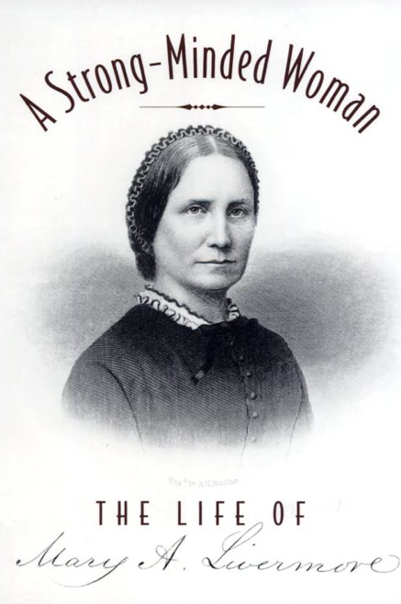
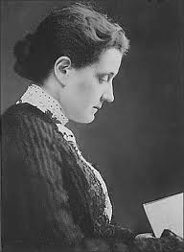
Leaders in
Suffrage
Peace Movement
Hidden story of
Public Administration
Jane Addams
Mary Livermore
1860-1935
1820-1905
Notes:
The connection to women in PA. These are the three women who anchor the discussion to follow. All three are public administrators and non-profit administrators

Slide 4
Key Women’s Social Movements 1800 – 1920’s
Ladies Aid Societies (provided underlying network).
Abolitionist Movement (1800 – 1865)
Suffrage Movement (1848 – 1920)
Women’s Christian Temperance Movement (1874 – present)
Settlement Movement (1880 – 1920…1970s)
Federated Clubs (1892 – 1911) All states
Women’s Peace Movement (1890s -1918)

Slide 5
1918

Slide 6
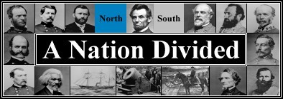
THE AMERICAN CIVIL WAR
1861-1865
Notes:
Move to the second non-profit era. Introduce the Us Sanitary Commission.

Slide 7
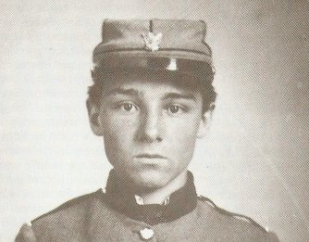
Medical Crisis – Sanitation in camps/hospitals
Supply Crisis - Chaotic Volunteer response
20,000
1865 2,000,000

Slide 8
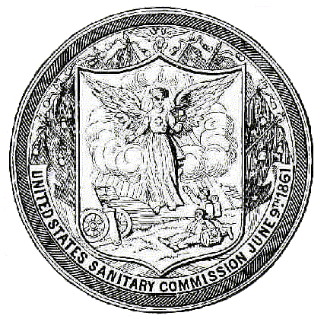
US Sanitary Commission
Inspection – Camps/hospitals
Relief Supplies
10,000+
Ladies Aid
Societies
Notes:
Primary roles of the sanitary commission. Men responsible for inspection of camps/hospitals and women for the distribution of the relief supplies.

Slide 9
Manager of Northwest Branch
Coordinated relief supply effort
Nurse
Fundraising
New programs
Abolitionist

Slide 10
US Sanitary Commission
Inspection – Camps/ hospitals
Relief Supplies
Convalescence homes
Nursing sick
Collect Supplies
Messages to families
Gardens to feed sick
Warehouse supplies
Deliver Supplies
Fundraising
Transport Wounded
Widows relief
Sanitary Fairs
Managed by women
Network of aid societies
(women’s clubs)
$25 Million
Nurse made $3 week (90 hour week)
8.33 million weeks of nursing time.
Notes:
This shows how the activities and role of the USSC grew with the war. Non-profits have the ability to morph into all kinds of activities.

Slide 11
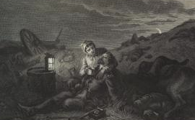
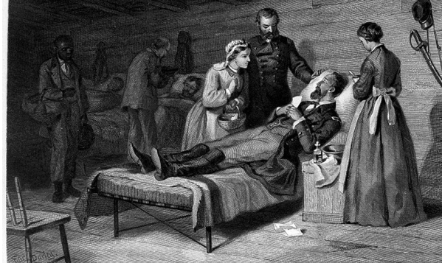
Nursing
Dorathea Dix required nurses “be over thirty years of age, plain almost to repulsion in dress, and devoid of personal attractions” (Livermore, 1887, 246).
Mature women – Mother role
use the moral authority of Mother to serve the Union’s Sons
Clean bedding, Clean clothes, Good food

Slide 12
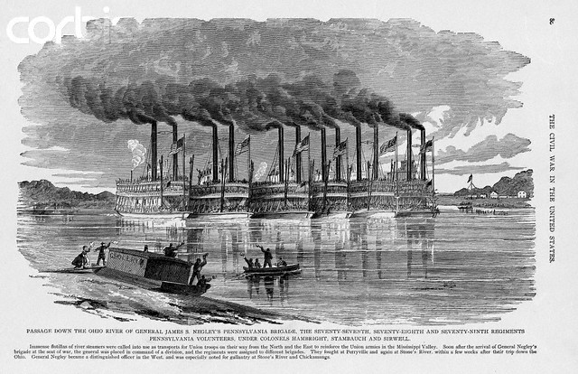
Supply Transport
Wounded Soldier Transport

Slide 13
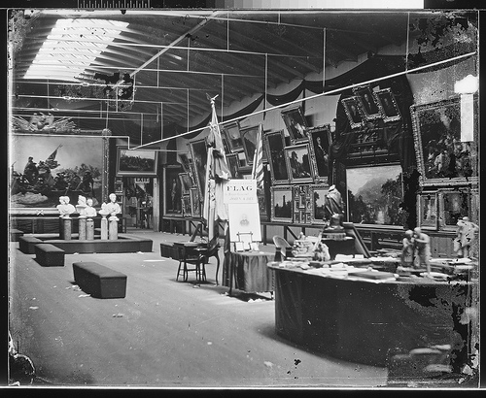
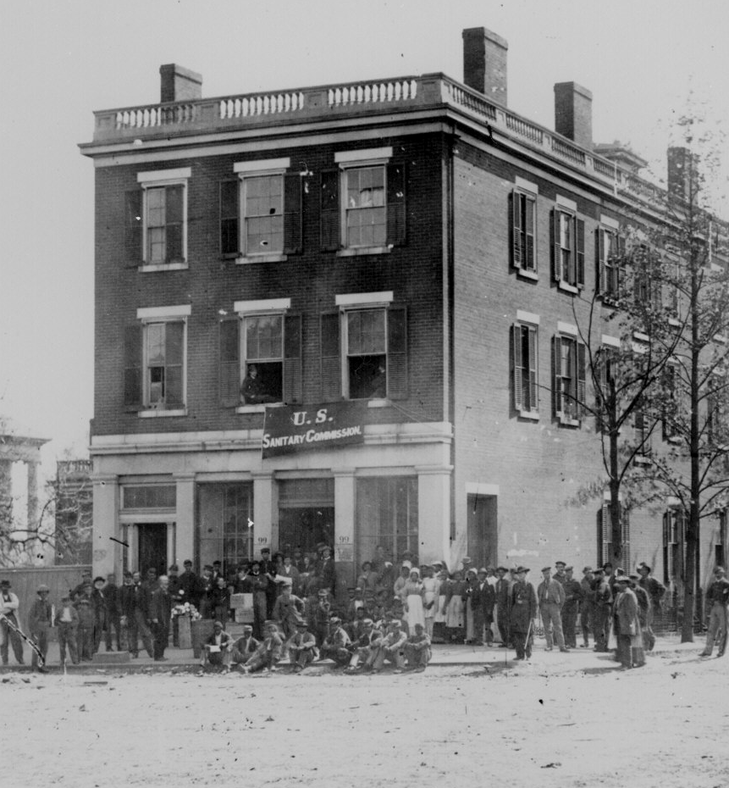
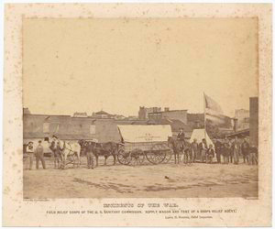
Chicago Hub
Fund raising – sanitary fairs

Slide 14
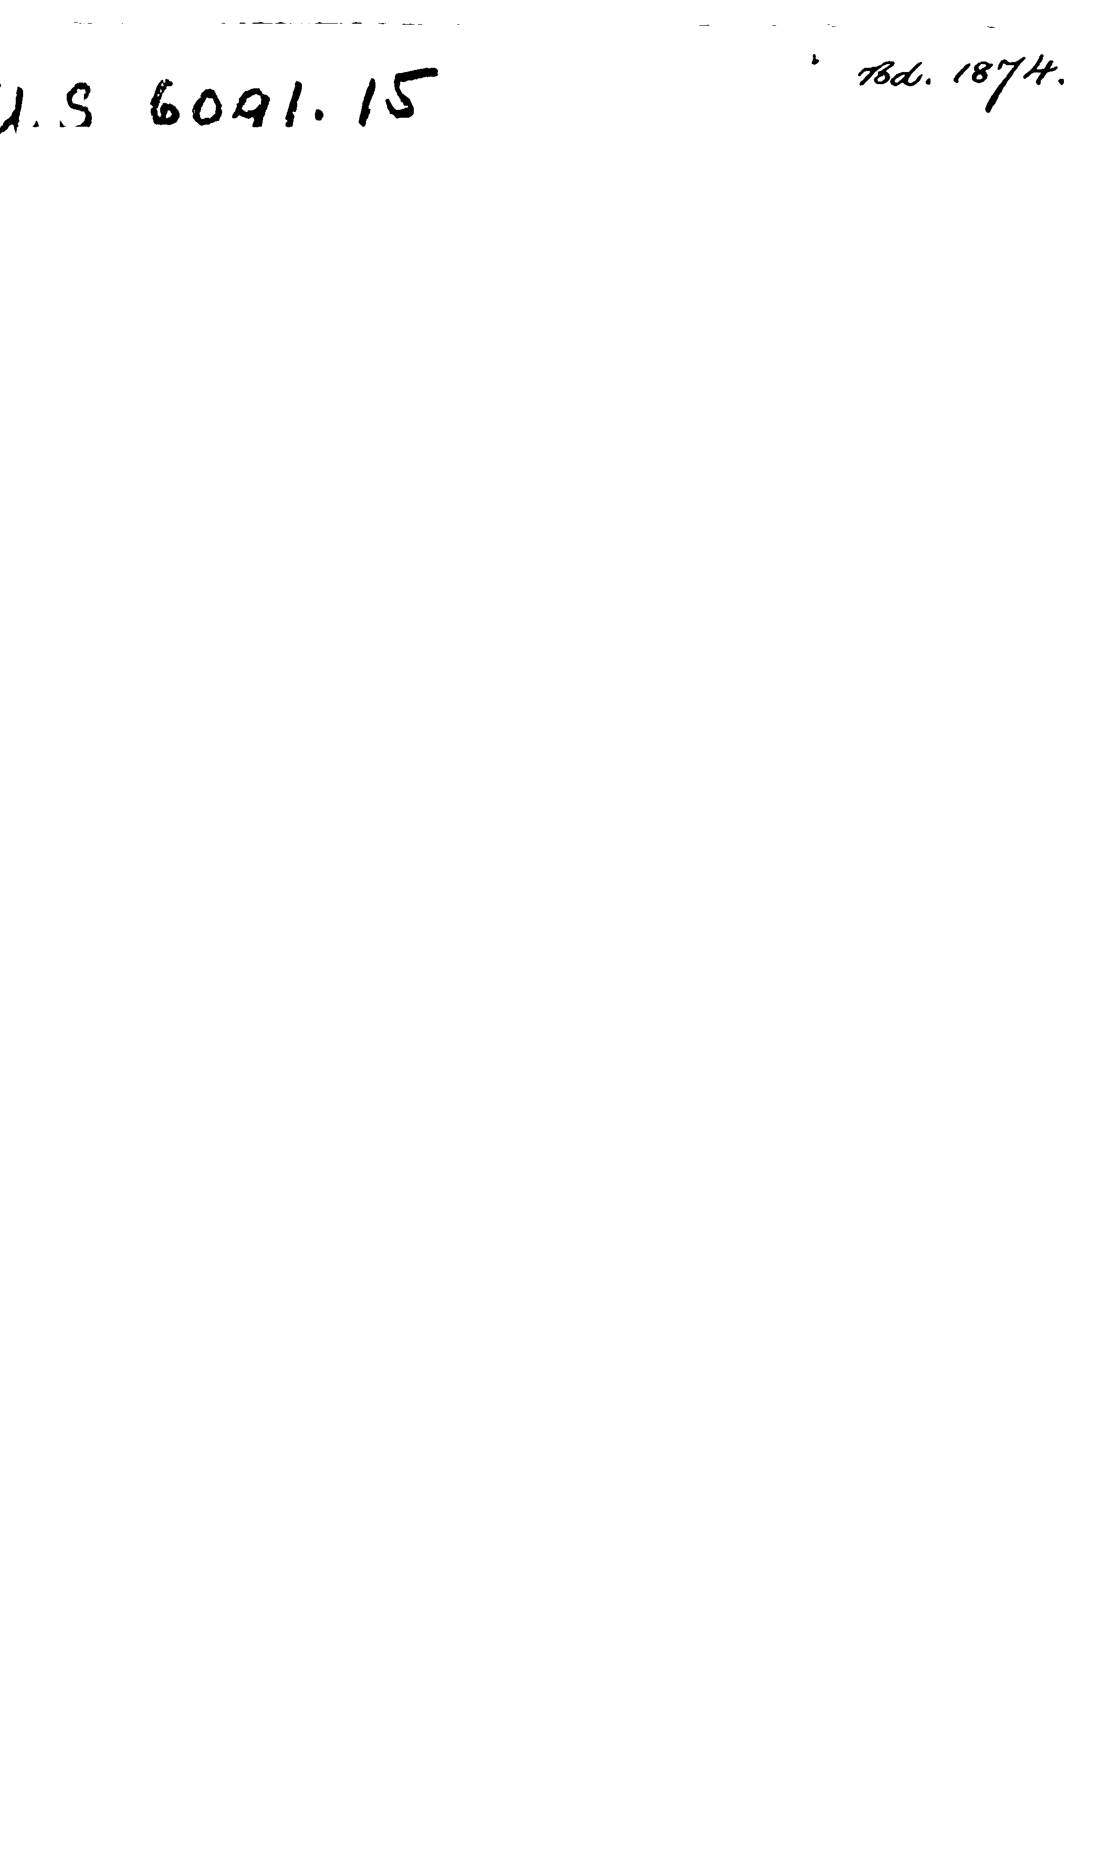

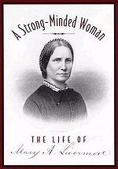
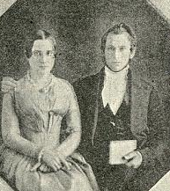
I registered a vow that when the war was over I would take up a new work – the work of making law and justice synonymous for women. I have kept my vow religiously (Livermore 1887/1995, 437).
Mary and Daniel Livermore
Mary Livermore 1920 - 1905

Slide 15
After Civil War
Published – Editor Agitator Books
Speaker
My Story of War – 25,000 miles year
Leader Suffrage Movement
President, American Women’s Suffrage Assoc.
Help establish colleges for women
Next Generation
Active early Peace movement

Slide 16
Tilling the soil for Suffrage
Widespread
Recognition
Appreciation women’s competency

Slide 17
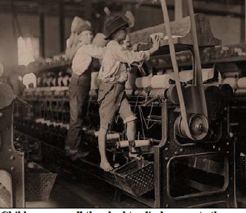
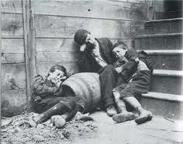
Urbanization & Industrialization
Women Organized around
these Problems
Sanitation
Labor
and factory abuses
Child welfare
Notes:
The Settlement movement – spearheaded by women had the tools to tackle reforms called for by urbanization and industrialization.

Slide 18
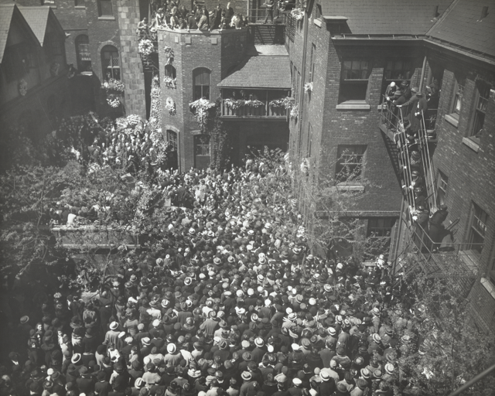
Leader of the Settlement Movement
Jane Addams
1860 - 1935
Jane Addams’s Funeral
Steps of Hull House

Slide 19
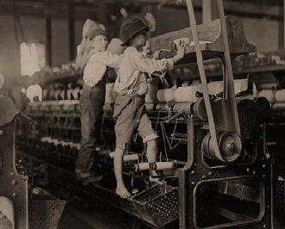
Active social reform
Child labor laws
Playgrounds
Juvenile Courts
Street Cleaning/garbage
collection
Water/Sewer
Healthier workplace

Slide 20
Hull House (Chicago)
Residential Community Center
Primarily Young Women (6-25)
Immigrant Community
Labor/management disputes
Lab – conflict resolution
Bottoms up model of reform
Participatory democracy

Slide 21
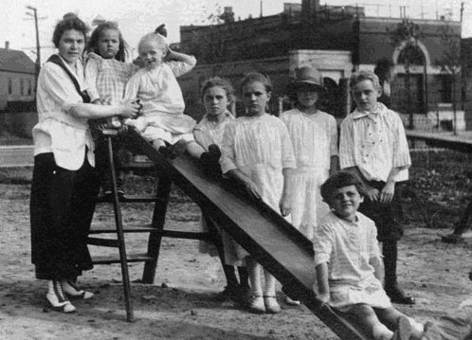
Settlement Movement
Texas Women’s Clubs
Libraries
School playgrounds
City playgrounds
Traveling Art Exhibits
Literary groups
Civic beautification
“soap & water days”
Concerts
lectures
drama classes,
day care programs,
Kindergarten,
coffee house/theater,
art and labor museum,
Sunday concerts,
Speaker Series, choir,
Urban Neighborhood Services
College Extension courses
Voter Registration
War on flies
Playgrounds

Slide 22

US Peace Movement (1890s – WWI)
Establish International “Law and Order”
Arbitration
US Supreme Court as Model
Peace Good for Business
Christian Values
Women’s social policy agenda
Henry Ford

Slide 23
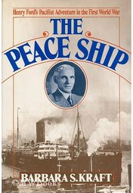
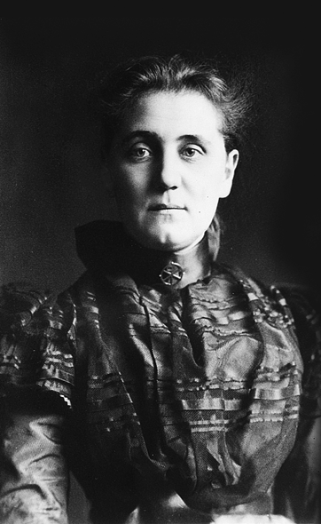
Peace Organizations (Elite)
Social conservative
National political figures
Important Businessmen
Livermore
Taft
Ford
Wilson
Roosevelt
Addams
Carnegie

Slide 24
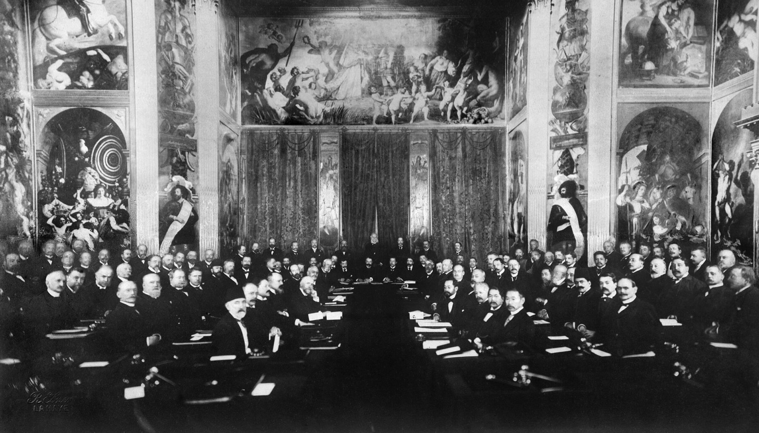
International Peace Conference
World leaders actively sought new institutions, legal frameworks and policy tools
multilateral treaties
Permanent Court of Arbitration
1st formal statement laws of war, war crimes
War replaced by a system for the peaceful settlement of disputes among states.
The Hague 1899 & 1907

Slide 25
1907
Sponsored by Baylor and
Texas Federation of Women’s
Clubs

Slide 26
Roots of Women’s Peace Movement
Women organizing politically
North
South
Abolition
US Sanitary Commission
Women’s Clubs
Settlement movement
Literary Clubs
Women’s Clubs
Moral authority of the Mother

Slide 27
Women’ Peace Movement
Responded to outbreak WWI
Battle of Frontier
August 1914

Slide 28
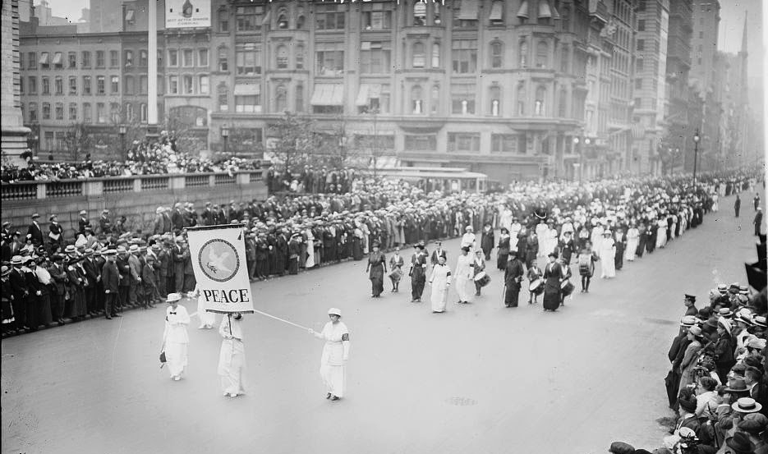
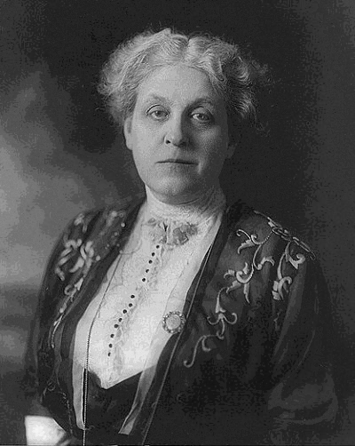
Maternal Instinct
Woman’s Peace Party established
– Jane Addams Leader
Women have an instinctive
and rational opposition to war
Women & Children suffer
but not at table
Need increase participation of
women in politics.
Linked to Suffrage Movement
Aug. 1914
Women’s Peace March
Carrie Chapman Catt

Slide 29
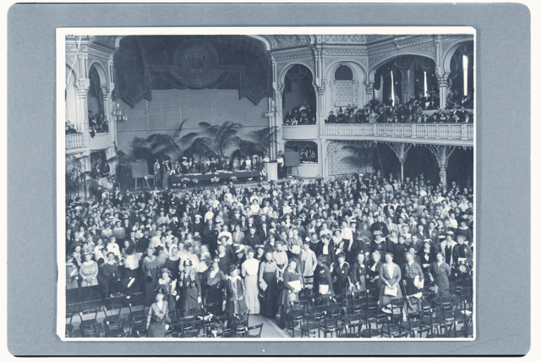
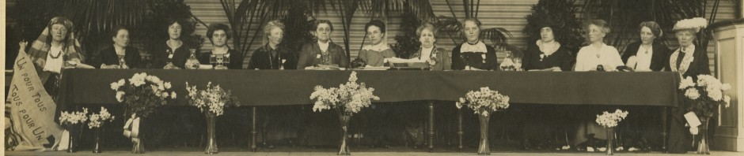
International Peace Congress of
Women at the Hague
April 1915
International Suffrage networks used to organize

Slide 30
Begin peace negotiations immediately
Organization “Society of Nations”
Acknowledge women’s suffering
during war
Give women right to vote
Women participation in Peace Processes
*
* 18 total resolutions
Women’ s Peace Delegations
-- Capitals

Slide 31
Social Claim
International Committee of Women for Permanent Peace
April 1915

Slide 32
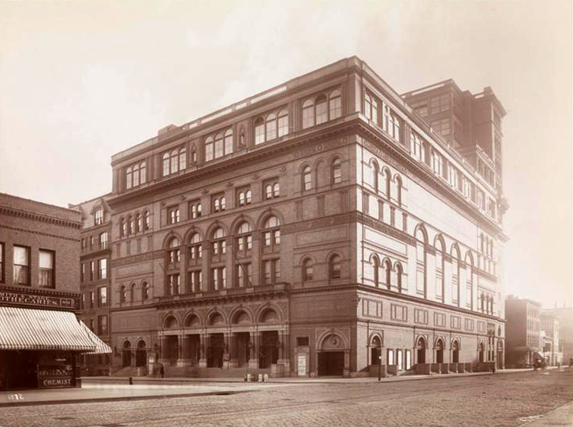
Jane Addams Public Timeline
1889
1915
1931
Demeaned
Traitor
Communist
Silly old woman
Celebrated
Nobel Prize
DOJ Surveillance

Slide 33
Suffrage Movement
Used WWI as a way
To Prove Women’s
value
War ended in 1918
19th Amendment 1920

Slide 34
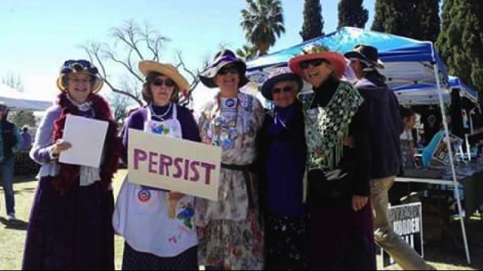

Women’s Peace movement legacy
UN Resolution 1325
on Women, Peace and Security
Increased participation of women in decision making
related to, prevention, management and resolution
of armed combat.
Women Peacekeepers

Slide 35
2015
Support “Peace” broadly defined by
Targeting family violence

Slide 37
References
Addams, J. (1990/1910). Twenty years at Hull House. Champaign, IL: University of Illinois Press.
Addams, J. (2002/1902). Democracy and social ethics. Champaign, IL: University of Illinois Press.
Addams, J. (2002/1922). Peace and bread in time of war. Champaign, IL: University of Illinois Press.
Addams, J. Balch, E. & Hamilton, A. (Eds.), (1915)Women at The Hague: the international congress of women and
its results (pp. 107-115). Champaign, IL: University of Illinois Press.
Addams, J. (2007/1907). Newer ideals of peace. Champaign, IL: University of Illinois Press. (Original work published 1907)
Giesberg, J. A. (2006). Civil War Sisterhood: The US Sanitary Commission and Women's Politics in Transition. Upne.
Knight, L. (2010). Jane Addams: spirit in action. New York, NY: W. W. Norton & Co.
Livermore, M. A. (1890). My Story of the War: A Woman's Narrative of Four Years Personal Experience as Nurse in the
Union Army, and in Relief Work at Home, in Hospitals, Camps, and at the Front, During the War of the Rebellion.
AD Worthington
Marchland, R. (1972). The American peace movement and social reform, 1898-1918. Princeton, NJ:
Princeton University Press.
Rissler, G. E., & Shields, P. M. (2019). Positive Peace—A Necessary Touchstone for Public Administration. Administrative
Theory & Praxis, 41(1), 60-78.
Shields, P. M. (2004). Mary Livermore: Cooperative Womanhood Serving the State. In C. Felbinger & W. Haynes (Eds.),
Outstanding Women in Public Administration. (pp. 49–64). New York: M. E. Sharpe.
Shields, P. (2003). The community of inquiry: Classical pragmatism and public administration. Administration & Society 35
(5), 510-538.
Shields, P. (2006). Democracy and the social ethics of Jane Addams: A vision for public administration. Administrative
Theory and Praxis 28(3), 418-443.

Slide 38
Shields, P. (2008). Rediscovering the Taproot: Is Classical Pragmatism the Route to Renew Public Administration. Public Administration Review 68(2), 205-221.
Shields, P. (Ed.). (2017). Jane Addams: Progressive pioneer of peace, philosophy, sociology, social work and public administration (Vol. 10). Springer.
Shields, P. & Rangarajan, N. (2011). Public Service Professionals: The Legacy of Florence Nightingale, Mary Livermore and Jane Addams. In Menzel, D. & White, H. (Eds.) The State of Public Administration: Issues, Challenges and Opportunity. 36-53. New York: M.E. Sharpe.
Shields, P. M., & Soeters, J. (2017). Peaceweaving: Jane Addams, positive peace, and public administration. The American Review of Public Administration, 47(3), 323-339.
Shields, P. (2010). Jane Addams Theory of Democracy and Social Ethics: Incorporating a Feminist Perspective. In M. D’Agostiono & H. Levine (Eds.), Women in Public Administration: Theory and Practice (pp. 15–34). Sudbury, MA: Jones & Bartlett.
Skocpol, T. (1995). Protecting soldiers and mothers: The political origins of social policy in the United States. Cambridge, MA: Harvard University Press.

Slide 39
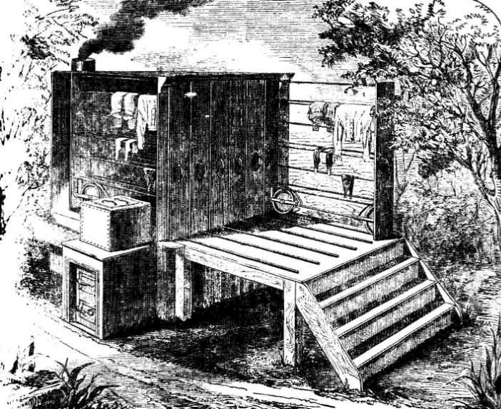
Hospital Dryer
Notes:
A snapshot and behind the scene insight. To staff and supply – keep the hospitals going need to be able to dry the clothes and sheets. This is what they used.

