Slide 1


Who’s Doing What?
Using office 365 to juggle e-resource tasks
Stephanie Larrison
University Libraries
Texas State University
Scott Pope
Electronic Resources and Libraries / March 5, 2019

Slide 2
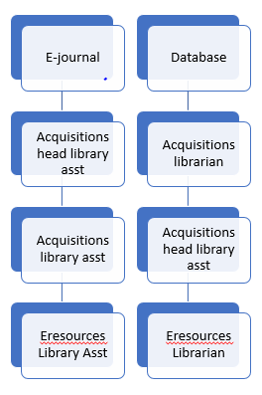
Motivation:
Paper Forms Had Problems.
Used paper forms called Electronic Title Processing Sheets.
Piles of paper. Staff on vacation, working on other projects, etc.
Who has this certain form?
Can’t check my own work because someone else has form.
Steps were missed in the workflow.

Slide 3
Benefits We Were Hoping For in Online Task List
Transparency. Obvious what has and has not been done.
Multiple people can work on different tasks at same time.
See what you have yet to do that is assigned to you.
Can see what steps have been done and what hasn’t been done.

Slide 4
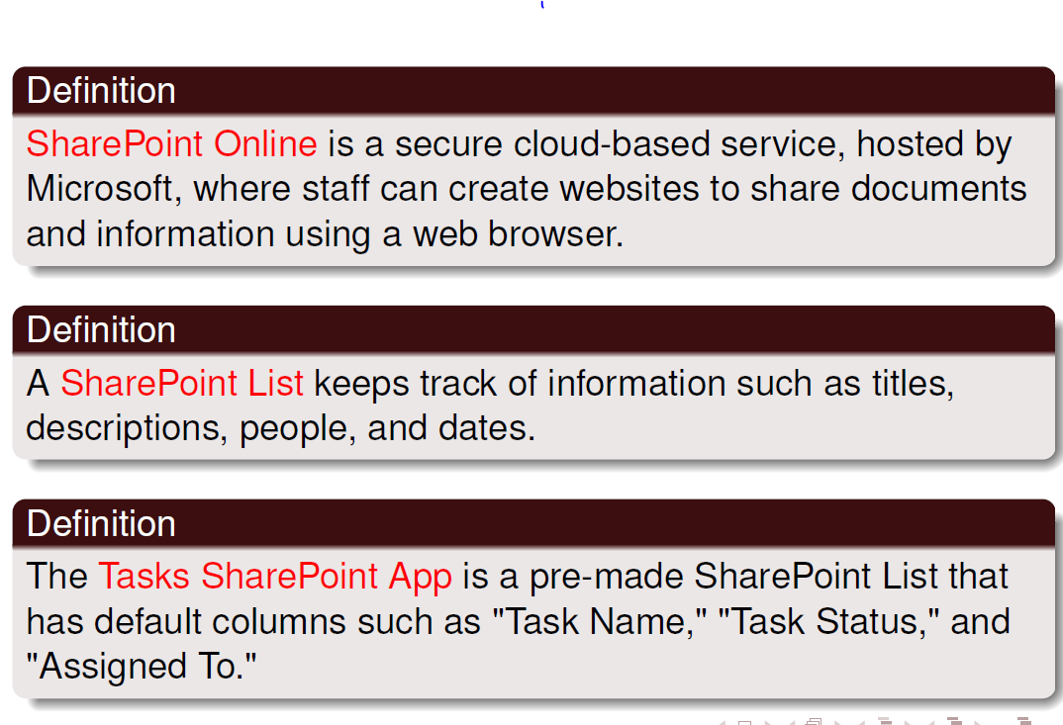
What are SharePoint Lists?

Slide 5
What Acquisitions Columns Did We Use?
Fiscal year
Title
Assigned to
Description/order notes
Vendor
Processing status
Acq workflow complete
License required
Binding retention
Documentation
Form
Order type
Price
Fund
Department group
Faculty or librarian
Requestor

Slide 6
What Electronic Resources Columns Did We Use?
Volumes/dates purchased
Access begins with
Access URL
Access Type
pISSN
eISSN
Perpetual access
EJ is archived in LOCKSS
Perpetual access note added o oRecord
Link activated in HLM
Order record# added to HLM
Resources type is journal or newspaper
E-resource notes
Holding coverage dates checked
Reported EZProxy error message
Request EBSCO to add to HLM
Admin login confirmed
Usage stats available
Resource record#

Slide 7
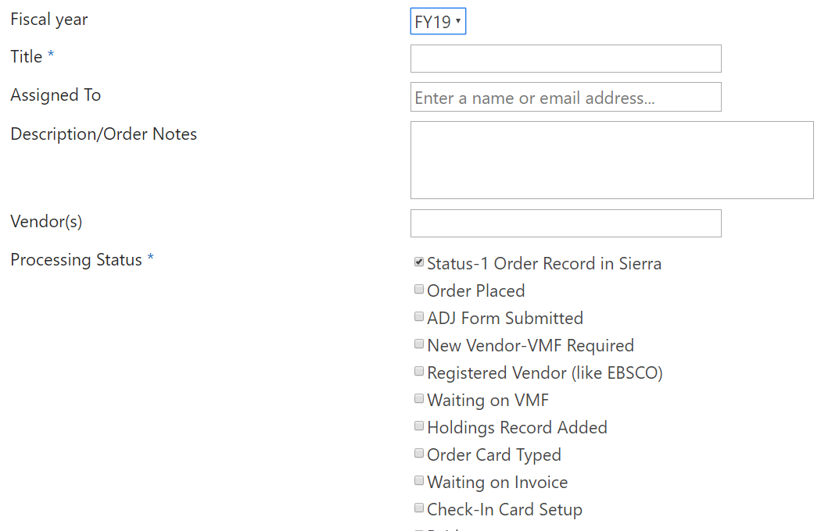
Result: What Does It Look Like?

Slide 8
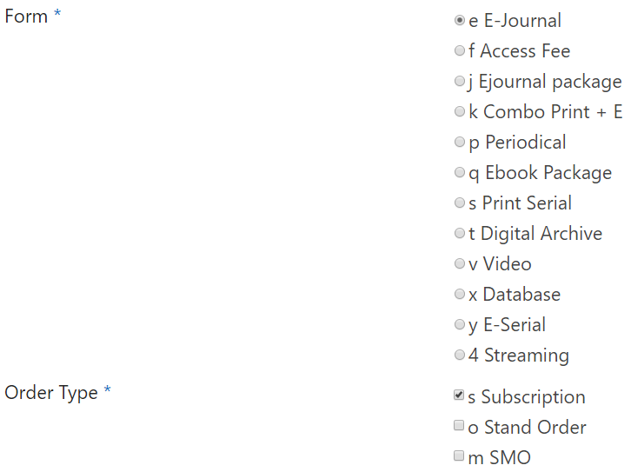

Slide 9
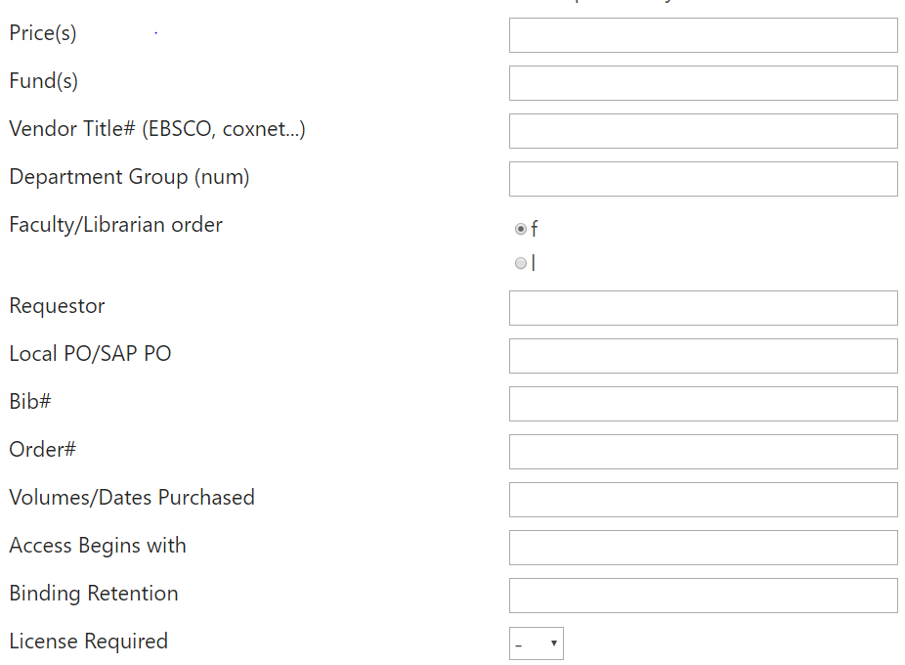

Slide 10
Assign, Monitor, and Adjust Tasks
Assign:
  First person, Acquisitions Librarian (Scott) fills out enough and assigns it to the next person
  The next person edits the “assigned to” field to the next person
Monitor
  Anyone can monitor the tasks by having a “view” that show which tasks they want to look at
Adjust tasks
  Anyone can edit a task or put notes in the task about a question they have.

Slide 11
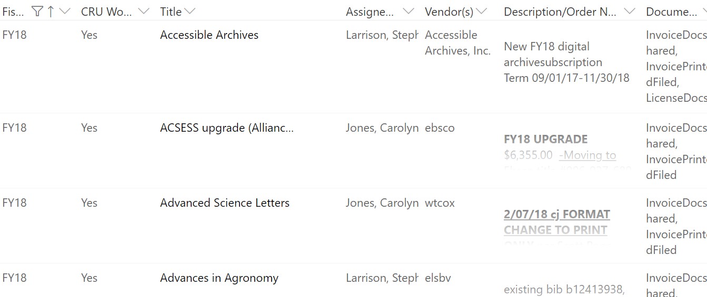
Acquisitions "View"

Slide 12
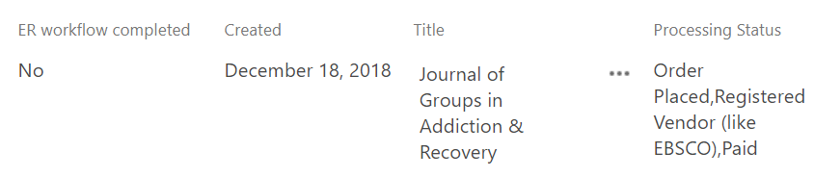
E-Resources "View"
Column order is specific to this view
Sorted by Create Date (oldest to newest)
Filtered first by ER Workflow = No; then by Form ≠ print

Slide 13
Results: All of our Hopes and More
Self-review. You can make sure you did all of your steps and go look at it later even if assigned to someone else.
Different views. Each person can have multiple views of some data
Can export to Excel, if desired
Sparked desire to use another SharePoint list for our drops
Transparent. Clear who has the task.
Different formats can be routed differently.
Each person has the information they need when it is their turn to take over the task.
BUT…..

Slide 14
SharePoint Task System Disadvantages
One extremely long form to scroll through.
Training is needed to use views effectively.
Little control over navigation of SharePoint site.
Impossible to find the task list without a personal bookmark.
Notes:
Although the new task list was a success, it became clear early on that the form was too long and required a lot of scrolling to see the information you needed.
Second, creating the views in SharePoint requires training and understanding difference between customizing a list versus customizing a view. Using anything in SharePoint requires training. It is not very user friendly or intuitive in my experience.
We have very little control over navigation in SharePoint site so it is impossible to find the task list without a personal bookmark, or without creating a customized page with links to the task list of various views. There is no breadcrumb to follow, there is not hierarchy to drill down in to find what you need.

Slide 15
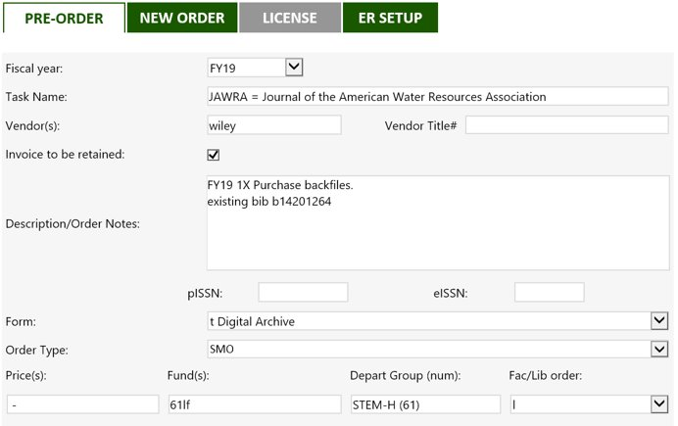
Solution: InfoPath to Customize Forms
Notes:
To address the very long form, we received assistance from the library’s programmer analyst, Jason Long. He investigated other Office 365 apps such as Flow and PowerAps but none of them could accomplish the vision we had to see only the fields applicable to our part of the workflow.
He found the best option was to use InfoPath to create a customized form with tabbed sections.
This view is the Pre-Order tab filled out by Scott with all the information his assistant needs to place a new order. Everything he fills out on this form, will be viewable in the next tab, New Order.

Slide 16
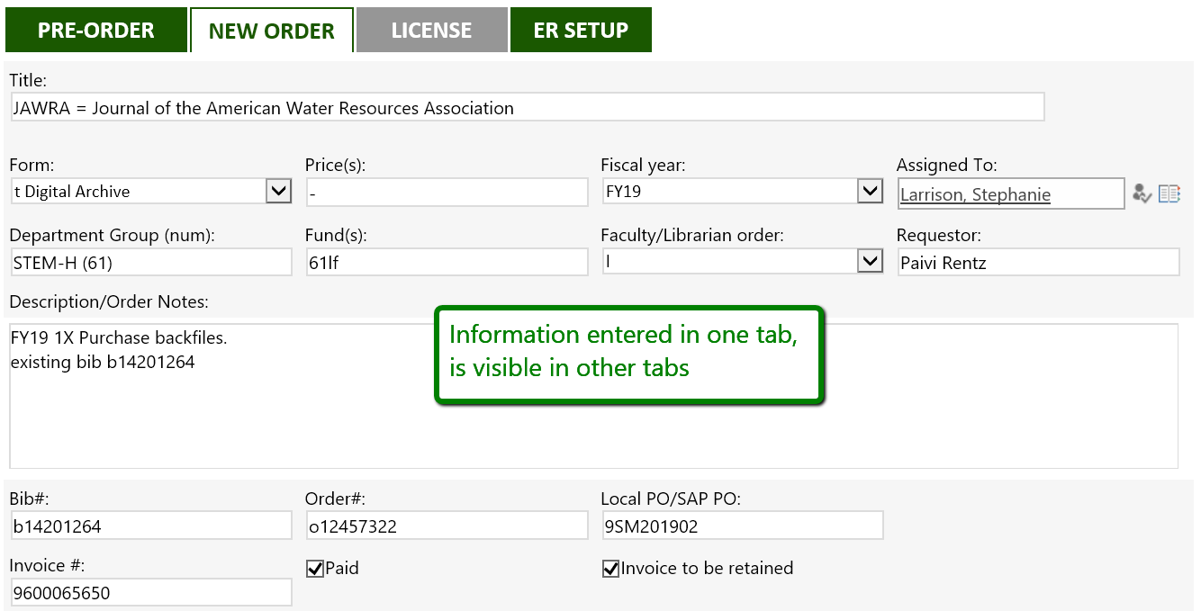
Notes:
The head assistant receives an email notice when Scott finishes his part of the form. There is no need for the assistant to go to the pre-order tab to get the information they need. Everything is visible here, and the assistant is able to fill in the PO Numbers, order numbers, invoices, and so on from this tab.

Slide 17
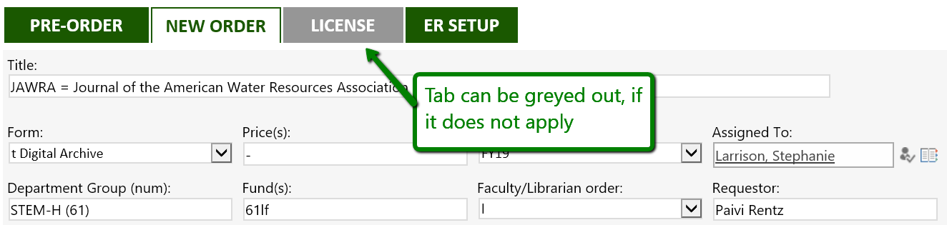
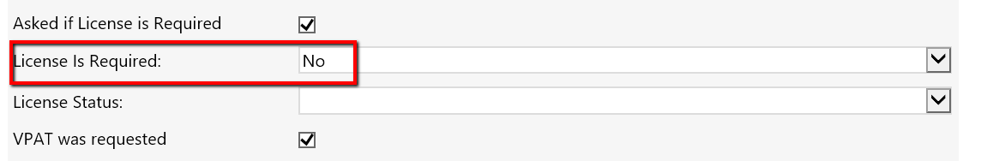
Notes:
Another nice feature our programmer was able to create was graying out tabs when they are not applicable. In this example, we are still in the New Order tab, but you can see that the License tab is grayed out which will occur only when the License is Required field is set to No. We can easily see that separate workflow is not required for this particular order.

Slide 18
Complications of InfoPath
Supported, but not actively developed by Microsoft​
Only accessible from the classic SharePoint list experience
Viewing the customized forms requires small work arounds​
        New experience - the tabbed form will only open if you right click title and select Open or Edit, OR by clicking in the Task ID​
        Classic experience – the tabbed form is not visible unless in editing mode
Notes:
InfoPath is not a perfect solution, however. It has some quirks.
As an older Microsoft product it is no longer developed, but we are happy that it should be supported for several more years.
Also because it is an older product InfoPath is only accessible from the Classic SharePoint experience – which I will show in the next slide.
Ironically you have to use Classic SharePoint to access Infopath to create the tabbed form, but you cannot see the tabbed form in Classic SharePoint. You can only view it in the quote “New Experience” of SharePoint lists and that requires a work around as well

Slide 19
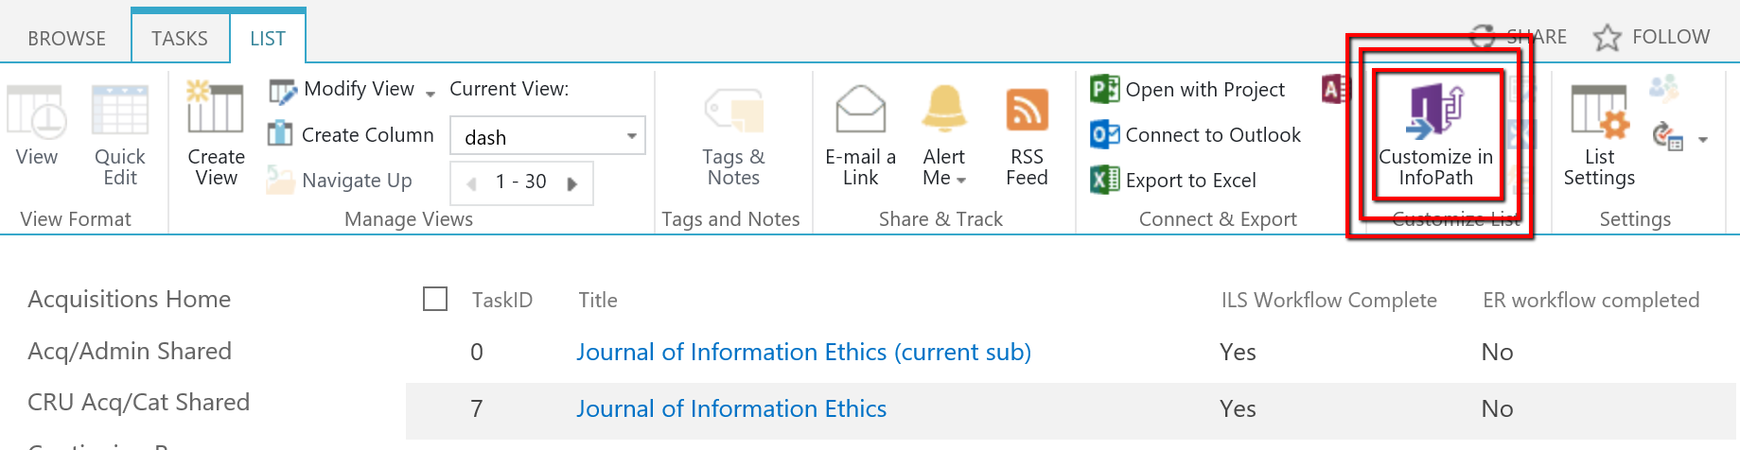
SharePoint Classic Experience
Notes:
This is the Classic Experience of SharePoint lists, where you can find the link to Customize it using InfoPath. It is located in the List tab of the Microsoft ribbon. Incidentally, InfoPath is a separate software product that you need to have installed on your computer to create or edit the forms.
For uploaded version of PPT:
How to change the "list experience" in SharePoint
Editing lists and tasks can only be done in Internet Explorer.
From Classic SharePoint, open List tab, then choose List Settings.
Under General Settings, choose Advanced Settings
Scroll to List experience at the very bottom of the page.

Slide 20
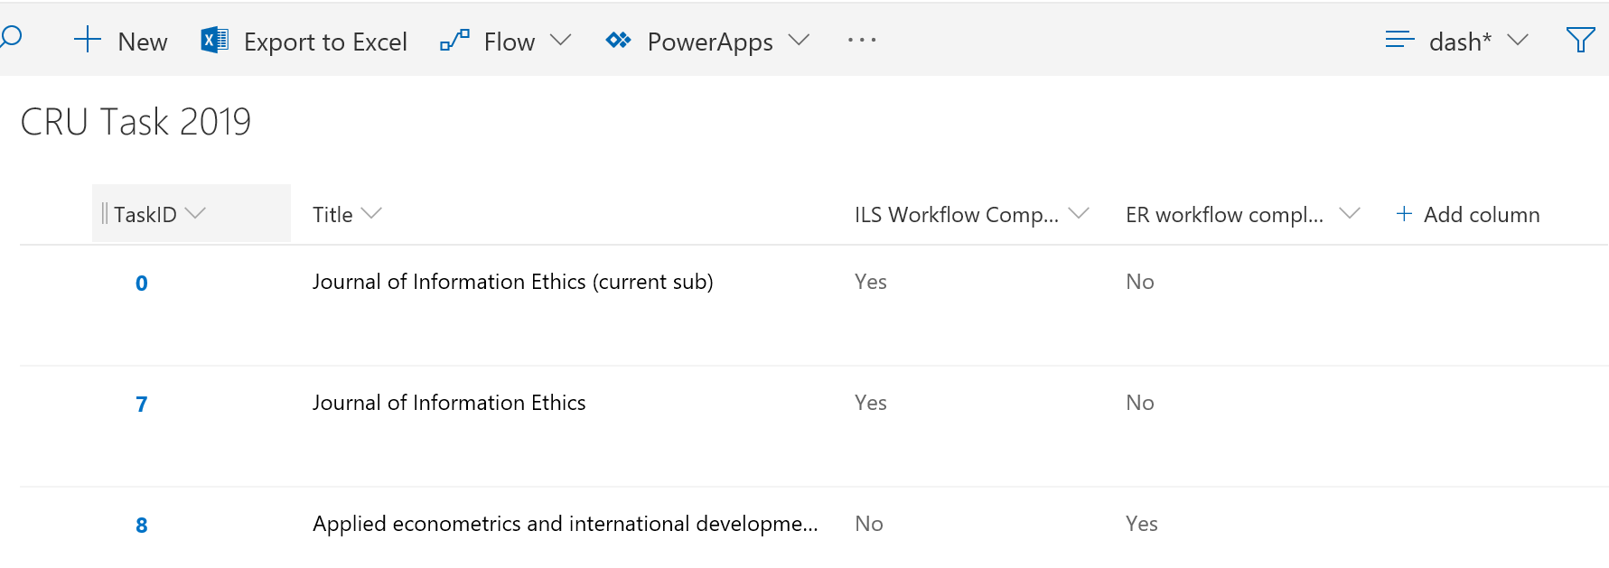
SharePoint New Experience
Notes:
SharePoint’s new list experience provides a cleaner look and feel ….filtering by multiple columns….easier sorting….and better compatibility with other Office 365 apps.
However, the forms created and customized in InfoPath are not fully compatible. To open a task, you must right click on the title and select Open or Edit. Jason also created a shortcut to the tabbed view by using a TaskID.

Slide 21
What's Next
Train staff on how to use filters effectively
Set up custom views and train on how to use most effectively
Organize views and make all of them available in a single shared page
Using SharePoint tasks for tracking titles to drop
Notes:
Our next steps are to address the other issues we have with SharePoint lists.
We plan to train staff on how to use filters more effectively; set up their custom views and train on how to use views more effectively; and organize the various views and make them available from a single easily accessible page to eliminate the need for multiple books marks.
Finally, we’ve started using SharePoint tasks to keep track of titles to be dropped, or that are changing format, platform, or publishers in the next fiscal year.

Slide 22
Thank you! Questions?
Stephanie Larrison
Larrison@txstate.edu
Texas State University
Scott
Pope
Pope@txstate.edu
*With Special Thanks to Jason Long, Programmer Analyst
Electronic Resources and Libraries / March 5, 2019

