Slide 1
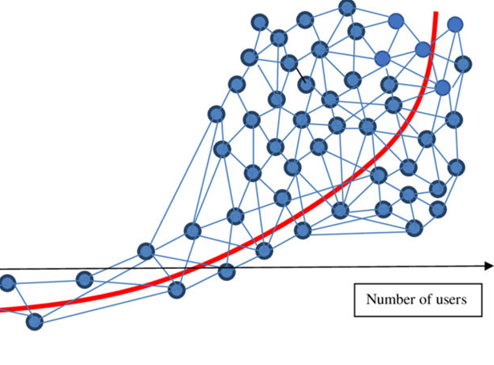
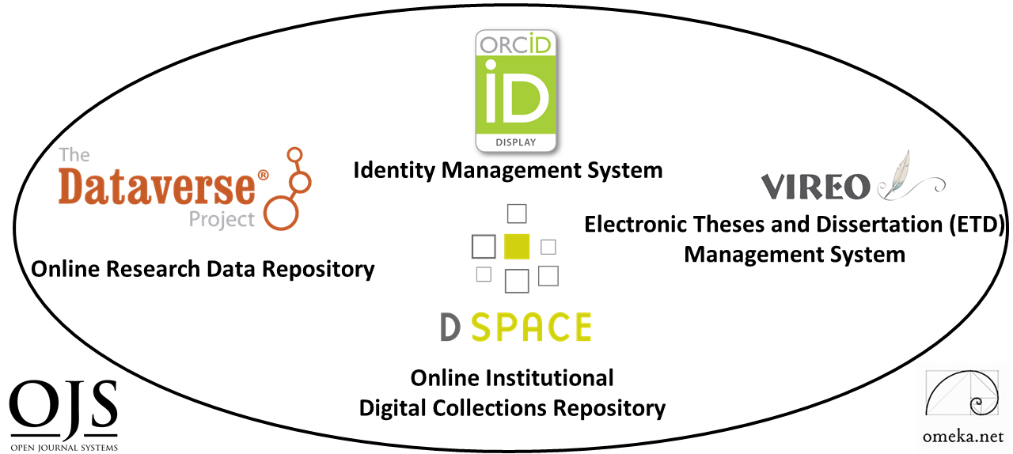
Digital Scholarship Ecosystems for Open Science
(Lightning Talk)
Ray Uzwyshyn, Ph.D. MBA MLIS
http://rayuzwyshyn.net
Director, Collections and Digital Services
Texas State University Libraries
Presented for AIDR and Open Science
Symposium, Carnegie Mellon University
October 20, 2020

Slide 2
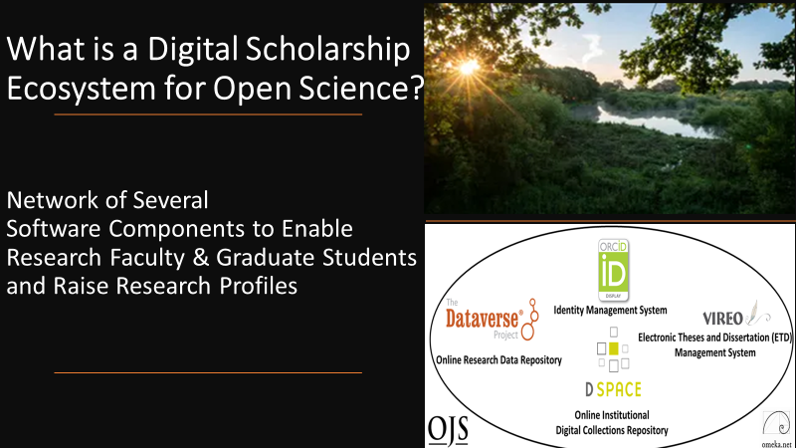

What is a Digital Scholarship Ecosystem for Open Science?
Network of Several Software Components to Enable Faculty and Graduate Student Research
and Raise Research Profiles
Notes:
Ecosystem Metaphor Look at Relationships in the Digital Environment
Specifically Focuses Upon the Discrete Component Relationships with the Networked Digital Environment

Slide 3
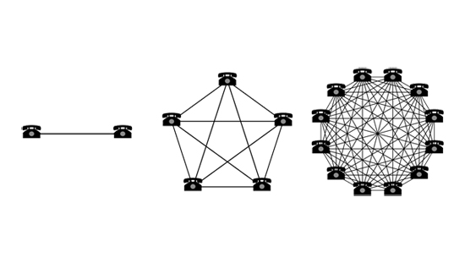
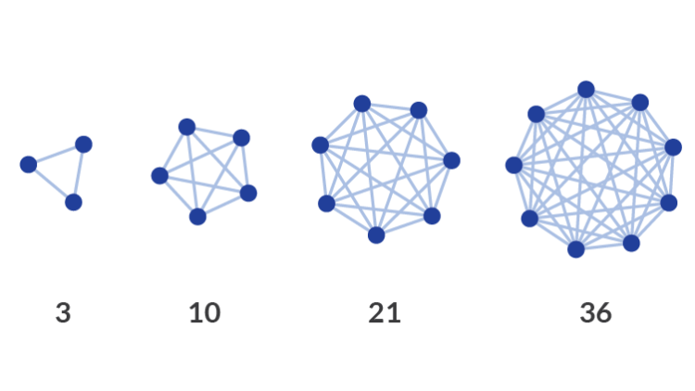

Collocating Open Source Digital Components in a Networked Research Ecosystem Enables Larger Connections and/or Network Effects
Simple Larger Idea
Notes:
Ecosystem Metaphor Look at Relationships in the Digital Environment
Specifically Focuses Upon the Discrete Component Relationships with the Networked Digital Environment

Slide 4
What are the General Characteristics of this Digital Scholarship Ecosystem?
Customizable Components
Active Developer Communities
Open Source Software

Slide 5
Digital Scholarship Ecosystem Consists of Six Open Source Software Components
TWO PRIMARY
DIGITAL COLLECTIONS REPOSITORY
FOUR TERTIARY
Electronic Thesis and Dissertation Management System
User Interface/Content Management Software
Identity Management System
Open Academic Journal Software
RESEARCH DATA REPOSITORY
Content
Communication

Slide 6
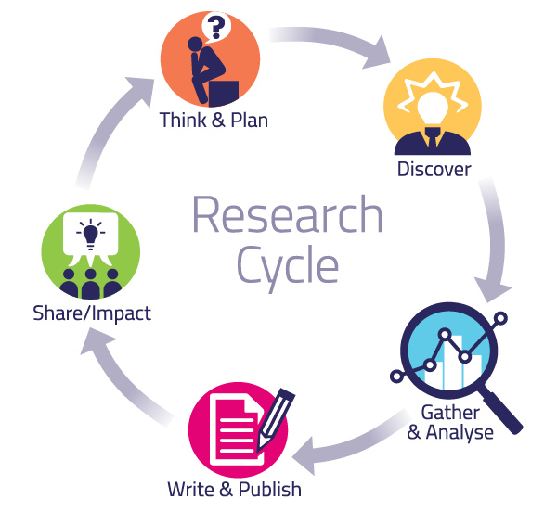
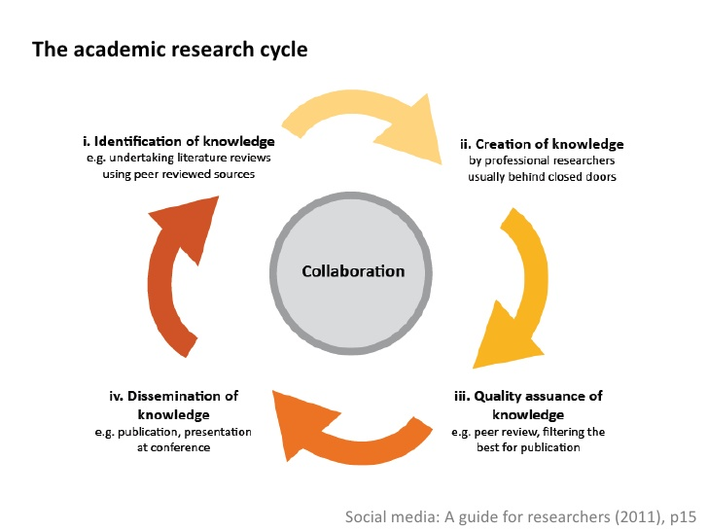
These Digital Ecosystem Components Together
Enable the Academic Research Cycle
Pragmatic Levels
Abstract Levels

Slide 7
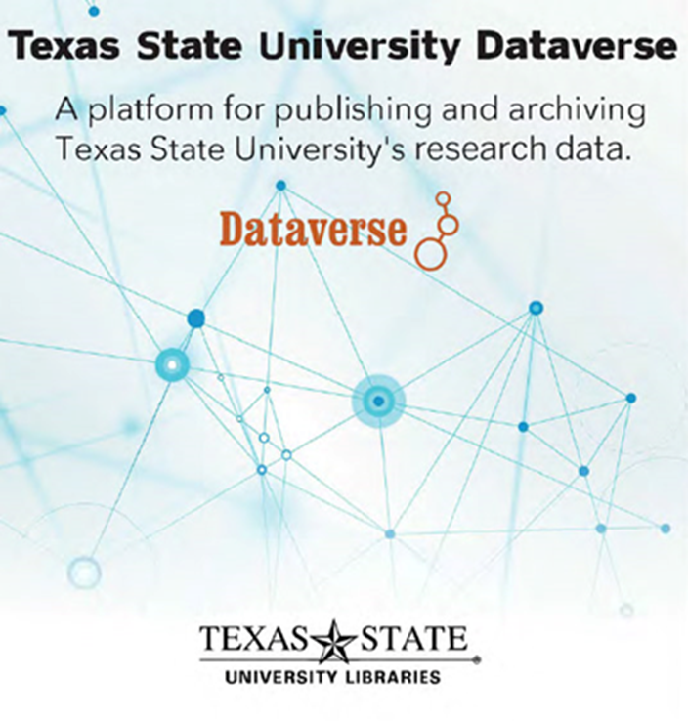
#1 Component for Open Science,
Research Data Repository
https://dataverse.tdl.org/dataverse/txstate

Slide 8
Research Data Repository
https://dataverse.tdl.org/dataverse/txstate

Slide 9
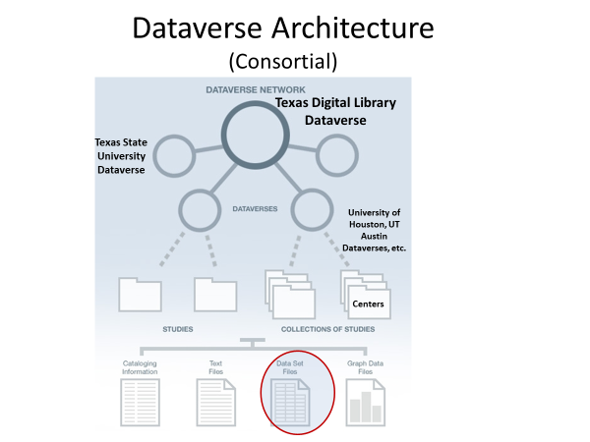
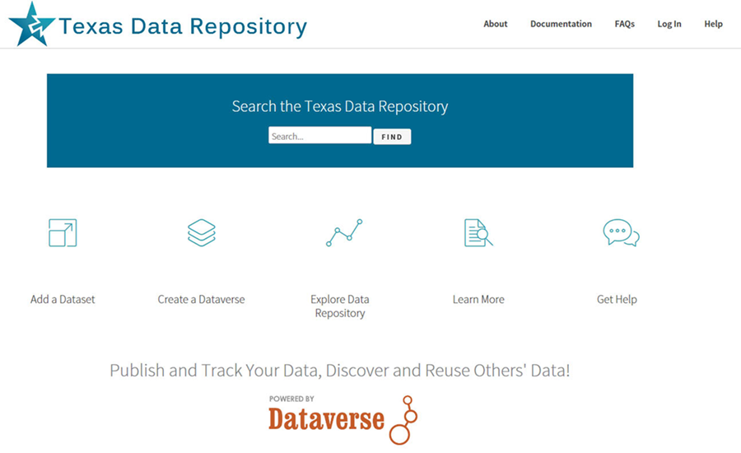
Dataverse can be configured as Single Instance or as a Consortial Model
(Texas Aggregates
22 Individual Instances, through the Texas
Digital Library)
https://dataverse.tdl.org/

Slide 10
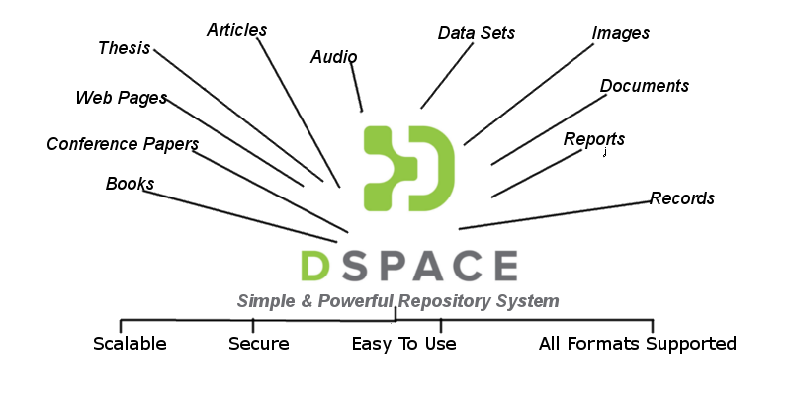
#2 Institutional Digital Collections Repository (Dspace)
Organizes, centralizes and makes accessible
research and knowledge generated by the institution’s research community (Research Faculty and Graduate Students):
Pre-prints
Faculty Publications
White Papers
Conference Presentations
Graduate Student Theses
and Dissertations

Slide 11
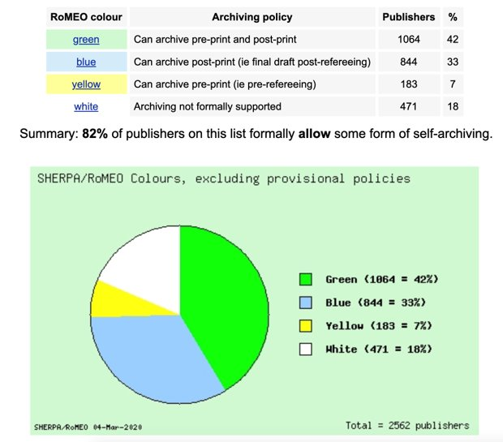
A Vast Majority of Publishers Allow Digital Archiving
in some form. (82% from 2562 publishers)
March 2020 Sherpa/Romeo Copyright Polices & Self Archiving
Source: www.sherpa.ac.uk/romeo/statistics.php?la=en&fIDnum=|&mode=simple
Clicto adtext

Slide 12
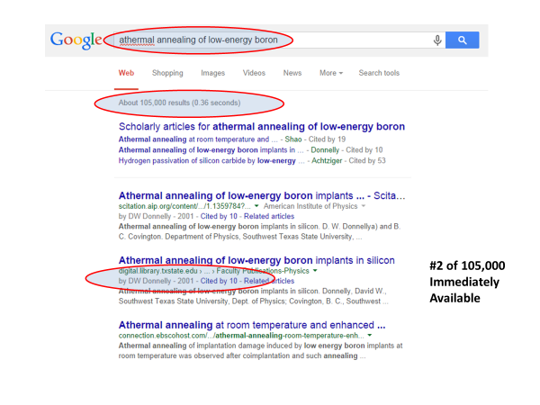
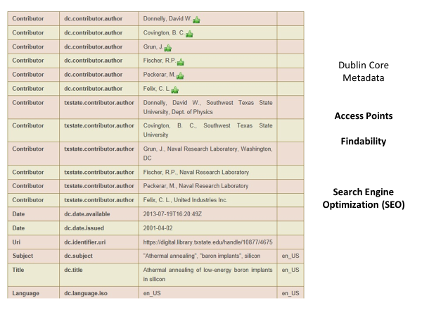


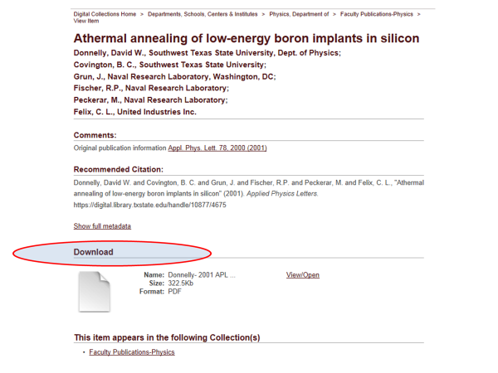
Primary Use Case Value
Application of Structured Metadata Schema for Search Engine Optimization

Slide 13
https://digital.library.txstate.edu/

Slide 15
Percent Increase in Article Citations by Discipline with Open Access Online Availability Through Google
Range = 36%-250% Increase in Citations over 2 Year period
(Data: Stevan Harnad and Heather Joseph, 2014)

Slide 16
Percent Increase in Article Citations by Discipline with Open Access Online Availability Through Google
Range = 36%-250%
(Data: Stevan Harnad and Heather Joseph, 2014)

Slide 17

Vireo
Electronic Thesis and Dissertation Management System
Bridges Student Thesis/Dissertation Submission with Graduate School Review,
Connects the Collections Repository And Data Repository so graduate students can publish and link their theses/dissertations, data and research
Addresses Intermediary steps in the ETD Process

Slide 18
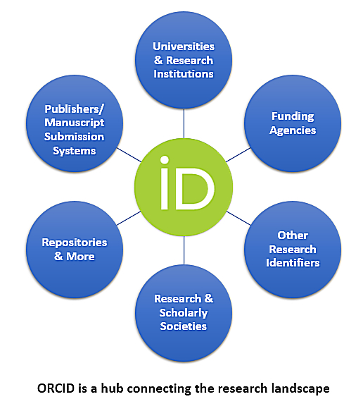

Researcher Identity Management System
Gives Researchers Unique Number (ORCID ID) Connecting and Disambiguate Scholars names:
Maria Hernandez, Biochemist
Maria Hernandez, M.D. or Astrophysicist
Allows Papers in the collections repository and datasets in data repository to be associated with ORCID ID’s for aggregation of research profiles.
Orcid can act as a Network Hub aggregating from several sources and connecting to other internal and external networks

Slide 19


Omeka and OJS3
Open Source User Interface Software
Provides a front end gateway for more complex research projects - linking text, image media and datasets and acting as a front end for connecting components.
Open Access Academic Journal Software for refereed journal online publishing, workflow and connections with background research and datasets etc. through Dataverse/Dspace connections

Slide 20

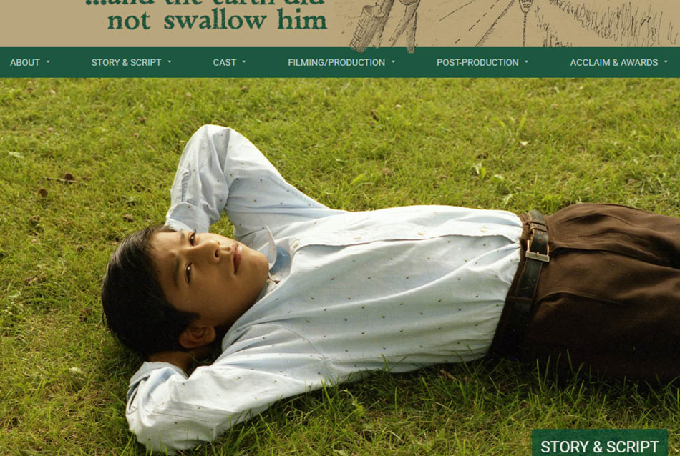
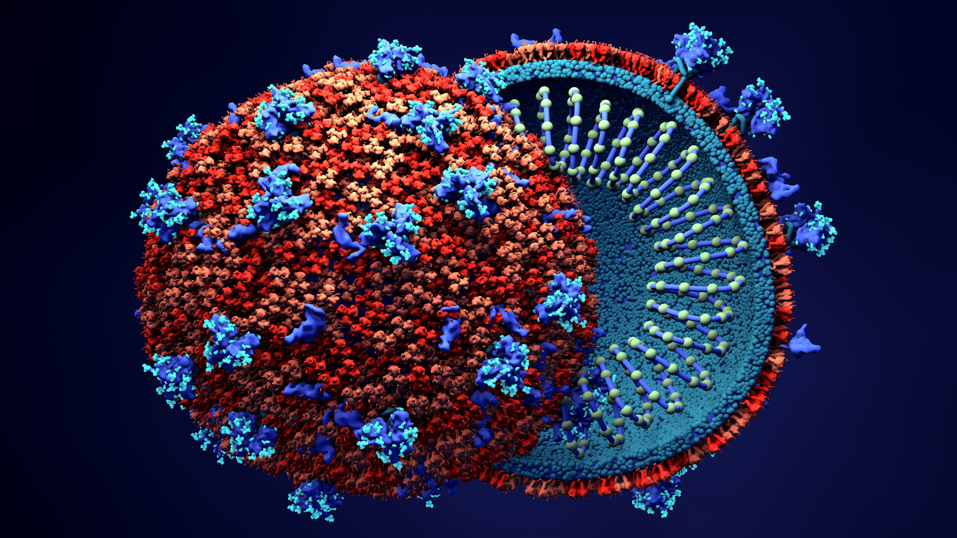
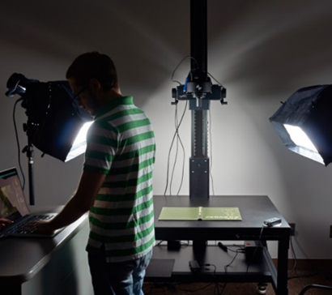
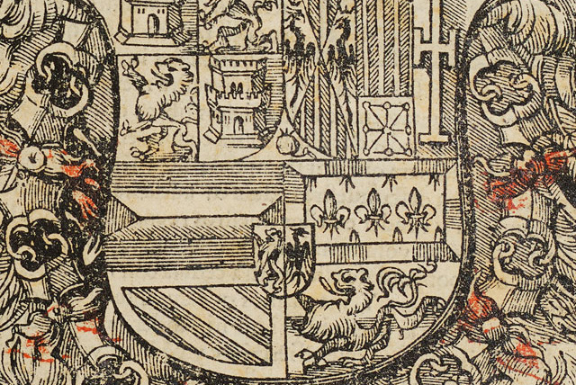
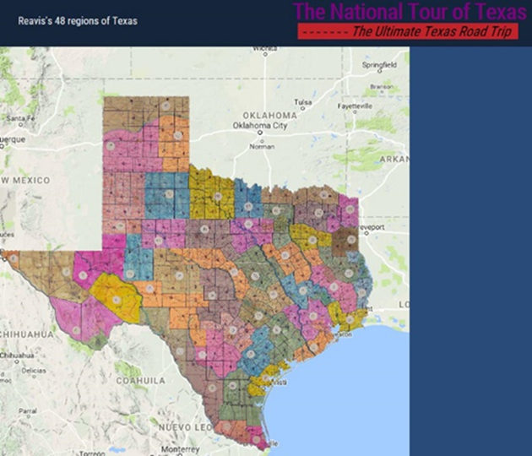
The Digitization Lab
Expands Possibilities for Faculty/Graduate Student Research Projects
Possibilities range from OCR, scientific slides, image, manuscript & journal digitization to 3D objects, audiovisual material, GIS and visualization technologies

Slide 21
Together, These Research Ecosystem Components
Open Amazing Possibilities For Digital Scholarship & Collaboration
Complexity
Complex Multimedia Archives/Cognitive Cartographies
Digital Archives/ETD Projects
Online Exhibits/ Online Academic Journals
Interactive Image Archives/Data Projects
Digital Libraries, Research Documentation Projects
Faculty Digitization Proposals/Partnerships
Projects,Prototypes Grant Partnerships

Slide 22

Human Resources
Essential
System Administrator/Programmer
server infrastructure set-up/maintenance/basic customization
Digital Collections Librarian: Administration, Marketing, User Support, Collections and Data Repository, OJS/ORCID
Optional as System Expands
Metadata Librarian: Dublin Core, Specialized Schema
Web Developer/Programmer: OMEKA, System Integration
Project Manager/Department Head (PMP Certification)
Digitization Specialist
GIS Specialist/Data Visualization Specialist
AI Specialist/Post-Doc/CLIR Fellow

Slide 23


Implementation Paths
For Open Science
(Many Roads To Rome for Timelines, 1-5 Year Paths)
Year 1
Data Repository and Digital Collection Repository
Year 2
User Interface Software (OMEKA), Identity Management System, ORCID
Year 3
Digitization Lab
Year 4
ETD Middleware (VIREO) and OJS Software
Year 5
Complex Digitization Projects, IIIF Server, Faculty Grant Projects etc.

Slide 24
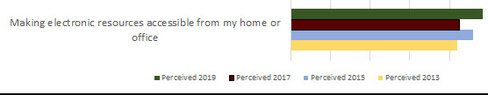
Assessment and Results
Quantitative and Qualitative Measures
Annual Usage Growth
(Downloads, Number of Items, ORCID ID’s
and Hosted Journals)
LibQual Biannual Survey 2013-2019, Faculty and Student System Perceptions, Comments
Ecosystem Implemented in Stages, 2014-2019
System | 2014 | 2015 | 2016 | 2017 | 2018 | 2019
Downloads
DSpace | 326,762 | 318,742 | 385,163 | 341,224 | 972,359 | 1,010,349
ETDs | 136,985 | 158,240 | 200,373 | 328,420 | 470,437 | 505,658
Dataverse | n/a | n/a | n/a | 455 | 3,451 | 2,043
Number of Items
DSpace | 1,340 | 1,437 | 1,546 | 1,660 | 2,135 | 2,720
ETDs | 967 | 1,174 | 1,326 | 1,581 | 1,789 | 2,218
Dataverse | n/a | n/a | n/a | 28 | 33 | 53
ORCID IDs
ORCID | 101 | 190 | 316 | 438 | 545 | 669
Hosted Journals
OJS | 1 | 1 | 2 | 2 | 3 | 4

Slide 25
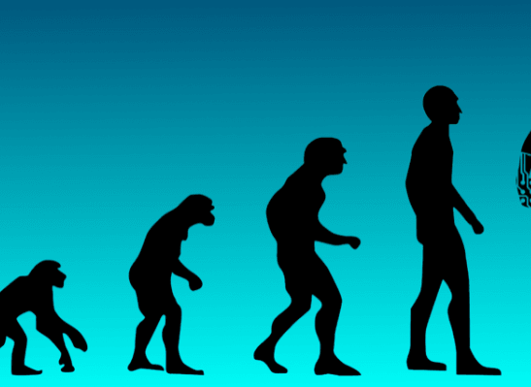
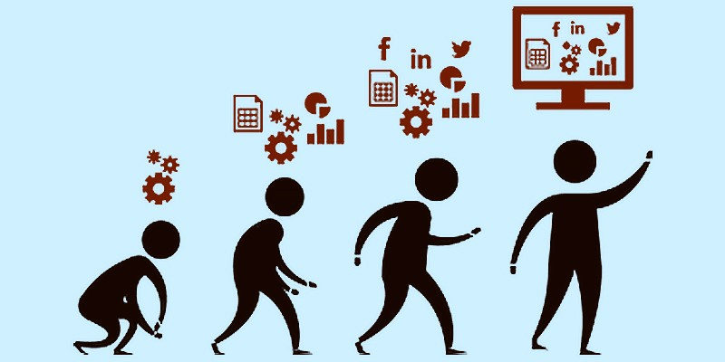
Summary Reflections
Placing Open Science Research Cycle Components within an Ecosystem Paradigm Enables:
1) New Possibilities For Research accessiblity, retrieval and sharing
2) Better Roadmaps for Future Development of Digital Open Science Components
3) Evolutionary Guideposts for Research Systems Development

Slide 26
Further References,
Papers
& Working Examples
Uzwyshyn, R. 2020 Developing an Open Source Digital Scholarship Ecosystem (Preprint). ICEIT2020. Oxford, UK. https://www.researchgate.net/publication/336923249_Developing_an_Open_Source_Digital_Scholarship_Ecosystem
Texas State University Libraries Website.
https://www.library.txstate.edu/
Texas State Digital Collections Repository
https://digital.library.txstate.edu/
Texas State Data Research Repository https://dataverse.tdl.org/dataverse/txstate
Texas State Online Research Identity Management System:
https://guides.library.txstate.edu/researcherprofile/orcid
Texas State Electronic Thesis and Dissertation Management (VIREO): https://www.tdl.org/etds/
Texas State Digital & Web Services:
https://www.library.txstate.edu/services/faculty-staff/digital-web-services.html

Slide 27
Further Links to Open Source
Software & Downloads
Dspace
https://duraspace.org/dspace/
Dataverse
https://dataverse.org/
Omeka
https://omeka.org/
Open Journal Systems 3
https://pkp.sfu.ca/ojs/
ORCID
https://orcid.org/
Vireo
https://www.tdl.org/etds/

Slide 28
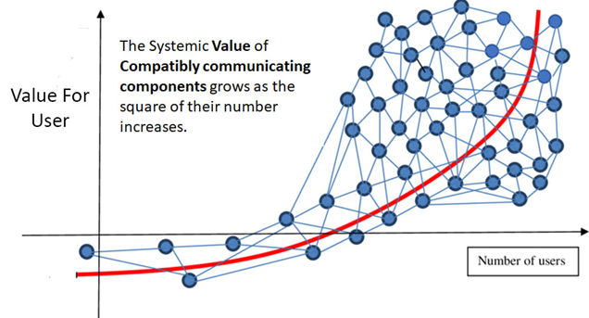
Questions, Comments
Ray Uzwyshyn, Ph.D. MBA MLIS
Director, Collections and Digital Services
Texas State University Libraries
ruzwyshyn@txstate.edu, 512-245-5687
http://rayuzwyshyn.net

Slide 30


Future
Pathways
Networked Global Scholarly Research Environment

Slide 31


Research Universities and Digital Research Ecosystems
~266-300 Research Institutions US & Canada
Carnegie R1 & R2, Very High or High Research Activity
~1000-1250 Research Universities Worldwide
QS Rankings and Times Higher Education Supplement. (40% Europe, 26.5% Asia Pacific, US/Canada 18%, Latin America 9% and Middle East/Africa.
Enable Top 2-3% Research Institutions Globally, 1000 Institutions beyond the US and Canada.
(This represents the other 90% of Research Libraries Globally)

Slide 32




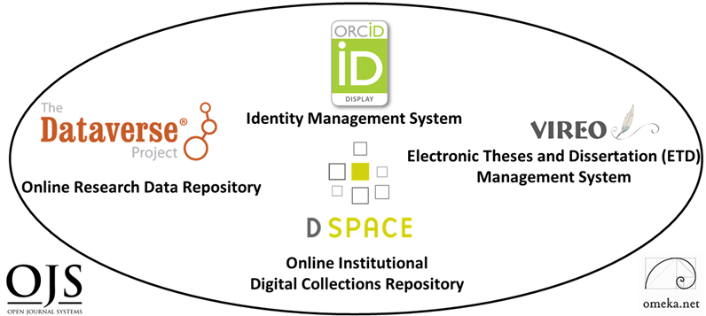
One Server Per Research Institution
2020-2025
Empower 1000 Research University Institutions/Research Libraries Globally
Gift each Research University One Configured Server Ecosystem with 6 Open Source Scholarly Research Software Components,
< $1000.00 US/Server or set up Fractional Server Space with Mirror Sites Globally (SAAS)
Set Up brief weeklong training over five continents
Connect Networks
Measure the Effects

