Slide 1
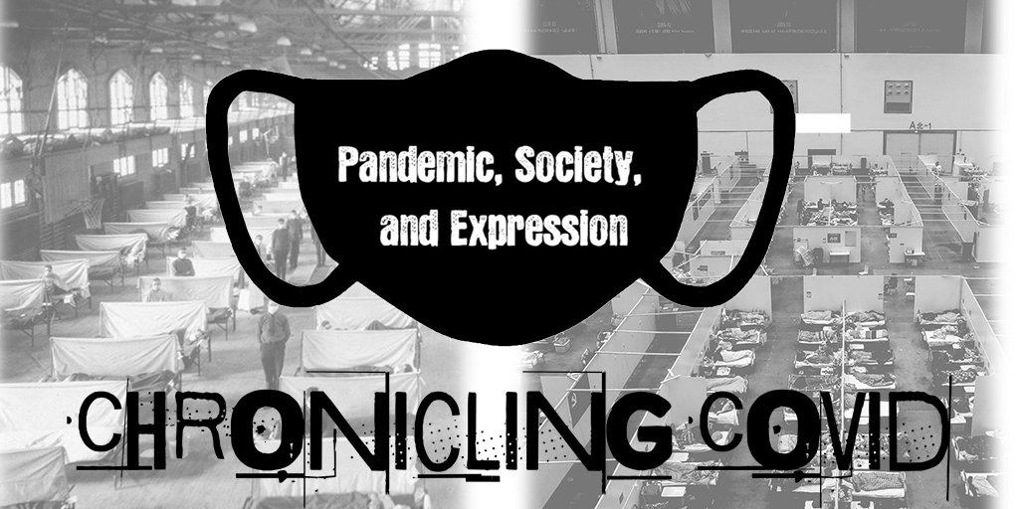
Notes:
Welcome All
My name is Jodi Brown and I am the collection development librarian at Texas State University
This presentation focuses on a project which aims to document the experiences and expressions of both the campus and local community living with and through COVID-19

Slide 2
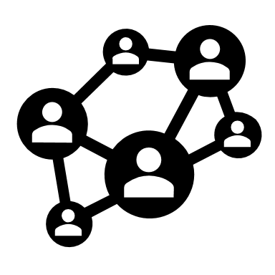
Jodi Brown
  Collection Development Librarian
  jrb402@txstate.edu
  Laura Kennedy
  Assistant Archivist
  lsk33@txstate.edu
Stephanie Towery
  Copyright Officer
  sst25@txstate.edu
  Laura Waugh
  Digital Collections Librarian
  lwaugh@txstate.edu
Notes:
This was a collaborative project between:

Slide 3
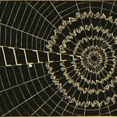
Collaboration Across Library Units
Archives, Collections, Digital Collections, & Copyright
  Archives envisioned taking on a project to document COVID-19 as part of an internship.
    Archives intern (Nikolas Koetting)– conducted interviews for oral history project
  Collection Development – Promote available resources
    LibGuide
    Coordinating efforts with Archives, Copyright, Digital Collections
  Since items submitted would become part of the Digital Collections, we reached out the Digital Collections Librarian for insight
  Finally, to make sure we were protecting our patrons and ourselves, we consulted with our Copyright Officer for advice
Image from page 57 of "American spiders and their spinning work. A natural history of the orbweaving spiders of the United States, with special regard to their industry and habits" (1889)
Notes:
ARCHIVES: Laura took notice of
Other institutions’ initiatives on documenting the pandemic. Originally the plan was to have students interns work on a similar project for TXST's University Archives. Unfortunately students weren't available when needed & Laura began planning to get the project in place sooner. Laura and I began discussing the project and how we might form a collaborative project between UA & collection development.
The Archives did have one student, Nikolas Koetting, working on oral histories over the summer. These will become part of the covid collection.
COLLECTION DEVELOPMENT:
For CD, I wanted also to bring awareness to the materials/resources the library already has. This includes info on 1918 flu and its parallels to covid-19. We created a LibGuide including a section for submissions, and several tabs with info on various resources such as art, history, and experiences, which all relate to the pandemic now and in 1918.
DIGITAL COLLECTIONS:
The goal was to store and preserve expressions/experiences for future, which is why we felt it vital to invite Laura Waugh to collaborate since she manages the IR. To eliminate potential barriers to submission/participation we collectively determined that accepting most any file format or size in the Digital Collections Repository was key. In addition we were able to use our existing workflows for transcription or captioning. For security, and based on the tools available at our institution, we chose to create a submission form in Qualtrics that the team could access and setup to send us each alerts of new submissions (which allowed various file format and sizes)
COPYRIGHT:
Stephanie Towery is the copy right librarian (holds a JD) and her expertise was very much needed to carry out this project
We reviewed releases from similar COVID projects at other universities, and Stephanie assisted with creating a release that we thought would work for our institution. In discussion, we decided to include an option for items to be archived and made available anonymously. While an internal record of the submission, is kept, identifying information will not be made available publicly.

Slide 4
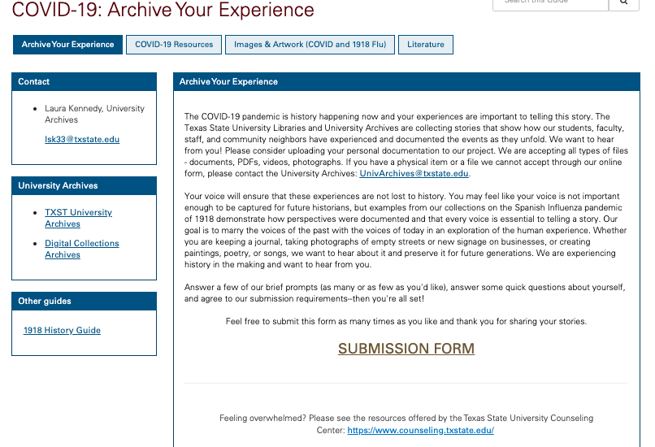
Chronicling Community Experiences/Expression
Scholarship as Conversation -
  Voices now = primary sources later
  Archive history in real time
Authority is constructed & contextual
  Specialized experience is authoritative
Information creation as a process
  Invite campus & local community to submit original materials
https://guides.library.txstate.edu/c.php?g=1044853&p=7580583
Notes:
Because this project elicits personal expression, our group saw this as an opportunity to demonstrate its correlation to the ACRL Framework for Information Literacy
Let me work backwards from the bottom of the slide:
This group felt it important to reach out to our campus and local community and to provide a format and opportunity to let their voices be heard.
As I have explained to students in the past, living through a movement or other significant period in history equals specialized experience that is authoritative! They have lived to tell the tale! Much like prominent figures in the American Civil Rights Movement or Black Lives Matter Movement.
The voices of today will become our primary sources later, and this is an opportunity to capture history as it happens for future generations. These expressions are part of the scholarly conversation landscape.
For anyone interested, please take a look at the link provided at the bottom of this slide.

Slide 5
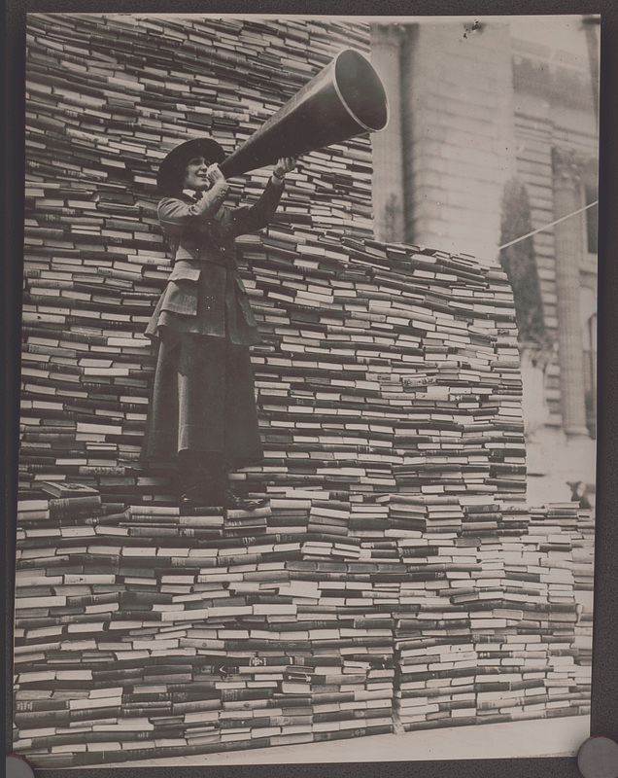
Connect Campus & Community to Library Collections & Resources
Users/patrons often are unaware of vast resources
  Archives
  Library collections
Outreach to campus as well as community
Connect history to the present: parallel separate events
  Understand the present through past and resources of past
SMPL assisted in promoting the project to patrons/community
    Pamela Carlile Programming & Outreach Librarian
    Kim Morgan-Benson Programming & Outreach Librarian
Abel & Company, photographer
New York City book campaign / Abel & Company, Inc., commercial photographers, 903 E Street, N.W., Washington, D.C.
1919.
Notes:
Myself in CD and Laura Kennedy wanted to also use this project as an opportunity to highlight the vast and interesting collections help both in the library and the archives.
Because this pandemic shares so many elements with the 1918 Influenza we felt it necessary to include those resources to show the parallels and help others to see clearly the events of today through sources of the past.
In San Marcos, our campus community is embedded in the local community and we wanted to be able to offer our community members the ability to give voice to their experiences as well.
Finally,
I want to give a huge thank you to the SMPL, specifically Pamela Carlile and Kim Morgan-Benson who helped myself and my colleagues promote the project via social media.

Slide 6
Thank you!
Jodi Brown
  Collection Development Librarian
  jrb402@txstate.edu
  Laura Kennedy
  Assistant Archivist
  lsk33@txstate.edu
Stephanie Towery
  Copyright Officer
  sst25@txstate.edu
  Laura Waugh
  Digital Collections Librarian
  lwaugh@txstate.edu
Notes:
Thank you for attending!
And thank you to my colleagues for allowing me to pull them into this project.

