Slide 1
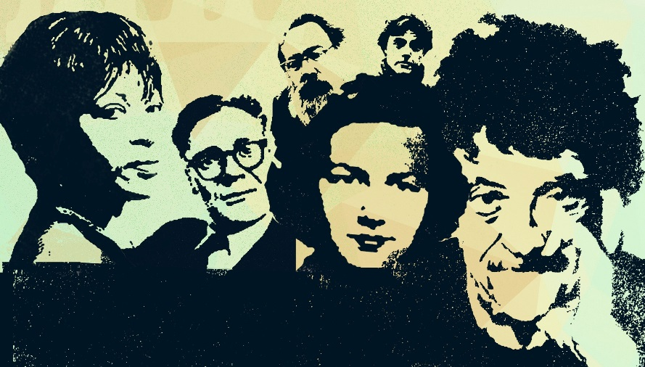

Exploring Aesthetic Communities with Text Mining and Data Visualization:
The Program Era Project and the Iowa Writers' Workshop
Nicholas M Kelly
Department of Rhetoric
The University of Iowa
@newreadia, nicholas-Kelly@uiowa.edu

Slide 2
Our Literary History
“We need to start documenting this phenomenon, moving out from the illustrious cases of the Iowa Writers’ Workshop and Stanford University to grasp the reality of an enterprise that now numbers some 350 institutional participants and continues to grow. This enterprise is our literary history.”
                - Mark McGurl, The Program Era
Notes:
In The Program Era: Postwar Fiction and the Rise of Creative Writing, Mark McGurl suggests that greater scholarly attention should be directed towards the influence of Creative Writing programs on contemporary literature. He contends:
“We need to start documenting this phenomenon, moving out from the illustrious cases of the Iowa Writers’ Workshop and Stanford University to grasp the reality of an enterprise that now numbers some 350 institutional participants and continues to grow. This enterprise is our literary history.”

Slide 3
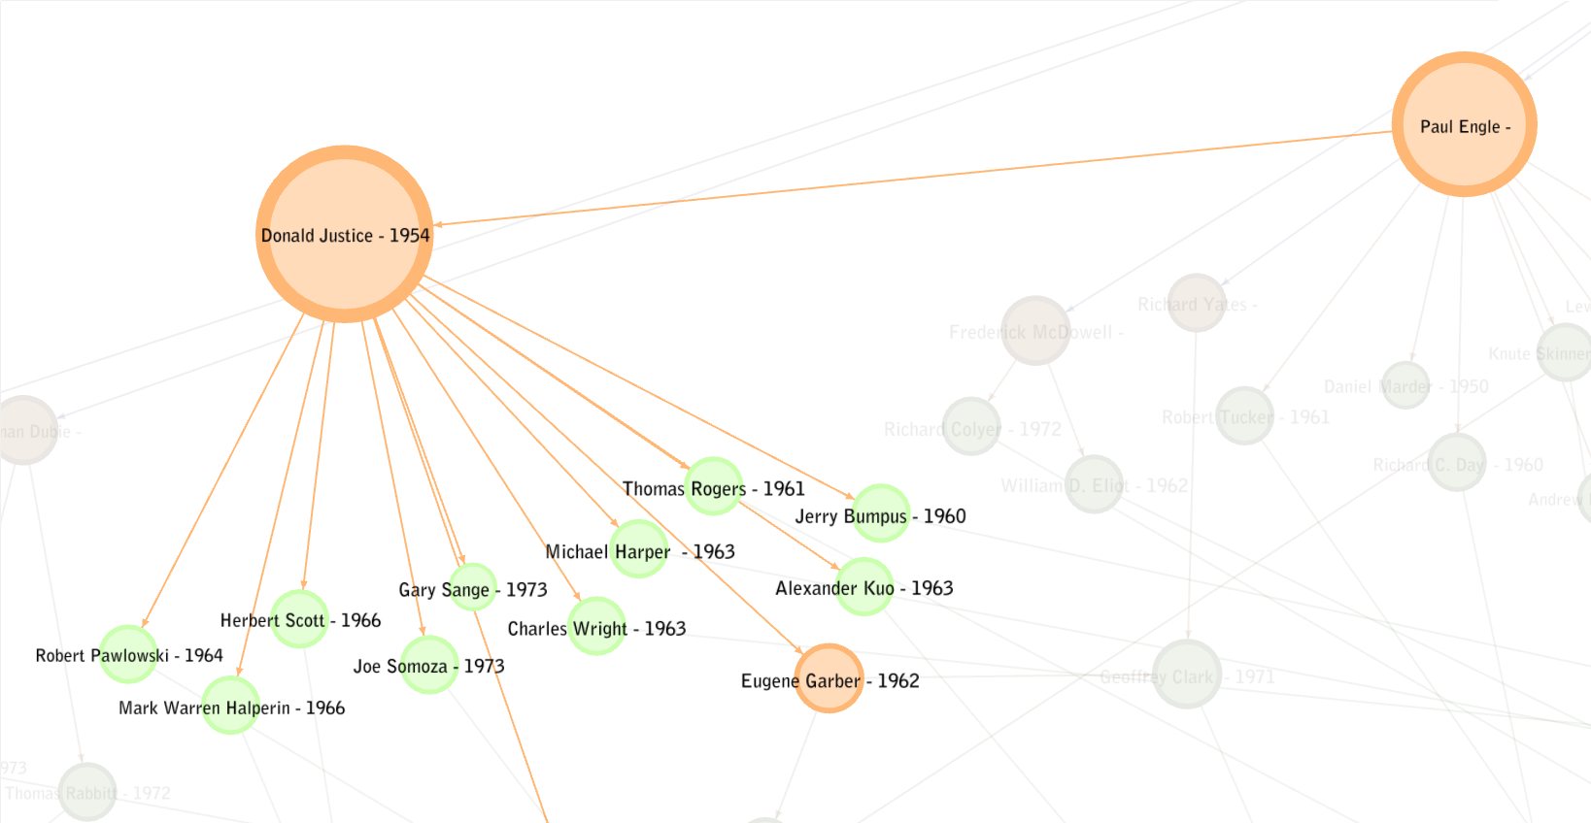
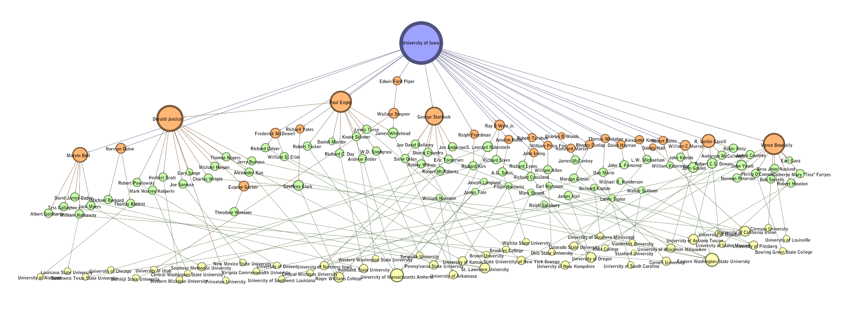
The program Era Project
Develop techniques to study Program Era
Create public database on Iowa Writers’ Workshop
  Writers (Professional/Biographical info)
  Workshop writing text metrics
    Formal features, sentiment, location references, topic modeling…
Notes:
I am a founder of and software developer for the Program Era Project, a DH initiative at the University of Iowa focused on developing methods that can be used to examine and document the Program Era at a scale such an object of study requires. The Project takes as its institutional test case the Iowa Writers’ Workshop, one of the oldest and best known creative writing programs. We’re working to build an online, public database of information on the Workshop, its writers, and text-mined data on their works, things like formal features, location references, sentiment, or topic models.

Slide 4
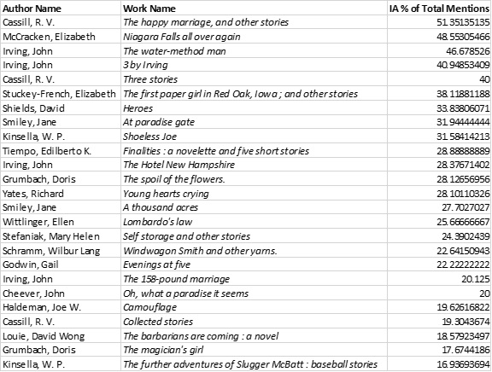
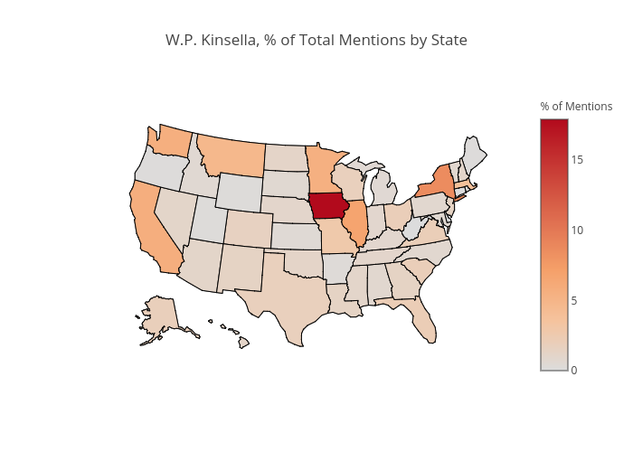
Pep and aesthetic communities
PEP, Text Mining, Data Visualization
“Squatter Regionalism”
Notes:
Today, I’ll be speaking about how the Program Era Project team has used text mining and data visualization techniques to examine trends in aesthetic communities like the Iowa Writers’ Workshop. In specific, I will discuss a trend we discovered in Workshop writing that we call “Squatter Regionalism,” that is, a tendency for authors who have attended—or taught at—MFA programs to adopt the location of their MFA program as sort of literary home, frequently mentioning it in their subsequent literary production.
When we use computational text analysis techniques to examine roughly 400 fiction titles by Workshop authors, we find that Iowa references in that corpus are significantly higher than in a control corpus of post-war literature. We will also see how the works that mention Iowa most frequently in our Workshop corpus are, overwhelmingly, not authored by Iowans. Instead, we will be able to identify a cohort of squatter regionalists, authors whose writings prominently feature Iowa—that is, the state in which they received their MFA, found faculty employment, or both.

Slide 5
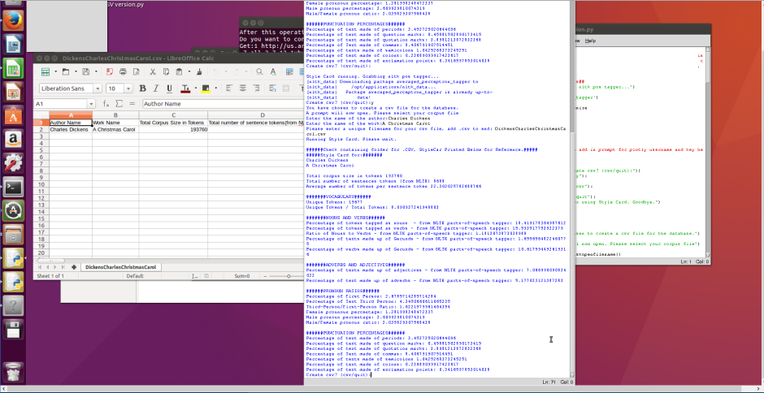
Collecting data
Count place names
  State names (except Washington)
  State capitols
  Top 50 U.S. Cities
  Top four cities
  Nicknames (Windy City, Big Apple)
Exceptions
  Common first names (Norman, Charlotte)
  Geographic features (Mesa, Butte)
  Extremely common names (Springfield, Columbus)
  Geographic features (Mississippi River)
Assign counts to each state
Above: HTRC/PEP Data Capsule
Notes:
To begin, let’s talk about how we collected our text data. To do this, I developed a tool that tracks state-associated place mentions in text corpora and produces a mention score for each state and U.S. Census region. This tool counts toponyms like state names (except for Washington, which I’ll say more about in a moment) state capitols, the names of the United States’ 50 most populous cities, the names of the four most populous cities in each state and, where it applies, nicknames for cities like “Big Apple” or “Windy City.”
I’ll note that some extremely ambiguous place names are excluded from these counts. City names that are also common first names, such as Charlotte or Norman, are excluded. So, too, are names that are common geographic features, such as Mesa, or names found in a large number of states like Springfield of Columbus. The tool also excludes references to geographic features that are also state names. Mississippi will be counted, for instance, while Mississippi River will not.

Slide 6
disambiguation
Exclude false positives, Collect context
Weigh context, add ambiguous mentions
  Total unambiguous references, assign %
  Distribute ambiguous counts based on proportion
Aim: Transparency,
  Comprehend, verify
Notes:
These selection criteria help increase the accuracy of our tool, but that only gets us part of the way there. As many scholars working to track location references in large corpora have discovered, the primary challenge lies in disambiguating words that might reference multiple locations, or even reference something like a person’s name. Washington, for instance, can be all three. A long-used strategy for disambiguating place names has been to rely on context within the corpus and assign the location references based on what other places or things are mentioned most frequently. This is the basis of our approach.
Step one of our disambiguation process is to count and an exclude any false positives we can find, but have our tool keep a count of those false positives for context. The tool will flag, for example, any instances of a Ms. or Mr. Henderson, a Sgt. or Dr. Henderson, etc… and exclude it from a count for Henderson, Nevada. It will also look for any indication of a first name + Henderson combination, excluding—but tracking— how often instances of Henderson as a person appears.
Next, the tool looks at the overall context of a work to proportionally assign ambiguous references to state counts. The tool, for example, will count references to Washington D.C., places in Washington state, or uses of Washington as a name. Those references are totaled. After that, the tool finds what percentage of that total each type of Washington represents. It then distributes any ambiguous counts of “Washington” proportionally. Our aim here was to produce a tool that maximized accuracy, but works in a way that is transparent, minimizes a “black box” feeling, and could even be verified by scholars without a technical background.

Slide 7
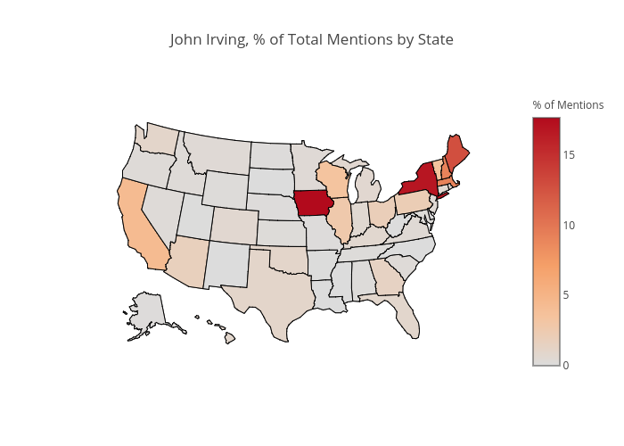
tests
Classic Regionalists:
  Hamlin Garland
  Sarah Orne Jewett
  Willa Cather
Iowa Regionalism:
  John Irving
  W.P. Kinsella
Above: John Irving (14 volumes), born and raised New Hampshire, IWW MFA (1967).
Left: W.P. Kinsella (9 volumes), born and raised Alberta, Canada, IWW MFA (1978).
Notes:
After we developed the tool and refined the disambiguation method, we used data visualization to help us test it on corpora where we had expectations about what we would find. We tested classic regionalist authors like Willa Cather, Sarah Orne Jewett and Hamlin Garland, authors whose regional focus had already been noted by previous scholars and was supported our visualizations. We also tested authors we thought would have Iowa-heavy corpora. For instance, on the map for New-Hampshire born author John Irving you can see evidence of his northeastern roots and his later interest in Iowa. On our other map you can see that no, it’s not heaven, its Iowa that’s featured heavily in the writings of Shoeless Joe author W.P. Kinsella.

Slide 8
corpus
Criteria:
  Fiction only
  > 10 Location references
Trimming:
  Cut first, last five pages
  Limit publication, bio material
Final size:
  ~ 150 Authors
  ~ 400 Volumes
Notes:
The next step, then, was to use the tool with a full corpus. In 2017, we entered a research partnership with the HathiTrust Research Center, an extensive digital library designed to facilitate scholarly work such as computational text analysis. Through this collaboration, we have access to approximately 1600 volumes by nearly 300 Workshop-affiliated writers. For our squatter regionalism study, we decided to make our focus slightly more specific. Because we wanted to consider squatter regionalism alongside classic regionalism, we chose to only examine fiction. Secondly, we included only volumes that had at least 10 location references. Lastly, each work we analyzed had its first and last five pages trimmed, in order to eliminate publication or biographical material. Ultimately, this left us with a corpus of approximately 400 works written by roughly 150 authors.

Slide 9
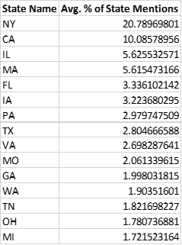
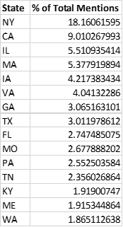
Findings - Rankings
New York, California
  NY: 18% total, 20.7% average
  CA: 9% total, 10% average
Iowa 5th, 6th in average/total
  Higher than .97%, 27th (pop.)
Above: Top 15 states by avg. % of State Mentions, HTRC Workshop Corpus
Left: Top 15 states by % of total mentions, HTRC Workshop corpus
Notes:
So, let’s talk about what we found when we combined this corpus with our text analysis tool. Firstly, even among the Workshop corpus, it needs to be noted that, in aggregate, the Midwest, and, really, much of the U.S., receives little attention when compared to California, and, more significantly, New York. 18 percent of the total mentions point to New York, 9 percent are for California. If we look at every text in the corpus and average what percentage of references are made up by each state, we find that an average text in our corpus would have 20.7% of its total state mentions be New York mentions. The average for California is 10%.
However, with both averaged and totaled references, Iowa is still ranked much higher than would otherwise be expected. The average percentage of state mentions for Iowa in our corpus is 5%, sixth amongst the states. Counting all location references, Iowa is the fifth most represented state. This, it should be noted, is much higher than Iowa’s ranking in terms of population, where it sits at 27th , with just under 1% of the U.S. population.

Slide 10
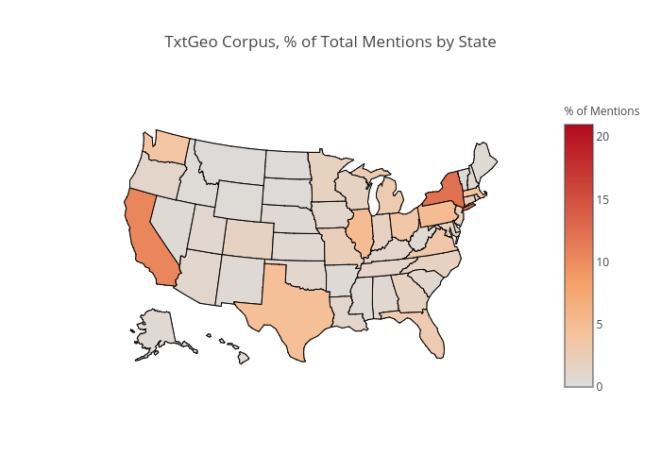
txtGeo Comparison
TxtGeo
  Location references in 10 million volumes
  Comparison corpus
    1930 – 2015
    LOC “Language and Literature”
TxtGeo Corpus:
  Iowa = 1.058% of total
  1.1x Iowa pop.
Workshop Corpus:
  Average: 3.2%
    3x TxtGeo
  Total: 4.2% of
    4x TxtGeo
Notes:
Another question to consider is how the Workshop corpus differs from comparison corpora. The Textual Geographies (or TxtGeo) project is an online repository of text location data. It tracks place references in more than 10 million books and journals. Users can specify date and text category ranges and see what states are most mentioned in the data subset they choose.
When we look at TxtGeo’s data for place references found in books published between 1930 and 2015, books categorized under the Library of Congress Classification “Language and Literature,” we can see that Iowa represents just over 1 percent of references, about 1.10 times the population figure. In our study’s corpus, with an average text, Iowa represents 3.2% of all location references, more than three times the TxtGeo number. If we count the total mentions for each state, the number increases to roughly 4.2 percent, 4 times the population figure.

Slide 11
iowa volumes
Top 25
  Iowa as % of total state mentions.
Repeat authors
  John Irving
  W.P. Kinsella
New Names
  Jane Smiley
  Doris Grumbach
One Iowan
  R.V. Cassill
Notes:
That said, the data becomes even more interesting when we look at our corpus at the volume level. If we take every work in our corpus and rank them based on what percentage of the total location references are Iowa references, we can identify a collection of Iowa-centric books. In this list, we can find a collection of authors who appear frequently. Test case authors such as John Irving and W.P. Kinsella appear in this list, having multiple works in the top 25. We also see new authors with multiple works in the top list, authors such as R.V. Cassill, Jane Smiley, and Doris Grumbach. What is most striking, though, is that among this list of authors who produced Iowa-focused works, only one, R.V. Cassill, is an Iowan. The remainder are a collection of authors who taught or studied at the Iowa Writers’ Workshop and who later wrote at least one work of fiction proportionally heavy with Iowa references. We have, in short, what looks to be our squatter regionalists, authors connected by a shared experience in their professional itineraries and who share an emphasis on Iowa in at least one of their works.

Slide 12
Significance
Iowa part of larger trend?
  Implications for post-war writing
Starting point for future scholarship
  Suggestions, comments?
Expand, diversify toolkit
  Examine Program Era at scale
Notes:
So, what does our study of Squatter Regionalism mean for the overall study of the Program Era or, even, the use of text analysis and data visualization to examine aesthetic communities? We hope our findings might make other researchers curious about location representation connected to other creative writing programs. If Workshop authors are adopting new literary homes, where else might this happen? What might that mean for post-war writing?
Additionally, we hope our project might provide ideas or methodological starting points for future investigations or might inspire comments and suggestions about how we can improve our techniques. As the Digital Humanities community continues to evolve and expand the fields of text analysis and data visualization, we believe scholars will have a better, more diverse toolkit of ways to study aesthetic communities like the Writers’ workshop and to examine the Program Era at the scale such a phenomenon requires.

