Slide 1

Public Service in the 21st
Century: Nonprofits Take
the Lead
Historical Public Service: Public Administration
and Nonprofit Management
Patricia M. Shields
Texas State University
March 16, 2013

Slide 2
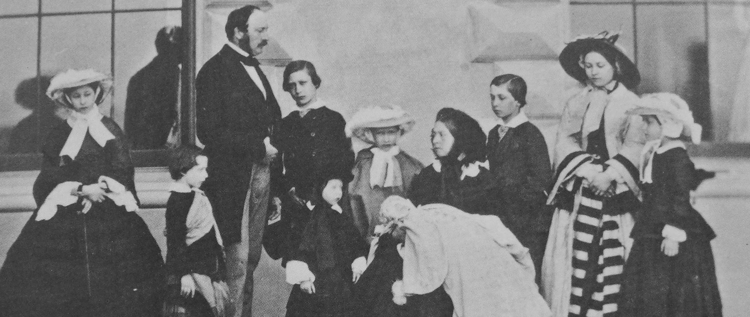
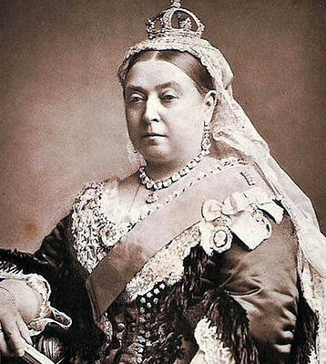
Queen Victoria
Life 1819 – 1901
Reign 1837 – 1901
Notes:
The discussion is during the Victorian Era. She later plays an important role.

Slide 3
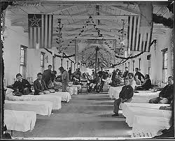
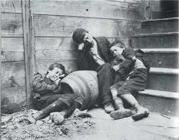
Reform
Faith
War/Disaster
Hospitals
Sanitation
Service
Notes:
These are the historical themes I will use through there cases.

Slide 4
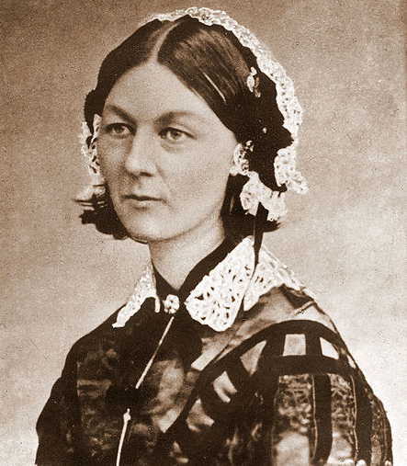
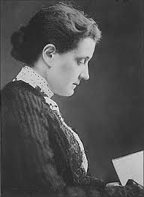
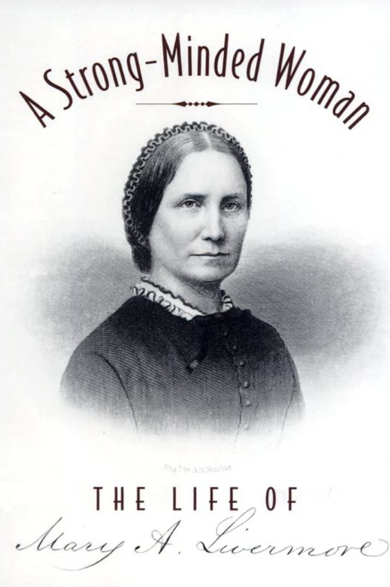
Florence
Nightingale
Jane Addams
Mary Livermore
Notes:
The connection to women in PA. These are the three women who anchor the discussion to follow. All three are public administrators and non-profit administrators

Slide 5
Her mission - use science to reduce suffering and save lives.
1820 – 1910
Diseases
Hospitals – need basic hygiene
Nursing
Genius
Reform & Faith
Notes:
A few words on Florence Nightingale. Her “call” to serve early on was a religious experience that inspired her entire life. She was a reformer on numerous fronts. Her work with the British Sanitary commission was instrumental to the creation of the red cross.
Interested in reducing the suffering and preventable death. Initially self taught, traveled to continent and studied hospitals there. Eventually put her ideas into practice as she was in charge small, failing hospital designed to serve gentlewomen in distressed circumstances (first non-profit role)
Early on she decided it made sense for her to focus on hospitals. Hospitals needed to practice sanitary methods and they needed to be places where nurses were respected and trained.

Slide 6
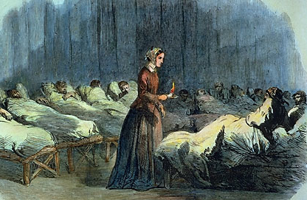
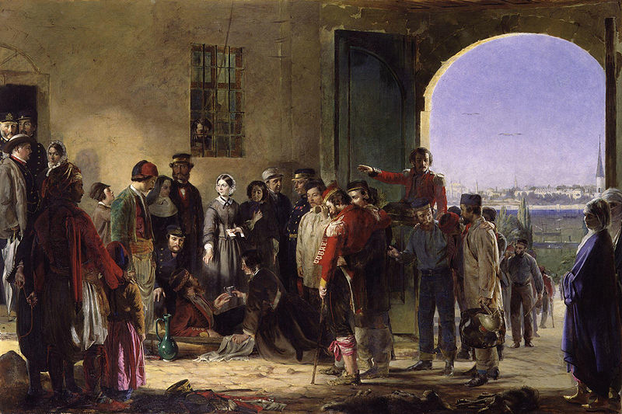
Crimean War
1853 – 1856
Death by Disease – telegraph
In the long wars the real arbiter of the destiny of
Nations is not the sword, but pestilence (Nightingale, 1863, p. 3)
Notes:
The themes of war/ disease sanitation and hospitals come to play.
British Sanitary Commission (Secretary of War, lord Hebert) authorized her to travel to the Crimea bring nurses and clean up mess.
** Ground swell of other “sanitary commissions” throughout Europe. Reform wounded soldier care and need to neutral party get the soldiers off the field. The neutral parties (kind of sanitary commission) identified themselves on the battle field with a flag with a red cross.

Slide 7
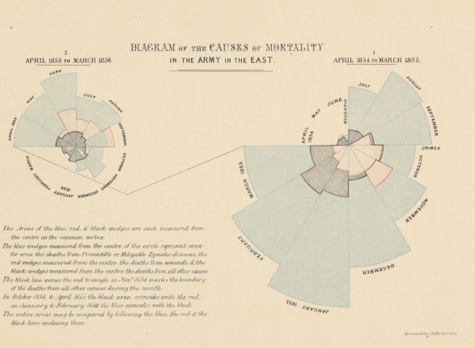
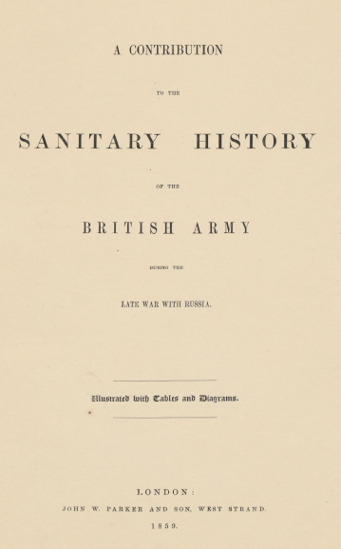
Rose Diagrams
Overcrowding
Lack of cleanliness
Drainage
Ventilation
British Sanitary Commission
Hospital in Scutari

Slide 8
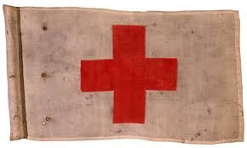
Notes:
Early red cross flag
** Ground swell of other “sanitary commissions” throughout Europe. Reform wounded soldier care and need to neutral party get the soldiers off the field. The neutral parties (kind of sanitary commission) identified themselves on the battle field with a flag with a red cross.

Slide 9
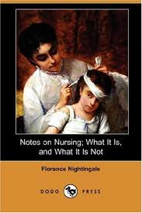
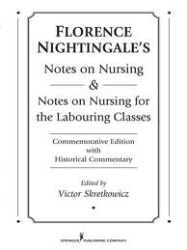
Notes On Nursing
2010 voice recording
1859
Notes:
Best selling book. Still in print. The link above is a voice recording.
She was wealthy and made money with the book – funded schools for nursing.

Slide 10
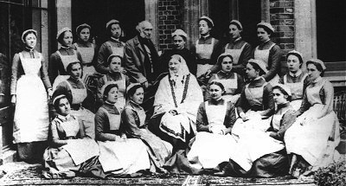
Florence Nightingale
School For Nurses
Nurses as embodied service
Notes:
Nurses training – non profit funded by Nightingale.
Now affiliated with a university.
Theme of service!

Slide 11
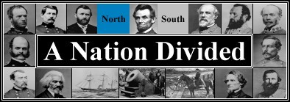
THE AMERICAN CIVIL WAR
1861-1865
Notes:
Move to the second non-profit era. Introduce the Us Sanitary Commission.

Slide 12
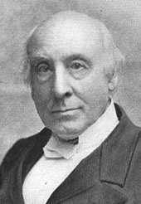
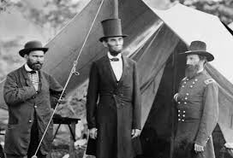
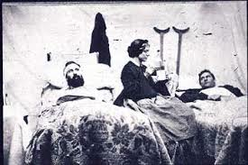
Reform
Faith
War/Disaster
Hospitals
Sanitation
Service
Rev. Bellows
Civil War
Hospitals/disaster

Slide 13
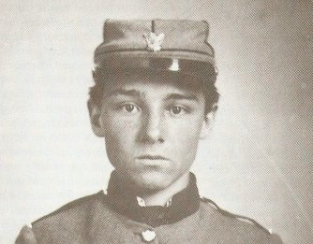
REFORM NEEDED - disaster
Medical Crisis – Sanitation in camps/hospitals
Supply Crisis - Chaotic Volunteer response
20,000
1865 2,000,000

Slide 14
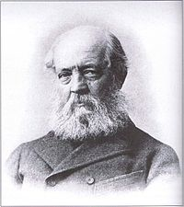
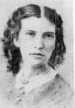

Frederick Olmsted
Rev. Bellows
Elizabeth Blackwell, MD
US Sanitary Commission
June 9, 1961
Notes:
Three founders of the sanitary commission

Slide 15
US Sanitary Commission
Inspection – Camps/hospitals
Relief Supplies
Notes:
Primary roles of the sanitary commission. Men responsible for inspection of camps/hospitals and women for the distribution of the relief supplies.

Slide 16
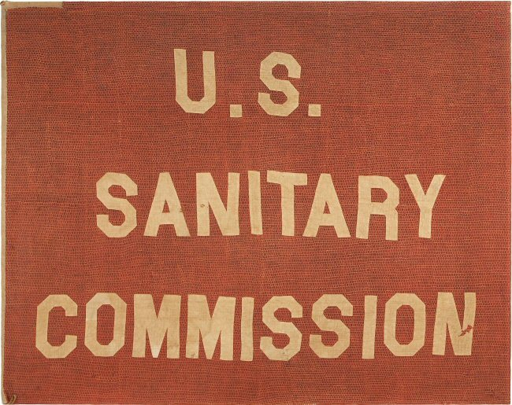
Authorized by Lincoln
Funded by Donations
Relied on Volunteers
?

Slide 17
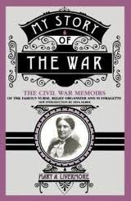
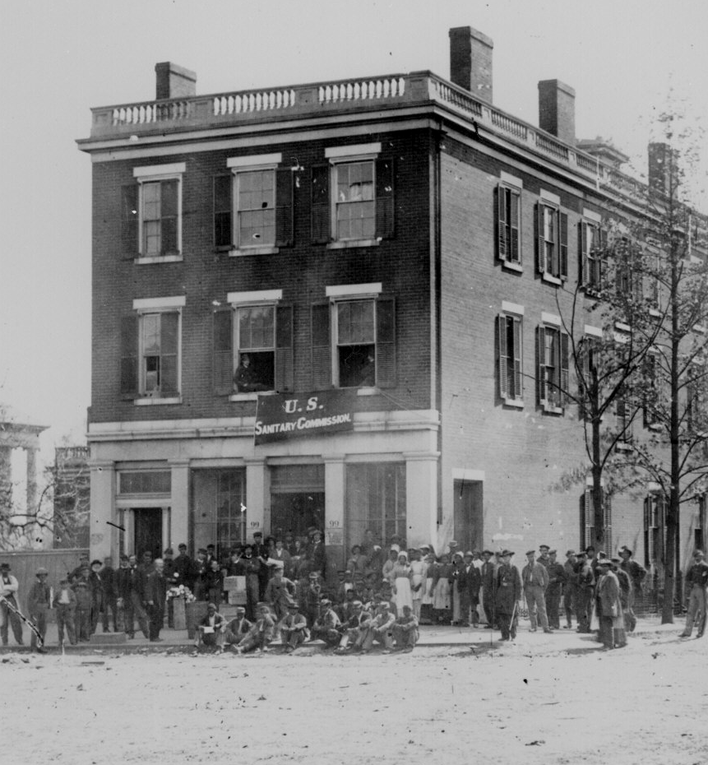
Chicago
Regional Hub
Mary Livermore
7,000 Ladies Aid Societies

Slide 18
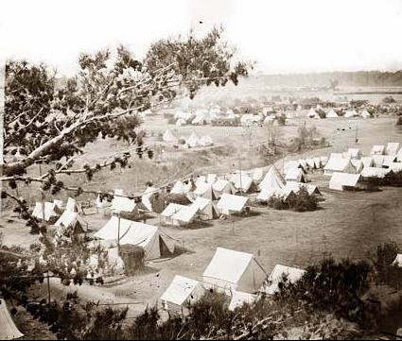
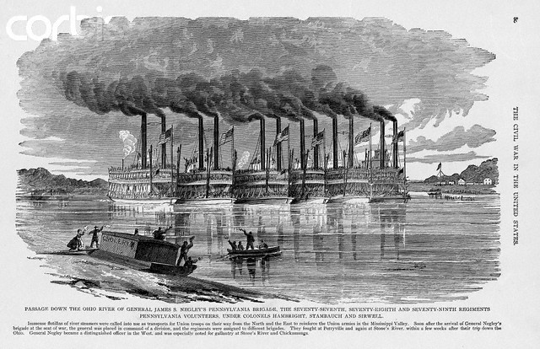
Inspect camps, hospital and transportation
Most of them had no experience whatever of campaigning and their knowledge of a soldier’s duty was confined to the requirements of a holiday parade. (Charles Stillé, Official Historian, USSC 1866,p. 21).
Primarily Men

Slide 19
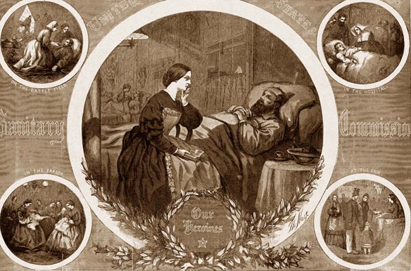
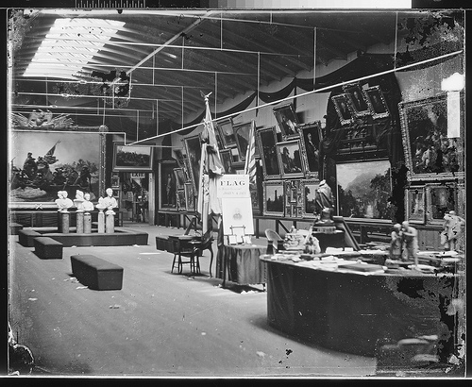
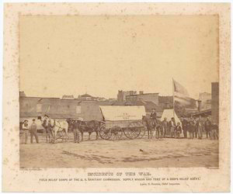
Fund raising – sanitary fairs
$25 Million
Nurse made $3 week (90 hour week)
8.33 million weeks of nursing time

Slide 20
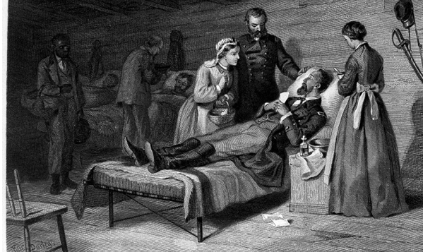
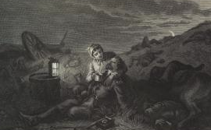
Nursing
Dix required nurses “be over thirty years of age, plain almost to repulsion in dress, and devoid of personal attractions” (Livermore, 1887, 246).
Mature women – Mother role
use the moral authority of Mother to serve the Union’s Sons
Clean bedding, Clean clothes, Good food

Slide 21
Inspect Camps & Hospital

Slide 22
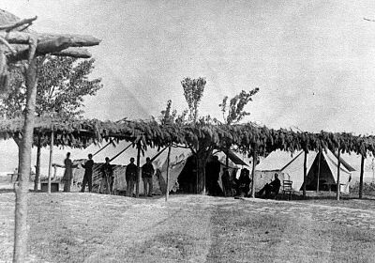
Civil War Hospital

Slide 23
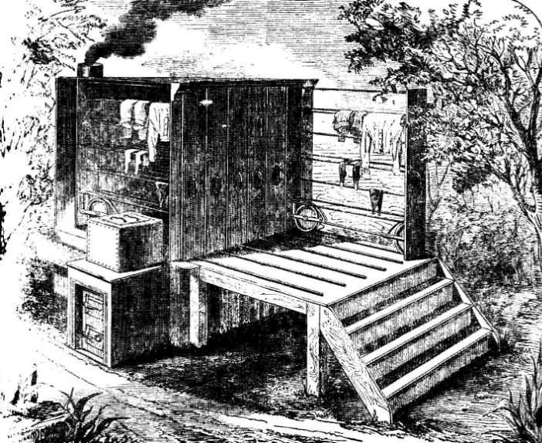
Hospital Dryer
Notes:
A snapshot and behind the scene insight. To staff and supply – keep the hospitals going need to be able to dry the clothes and sheets. This is what they used.

Slide 24
Supply Transport
Wounded Soldier Transport

Slide 25
US Sanitary Commission
Inspection – Camps/hospitals
Relief Supplies
Convalescence homes
Nursing sick
Collect Supplies
Messages to families
Gardens to feed sick
Warehouse supplies
Deliver Supplies
Fundraising
Transport Wounded
Widows relief
Sanitary Fairs
Managed by women
Notes:
This shows how the activities and role of the USSC grew with the war. Non-profits have the ability to morph into all kinds of activities.

Slide 26
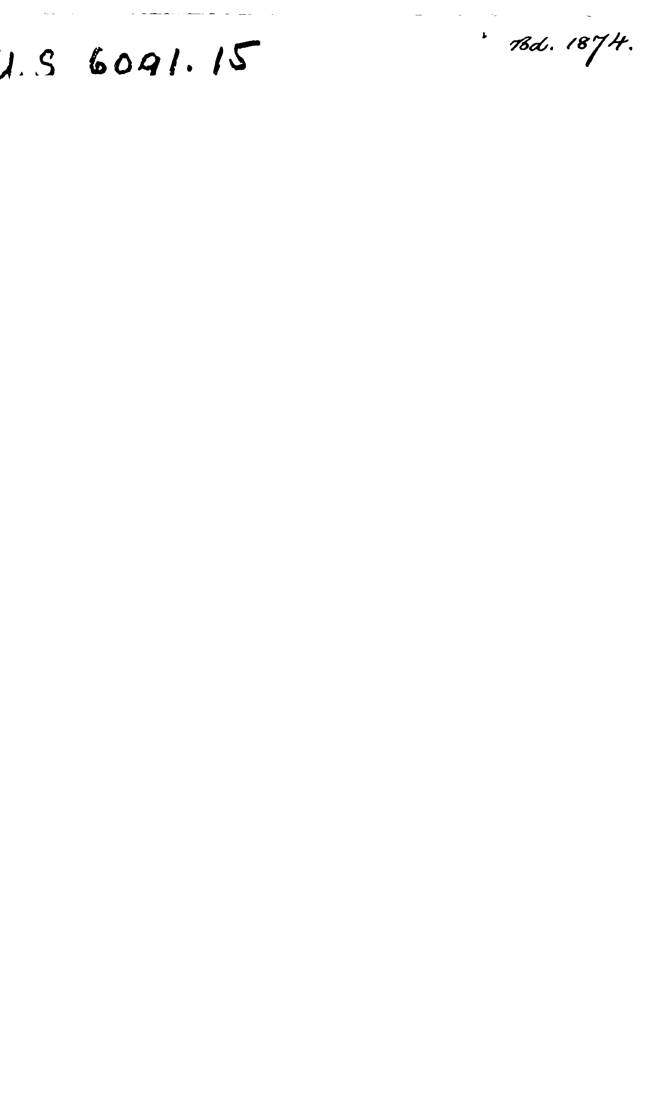

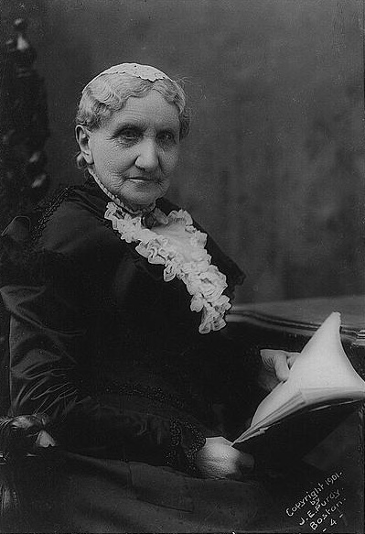
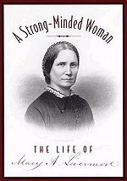
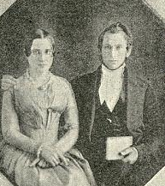
I registered a vow that when the war was over I would take up a new work – the work of making law and justice synonymous for women. I have kept my vow religiously (Livermore 1887/1995, 437).
Mary and Daniel Livermore
Most tangible accomplishment
– Better education for young women – established colleges (non-profit) for women. Jane Addams went to a college established by Livermore.
Intangible accomplishments
Greater acceptance of women’s competency
Missing link between female activism of the early 1800 and successful mass successful women’s movements of late 19th & early 20th century
EXPANDED WOMEN’S SPHERE - Open Door For Settlement women
Mary Livermore 1920 - 1905

Slide 27
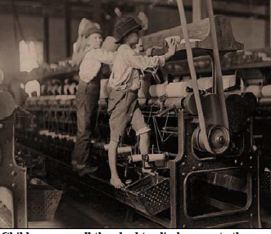
Urbanization & Industrialization
Sanitation
Labor
and factory abuses
Child welfare
Notes:
The Settlement movement – spearheaded by women had the tools to tackle reforms called for by urbanization and industrialization.

Slide 28
Reform
Faith
War/Disaster
Hospitals
Sanitation
Service

Slide 29

REFORM
Youth – child labor laws
Juvenile justice system
Labor/working conditions
Sanitation - garbage
Democracy …. affords a rule of
living as well as a test of faith
(Addams, 1902, p. 6).
Notes:
The themes of Faith (in democracy) reform and sanitation problems come to bear.

Slide 30
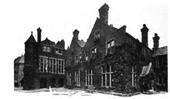
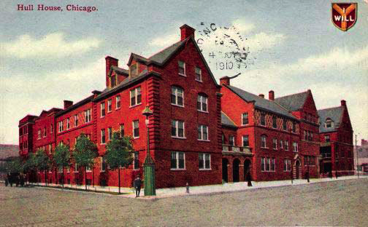
Settlement Movement
Toynbee Hall , England
Hull House, Chicago
Both non-profit organizations
Notes:
Settlement movement began in England. Toynbee Hall. Jane Addams visited Toynebee hall and was inspired to join the movement and establish Hull House.

Slide 31
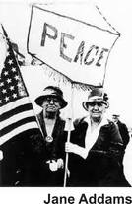
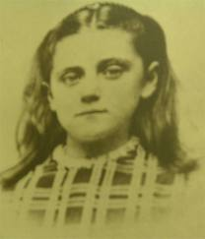
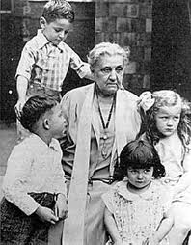
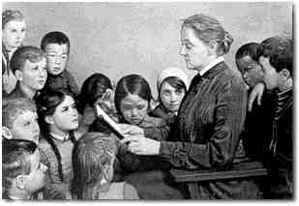
Jane Addams 1860-1935
Founder Settlement Movement
Founder American Pragmatism
Woman of Action
Woman of Ideas

Slide 32
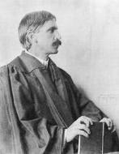
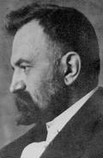
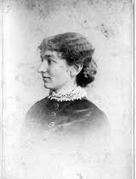
John Dewey
Hull House 1889 – 1940+
Community Center
Kindergarten/nursery
Social Reform
Scientific Inquiry
George Herbert Mead
Ellen Gates Starr

Slide 33
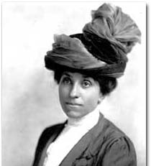
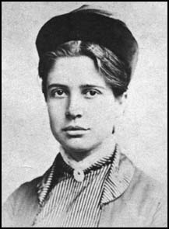
Hull-House Maps and
Papers (1895)
Julia Lathrop
Florence Kelly
Kelley. “The Sweating System”
Kelley & Stevens. “Wage Earning Children”
Lathrop. “The Cook County Charities”

Slide 34

Mapped the neighborhood
Around Hull House

Slide 35
Kelley, Florence. 1970/1895 “The Sweating System,” in Hull-House Maps and Papers pp. 27-48. Authored by Residents of Hull House. New York: Arno Press.
Kelley, Florence and Stevens, Alzina. 1970/1895. “Wage Earning Children,” in Hull-House Maps and Papers pp. 49-78. Authored by Residents of Hull House. New York: Arno Press.
Lathrop, Julia. 1970/1895. “The Cook County Charities, “The Cook County Charities,” in Hull-House Maps and Papers pp. 143-164. Authored by Residents of Hull House. New York: Arno Press.
Linn, James. Jane Addams: A Biography. New York: Greenwood Press. 1968.
Livermore, Mary. [1887] 1995. My Story of the War: The Civil War Memories of the Famous Nurse, Relief Organizer and Suffragette. New York: Da Capo Press.
Livermore, M. 1891. “Cooperative Womanhood in the State.” North American Review 153, 418(September): 283-295.
Livermore, M. 1895. “Massachusetts Women in the Civil War.” In Massachusetts in the Army and Navy during the War of 1816-65, ed. T. Higginson, 586-602. Boston: Wright and Potter.
Maxwell, William Q. 1956. Lincoln’s Fifth Wheel: The Political History of the United States Sanitary Commission. New York: Longmans, Green & Co.
McDonald. Lynn. 2001. “Florence Nightingale and the early origins of evidence-based nursing.” Evidence-Based Nursing Vol. 4. No. 3: 68-71.
The National Review. 1863. “Health of the British Army at Home and Abroad” Vol. 17 October: 323-338. [no Author – Summary of a set of Sanitary Condition Reports]
Neuhauser, Duncan. 1999. Florence Nightingale: Measuring Hospital Care Outcomes. Oakbrook terrace, IL: Joint Commission on Accreditation of Healthcare Organizations.
Nightingale, Florence. 1858. Notes on Matters Affecting the Health, Efficiency and Hospital Administration of the British Army, Founded Chiefly on the Experience of the Late War. London: Harrison and Sons. Reprinted in Neuhauser.
Nightingale, Florence. [1860] 1922. Notes on Nursing: What it is, and What it is Not. New York: D. Appleton and Company
Nightingale, Florence 1862. Army Sanitary Administration and its Reform under the Late Lord Herbert. London: McCorquodale & Co.
Nightingale, Florence, 1863. Notes on Hospitals (3rd Edition enlarged and for the most part rewritten). London: Longman, Green Longman, Roberts and Green.
Pacey, Lorene. 1950. Readings in the Development of Settlement Work. New York: Associated Press.
Rejean, Attie. 1987. ‘A Swindling Concern’: The United States Sanitary Commission and the Northern Female Public, 1861-1865” PhD Dissertation Columbia University.
Residents of Hull House. 1895. Hull-House Maps and Papers: A Presentation of Nationalities and Wages in congested District of Chicago. New York: Thomas Y. Crowell & Co.
Reverby, Susan. 1987. “A Caring Dilemma: Womanhood and Nursing in Historical Perspective.” Nursing Research 36(1)5-?
Sanitary Commission of the United States Army. [1864] 1972. A Succinct Narrative of Its Works and Purposes. New York: Arno Press and the New York Times.
Schultz, Jane. 2004. Women at the Front: Hospital Workers in Civil War America. Chapel Hill, NC: The University of North Carolina Press.
Seigfried, Charlene 1996. Pragmatism and feminism. Reweaving the Social Fabric. Chicago: The University of Chicago Press.
Skocpol, Theda. 1992. Protecting Soldiers and Mothers: The Political Origins of Social Policy in the United States. Cambridge MA: The Belknap Press of Harvard University Press.
Shields, Patricia. 2003. The Community of Inquiry: Classical Pragmatism and Public Administration. Administration & Society 35(5): 510-538.
Shields, Patricia. 2004. Mary Livermore: A Legacy of Caring and Cooperative Womanhood in Service to the State. In Outstanding Women in Pubic Administration: Leaders, Mentors, and Pioneers edited by Claire Felbinger, Claire and Wendy Hanes. New York: M.E. Sharpe.
Silber, N. 1995. “Introduction.” In My story of the War: The Civil War Memories of the Famous Nurse, Relief Organizer and Suffragette, ed. M. Livermore, i-xxi. New Your: Da Capo Press.
Stillé, Charles J. 1866. History of the United States Sanitary Commission: Being the General Report of its Work During the War of the Rebellion. Philadelphia: J. B. Lippincott & Co.
Stivers, Camilla. 2000. Bureau Men, Settlement women: Constructing Public Administration in the Progressive Era. Lawrence: University Press of Kansas.
Ulrich, Beth. 1997. Management and Leadership According to Florence Nightingale. Upper Saddle River, NJ: Prentice-Hall.
Venet, Wendy H. 2005. A Strong Minded Woman: The Life of Mary Livermore. Amherst: University of Massachusetts Press.
Women’s Central Association of Relief, New York. 1863. How can We Best Help Our Camps and Hospitals? New York: Wm. C Bryant & Co.
Wood, A. 1972. “The War Within a War: Women Nurses in the Union Army,” Civil War History 18, no. 3 (September): 197-212.
Wormeley, Katherine Prescott. 1898. The Cruel Side of War. Boston: Roberts Brothers.
Jane Addams in Hull House
Surrounded by Children

Slide 36
Florence
Nightingale
Jane Addams
Mary Livermore
Hope you have learned a little about the history of
non-profits through the lives of these women.
Notes:
The connection to women in PA. These are the three women who anchor the discussion to follow. All three are public administrators and non-profit administrators

Slide 37
References
Addams, Jane 1902. Democracy and Social Ethics. New York: Macmillan Co.
Addams, Jane 1910. Why Women Should Vote. Ladies Home Journal (1910) 27:21-22 in Selected Articles on Woman Suffrage compiled by Edith Phelps pp. 173-183. Minneapolis: The HW. Wilson Company.
Addams, Jane. 1930/1910. Twenty Years at Hull-House. New York. McMillan Co.
Breyton, Mary and Ellen Terry. 1869. Our Acre and Its Harvest: Historical Sketch of the Soldiers’ Aid Society of Northern Ohio, Cleveland Branch of the United States Sanitary Commission, Cleveland: Fairbanks, Benedict and Co.
Brasseur, Lee. 2005. Florence Nightingale’s visual Rhetoric in the Rose Diagrams. Technical Communication Quarterly, 14(2), 161-182.
Cott, Nancy F. 1977. The Bonds of Womanhood: ‘Women’s Sphere’ in New England, 1780-1835. New Haven: Yale University Press.
Deegan, M. 1990. Jane Addams, and the Men of the Chicago School. New Brunswick: Transaction Books
Elshtain, Jean B. 2002. Jane Addams and the Dream of American Democracy. New York: Basic Books
Elshtain, Jean Bethke. 2001. Jane Addams and the social claim. The Public Interest 145 (Fall): 82-92.

Slide 38
Gatlin, Heather. 2006. The Search for a Theoretical Framework for long-Term Disaster Recovery Efforts: A Normative Application of Jane Addams Social Democratic Theory and Ethics. Applied Research Project. Texas State University.
Giesberg, Judith. 2000. Civil War Sisterhood: The U. S. Sanitary Commission and Women’s Politics in Transition. Boston: Northeastern University Press.
Hobbs, Colleen. 1997. Florence Nightingale. New York. Twayne Publishers.
Holbrook, Agnes. 1970/1895. “Map Notes and Comments” in Hull-House Maps and Papers pp.3-26. Authored by Residents of Hull House. New York: Arno Press.
Hoge, A. H. 1867. The Boys in Blue: or Heroes of the Rank and File. New York: E. B. Treat & Co.
Kelley, Florence. 1970/1895 “The Sweating System,” in Hull-House Maps and Papers pp. 27-48. Authored by Residents of Hull House. New York: Arno Press.
Kelley, Florence and Stevens, Alzina. 1970/1895. “Wage Earning Children,” in Hull-House Maps and Papers pp. 49-78. Authored by Residents of Hull House. New York: Arno Press.
Kurian, George and Chernow, Barbara (eds.) 2007. DATAPEDIA of the United States: American History in Numbers. Lanham, MD: Bernan Press.
Lathrop, Julia. 1970/1895. “The Cook County Charities, “The Cook County Charities,” in Hull-House Maps and Papers pp. 143-164. Authored by Residents of Hull House. New York: Arno Press.
Linn, James. Jane Addams: A Biography. New York: Greenwood Press. 1968.

Slide 39
Livermore, Mary. [1887] 1995. My Story of the War: The Civil War Memories of the Famous Nurse, Relief Organizer and Suffragette. New York: Da Capo Press.
Livermore, M. 1891. “Cooperative Womanhood in the State.” North American Review 153, 418(September): 283-295.
Livermore, M. 1895. “Massachusetts Women in the Civil War.” In Massachusetts in the Army and Navy during the War of 1816-65, ed. T. Higginson, 586-602. Boston: Wright and Potter.
Maxwell, William Q. 1956. Lincoln’s Fifth Wheel: The Political History of the United States Sanitary Commission. New York: Longmans, Green & Co.
McDonald. Lynn. 2001. “Florence Nightingale and the early origins of evidence-based nursing.” Evidence-Based Nursing Vol. 4. No. 3: 68-71.
The National Review. 1863. “Health of the British Army at Home and Abroad” Vol. 17 October: 323-338. [no Author – Summary of a set of Sanitary Condition Reports]
Neuhauser, Duncan. 1999. Florence Nightingale: Measuring Hospital Care Outcomes. Oakbrook terrace, IL: Joint Commission on Accreditation of Healthcare Organizations.
Nightingale, Florence. 1858. Notes on Matters Affecting the Health, Efficiency and Hospital Administration of the British Army, Founded Chiefly on the Experience of the Late War. London: Harrison and Sons. Reprinted in Neuhauser.
Nightingale, Florence. [1860] 1922. Notes on Nursing: What it is, and What it is Not. New York: D. Appleton and Company.
Nightingale, Florence 1862. Army Sanitary Administration and its Reform under the Late Lord Herbert. London: McCorquodale & Co.

Slide 40
Nightingale, Florence, 1863. Notes on Hospitals (3rd Edition enlarged and for the most part rewritten). London: Longman, Green Longman, Roberts and Green.
Pacey, Lorene. 1950. Readings in the Development of Settlement Work. New York: Associated Press.
Rejean, Attie. 1987. ‘A Swindling Concern’: The United States Sanitary Commission and the Northern Female Public, 1861-1865” PhD Dissertation Columbia University.
Residents of Hull House. 1895. Hull-House Maps and Papers: A Presentation of Nationalities and Wages in congested District of Chicago. New York: Thomas Y. Crowell & Co.
Reverby, Susan. 1987. “A Caring Dilemma: Womanhood and Nursing in Historical Perspective.” Nursing Research 36(1)
Sanitary Commission of the United States Army. [1864] 1972. A Succinct Narrative of Its Works and Purposes. New York: Arno Press and the New York Times.
Schultz, Jane. 2004. Women at the Front: Hospital Workers in Civil War America. Chapel Hill, NC: The University of North Carolina Press.
Skocpol, Theda. 1992. Protecting Soldiers and Mothers: The Political Origins of Social Policy in the United States. Cambridge MA: The Belknap Press of Harvard University Press.
Shields, Patricia. 2004. Mary Livermore: A Legacy of Caring and Cooperative Womanhood in Service to the State. In Outstanding Women in Pubic Administration: Leaders, Mentors, and Pioneers edited by Claire Felbinger, Claire and Wendy Hanes. New York: M.E. Sharpe.

Slide 41
Shields, P. M. (2003). The community of inquiry: Classical pragmatism and public administration.
Administration & Society, 35(5), 510-538.
Shields, P. (2006). Democracy and the social feminist ethics of Jane Addams: A vision for Public Administration.
Administrative Theory & Praxis 28(3), 418-443.
Shields, P. and Rangarajan, N. (2011). Public Service Professionals: The Legacy of Florence Nightingale,
Mary Livermore and Jane Addams in Menzel, D and White, J. (eds.) The State of Public Administration:
Issues Challenges and Opportunities. Taylor and Francis
Shields, P. (2017). Jane Addams: Pioneer in American Sociology, Social Work and Public Administration.
In Shields, P. (ed) Jane Addams: Progressive Pioneer of Peace, Philosophy, Sociology, Social Work and
Public Administration. pp. 43-67. Springer.

Slide 42
Silber, N. 1995. “Introduction.” In My story of the War: The Civil War Memories of the Famous Nurse, Relief Organizer and Suffragette, ed. M. Livermore, i-xxi. New Your: Da Capo Press.
Stillé, Charles J. 1866. History of the United States Sanitary Commission: Being the General Report of its Work During the War of the Rebellion. Philadelphia: J. B. Lippincott & Co.
Stivers, Camilla. 2000. Bureau Men, Settlement women: Constructing Public Administration in the Progressive Era. Lawrence: University Press of Kansas.
Ulrich, Beth. 1997. Management and Leadership According to Florence Nightingale. Upper Saddle River, NJ: Prentice-Hall.
Venet, Wendy H. 2005. A Strong Minded Woman: The Life of Mary Livermore. Amherst: University of Massachusetts Press.
Women’s Central Association of Relief, New York. 1863. How can We Best Help Our Camps and Hospitals? New York: Wm. C Bryant & Co.
Wood, A. 1972. “The War Within a War: Women Nurses in the Union Army,” Civil War History 18, no. 3 (September): 197-212.
Wormeley, Katherine Prescott. 1898. The Cruel Side of War. Boston: Roberts Brothers.

Slide 43


A, Popularized illustration, first printed in theIllustrated London News in 1855, of Florence Nightingale touring the wards of Barracks Hospital (copyright held and used with permission by the Florence Nightingale Museum [London, United Kingdom]).B, Photograph of the actual paper concertina lantern made for and used by Nightingale in 1855 (used with the courtesy of the Director of the National Army Museum [London]).
Gill C J , and Gill G C Clin Infect Dis. 2005;40:1799-1805
© 2005 by the Infectious Diseases Society of America
Notes:
A, Popularized illustration, first printed in theIllustrated London News in 1855, of Florence Nightingale touring the wards of Barracks Hospital (copyright held and used with permission by the Florence Nightingale Museum [London, United Kingdom]).B, Photograph of the actual paper concertina lantern made for and used by Nightingale in 1855 (used with the courtesy of the Director of the National Army Museum [London]). The popular depictions of Nightingale with an open flame lantern reflect the near absence of accurate portraits and the complete absence of photographs of her during the period of the Crimean War.

