Slide 1

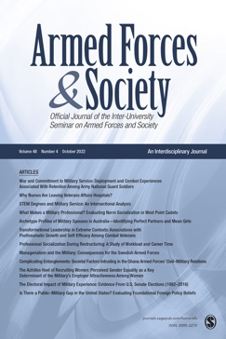

The Afghanistan War through the Pages of Armed Forces & Society
An Editors Perspective
Patricia M. Shields
Texas State University
Editor-in-Chief
Armed Forces & Society
Ottawa October 21-23, 2022

Slide 2
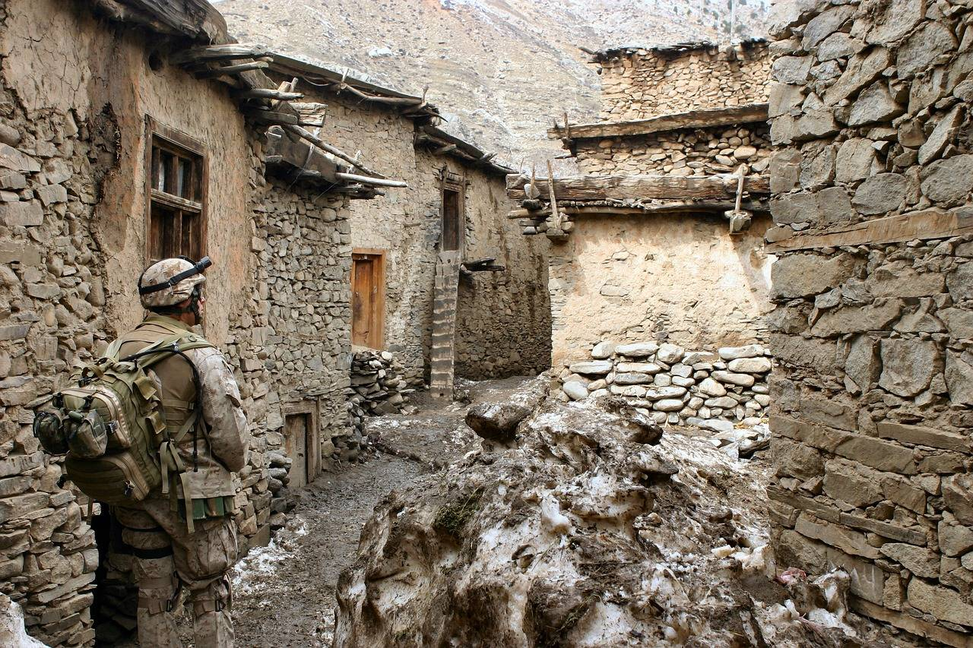
Virtual Special Issue – Aug 2022
13 commentary on Afghanistan war
this paper part of this special issue
How did the War influence the content of AF&S?
A complete list of the commentary can
be found at the end of this ppt

Slide 3

Journal like a forest
Editor Steward of forest

Slide 4
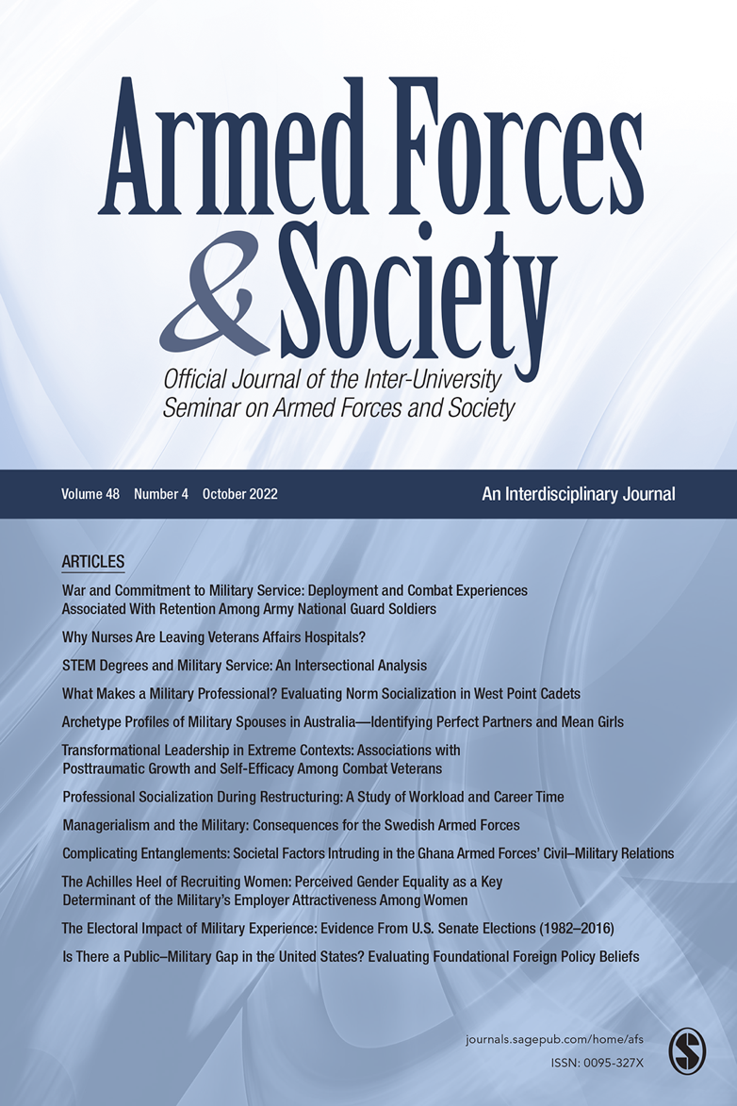
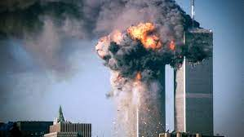
Began Editing – Feb. 2001
Sept. 2001

Slide 5
Afghanistan War Timetable
Important Dates | Influential Events
September 2001 | Attack on US by terrorists
October 2001 | US and British Air campaign in Afghanistan to root out al-Qaida Operation Enduring Freedom
December 2001 | International Security Assistance Force (ISAF) begun (Multinational force) Mandated by UN
March 2003 | Iraq war begins
August 2003 | NATO takes over ISAF –.
2006 | ISAF expanded to cover the whole country. Nation building mission
2007 - 2008 | Insurgency grows
2009 | New counter insurgency launched 40,000 new troops
December 2011 | Iraq war ends
December 2014 | ISAF ended as did NATO’s responsibility.
January 2015 | NATO launched Resolute Support Mission - training the Afghan security forces
February 2020 | US and Taliban sign agreement to withdraw international forces by May 2021
August 2021 | Withdrawal of forces. Evacuation of 120,000 people airlifted from the Afghanistan airport.

Slide 6
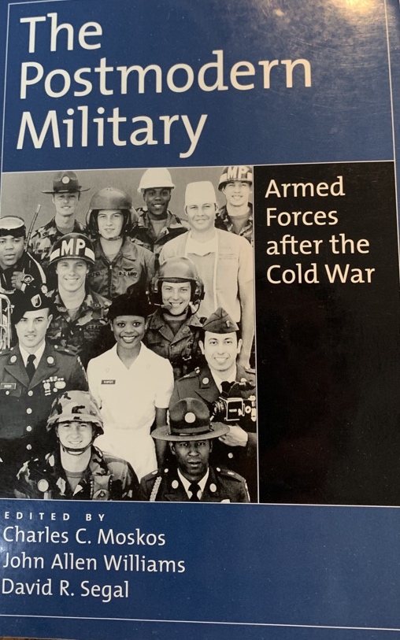
Postmodern Military
Volunteer Force
New missions – small wars
Multinational divisions –
led international organizations
Biggest Test

Slide 7
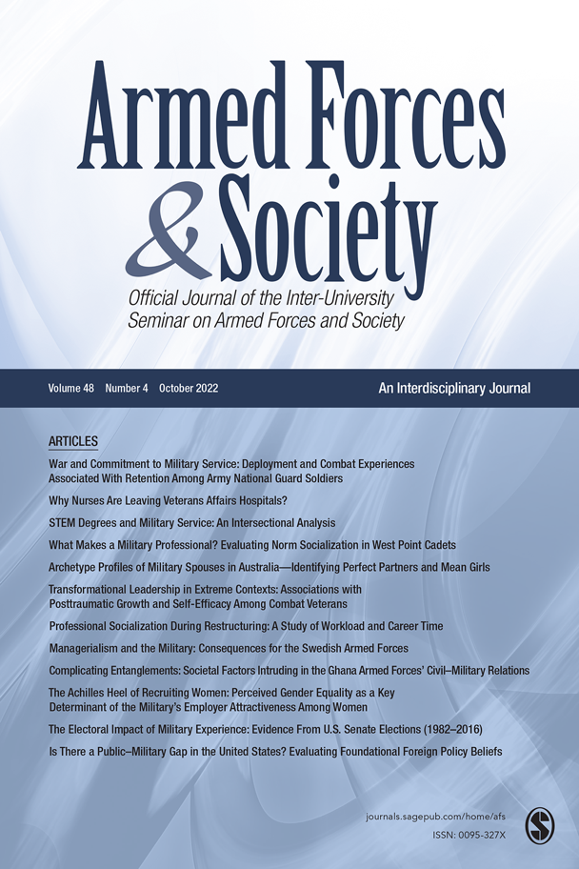
How was this test reflected in the
pages of Armed Forces & Society?
International contributions increased

Slide 8


Reviewed all titles every volume
(2002 – 2021)
Printed abstracts of Afghanistan related articles
Sorted the abstracts into piles (topics that adhere)
Labeled the piles
Used labels to do search of website - find additional articles
Find list of articles used end of ppt
My reflections as the decision-maker

Slide 9

Key themes
Lives of service members
How military organizations responded
Public Opinion
Civil Military Relations
Dark Outliers

Slide 10
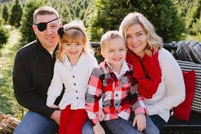
Lives of Service members
Veterans Literature
Traditional themes Transition to civilian life with
greater emphasis – PTSD, Disabilities and suicide
more papers on women veterans
Military Families (highly cited)
Emphasized the stress associated with multiple deployments
Physical and Mental Health
Prior to war, seldom got a paper on health – Major shift (2015- 2021)
Physical & Mental health
Cross category complication – Health of veterans, service members, contractors
Physical and Mental Health
Prior to war, seldom got a paper on health – Major shift (2015- 2021)
Physical & Mental health
Cross category complication – Health of veterans, service members, contractors

Slide 11
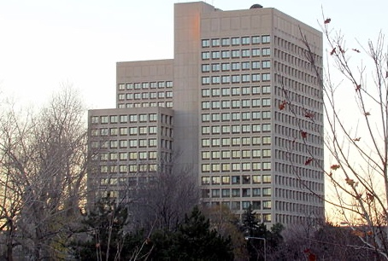
How the Institution Responded AVF smaller force
Reserve forces
Marked uptick in this topic -- Two special issues (2011/2021)
Topics began to mirror the force – retention, health, family
Transmigrant
Contractor – private security
Effectiveness of contractors, hidden costs as move closer to deployed forces
Missing voices -- motivation, medical care, new veterans
Unique data – contractor deaths (secret proprietary info)

Slide 12
How the Institution Responded
nature of war
Small, Unconventional, Multilateral War
evolving approaches – mindset
Soldiers role, diplomat, peacekeeper…
Relationships with host nationals –
interpreters/linguists
Challenges of managing –
New questions/ Old questions new context

Slide 13
New questions/ Old questions new context
What skills are needed? Norway
What are soldier roles in this environment? Germany
What kind of training is needed for unconventional war? USA
What factors influence leadership acceptance? The Netherlands
What are new ways to manage the situation? The Netherlands
How does the notion of professionalism change? Australia
How is power understood? UK
Why do soldiers fight? USA
How do we integrate Nongovernmental Organizations into the mix? Turkey
How do civilians cope? USA
What are the emotional dimensions of intercultural interactions? The Netherlands
How was minority representation effected? Armor and Gilroy? USA
What is the nature of victory? USA
17 articles 2 issues+

Slide 14
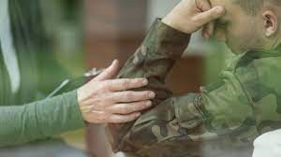
Public Opinion
Public support or lack of support for war
Returning veterans media characterization
Hero
Victim
Veterans reaction to media characterization

Slide 15
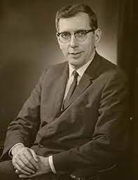
Civil Military Relations
Case of Shirking General Shinseki’s congressional testimony
Military Covenant
UK changed in response to war – improved medical care
Janowitz – greater applicability
pragmatism
small war context
Constabulary force

Slide 16
Dark Themes
Green on blue murder
ISAF caused civilian casualties
Torture
War traumatized offenders – Military Catch 22

Slide 17
Postmodern Military
Volunteer Forces Major adjustments
multiple deployments (PTSD health)
reserve forces
contractors
New missions – small wars
Multinational
Management challenges
New roles
Janowitz perspective compatible
Biggest Test

Slide 18
Check out the virtual Issue!
https://journals.sagepub.com/topic/collections-afs/afs-1_perspectives_on_the_afghanistan_war/afs

Slide 19
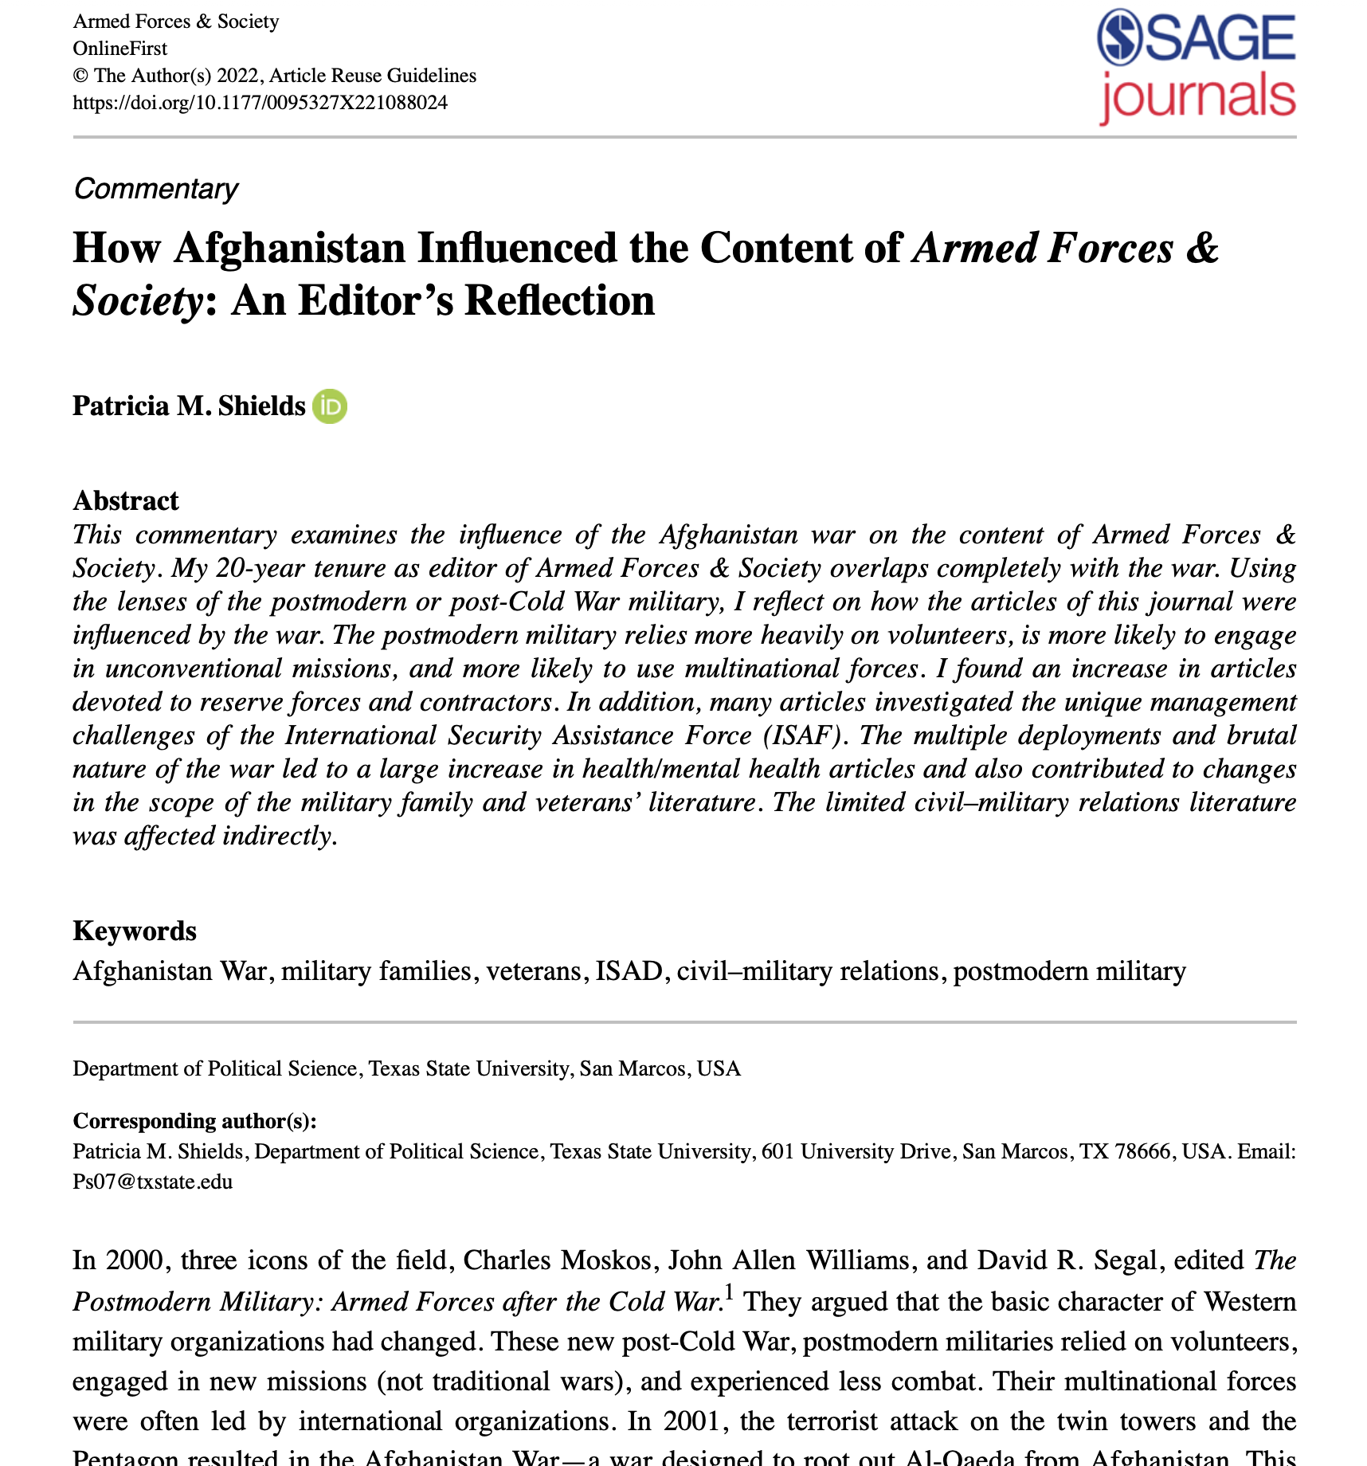
Find complete article
https://journals.sagepub.com/doi/full/10.1177/0095327X221088024
AF&S website search
Key words -- Shields Afghanistan

Slide 20
References used in the analysis
Andres, M. D., & Moelker, R. (2011). There and back again: How parental experiences affect children’s adjustments in the course of military deployments. Armed Forces & Society, 37(3), 418-447.
Armor, D. J., & Gilroy, C. L. (2010). Changing minority representation in the US military. Armed Forces & Society, 36(2), 223-246.
Arsenault, E. G., & Chiang, C. (2020). The US department of defense and its torture program. Armed Forces & Society, 46(2), 191-213.
Azari, J., Dandeker, C., & Greenberg, N. (2010). Cultural stress: How interactions with and among foreign populations affect military personnel. Armed Forces & Society, 36(4), 585–603.
Bailey, A. K., Drury, M. B., & Grandy, H. (2019). Student veterans’ academic performance before and after the Post–9/11 GI Bill. Armed Forces & Society, 45(1), 101-121.
Bennett, S. E., & Flickinger, R. S. (2009). Americans' knowledge of US military deaths in Iraq, April 2004 to April 2008. Armed Forces & Society, 35(3), 587-604.
Berndtsson, J., Dandeker, C., & Ydén, K. (2015). Swedish and British public opinion of the armed forces after a decade of war. Armed Forces & Society, 41(2), 307-328.
Blair, J. D., Stanley, J., & Whitehead, C. J. (1992). A stakeholder management perspective on military health care. Armed Forces & Society, 18(4), 548-575.
Bierman, A., & Kelty, R. (2018). Subjective Cohesion as Stress Buffer Among Civilians Working with the Military in Iraq and Afghanistan. Armed Forces & Society, 44(2), 238–260. https://doi.org/10.1177/0095327X17707203
Brænder, M. (2016). Adrenalin junkies: Why soldiers return from war wanting more. Armed Forces & Society, 42(1), 3-25.
Bryan, C. J., Wood, D., Applegarth, M., & Bryan, A. O. (2020). Subtypes of Mental Health Stigma and Barriers to Care Among National Guard Personnel: Results of a Latent Class Analysis. Armed Forces & Society, 46(3), 424-437.

Slide 21
Burdett, H., Woodhead, C., Iversen, A. C., Wessely, S., Dandeker, C., & Fear, N. T. (2013). “Are you a veteran?” Understanding of the term “veteran” among UK ex-service personnel: A research note. Armed Forces & Society, 39(4), 751-759.
Burrelli, D. F. (1992). HIV-1/AIDS and US military manpower policy. Armed Forces & Society, 18(4), 452-475.
Bury, P. (2017). Recruitment and Retention in British Army Reserve Logistics Units. Armed Forces & Society, 43(4), 608–631. https://doi.org/10.1177/0095327X16657320
Bury, P. (2019). The Changing Nature of Reserve Cohesion: A Study of Future Reserves 2020 and British Army Reserve Logistic Units. Armed Forces & Society, 45(2), 310–332. https://doi.org/10.1177/0095327X17728917
Camacho, P. R. (2007). Veterans and veteran’s issues. Armed Forces & Society, 33(3), 313–315.
Camacho, P. R., & Hauser, W. L. (2007). Civil–Military Relations—Who Are the Real Principals? A Response to “Courage in the Service of Virtue: The Case of General Shinseki's Testimony before the Iraq War”. Armed Forces & Society, 34(1), 122-137.
Camacho, P. (2010). A forum on privatization with comments on the relevant literature found in Armed Forces & Society. Armed Forces & Society, 36(4), 647-659.
Canan-Sokullu, E. Ş. (2012). Domestic support for wars: a cross-case and cross-country analysis. Armed Forces & Society, 38(1), 117-141.
Campbell, D. J., & Campbell, K. M. (2010). Soldiers as police officers/police officers as soldiers: Role evolution and revolution in the United States. Armed Forces & Society, 36(2), 327-350.
Canby, S. L. (1978). European Mobilization: U.S. and NATO Reserves. Armed Forces & Society, 4(2), 227–244.
Chew, E. (2014). How big powers fight small wars: Contending traditions of asymmetry in the British and American ways of war. Armed Forces & Society, 40(1), 17-48.
Cochran, S. T. (2014). The Civil–Military Divide in protracted small war: An alternative view of military leadership preferences and war termination. Armed Forces & Society, 40(1), 71-95.
Coletta, D. (2007). Courage in the Service of Virtue: The Case of General Shinseki's Testimony before the Iraq War. Armed Forces & Society, 34(1), 109-121.
Cohn, L. P. (2011). It Wasn’t in My Contract: Security Privatization and Civilian Control. Armed Forces & Society, 37(3), 381–398. https://doi.org/10.1177/0095327X10388135
Cooper, L., Caddick, N., Godier, L., Cooper, A., & Fossey, M. (2018). Transition from the military into civilian life: An exploration of cultural competence. Armed Forces & Society, 44(1), 156-177.

Slide 22
Crosbie, T., & Kleykamp, M. (2018a). Fault lines of the American military profession. Armed Forces & Society, 44(3), 521-543.
Crosbie, T., & Kleykamp, M. (2018b). Ethical lapses and the military profession: Three problems and a solution. Armed Forces & Society, 44(4), 748-757.
Crowley, K., & Sandhoff, M. (2017). Just a girl in the army: US Iraq war veterans negotiating femininity in a culture of masculinity. Armed Forces & Society, 43(2), 221-237.
Dandeker, C., Wessely, S., Iversen, A., & Ross, J. (2006). What's in a name? Defining and caring for “Veterans” the United Kingdom in international perspective. Armed Forces & Society, 32(2), 161-177.
Dandeker, C., Eversden-French, C., Greenberg, N., Hatch, S., Riley, P., van Staden, L., & Wessely, S. (2010). Laying Down Their Rifles: The changing influences on the retention of volunteer British army reservists returning from Iraq, 2003—2006. Armed Forces & Society, 36(2), 264–289.
Dimiceli, E. E., Steinhardt, M. A., & Smith, S. E. (2010). Stressful experiences, coping strategies, and predictors of health-related outcomes among wives of deployed military servicemen. Armed Forces & Society, 36(2), 351-373.
Eichler, M. (2017). Add female veterans and stir? A feminist perspective on gendering veterans research. Armed Forces & Society, 43(4), 674-694.
Faulk, K. E., Gloria, C. T., Cance, J. D., & Steinhardt, M. A. (2012). Depressive symptoms among US military spouses during deployment: The protective effect of positive emotions. Armed Forces & Society, 38(3), 373-390.
Feinstein, Y. (2015). The thin line between “Crazy” and “Hero” Exploring the multiple statuses of US veterans in a work-therapy program. Armed Forces & Society, 41(1), 3-22
Firestone, J. M., & Harris, R. J. (2009). Sexual Harassment in the U.S. Military Reserve Component: A Preliminary Analysis. Armed Forces & Society, 36(1), 86–102.
Flores, D. (2017). Politicization beyond politics: Narratives and mechanisms of Iraq war veterans’ activism. Armed Forces & Society, 43(1), 164-182.
Fogarty, F. (2015). Backing the Bundeswehr: A research note regarding the state of German civil–military affairs. Armed Forces & Society, 41(4), 742-755.

Slide 23
Forster, A. (2012). The Military Covenant and British civil–military relations: Letting the genie out of the bottle. Armed Forces & Society, 38(2), 273-290.
Franke, V., & Von Boemcken, M. (2011). Guns for hire: Motivations and attitudes of private security contractors. Armed Forces & Society, 37(4), 725-742.
Giegerich, B., & von Hlatky, S. (2020). Experiences may vary: NATO and cultural interoperability in Afghanistan. Armed Forces & Society, 46(3), 495–516.
Griffith, J. (2005). Will Citizens Be Soldiers? Examining Retention of Reserve Component Soldiers. Armed Forces & Society, 31(3), 353–383. https://doi.org/10.1177/0095327X0503100303
Griffith, J. (2008). Institutional Motives for Serving in the U.S. Army National Guard: Implications for Recruitment, Retention, and Readiness. Armed Forces & Society, 34(2), 230–258. https://doi.org/10.1177/0095327X06293864
Griffith, J. (2009). After 9/11, What Kind of Reserve Soldier?: Considerations Given to Emerging Demands, Organizational Orientation, and Individual Commitment. Armed Forces & Society, 35(2), 214–240. https://doi.org/10.1177/0095327X07312490
Griffith, J. (2009a). Being a Reserve Soldier: A Matter of Social Identity. Armed Forces & Society, 36(1), 38–64.
Griffith, J. (2011). Reserve Forces—After the Cold War: An International Perspective. Armed Forces & Society, 37(2), 209–215.
Griffith, J. (2011a). Contradictory and Complementary Identities of U.S. Army Reservists: A Historical Perspective. Armed Forces & Society, 37(2), 261–283.
Griffith, J. (2011b). Reserve Identities: What Are They? And Do They Matter? An Empirical Examination. Armed Forces & Society, 37(4), 619–635.
Griffith, J., & Bryan, C. J. (2016). Suicides in the U.S. Military: Birth Cohort Vulnerability and the All-Volunteer Force. Armed Forces & Society, 42(3), 483–500. https://doi.org/10.1177/0095327X15614552
Griffith, J. (2020). Community service and voting among veterans and nonveterans using a national sample of college undergraduates. Armed Forces & Society, 46(2), 323-341.
Griffith, J., & Vaitkus, M. (2013). Perspectives on suicide in the Army National Guard. Armed Forces & Society, 39(4), 628-653.
Hajjar, R. M. (2010). A new angle on the US military’s emphasis on developing cross-cultural competence: Connecting in-ranks’ cultural diversity to cross-cultural competence. Armed Forces & Society, 36(2), 247-263.

Slide 24
Hajjar, R. M. (2014). Military warriors as peacekeeper–diplomats: building productive relationships with foreign counterparts in the contemporary military advising mission. Armed Forces & Society, 40(4), 647-672.
Hajjar, R. M. (2017). Effectively working with military linguists: Vital intercultural intermediaries. Armed Forces & Society, 43(1), 92–114.
Harrison, D., & Laliberté, L. (2008). The competing claims of operational effectiveness and human rights in the Canadian context. Armed Forces & Society, 34(2), 208-229.
Harrison, D., Robson, K., Albanese, P., Sanders, C., & Newburn-Cook, C. (2011). The Impact of Shared Location on the Mental Health of Military and Civilian Adolescents in a Community Affected by Frequent Deployments: A Research Note. Armed Forces & Society, 37(3), 550–560.
Hauser, W. L. (2006). How Not to Lose in Iraq: A Commentary on Dr. Alice Hills’s “Fear and Loathing in Falluja”. Armed Forces & Society, 32(4), 640-644.
Heinecken, L. (2003). Facing a Merciless Enemy: 1W/AIDS and the South African Armed Forces. Armed Forces & Society, 29(2), 281–300.
Heinecken, L. (2014). Outsourcing Public Security: The Unforeseen Consequences for the Military Profession. Armed Forces & Society, 40(4), 625–646.
Hills, A. (2006). Fear and loathing in Falluja. Armed Forces & Society, 32(4), 623-639.
Hines, L. A., Gribble, R., Wessely, S., Dandeker, C., & Fear, N. T. (2015). Are the armed forces understood and supported by the public? A view from the United Kingdom. Armed Forces & Society, 41(4), 688-713.
Hipes, C., Lucas, J. W., & Kleykamp, M. (2015). Status-and stigma-related consequences of military service and PTSD: Evidence from a laboratory experiment. Armed Forces & Society, 41(3), 477-495.
Hinojosa, R., Hinojosa, M. S., & Nguyen, J. (2019). Military service and physical capital: Framing musculoskeletal disorders among American military veterans using Pierre Bourdieu’s theory of cultural capital. Armed Forces & Society, 45(2), 268-290.
Holmes-Eber, P., Tarzi, E., & Maki, B. (2016). US marines’ attitudes regarding cross-cultural capabilities in military operations: A research note. Armed Forces & Society, 42(4), 741-751.
Hoiberg, A., & White, J. F. (1992). Health status of women in the armed forces. Armed Forces & Society, 18(4), 514-533.
Humensky, J. L., Jordan, N., Stroupe, K. T., & Hynes, D. M. (2013). How are Iraq/Afghanistan-era veterans faring in the labor market?. Armed Forces & Society, 39(1), 158-183.
Jansen M. & Delahaij R. Leadership acceptance through the lens of social identity theory: A case study of military leadership in Afghanistan. Armed Forces & Society. 2020;46(4):657-676.
Jans, N., & Frazer-Jans, J. (2009). Still the “pragmatic professional”? Pre-and post-9/11 professional orientation in the Australian military. Armed Forces & Society, 35(2), 241-265.

Slide 25
Kelty, R., & Bierman, A. (2013). Ambivalence on the front lines: Perceptions of contractors in Iraq and Afghanistan. Armed Forces & Society, 39(1), 5-27.
Kleykamp, M., Hipes, C., & MacLean, A. (2018). Who supports US veterans and who exaggerates their support?. Armed Forces & Society, 44(1), 92-115.
Kolditz, T. A. (2006). Research in In Extremis Settings: Expanding the critique of ‘Why They Fight.’ Armed Forces & Society, 32(4), 655–658.
Krueger, J. S., & Pedraza, F. I. (2012). Missing voices: War attitudes among military service-connected civilians. Armed Forces & Society, 38(3), 391-412.
Kysar-Moon, A., & Mustillo, S. (2019). Race/ethnicity and traumatic brain injury: Are there disparities in positive screenings and diagnoses among service members returning from Afghanistan and Iraq?. Armed Forces & Society, 45(1), 155-176.
Lammers, C. J. (2014). The American occupation regime in comparative perspective: the case of Iraq. Armed Forces & Society, 40(1), 49-70.
Landes, S. D., London, A. S., & Wilmoth, J. M. (2021). Service-connected disability and the veteran mortality disadvantage. Armed Forces & Society, 47(3), 457-479.
Lara-Cinisomo, S., Han, B., & Neuhausen, R. (2020). Exploring the Role of Depressive Symptoms, Service Members, and Spousal Demographic Characteristics on Military Spousal Employment. Armed Forces & Society, 46(3), 397-423.
Lomsky-Feder, E., Gazit, N., & Ben-Ari, E. (2008). Reserve Soldiers as Transmigrants: Moving between the Civilian and Military Worlds. Armed Forces & Society, 34(4), 593–614.
Linn, S., Linn, R., Segal, D. R., Sheps, S., Levi, L., & Revach, M. (1992). Life satisfaction among Israeli soldiers with penetrating head wounds. Armed Forces & Society, 18(4), 534-547.
MacCoun, R. J., Kier, E., & Belkin, A. (2006). Does social cohesion determine motivation in combat?: An old question with an old answer. Armed Forces & Society, 32(4), 646–654.
Mandel, R. (2007). Reassessing victory in warfare. Armed Forces & Society, 33(4), 461–495.
Mannitz, S. (2011). Redefining soldierly role models in Germany. Armed Forces & Society, 37(4), 680-700.
McCoy, K. E. (2010). Beyond civil—military relations: reflections on civilian control of a private, multinational workforce. Armed Forces & Society, 36(4), 671-694.
Moelker, R. (2014). The Genesis of the “Dutch approach” to asymmetric conflicts: Operations in Uruzgan and the “softly, softly” manner of approaching the Taleban. Armed Forces & Society, 40(1), 96–117.
Moradi, B., & Miller, L. (2010). Attitudes of Iraq and Afghanistan war veterans toward gay and lesbian service members. Armed Forces & Society, 36(3), 397-419.
Moskos, C., Williams, J., & Segal, D. (2000). The Postmodern Military: Armed Forces after the Cold War Oxford University Press. USA

Slide 26
Mustillo, S. A., & Kysar-Moon, A. (2017). Race, Gender, and Post-Traumatic Stress Disorder in the US Military: Differential Vulnerability?. Armed Forces & Society, 43(2), 322-345.
Neill-Harris, K. A., Resnick, S., Wilson-John, W. M., Miller-Stevens, K., Vandecar-Burdin, T., & Morris, J. C. (2016). Assessing partnerships between the military and civilian agencies to meet transitioning service members’ needs. Armed Forces & Society, 42(3), 585-604.
North Atlantic Treaty Organization (NATO). (2021a). ISAF’s mission in Afghanistan (2001 – 2014) (Archived). https://www.nato.int/cps/en/natohq/topics_69366.htm
North Atlantic Treaty Organization (NATO). (2021b). NATO and Afghanistan. https://www.nato.int/cps/en/natohq/topics_8189.htm
Oh, D., & Berry, F. S. (2021). The individual health insurance mandate and veterans’ health coverage. Armed Forces & Society, 47(2), 248-275.
Parrott, S., Albright, D. L., Dyche, C., & Steele, H. G. (2019). Hero, charity case, and victim: How US news media frame military veterans on Twitter. Armed Forces & Society, 45(4), 702-722.
Perez Jr, C. (2012). The soldier as lethal warrior and cooperative political agent: On the soldier’s ethical and political obligations toward the indigenous other. Armed Forces & Society, 38(2), 177-204.
Perliger, A. (2011). The changing nature of the Israeli reserve forces: Present crises and future challenges. Armed Forces & Society, 37(2), 216-238.
Petersohn, U. (2013). The effectiveness of contracted coalitions: Private security contractors in Iraq. Armed Forces & Society, 39(3), 467-488.
Popescu, I. (2019). Pragmatism and practicality: Rethinking US civil–military relations models for a turbulent era. Armed Forces & Society, 45(1), 198-205.
Prokos, A., & Cabage, L. N. (2017). Women military veterans, disability, and employment. Armed Forces & Society, 43(2), 346-367.
Resteigne, D., & Soeters, J. (2009). Managing militarily. Armed Forces & Society, 35(2), 307-332.
Rietjens, S. J. (2008). Managing civil-military cooperation: experiences from the Dutch provincial reconstruction team in Afghanistan. Armed Forces & Society, 34(2), 173-207.
Riley, J., & Gambone, M. D. (2016). Old wounds, new warriors: The problem of contractor medical care during and after contemporary American contingency operations. Armed Forces & Society, 42(2), 344-361.
Rothberg, J. M., Harris, J. J., Jellen, L. K., & Pickle, R. (1985). Illness and health of the US battalion in the Sinai MFO deployment. Armed Forces & Society, 11(3), 413-426.
Schut, M., De Graaff, M. C., & Verweij, D. (2015). Moral emotions during military deployments of Dutch forces: A qualitative study on moral emotions in intercultural interactions. Armed Forces & Society, 41(4), 616-638.
Scott, W. J. (1992). PTSD and Agent Orange: Implications for a sociology of veterans' issues. Armed Forces & Society, 18(4), 592-612.
Scott, W. J., McCone, D. R., & Mastroianni, G. R. (2009). The deployment experiences of Ft. Carson's soldiers in Iraq: Thinking about and training for full-spectrum warfare. Armed Forces & Society, 35(3), 460-476.

Slide 27
Seamone, E., Sreenivasan, S., McGuire, J., Smee, D., Clark, S., & Dow, D. (2018). A rehabilitative justice pathway for war-traumatized offenders caught in the military misconduct catch-22. Armed Forces & Society, 44(1), 139-155.
Shields, P. M. (2011). An American perspective on 21st Century expeditionary mindset and core values: A review of the literature. In Furst, H. and Kummel, G. (eds.) Core values and the expeditionary mindset: Armed forces in metamorphosis (pp. 15-35). Nomos Verlagsgesellschaft mbH & Co. KG.
Shields, P. M. (2020). Dynamic intersection of military and society. In ed. Sookermany, A. Handbook of military sciences, 1-23.
Shortland, N., Sari, H., & Nader, E. (2019). Recounting the dead: An analysis of ISAF caused civilian casualties in Afghanistan. Armed Forces & Society, 45(1), 122-139.
Shortland, N., Nader, E., Sari, H., Palasinski, M., & Hilland, C. (2019a). Murder on Maneuver: Exploring green-on-blue attacks in Afghanistan. Armed Forces & Society, 45(2), 368-388.
Sieg, H. M. (2014). How the transformation of military power leads to increasing asymmetries in warfare? From the battle of Omdurman to the Iraq Insurgency. Armed Forces & Society, 40(2), 332-356.
Simon, C. A., Lovrich, N. P., Liu, B., & Wei, Y. D. (2018). Citizen support for military expenditure post–9/11: Exploring the role of race, ethnicity, and place of birth. Armed Forces & Society, 44(4), 688-706.
Sirin, C. V. (2012). Public support for military interventions across levels of political information and stages of intervention: The case of the Iraq War. Armed Forces & Society, 38(2), 252-272.
Skomorovsky, A., & Bullock, A. (2017). The impact of deployment on children from Canadian military families. Armed Forces & Society, 43(4), 654-673.
Sookermany, A. M. (2011). The embodied soldier: Towards a new epistemological foundation of soldiering skills in the (post) modernized Norwegian armed forces. Armed Forces & Society, 37(3), 469-493.
Sookermany, A. M. (2012). What is a skillful soldier? An epistemological foundation for understanding military skill acquisition in (post) modernized armed forces. Armed Forces & Society, 38(4), 582-603.
Spera, C. (2009). Spouses' ability to cope with deployment and adjust to Air Force family demands: Identification of risk and protective factors. Armed Forces & Society, 35(2), 286-306.
Spera, C., Matto, H. C., & Travis, W. (2015). Research note: Satisfaction with Air Force way of life pre- and post-9/11. Armed Forces & Society, 41(4), 734–741.
Stanley, E. A., & Larsen, K. L. (2021). Difficulties with emotion regulation in the contemporary US Armed Forces: Structural contributors and potential solutions. Armed Forces & Society, 47(1), 77-105.
Swed, O., Kwon, J., Feldscher, B., & Crosbie, T. (2020). The corporate war dead: New perspectives on the demographics of American and British Contractors. Armed Forces & Society, 46(1), 3-24.
Swed, O., Sheehan, C. M., & Butler, J. S. (2020a). The digital divide and veterans’ health: Differences in self-reported health by internet usage. Armed Forces & Society, 46(2), 238-258.
Travis, D. S. (2017). Saving Samuel Huntington and the need for pragmatic civil–military relations. Armed Forces & Society, 43(3), 395-414.
Travis, D. S. (2018). Discovering the fault lines in American civil–military relations. Armed Forces & Society, 44(4), 731-747.

Slide 28
Travis, D. S. (2020). Decoding Morris Janowitz: Limited war and pragmatic doctrine. Armed Forces & Society, 46(1), 68-91.
Van Dijk, A., Soeters, J., & de Ridder, R. (2010). Smooth translation? A research note on the cooperation between Dutch service personnel and local interpreters in Afghanistan. Armed Forces & Society, 36(5), 917-925.
Van Slyke, R. D., & Armstrong, N. J. (2020). Communities serve: a systematic review of need assessments on US veteran and Military-Connected populations. Armed Forces & Society, 46(4), 564-594.
Van Winkle, E. P., & Lipari, R. N. (2015). The impact of multiple deployments and social support on stress levels of women married to active duty servicemen. Armed Forces & Society, 41(3), 395-412.
Vest, B. M. (2013). Citizen, Soldier, or Citizen-Soldier? Negotiating Identity in the US National Guard. Armed Forces & Society, 39(4), 602–627.
Vogel, J. A. (1992). Obesity and its relation to physical fitness in the US military. Armed Forces & Society, 18(4), 497-513.
Walker, D. I. (2013). Anticipating army exit: Identity constructions of final year UK career soldiers. Armed forces & society, 39(2), 284-304.
Weichong, O., & Chong, A. (2014). Waging “Small Wars” in the New Millennium: Chameleonic Missions and Virtual Aggression—An Introduction. Armed Forces & Society, 40(1), 3-16.
Wheeler, A. R., & Torres Stone, R. A. (2010). Exploring stress and coping strategies among National Guard spouses during times of deployment: A research note. Armed Forces & Society, 36(3), 545-557
White, A. (2018). Beyond Iraq: The socioeconomic trajectories of private military veterans. Armed Forces & Society, 44(3), 387-407.
Wolfe-Clark, A. L., & Bryan, C. J. (2017). Integrating two theoretical models to understand and prevent military and veteran suicide. Armed Forces & Society, 43(3), 478-499.
Wong, L. (2006). Combat motivation in today’s soldiers: U.S. Army War College Strategic Studies Institute. Armed Forces & Society, 32(4), 659–663.
Yalçınkaya, H. (2013). The nongovernmental organizations–military security collaboration mechanism: Afghanistan NGO Safety Office. Armed Forces & Society, 39(3), 489-510.
Zellman, G. L., Gates, S. M., Moini, J. S., & Suttorp, M. (2009). Meeting family and military needs through military child care. Armed Forces & Society, 35(3), 437-459.

