Slide 1
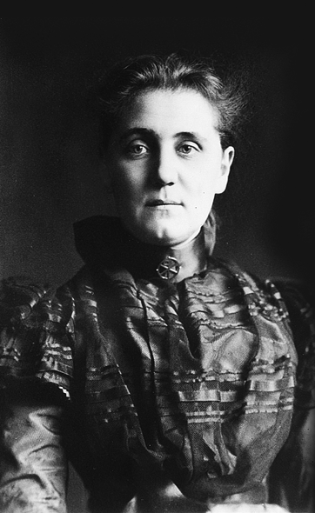
Recovering Jane Addams: Ethics, Social Work,
Social Justice and Peace
Patricia M. Shields
Professor Political Science
Texas State University
ps07@txstate.edu
October 5, 2017

Slide 2
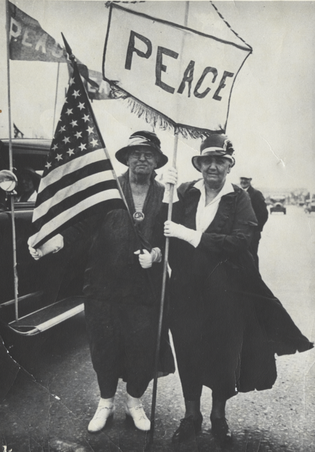
Logic of presentation
Who is Jane Addams
Jane Addams & Social Work
Philosophy – Social Justice/Peace
Peace movements & SW
My Story
Positive Peace & Peaceweaving

Slide 3
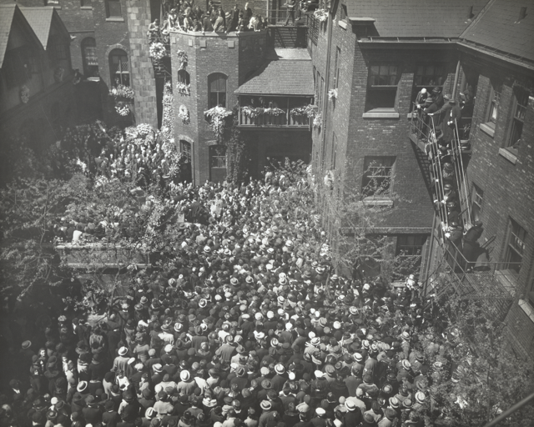
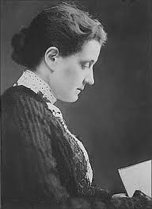
1860 - 1935
Jane Addams’s Funeral
Steps of Hull House
1.

Slide 4
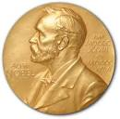


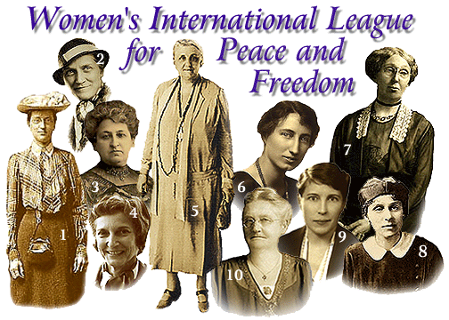

Nobel Peace Prize
1931
Founder

Slide 5
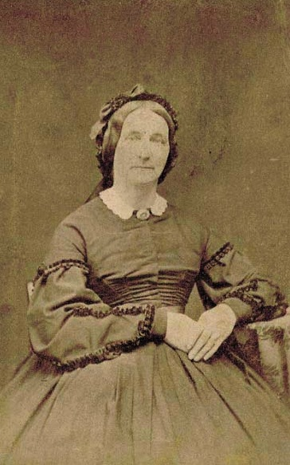
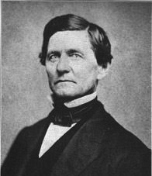
John Huy Addams
Father
Sarah Weber Addams
Mother
Anna Haldeman Addams
Stepmother

Slide 6
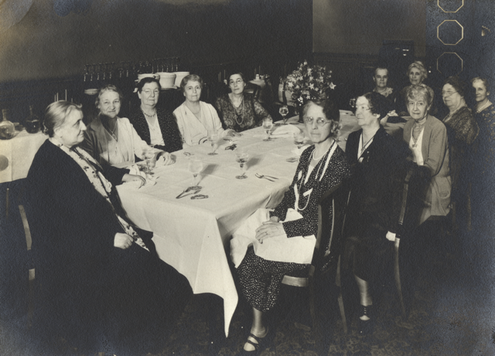
Rockford Female
Seminary
Valedictorian
Editor Newspaper
President Debate Club
President of Class

Slide 7
Leader Settlement Movement
1880s – 1920s
Problems of
Industrialization & Urbanization
Poverty
Health – Sanitation
Health – Industrial accidents
Education
Inspired by trip to
England’s Toynbee Hall
Top Down model of reform

Slide 8
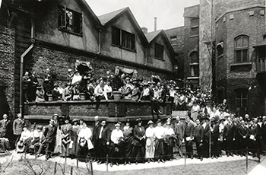
Hull House (Chicago)
Immigrant Community
Lab – conflict resolution
Hull House –
Settlement Workers gathering
1920
Bottoms up model of reform

Slide 9
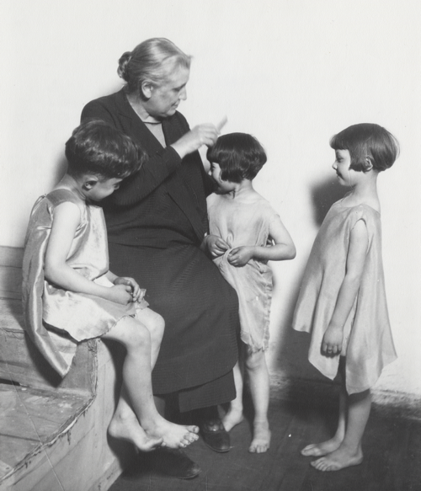
Hull House Activities
drama classes,
day care programs,
coffee house/theater,
art and labor museum,
Sunday concerts,
choir,
over 25 clubs,
meeting rooms for organized labor,
cooperative apartments for young women
College Extension courses
Voter Registration
Speaker series….
first in Chicago to establish a public
bath,
gymnasium,
kitchen,
playground,
swimming pool.

Slide 10
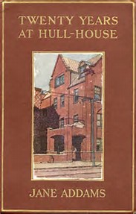
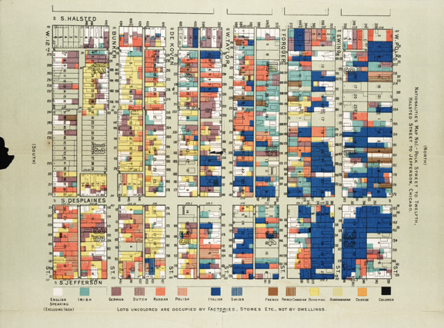
“The Settlement, then is an experimental effort to aid in the solution of the social
and industrial problems which are engendered by modern conditions of life in a great city.” (Addams, 1910, p. 125)

Slide 11
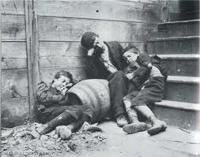
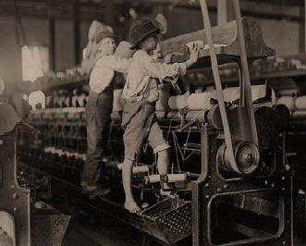
Active social reform
Child labor laws
Playgrounds
Juvenile Courts
Street Cleaning/garbage
collection
Water/Sewer
Healthier workplace

Slide 12
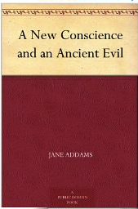




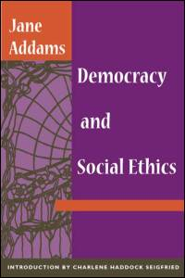



Noted Speaker - Author
1907

Slide 13
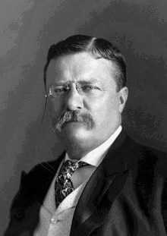
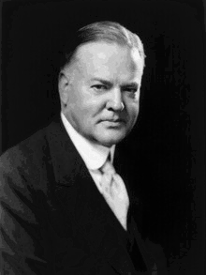
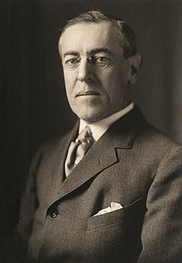
31st President
She and Hoover worked
on post
WWI humanitarian efforts
26th President
28th President
She nominated Progressive
party presidential
candidate.
Wilson nominated her for
Nobel prize

Slide 14
Founder- Organizer
Civil Liberties
Civil Rights

Slide 15

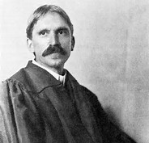
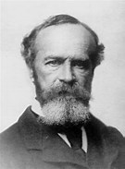
Founder Classical American Pragmatism
W. E. B. Du Bois
Jane
Addams
John Dewey
William James
George Herbert
Mead
Feminist Pragmatism
Public Philosopher
Recover - Woman of Ideas

Slide 16
Hull House
Ideas emerged from
This feminine experience
Feminist Pragmatism
Democracy /ethics/peace
Immigrant Community
Labor/management disputes
Lab – conflict resolution

Slide 17
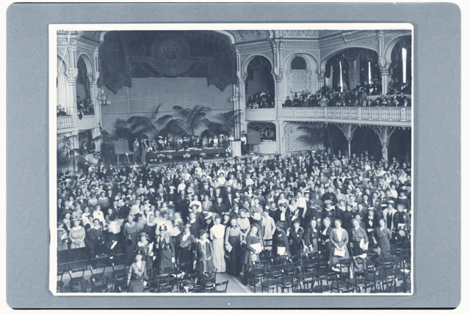
1915 Women’s Peace Conference The Hague

Slide 18
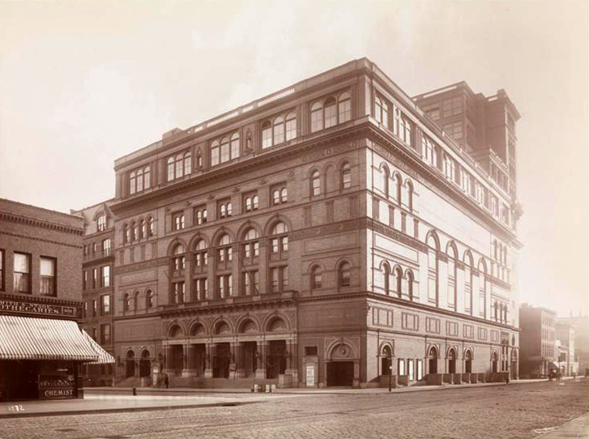
Speech Carnegie Hall

Slide 19

Philosophy
Peace
Sociology
Public Administration
Recovering Jane Addams
Peace Activist
Humanitarian
1889
1915
Demeaned
Traitor
Communist
Silly old woman
1935
Celebrated
DOJ Surveillance

Slide 20
Addams Ethics
Basic Tenets
Social Claim
Tension between individual and social claims
Perplexity
Problem of rigid moralisms
Need sympathetic understanding
Critical Optimism
Evolutionary ethics – each generation
new set of ethical challenges
1902

Slide 21
Clients -- Confusion --- Perplexity
Moving beyond rigid
(moral) belief systems
Change

Slide 22

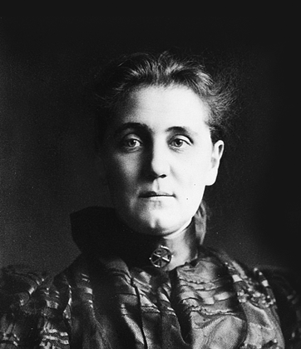
Jane Addams & Social Work
2.

Slide 23
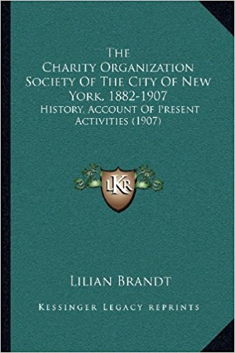
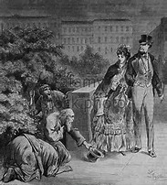
“Check Evils of Overlapping Relief”
“Notorious Professional Beggars”
Bring business efficiency… practice
of local relief

Slide 24
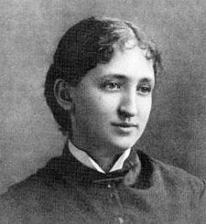
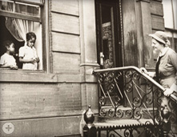
Friendly Visitor
Mary Richmond
Focus on Individuals and Families

Slide 25
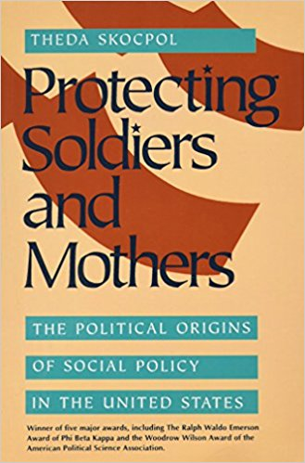
Maternalism
Moral Authority of Mother
Abolition
Prohibition
Women’s clubs
Women’s Sphere
Claim policy areas that
affected women and
children

Slide 26
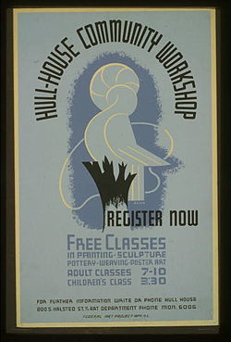
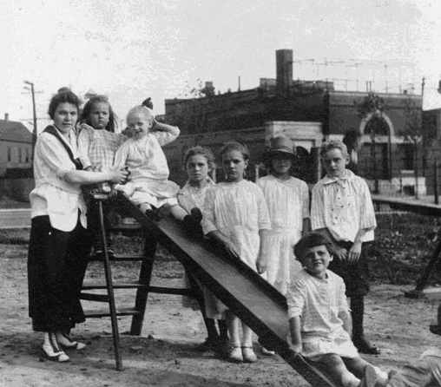
Settlement Movement
Part of Maternalist tradition
Reaction to
COS orientation

Slide 27
Non-profit (executive director)
Focus on Social Reform
Tradition of activism
Focus on Peace
Sole Focus Social Work
Social Work Education
Focus on Case Work
Professionalization of SW
Not a reformer (against Suffrage)

Slide 28

Philosophy – Social Justice/Peace
3

Slide 29
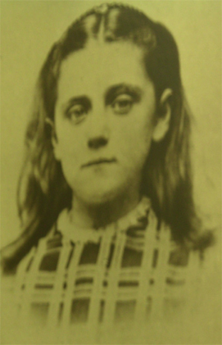
Paternalism
ç
Duty
Moral Absolutism
Man of integrity

Slide 30

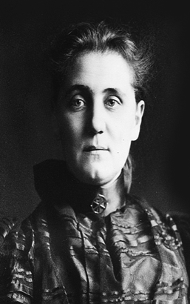
Social Claim

Slide 31

Municipal Housekeeping
City as Citadel
Argued in favor of a
more caring model of
city government.
Valued soldiers
Devalued Children
Women’s
experience
Criticized outmoded model
of city governance
Take women’s skills into a new sphere
Embrace a social claim

Slide 32
Clean Streets
Clean Water
Safe Meat/Food
Safe Clothing
Care for children
Literature

Slide 33
Civic Housekeeping
1907
“Survival of Militarism in City Government” (chapter 1)
“Failure to Utilize Immigrants in City Government
“Utilization of Women in City Government”
Social claim linked to Women’s
Experience
Natural Leader of Women’s Peace Movement

Slide 34
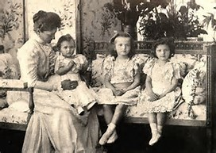

Slide 35
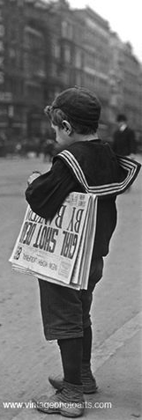
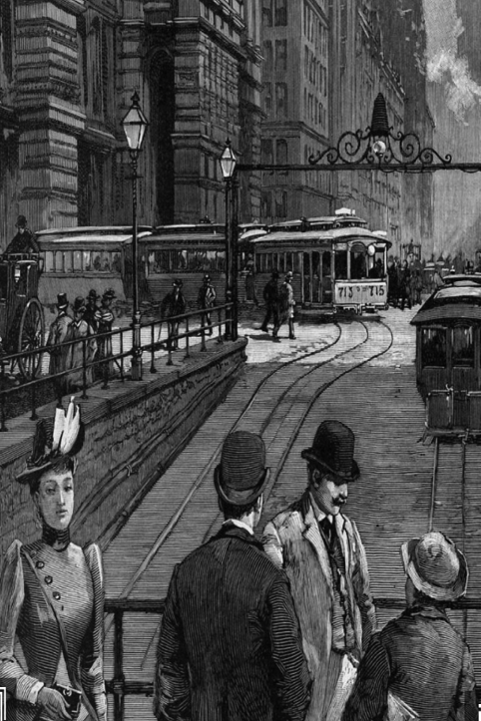

Slide 36
“Formerly it was believed that poverty was synonymous with
vice and laziness, and that the prosperous man was the righteous man, charity was administered harshly with a good conscience for the charitable agent really blamed the individual for his poverty”
(Addams, 1902, p. 11)

Slide 37
Friendly visitor moves beyond narrow
Family/private sphere.
Thrift, cleanliness, avoid vices,
Avoid Laziness, save.
Social Justice – move outside private sphere

Slide 38
Charity Worker
Tension between individual and social
Perplexity
Problem of rigid moralisms
Need sympathetic understanding
Evolutionary ethics – each generation
new set of ethical challenges

Slide 39
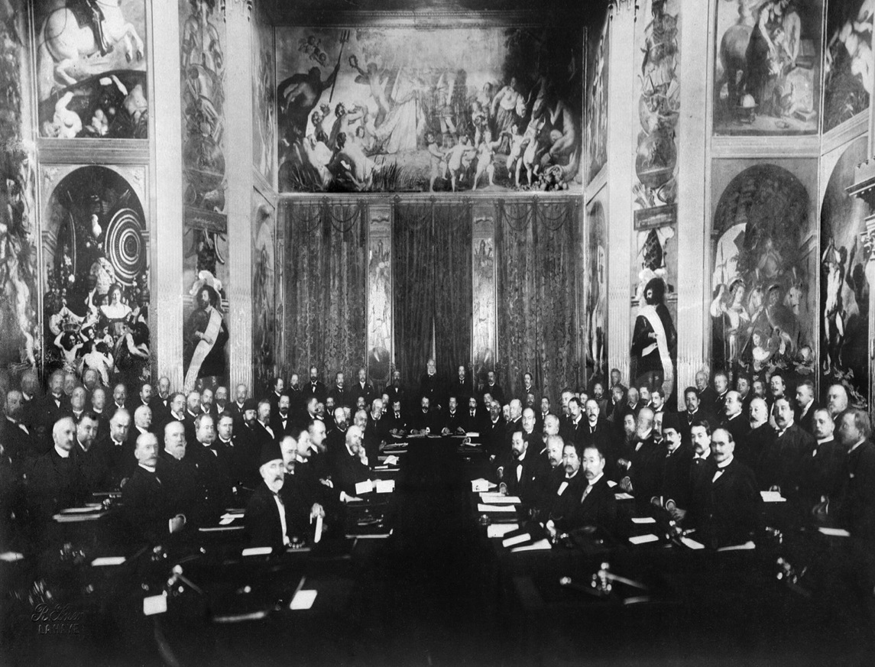
Peace Movements (1890s – WWI)
Establish International Law and Order
Peace Good for Business
Elite -- Social conservative
National political Business leaders
Legal framework for peaceful settlement of disputes
Hague Peace
Conferences
(1899-1907)

Slide 40
Women’ Peace Movement
Maternalist
Preserving the Social Fabric
Leader of Both

Slide 41
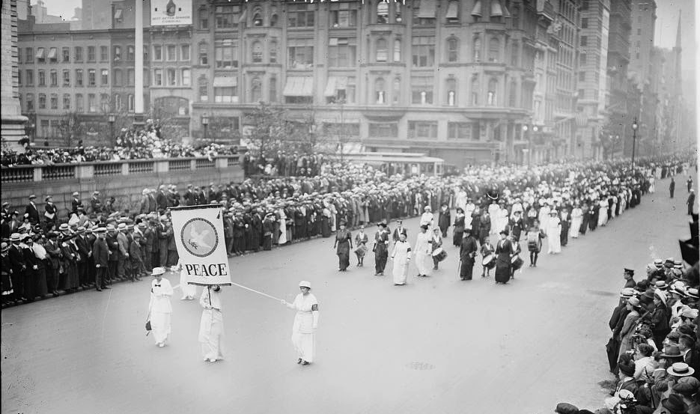
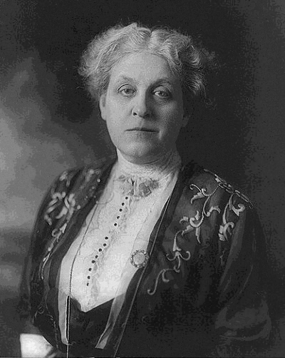
Maternal Instinct
Woman’s Peace Party established
– Jane Addams Leader
Women have an instinctive
and rational opposition to war
Women & Children suffer
but not at table
Need increase participation of
women in politics.
Linked to Suffrage Movement
Aug. 1914
Women’s Peace March
Carrie Chapman Catt

Slide 42
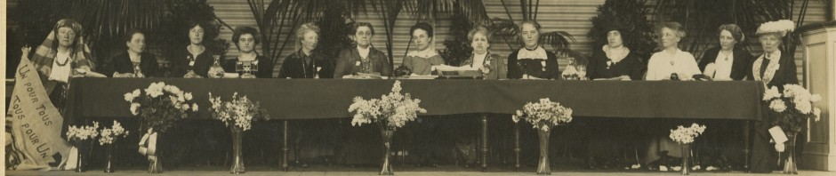
International Peace Congress of Women at the Hague
April 1915

Slide 43
Social Claim
April 1915
International Peace Congress of Women at the Hague

Slide 44
Begin peace negotiations
immediately
Organization “Society of Nations”
Acknowledge women’s suffering
during war
Give women right to vote
Women participation in Peace
Processes
14

Slide 45
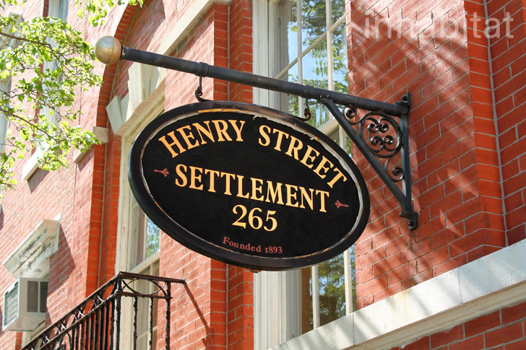
Preserving the Social Fabric
Time had come when “some of us who deal with the social fabric” ... Engage international relations..
Lilian Wald

Slide 46
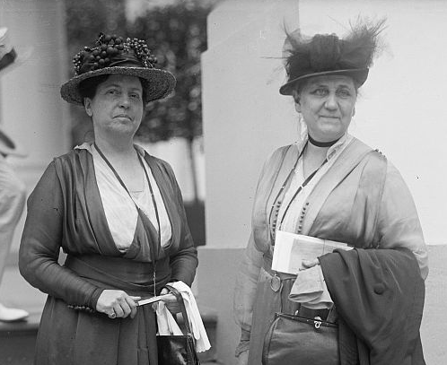
Preserving the Social Fabric
Led by Social Workers
Threat of war to domestic
social programs
Importance of conservation of society
SW expertise at Social Relations
- expanded to International Relations
Lillian Wald & Jane Addams
Henry Street Settlement

Slide 47
Close knit group of social work leaders …launch a national movement and proclaim a bolder program than that of the old peace societies, a program that would challenge commercialism and commercial exploitation, denounce armaments, and “breathe the spirit of democracy.”
Marchand 227

Slide 48
During WWI

Slide 49
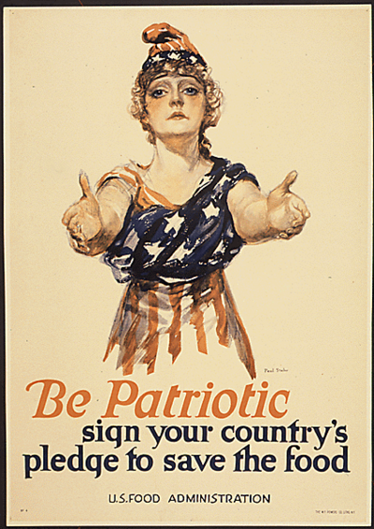
US Food Administration
American Relief
Administration
Addams traveled
across US
4 million tons of supplies
23 countries
Critical Optimism
Things can be bettered
Herbert Hoover

Slide 50
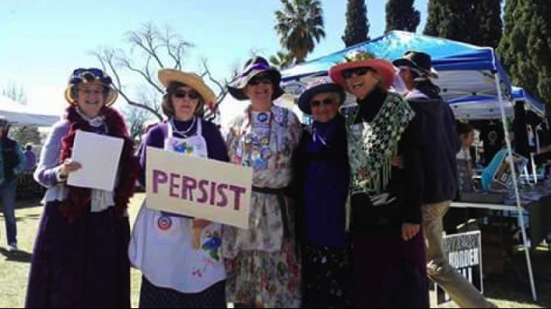

International Committee of Women for Permanent Peace
Becomes
UN Resolution 1325
on Women, Peace and Security
Increased participation of women in decision making
related to, prevention, management and resolution
of armed combat.

Slide 51
Recovering Jane Addams
1889
1915
Demeaned
Traitor
Communist
Silly old woman
1935
Celebrated
DOJ Surveillance

Slide 52
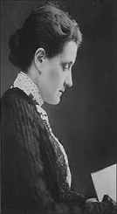
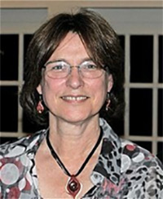
Expeditionary mindset/
Peacekeeping
Pragmatism/
Public Administration

Slide 53
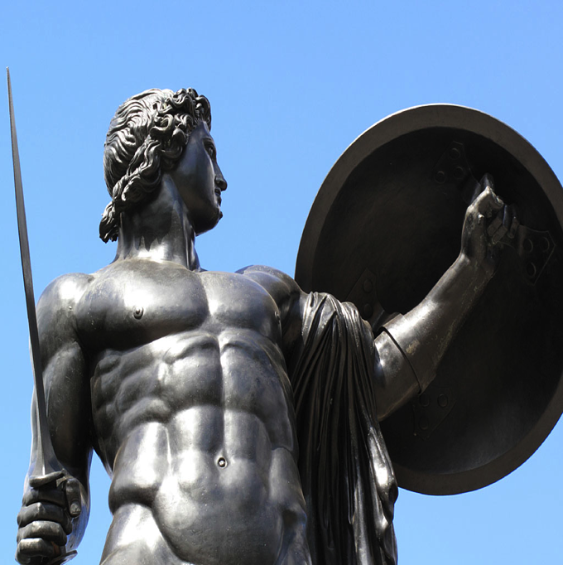

Warrior
Peacekeeper
Shields & Soeters, 2013

Slide 54
Nobel Peace Prize
1931
Faculty
Development
Leave
What was her idea
Of Peace?
Could it be applied
To Peacekeeping?

Slide 55
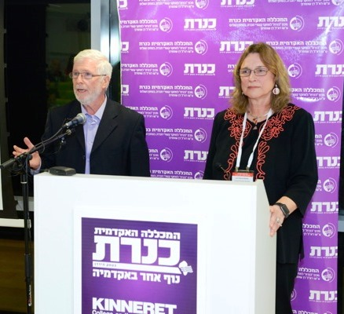

Slide 56

Addams – Peaceweaving

Slide 57
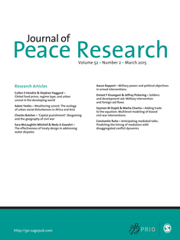
“Peace Research:
Just the Study of War”*
Negative Definition of Peace
* Gleditsch, N. Nordkvelle, J & Strand, H. (2014)

Slide 58
Problems with
Negative Definition
Shifts focus from peace to violence.
Focuses on a short run end state.
Divorced from the dynamics of relationships.
Shifts attention away from underlying
causes of violent conflict.

Slide 59

Positive Peace
Nonviolent and creative
conflict transformation.
Uneven long run focus.
The fabric of the kind of society to which
we aspire.
Integrity, wholeness and well-being that
arise from justice.
Humanity toward others.
Openness to a widely conceived social claim.

Slide 60

Feminine sensibility
PeaceWeaving
1. Relationships

Slide 61


2. Avoid Rigid Moralisms
Friend/enemy
good/evil
Courage

Slide 62


3. Sympathetic Understanding
How build
relationship

Slide 63


4. Community of Inquiry
Practical Problems
Scientific Attitude
Participatory Democracy

Slide 64


5. Lateral Progress
Duty toward the less fortunate – Social claim

Slide 65

PeaceWeaving
– building the fabric of peace by emphasizing relationships. These positive relationships are built by working on practical problems, engaging people widely with sympathetic understanding while recognizing that progress is measure by the welfare of the vulnerable. (Shields & Soeters, 2015)
Preserving the Social Fabric

Slide 66
True peace is not merely the absence of tension:
It is the presence of justice
Without justice there can be no peace.
Martin Luther King, Jr.
Both peace and justice are a process --
Jane Addams offers insights into these processes

Slide 67
Embrace
Heritage
Challenge of Social Ethics in 21st Century
Recover idea of positive peace
Integrate “positive peace”
into practice –
logical extension of social justice

Slide 68
Selected Bibliography
Addams, J. (1990). Twenty years at Hull House. Champaign, IL: University of Illinois Press. (Original work published 1910)
Addams, J. (2002). Democracy and social ethics. Champaign, IL: University of Illinois Press. (Original work published 1902)
Addams, J. (2002). A New Conscience and an Ancient Evil Chicago, IL: University of Chicago Press (Original work published 1912)
Addams, J. (2002). Peace and bread in time of war. Champaign, IL: University of Illinois Press. (Original work published 1922)
Addams, J. (2002). A modern Lear. In J. B. Elshtain (ed) The Jane Addams Reader (pp. 163-234). New York: Basic Books. (Original work published in 1912)
Addams, J. (2003). Women and internationalism. In J. Addams, E. G. Balch, & A. Hamilton (Eds.), Women at The Hague: the international congress of women and its results (pp. 107-115). Champaign, IL: University of Illinois Press. (Original work published 1915)
Addams, J. (2007). Newer ideals of peace. Champaign, IL: University of Illinois Press. (Original work published 1907).
Shields, P. (2003). The community of inquiry: Classical pragmatism and public administration Administration & Society 35 (5), 510-538.
Shields, P. (2006). Democracy and the social ethics of Jane Addams: A vision for public administration. Administrative Theory and Praxis 28(3), 418-443.
Shields, P. (2008). Rediscovering the Taproot: Is Classical Pragmatism the Route to Renew Public Administration. Public Administration Review 68(2), 205-221.
Shields, P. & Rangarajan, N. (2011). Public Service Professionals: The Legacy of Florence Nightingale, Mary Livermore and Jane Addams. In Menzel, D. & White, H. (Eds.) The State of Public Administration: Issues, Challenges and Opportunity. 36-53. New York: M.E. Sharpe.

Slide 69
Shields, P. & Soeters, J. (2013). Pragmatism, peacekeeping and the constabulary force. In Ralston (Ed.) A Bold New World: Essays on Philosophical Pragmatism and International Relations. 87-110. New York: Lexington Books.
Shields, P & Soeters, J. (2017). Peaceweaving: Jane Addams, Positive Peace and Public Administration. American Review of Public Administration
Shields, P. (2017). Jane Addams: Progressive Pioneer pf Peace, Philosophy, Sociology, Social Work and Public Administration. New York, Springer
Skocpol, T. (1995). Protecting soldiers and mothers: The political origins of social policy in the United States. Cambridge, MA: Harvard University Press.

