Slide 1
Increasing Access and Impact and Meeting Funder Mandates
Notes:
Introduce self

Slide 2










How it all got started:
Open Data Executive Order May 9, 2013
The Obama Administration took steps to make information generated and stored by the Federal Government more open and accessible to innovators and the public, to fuel entrepreneurship and economic growth while increasing government transparency and efficiency.
The public access requirement applies now to new awards resulting from proposals submitted, or due, on or after January 25, 2016.
Since that time Texas State University has received approx. 135 awards under this requirement.
Notes:
Executive Order in May 2013 called for:
Appropriations Act of 2014
requires selected federal agencies to provide public access to the research they fund.
The agencies require both raw research data and the publications produced by the research to be deposited in a public repository.
2 years to write and enact their policies (many implemented in 2015) such that awards from proposals submitted after 1/25/2016 are subject to the new policies.
The overarching goals are made clear, but details are generally left up to the funder.

Slide 3
Objectives of the executive order
(publications)
Public can read, download, analyze in digital form
12-month post-publication embargo as guideline, with stakeholder petitions to change
Easy public search, analysis of, and access to publications
Full public access to metadata without charge
upon first publication
Public-private collaboration
Attribution to authors, journals, and original publishers
Archival solutions that provide long-term preservation & access without charge
Uses widely available, nonproprietary standards/formats
Provides access for persons with disabilities
Enables integration and interoperability with other Federal archival solutions and other appropriate archives.
Notes:
These are overarching goals. Within this, there are a variety of solutions, but most are adhering to the 3 red points.
Most have their own pub repositories (PubMed Central for any health-related, NASA’s PubSpace, NOAA’s own repository, etc).
They allow for a maximum 12 months embargo, unless the researcher petitions to be allowed longer.
Most of these “objectives” are still considered best practice, even if they aren’t mandated. For example, allowing for accessibility – I did find that NASA, for example, recommends but doesn’t mandate that certain fonts to be used on uploaded publications, so that the text size is adjustable.

Slide 4
Objectives of the executive order
(Digital data)
Maximize free access while protecting privacy and confidentiality, national security
Recognizing intellectual property rights
Balancing costs & benefits of long-term preservation
Require data management plans (DMPs)
Allow inclusion of costs in applications for funding
Ensure appropriate evaluation of DMPs
Monitor compliance by investigators
Encourage deposit of data in public repositories, where possible
Cooperate with the private sector
Develop approaches for data citation & attribution
Support training, education and workforce development
Assess long-term needs for preservation and options for repositories
Notes:
While a lot of funders have their own publications repository or require a specific one (several use PMC), many do not have that infrastructure in place for raw data, though they do require it to be published openly.
PMC is for publications. They actually did not provide a data repository, but encouraged the use of the Data Discovery Index (now datamed.org), which is just an index to data published elsewhere.
The NSF merely states the researcher should use “an appropriate repository” (unless another is mandated by the directorate).
Note: Researcher who was specific about “publish” versus “share”. She wanted to publish her work so that others could see that she’s done something noteworthy, but she didn’t want to share that work with them. She doesn’t want them to be able to download and use it. She says it is “HERS”, and no one else can use it and get credit for the work she did to get it.
But on the other hand, when Texas State accepts funds on your behalf you essentially sign two agreements: one with the funder and one with Texas State saying you’ll comply with the mandates.

Slide 5
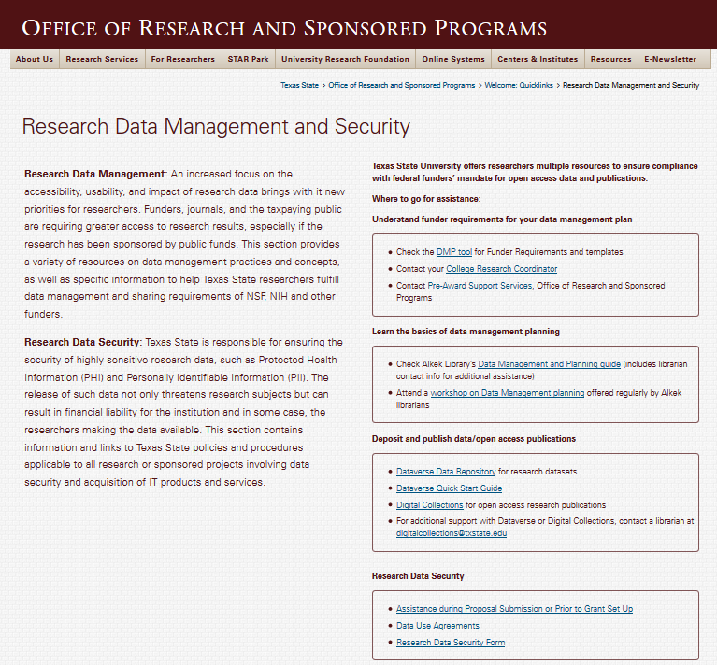
Available Resources
Notes:
Before applying, you need a Data Management Plan
Include information on where you will deposit your articles and where you will deposit your data (Repositories)
You will detail how the repositories meet the requirements of the funder (security, preservation, etc.)

Slide 6
Data Management Plans
Different funders = Different requirements
Types of data produced
Data and metadata standards
Policies for access
Policies for reuse
Plans for archiving
Roles and responsibilities
Notes:
Head over to dmptool.org – Learn tab

Slide 7
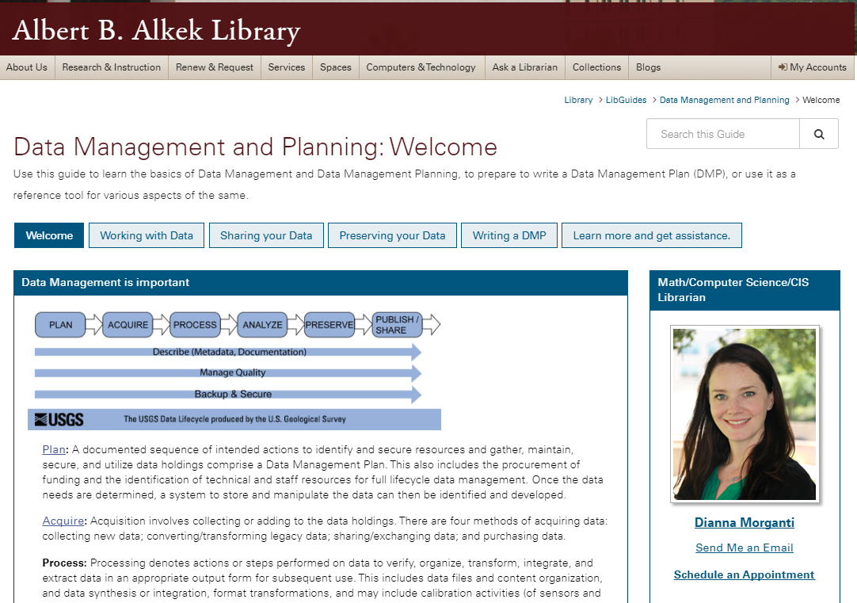
Data Management Planning and Data Curation
Notes:
Librarians are experts in describing information to make it optimized for findability
Data Curation is a service of the library to help make your data optimal for finding and re-use
Requires data to be reusable – that is data management!
Metadata standards
Documentation
File naming conventions
Anonymizing/scrubbing, etc.
Identifying/complying with relevant standards (tell us why you’re sharing your data – we can help)
All are elements of “Data Management”
Library providing workshops on Data Management Planning
Curation team: Digital Collections Librarian,
Metadata Librarian,
Subject Librarian
In addition to the Texas Digital Library staff provide support

Slide 8



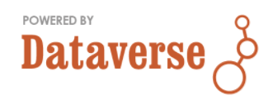

Choosing a Repository
Does the solicitation specify a repository for the data or software?
Does institution have an institutional repository?
Is there a discipline-relevant repository used by the research community?
Is the repository sustainable? And if not, are there contingency plans?
Does the repository require at least minimal identification and description sufficient to enable discovery, access, and retrieval?
Has the PI made any contingency plans in the event a designated repository becomes unavailable?
Notes:
NSF Guidelines on Selecting and Evaluating a repository (data):
Does the solicitation specify a repository for the data or software? (Pre-award stage consult with your ORSP pre-award specialist)
Does the PI's home institution have an institutional repository that mandates local deposit of the data/software? (No)
Is there a discipline-relevant repository used by the research community either as the expected repository for data/software or as the expected repository for discovering and reusing data/software? (Librarian can help discover this, if you’re not aware)
Is the repository sustainable? And if not, are there contingency plans?
Does the repository require at least minimal identification and description sufficient to enable discovery, access, and retrieval? For purposes of data citation, NSF requires a persistent identifier and some level of metadata including acknowledgement of the creator/author and federal support. (Dataverse data repository exceeds these basic requirements)
Has the PI made any contingency plans in the event a designated repository becomes unavailable? (Duplicate – lots of copies keeps stuff safe)
Discipline repositories

Slide 9
Who are our In-house Repositories best for?
Anyone who needs or wants to share their publications
  DOI issued for Data (meets base requirements for most funders)
  Data preserved for required time (plus more)
  Indexing, and others previously mentioned
  Collocate your data and pubs with your prior data and pubs, and with those of the department and University
Non-confidential data
  Funder requirement to de-identify/anonymize/cleanse
    Library can help with this
  Texas State Policy
Active Texas State NetID
  Though we are working on allowing cross-institution working groups
Small-Medium sized files self-service
  Large data accommodated via consultation
  Library can help facilitate that connection
Any file type
  Open non-proprietary is encouraged
  We can help with conversion
Notes:
Anyone who needs or wants to share data
DOI issued
Data preserved for required time (plus more)
Indexing, and others previously mentioned
Non-confidential data
Funder requirement to de-identify/anonymize/cleanse
Library can help with this
Texas State Policy
Active Texas State NetID
Though we are working on allowing diverse working groups
Small-Medium sized datasets
Large data accommodated via consultation with IT
Library can help facilitate that connection
Any file type
Open non-proprietary is encouraged
We can help with conversion

Slide 10
Learn More:
From Office of the White House Chief Information Officer: https://project-open-data.cio.gov/
Links to Federal Agency Open Mandates: http://www.library.cmu.edu/datapub/sc/publicaccess/policies/usgovfunders
ICPSR: What is data curation? https://www.youtube.com/watch?v=ZEkqF8cL2qQ
Find the Texas State University Dataverse on the library website under “Services to Faculty”: http://www.library.txstate.edu/services/faculty.html
Find Research Data information from the Office of Research and Sponsored Services at http://www.txstate.edu/research/avpr/data_mgmt

Slide 11


Digital Repositories
TXST Digital Collections Repository
TXST Dataverse Repository

Slide 12
TXST Digital Collections Repository

Slide 13

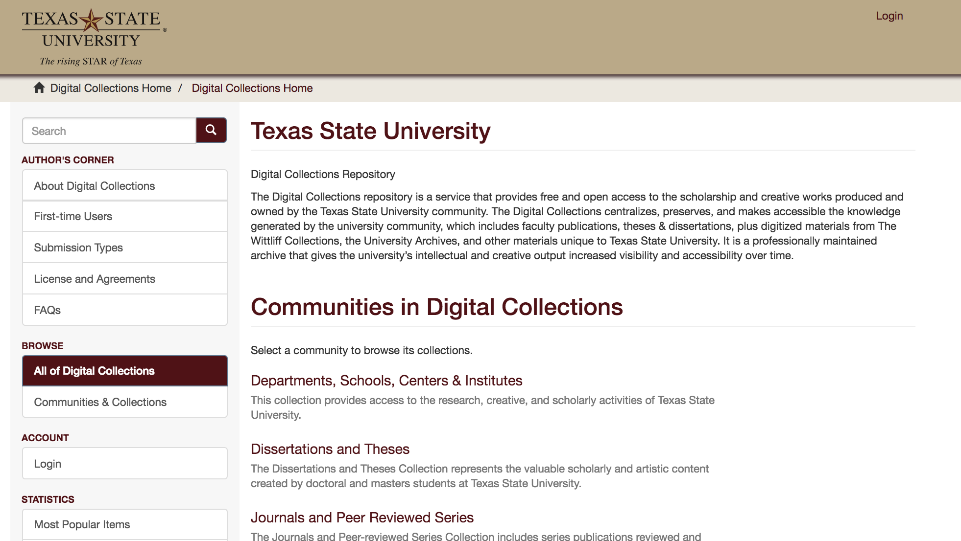
TXST Digital Collections Repository
https://digital.library.txstate.edu

Slide 14
TXST Digital Collections Repository
  Scholarly Work of TXST Community
    Articles
    Books and chapters
    Working papers
    Presentations
    Conference posters
    Reports
https://digital.library.txstate.edu

Slide 15
TXST Digital Collections Repository
  Benefits and Features
    Showcase for research output of TXST
    Permanent URL (handles)
    Organize and archive
    Increase citations and impact
    Viewable statistics
https://digital.library.txstate.edu

Slide 16
A Look Around Digital Collections

Slide 17
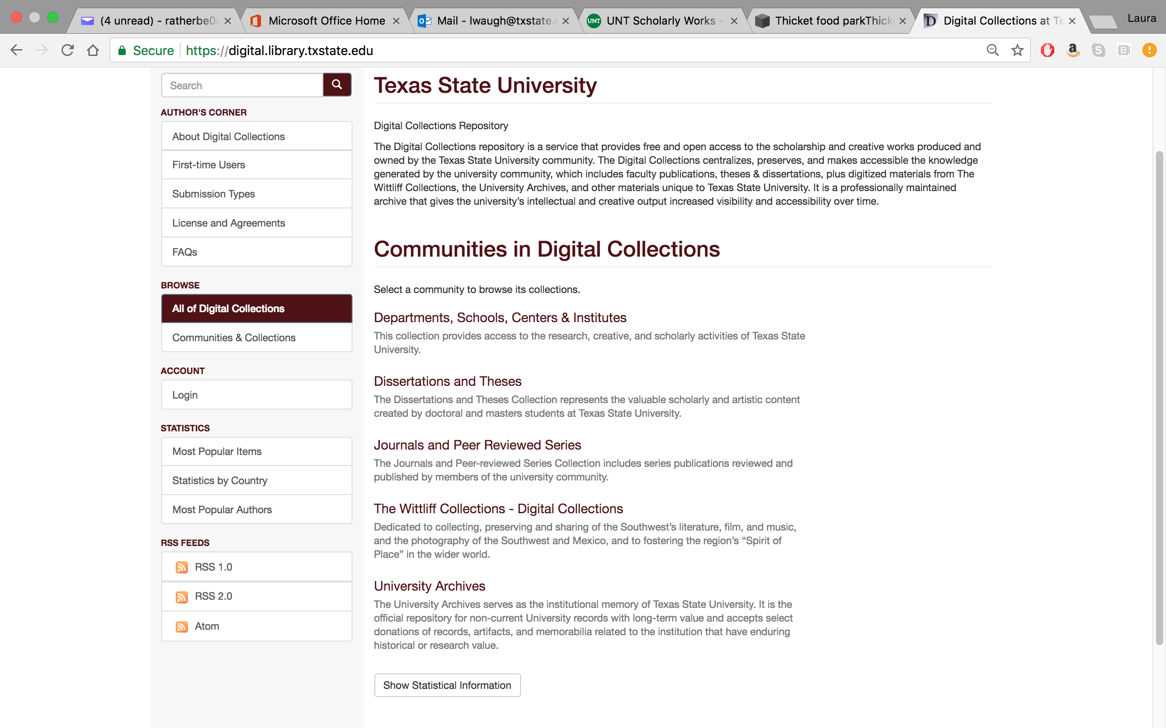

Slide 19
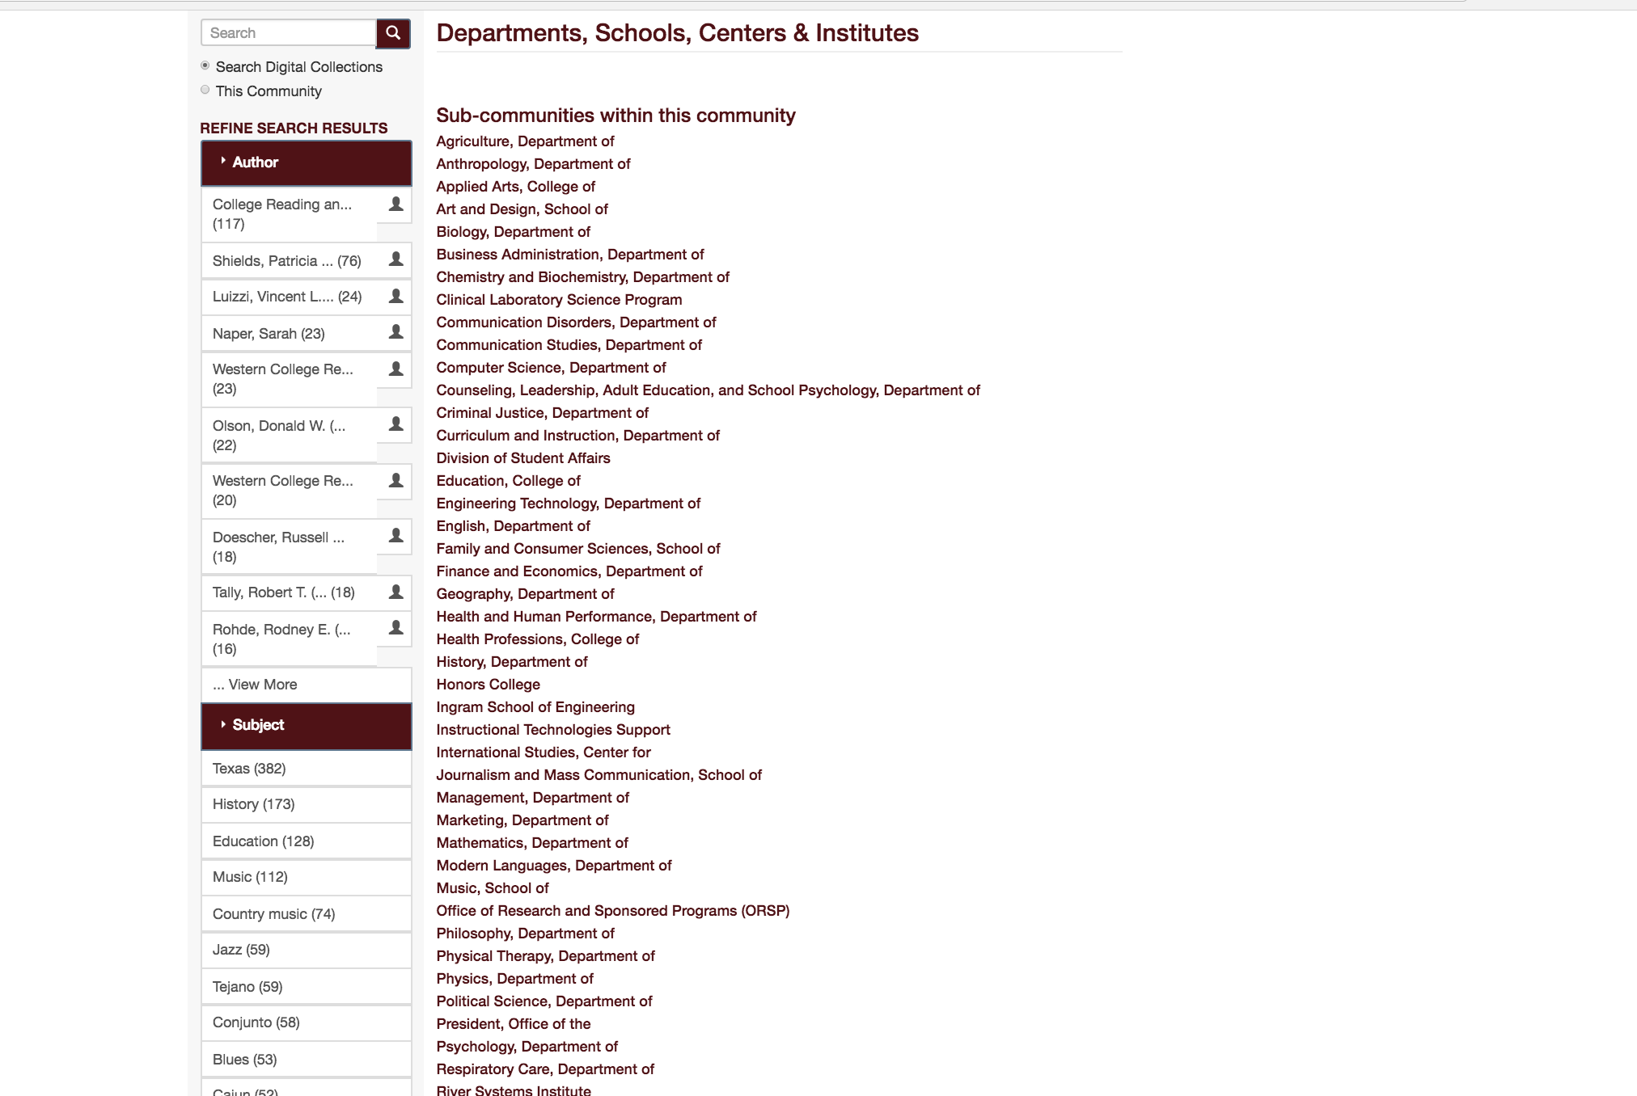

Slide 21
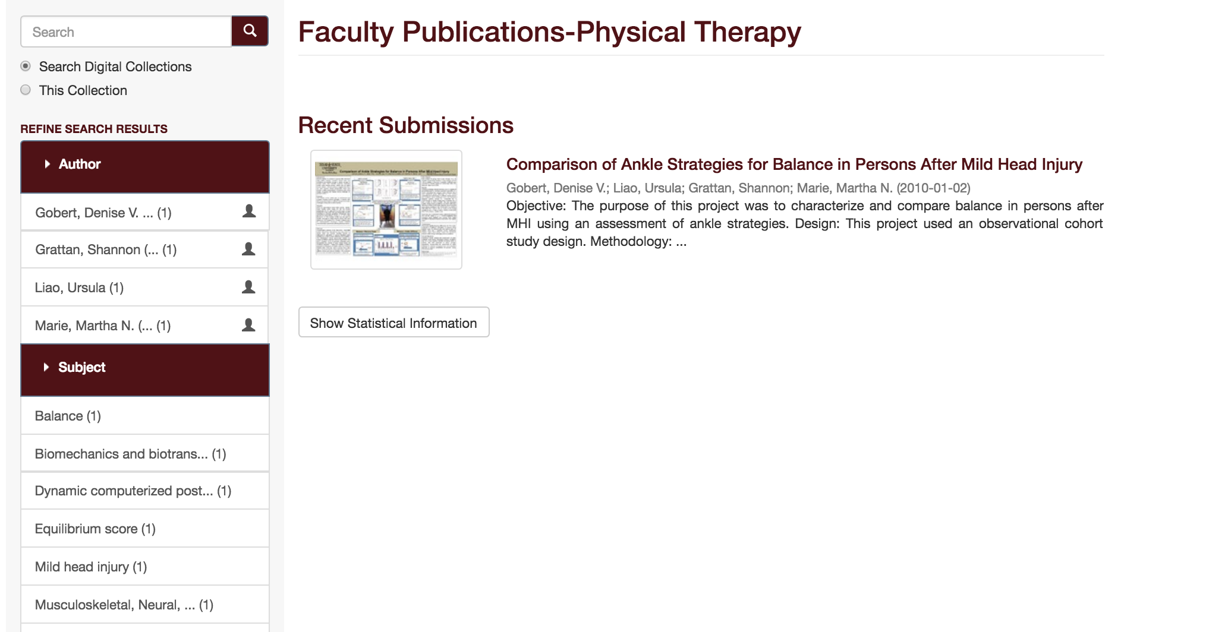

Slide 22
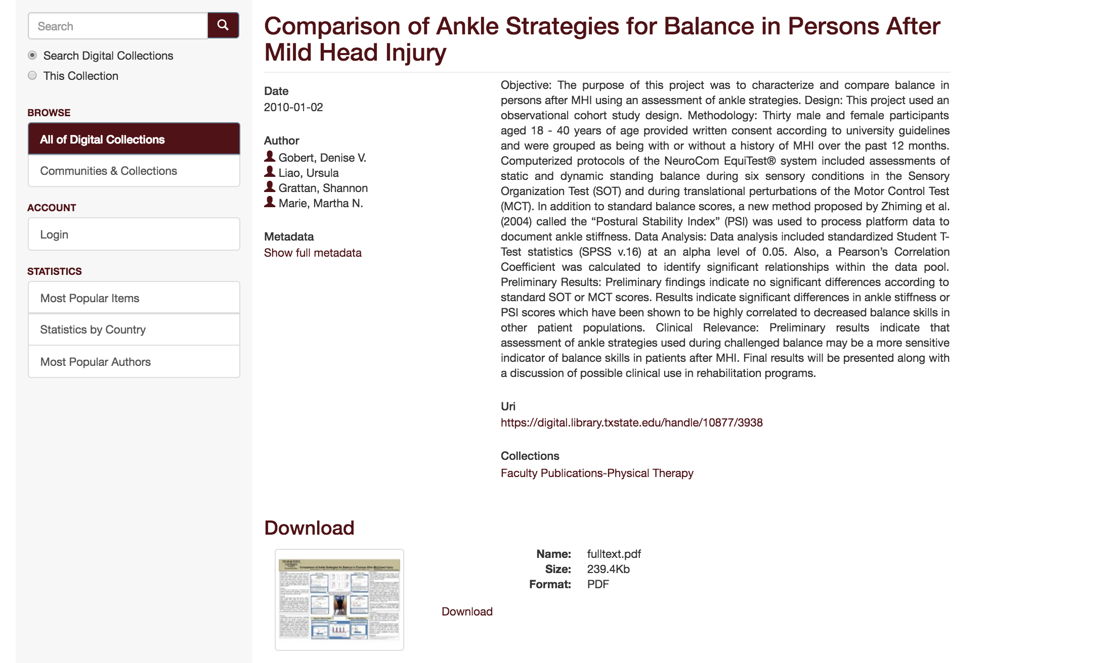

Slide 23
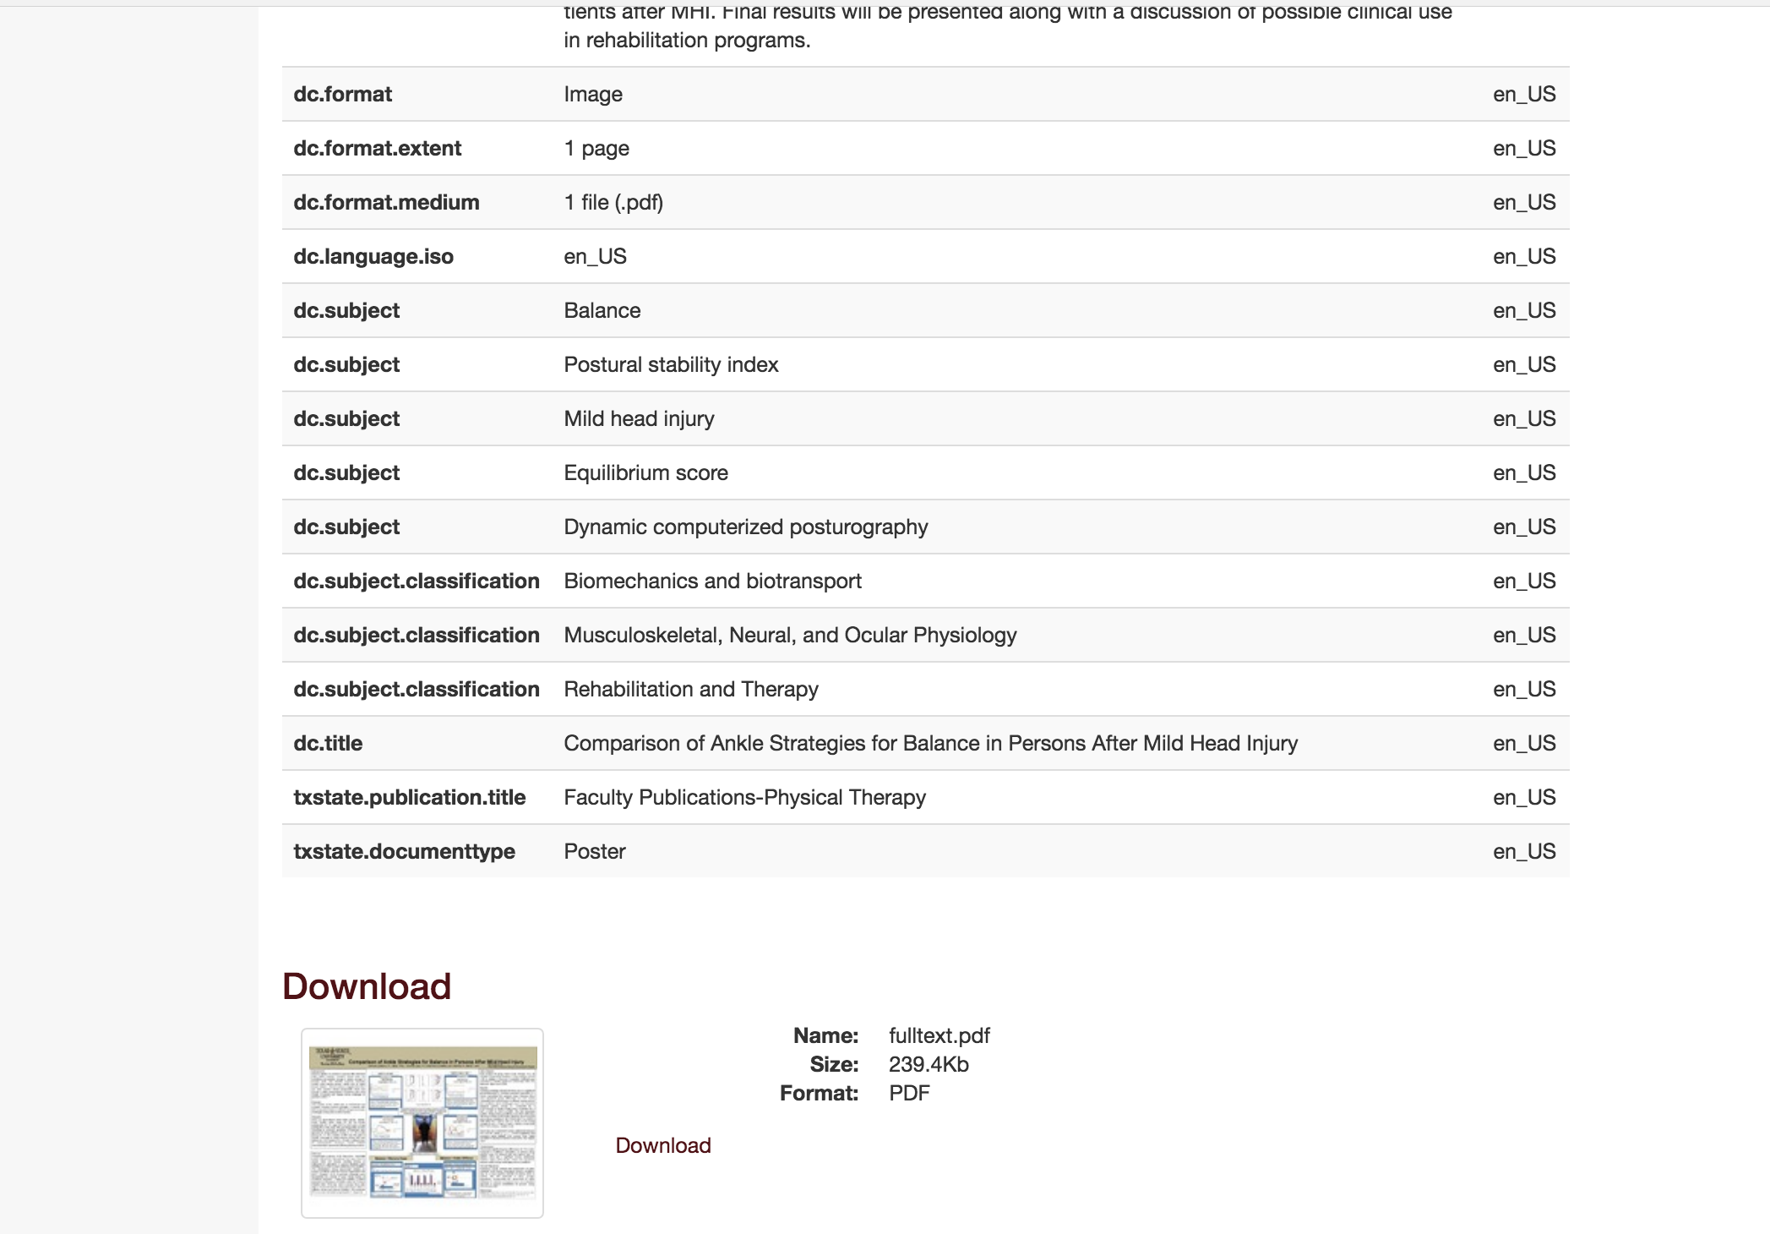

Slide 25
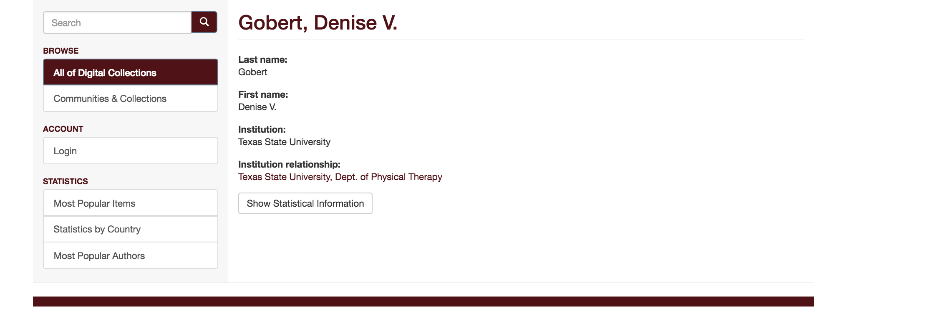
Author Profile Information

Slide 26
Citations and Impact

Slide 27
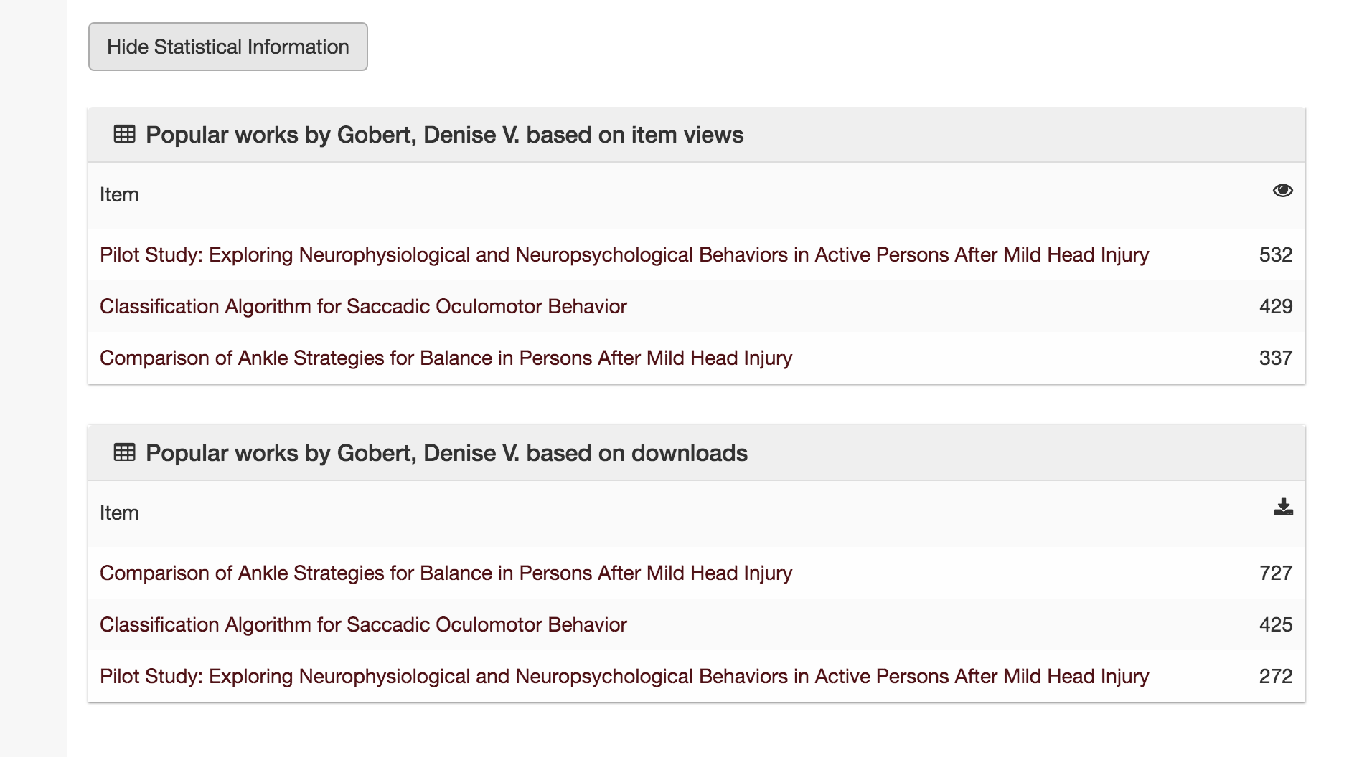

Slide 29
Example of Impact
    Faculty Member: Beatrice A. Jones
      May 2006 through March 2018
        Item Views: 59,722
            29% of all Faculty Item Views
        Downloads: 99,519
            17% of all Faculty Downloads
https://digital.library.txstate.edu

Slide 30
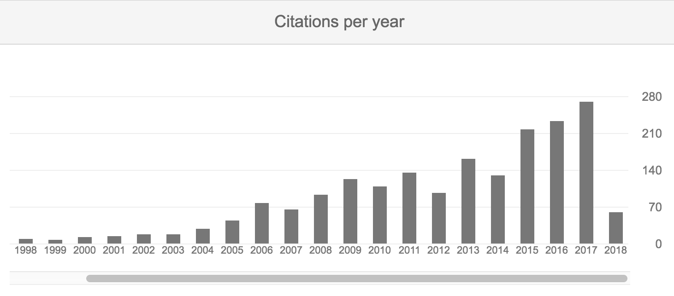
Example of Impact
https://digital.library.txstate.edu

Slide 31
Organization and Archiving

Slide 32

Where is that, again?
That article from 2012?
Report from 2015?
Presentation from the conference last year?

Slide 33
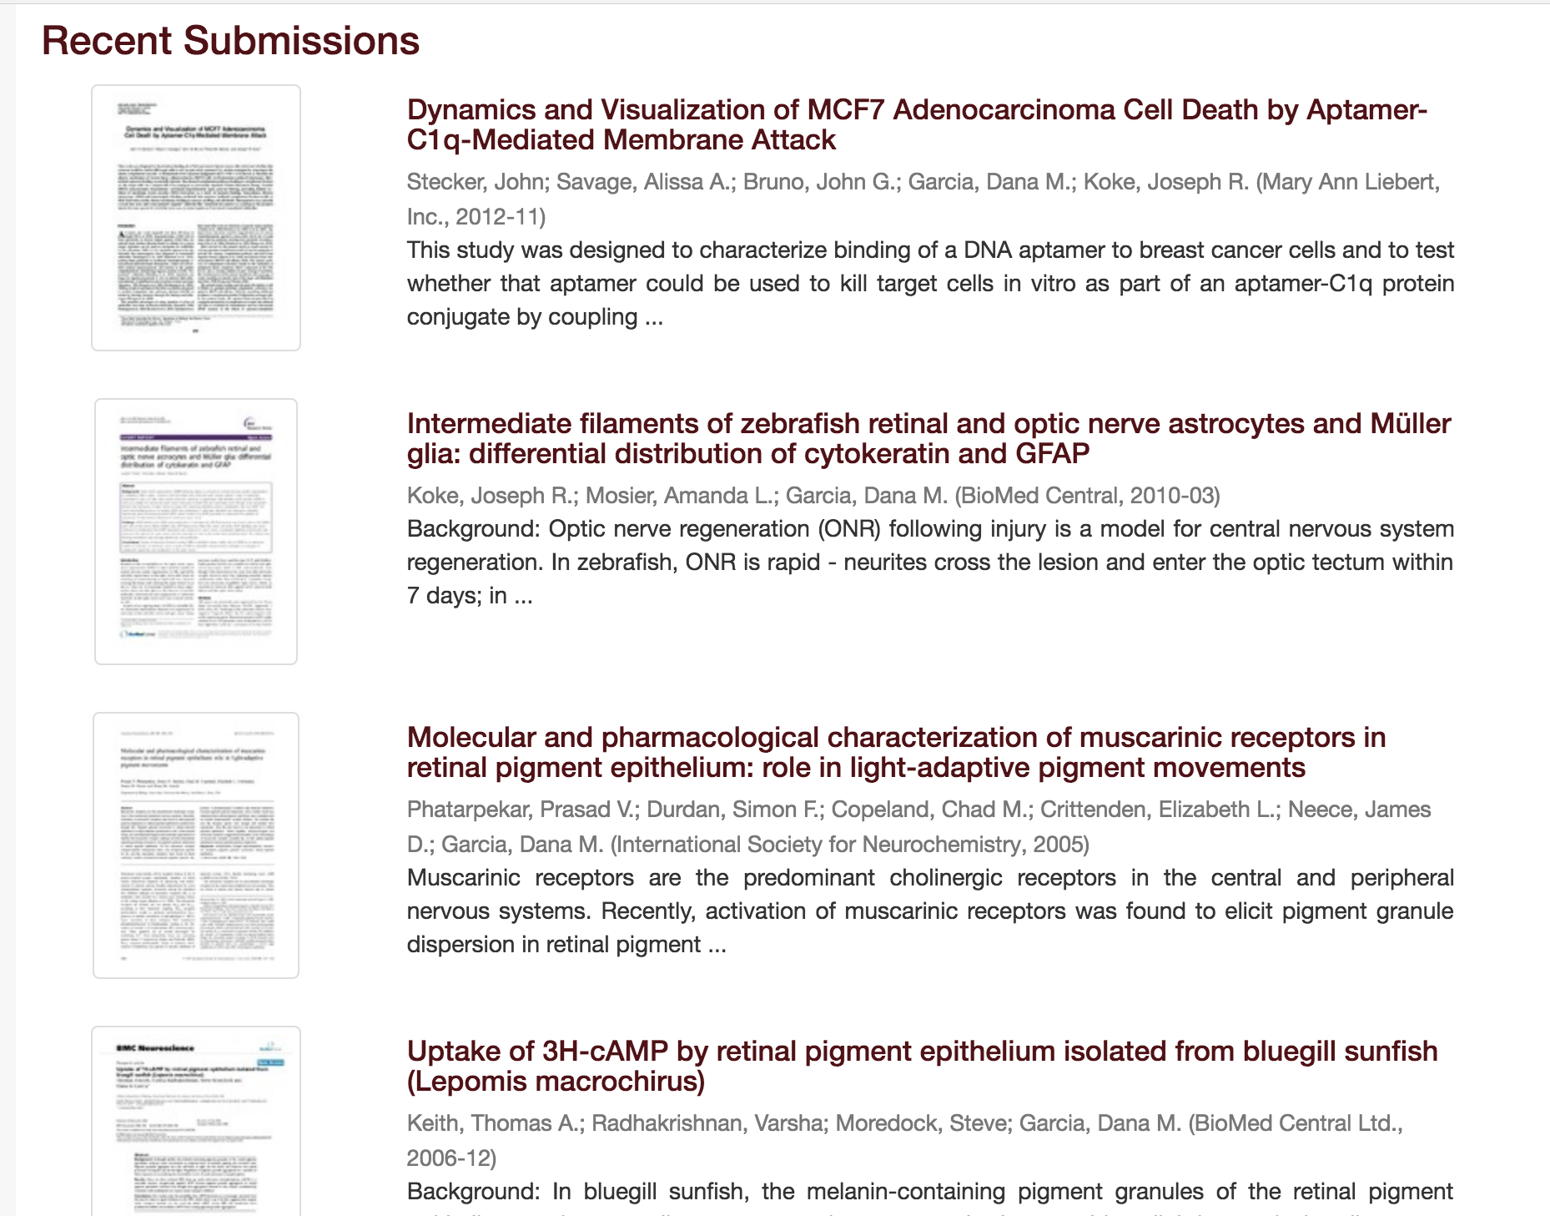

Slide 34
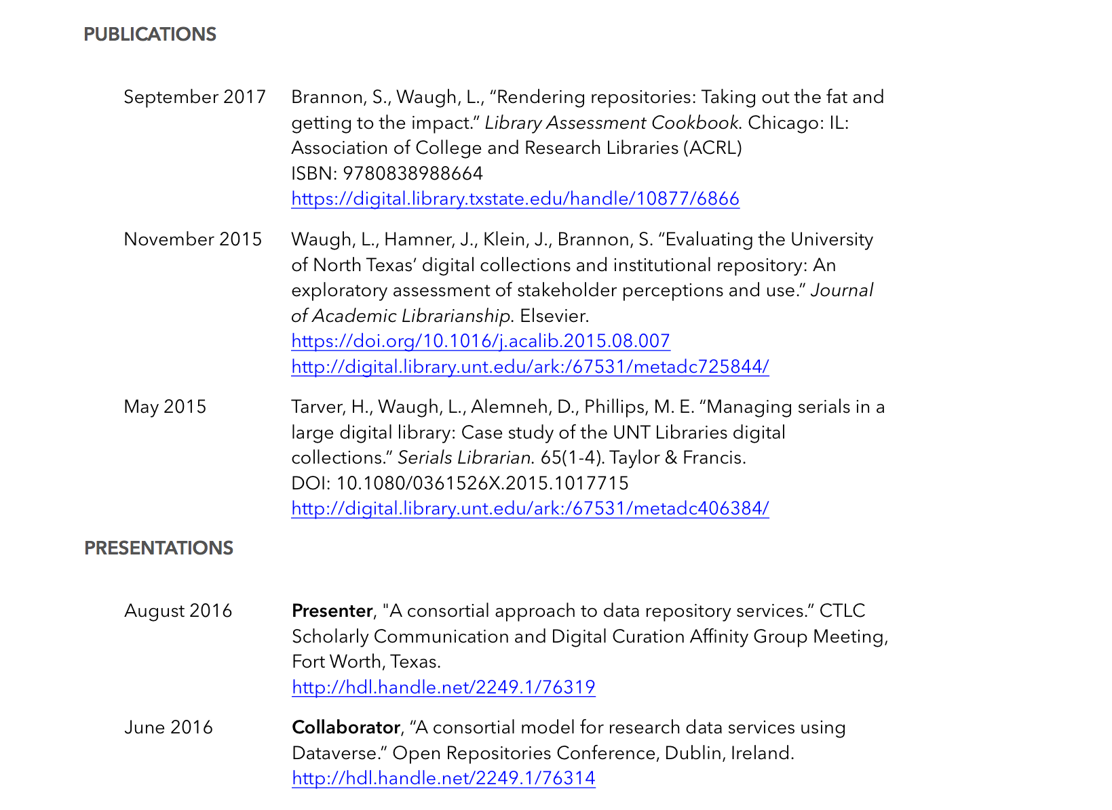

Slide 35
Submitting Your Work

Slide 36
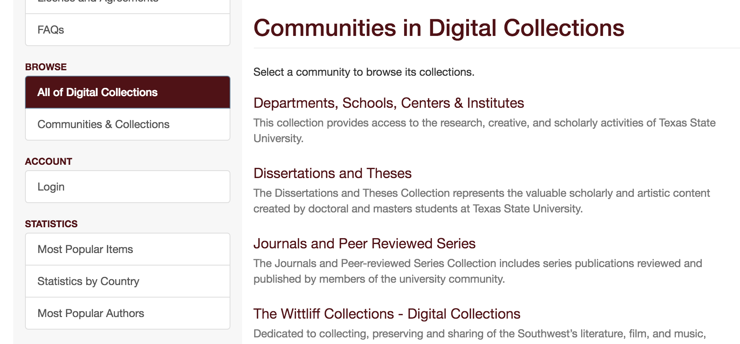
Submitting Your Work

Slide 37
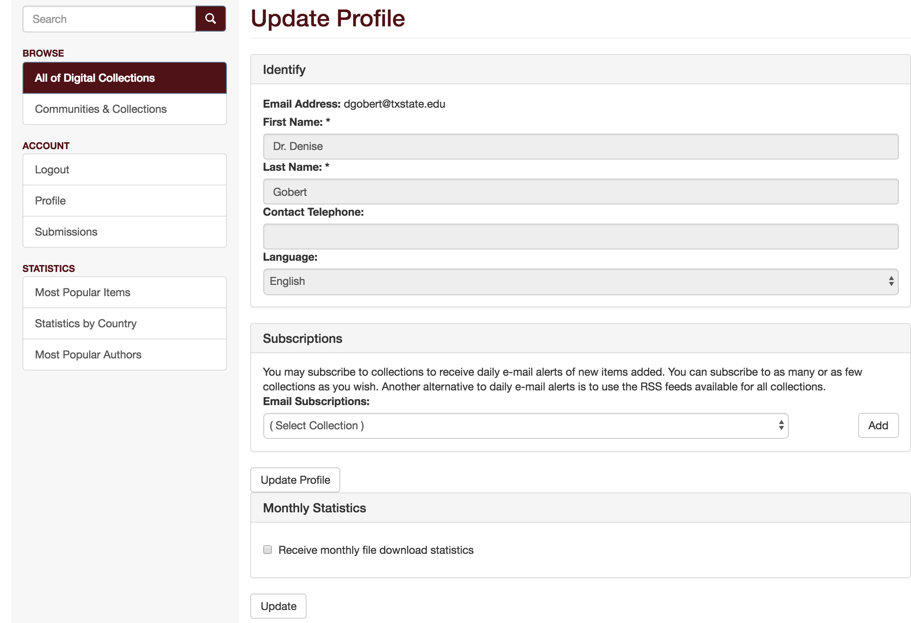

Slide 38
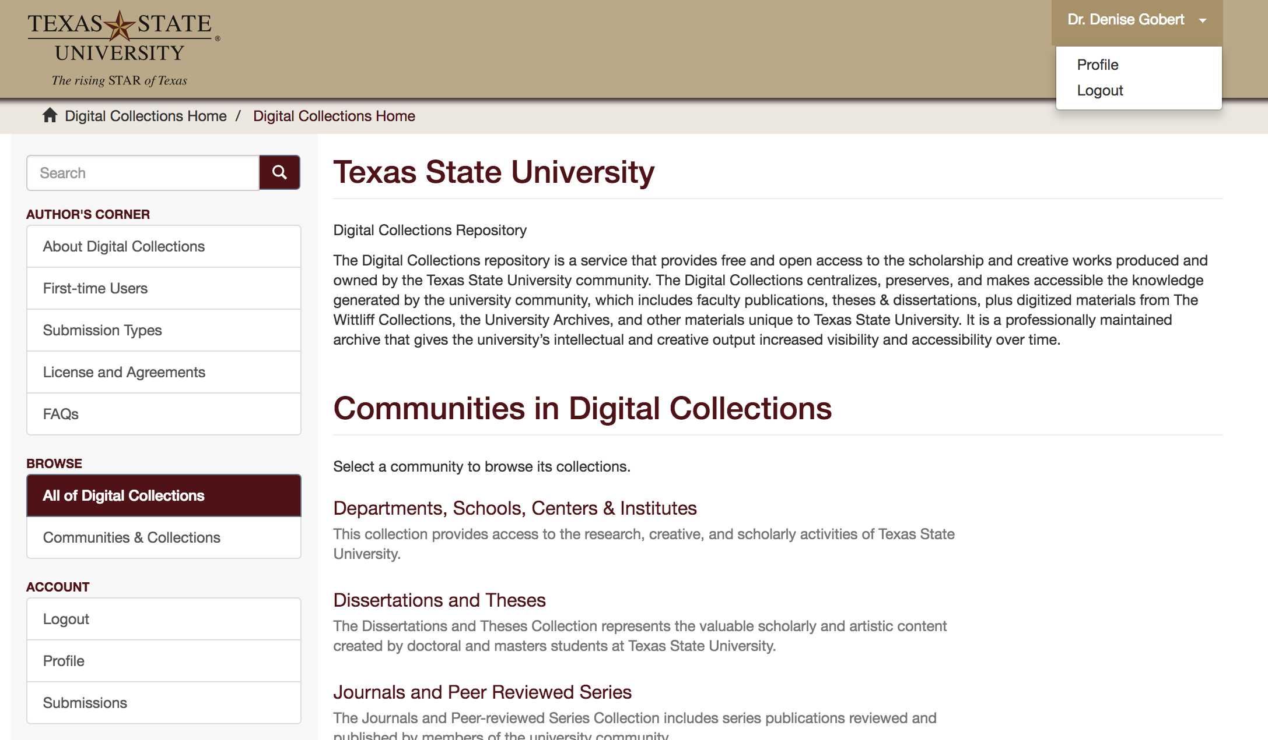

Slide 39
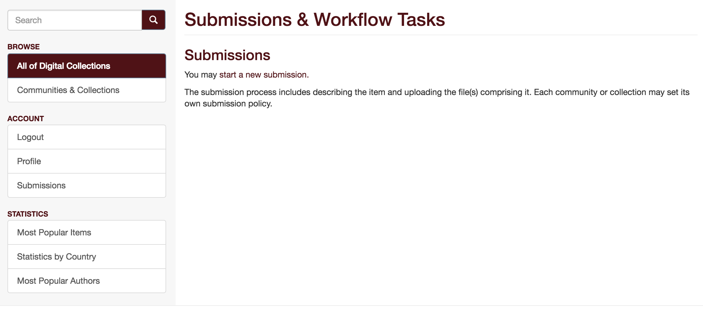

Slide 40
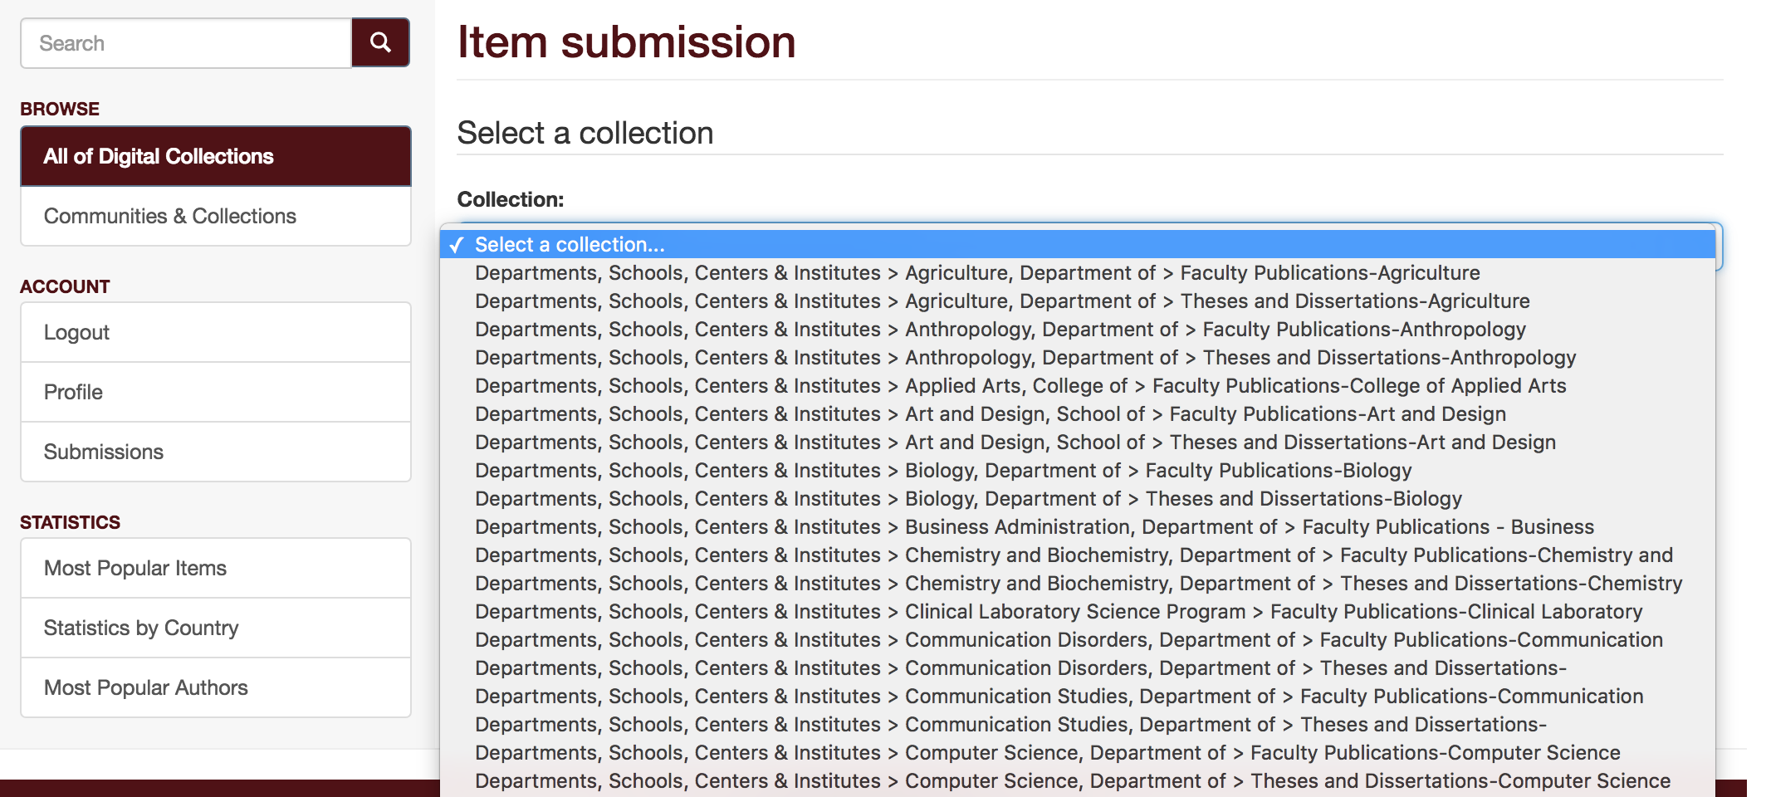

Slide 41
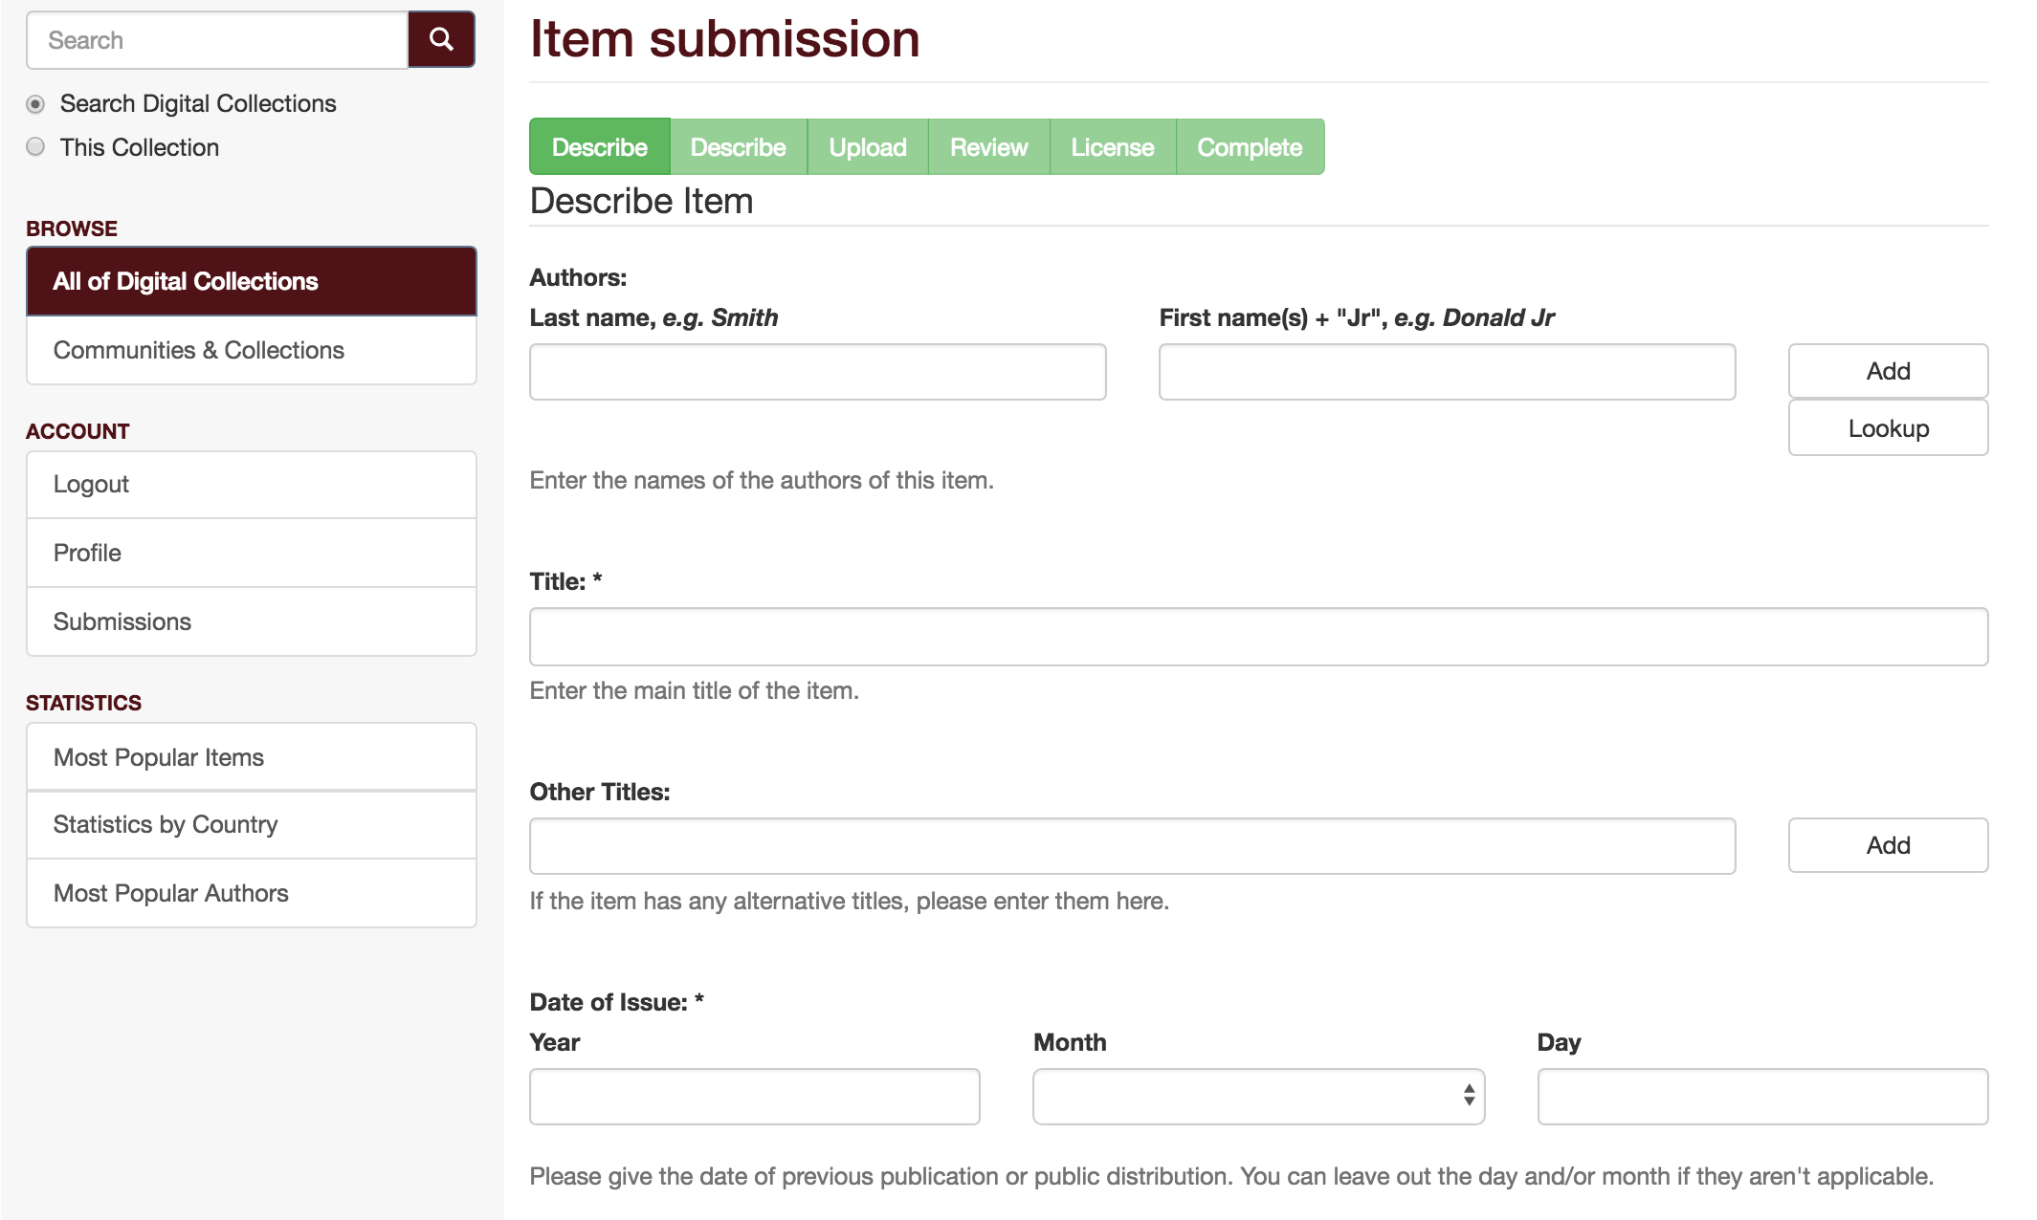

Slide 42
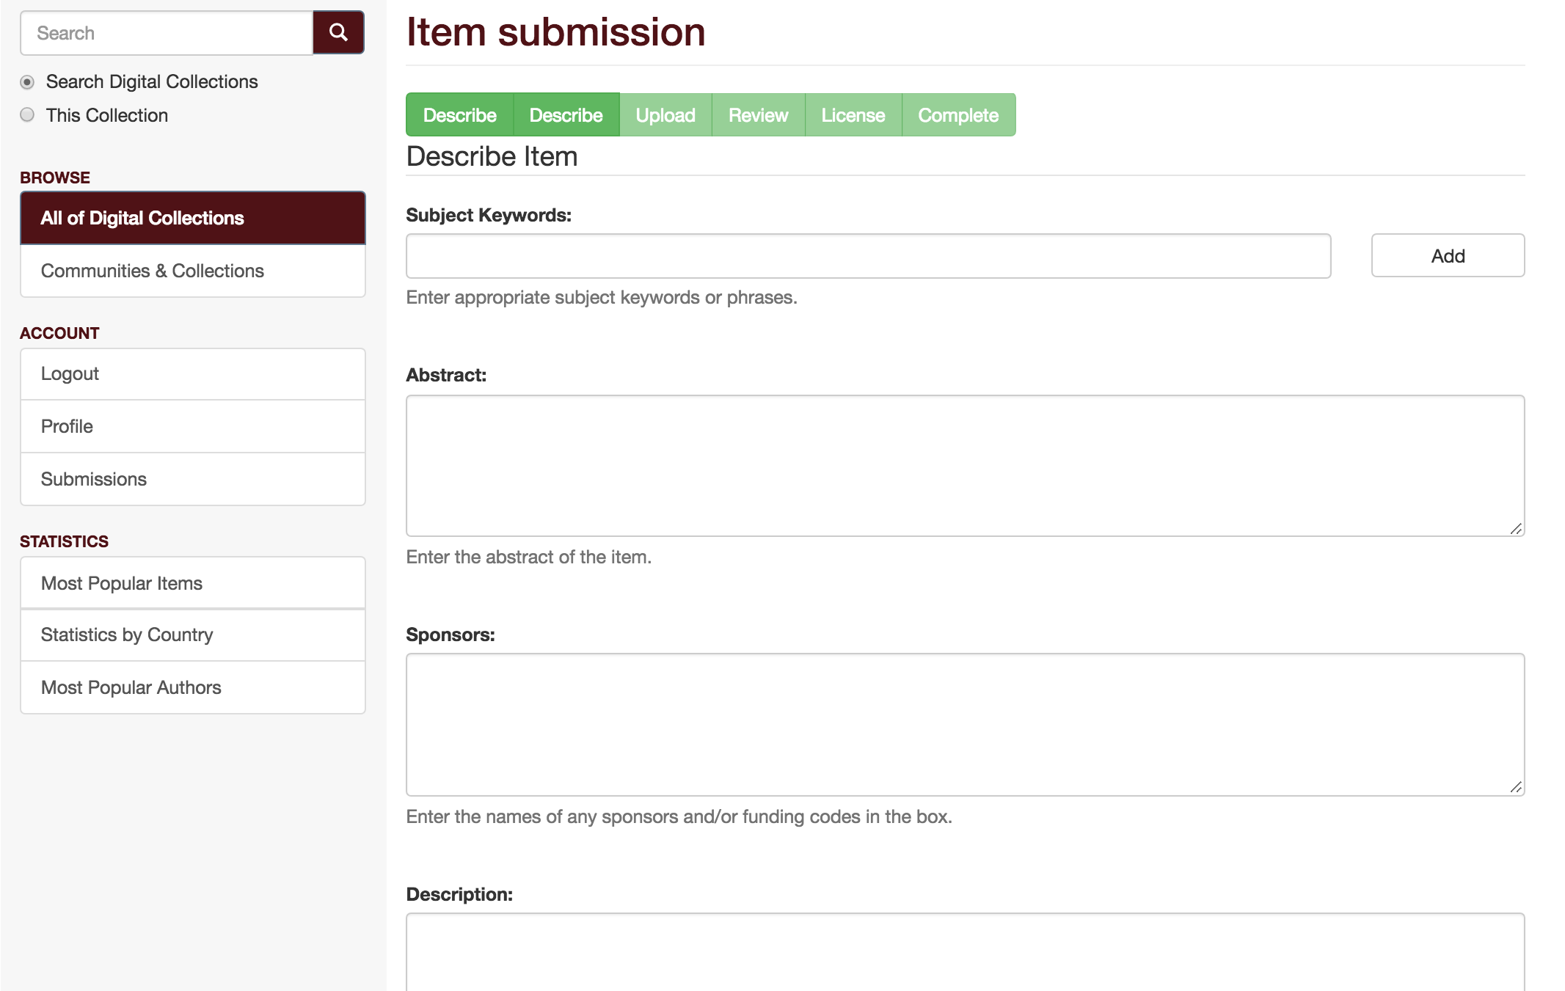

Slide 43
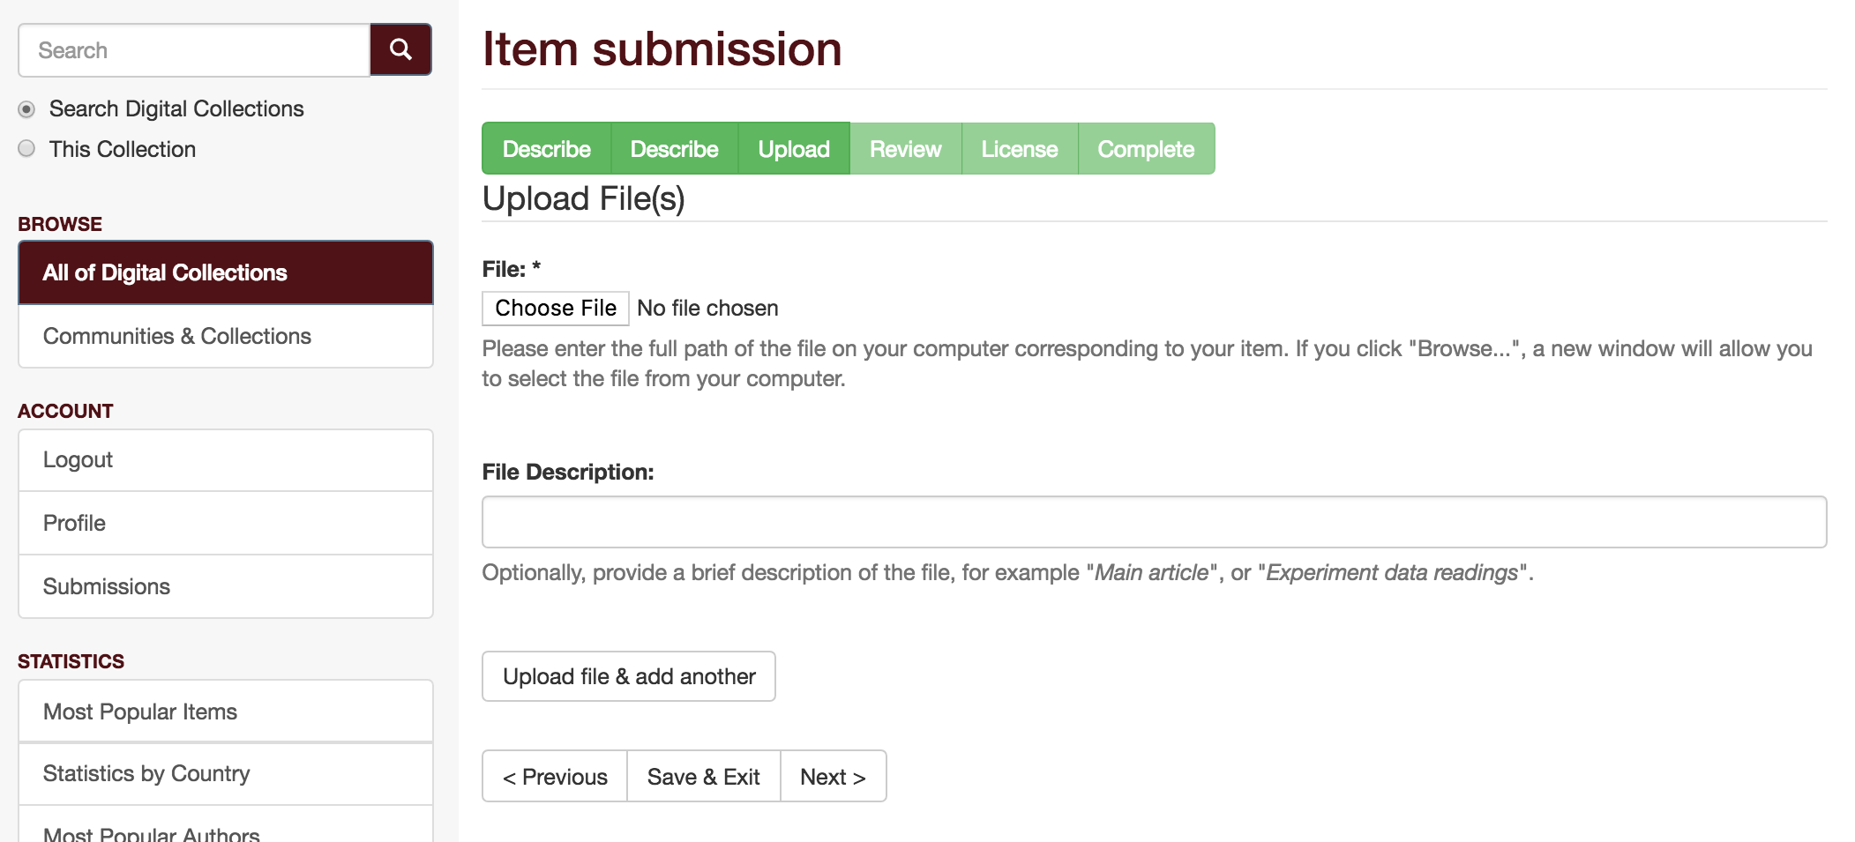

Slide 44
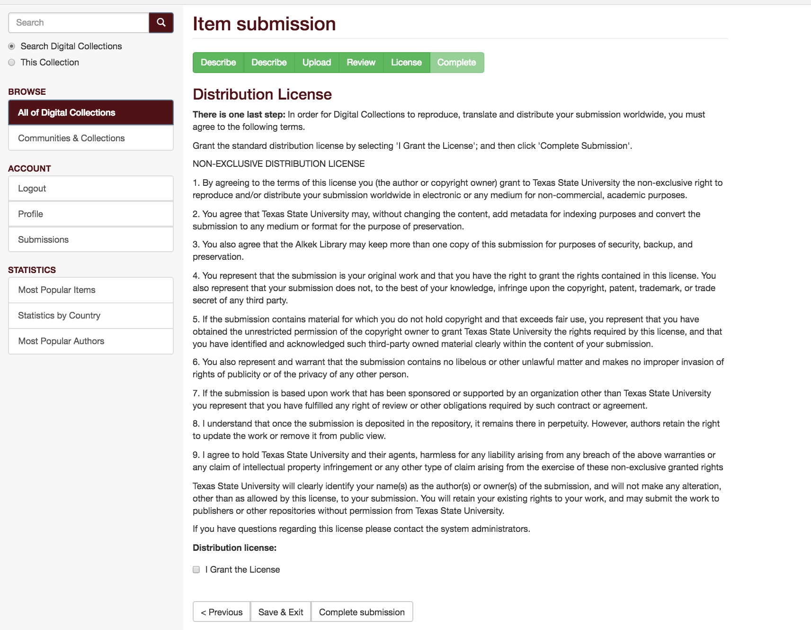

Slide 45
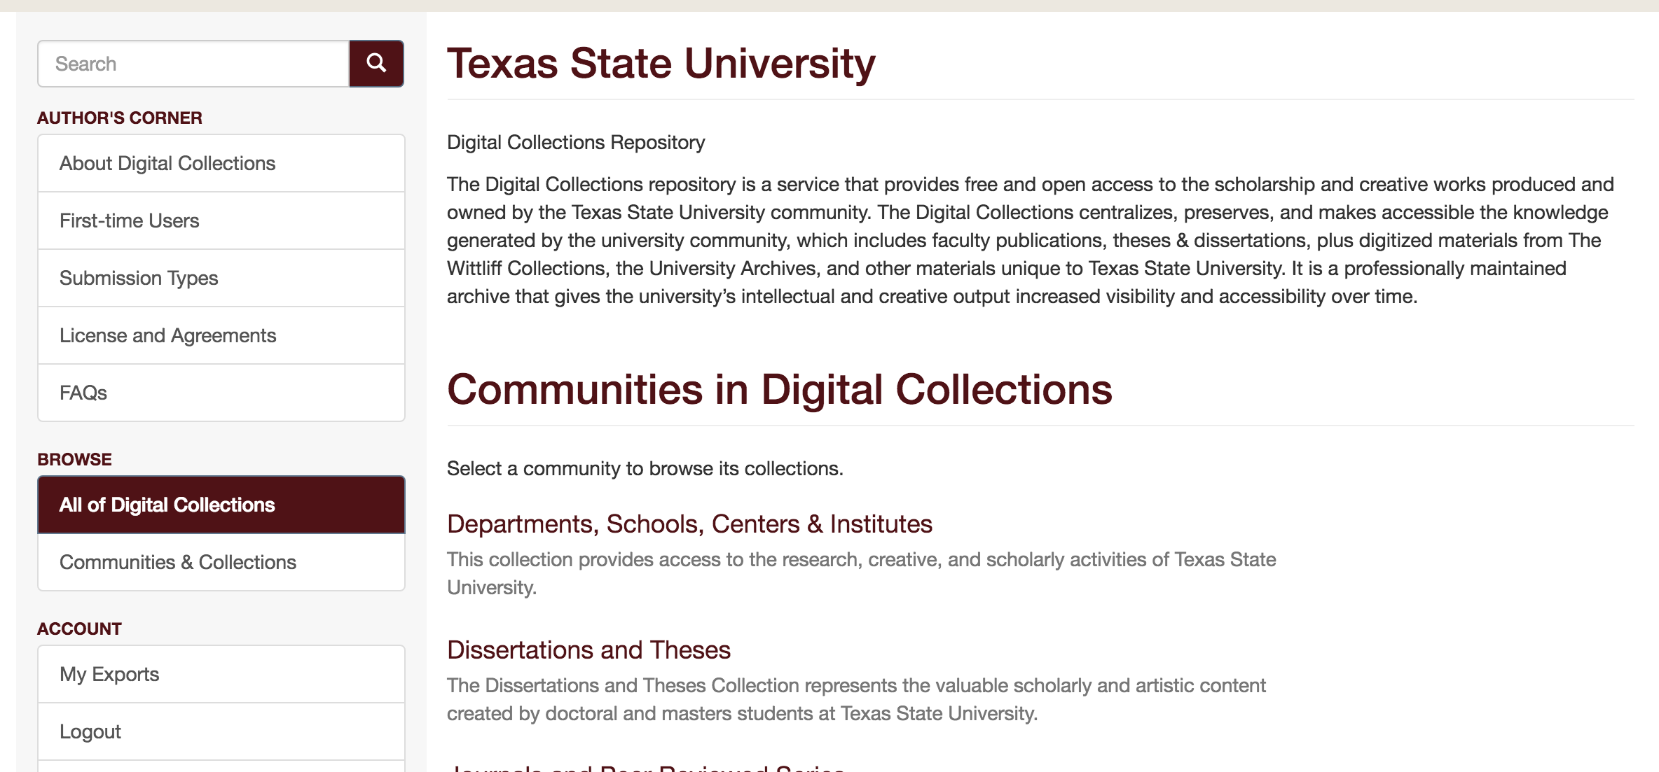

Slide 46
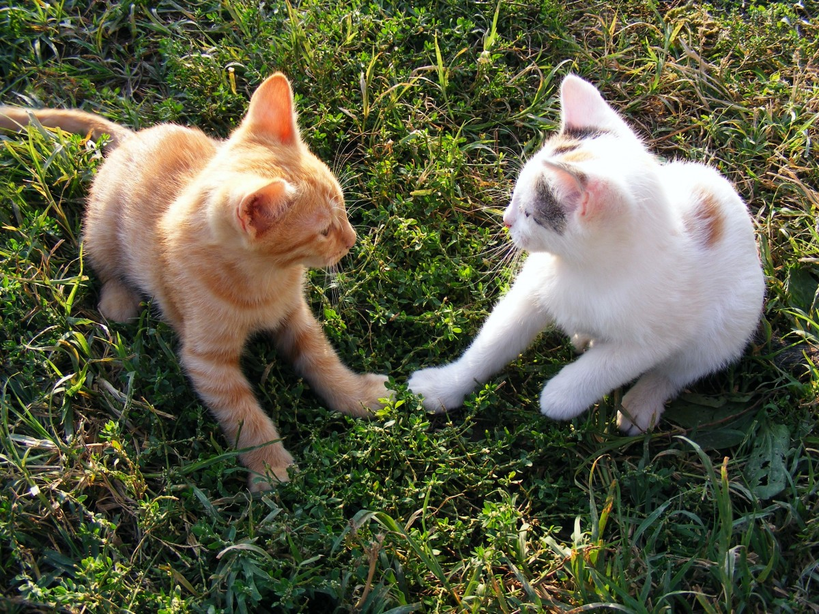
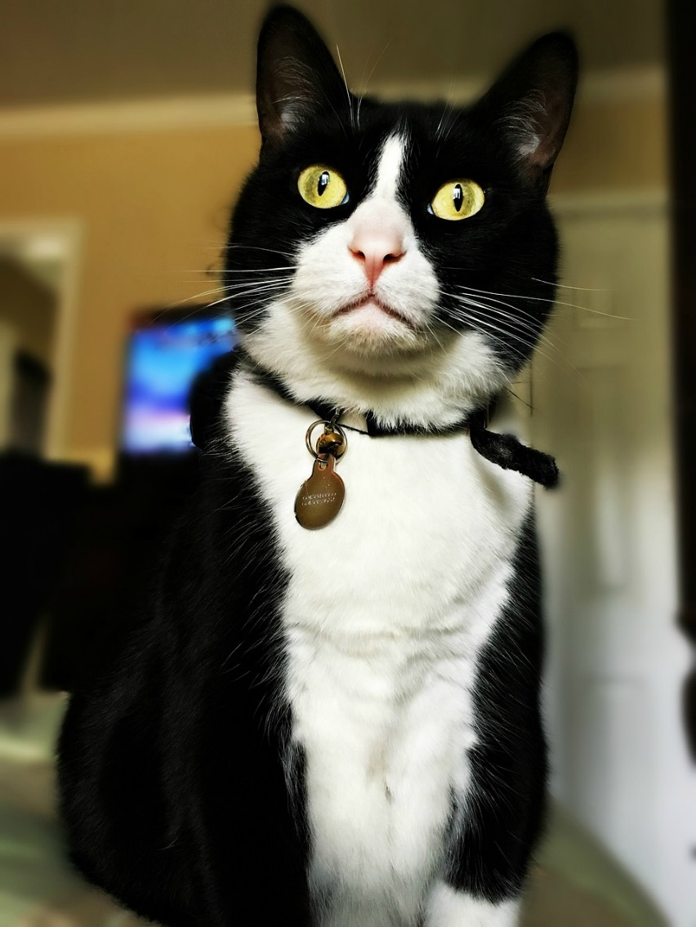
Submitting Your Work
Email me your items:
  lwaugh@txstate.edu
  digitalcollections@txstate.edu
We’ll upload it, normalize the file format, check copyright, add metadata – anything you need!

Slide 47
Preprint, Post-Print, Publisher PDF,
Oh my!

Slide 48
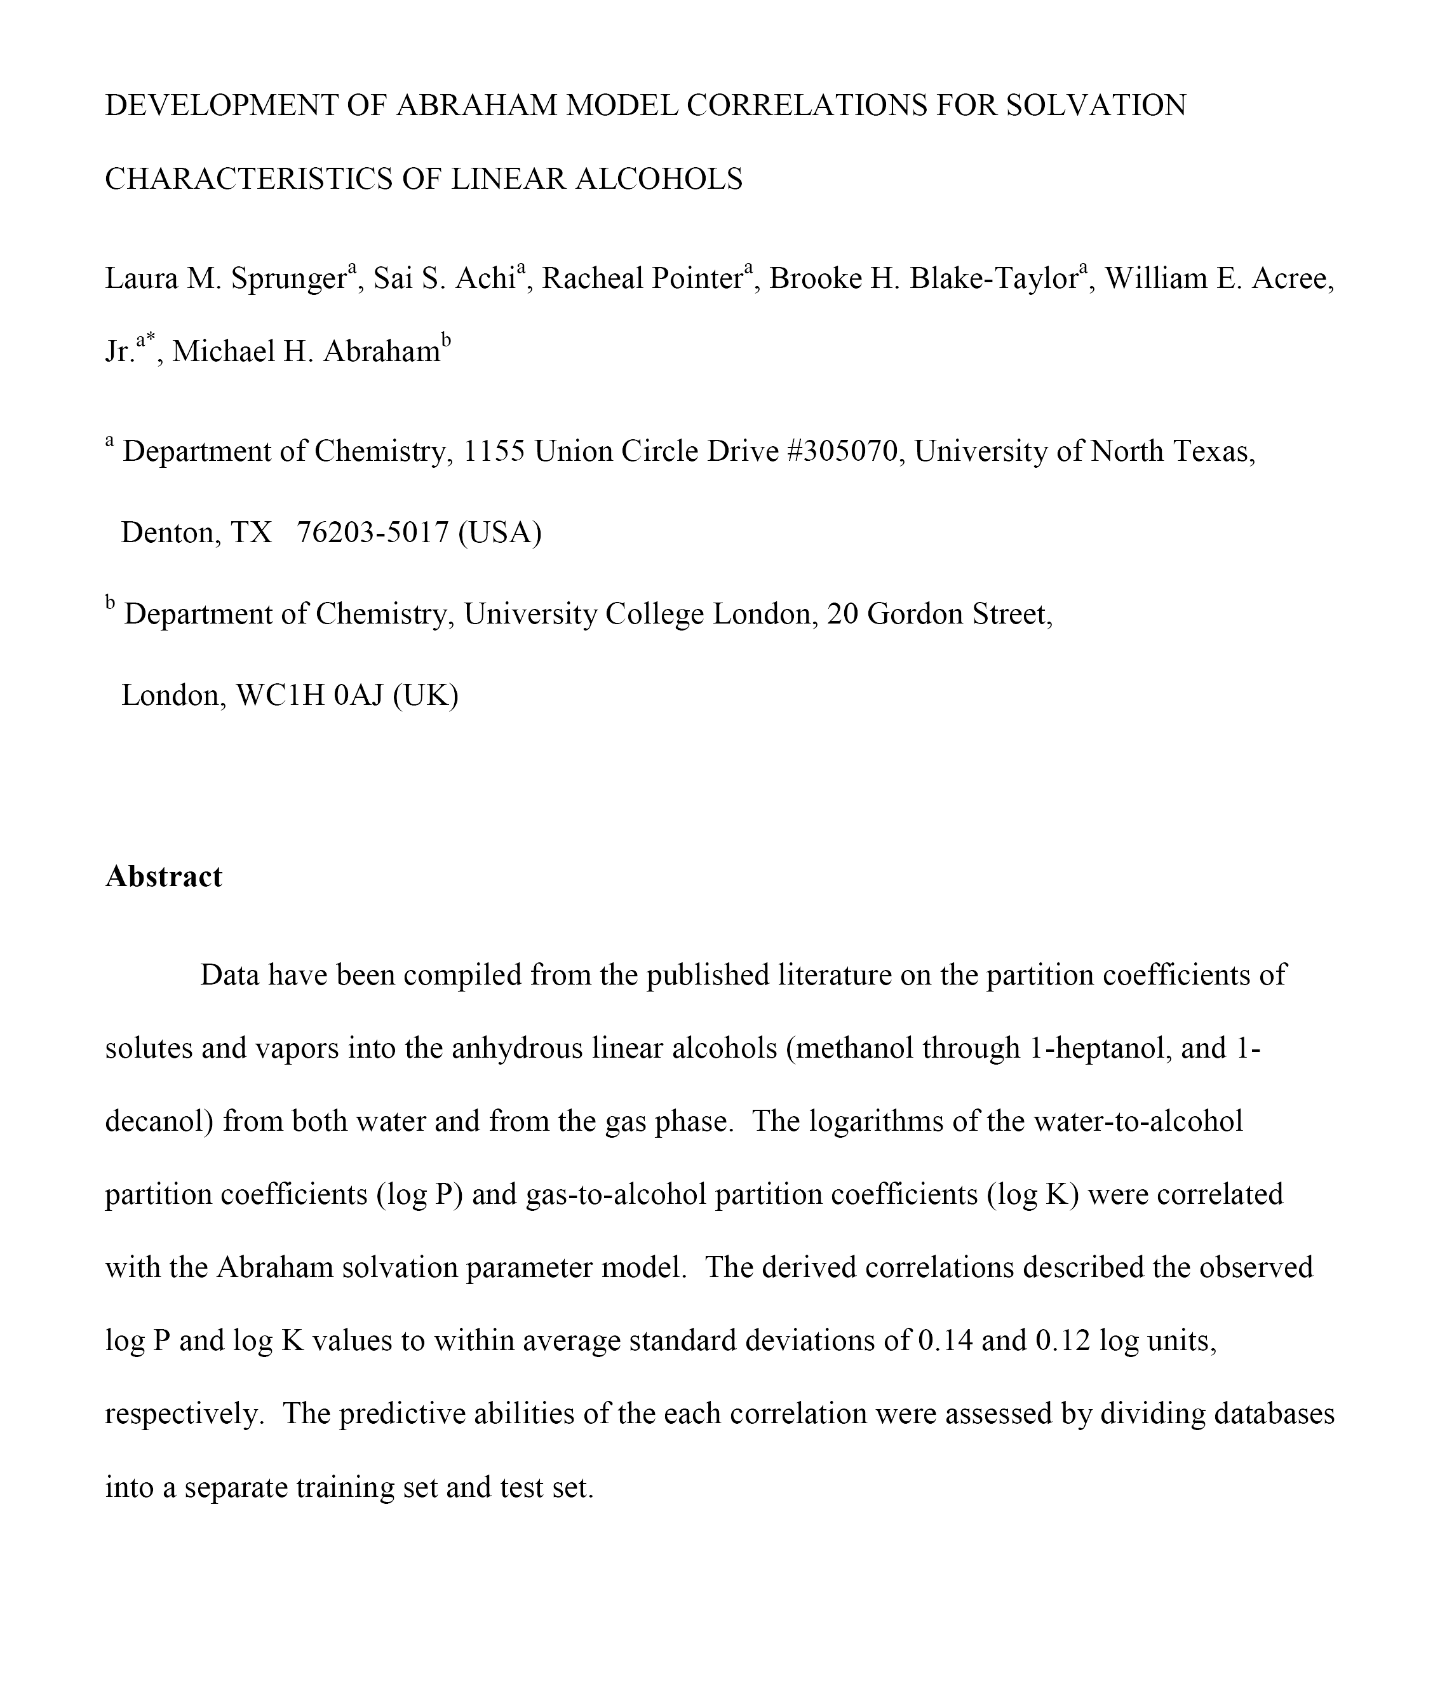
Preprint Version
Preprint:
  Submitted manuscript
  Authors’ initial, submitted version of the article before peer-review
  Include in Repository (most cases)

Slide 49
Post-print Version
Post-print:
  Accepted manuscript
  Authors’ version of the article after accepted, peer-reviewed, and revisions, but before publishing
  Include in Repository (most cases)

Slide 50
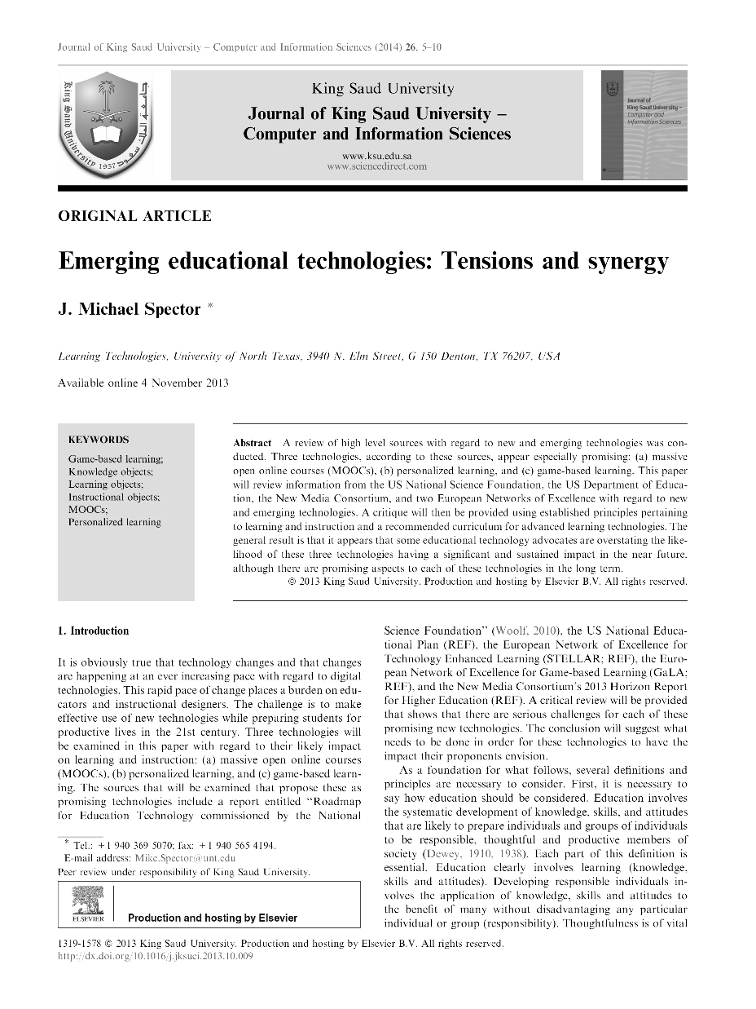
Published (PDF) Version
Published (PDF):
  Publisher-generated
  Final published version with typesetting and logos
  Sometimes, can include in Repository (potential copyright restrictions)

Slide 51


Submit & Send as You Go
Repository
&
Publisher

Slide 52
TXST Dataverse Repository

Slide 53
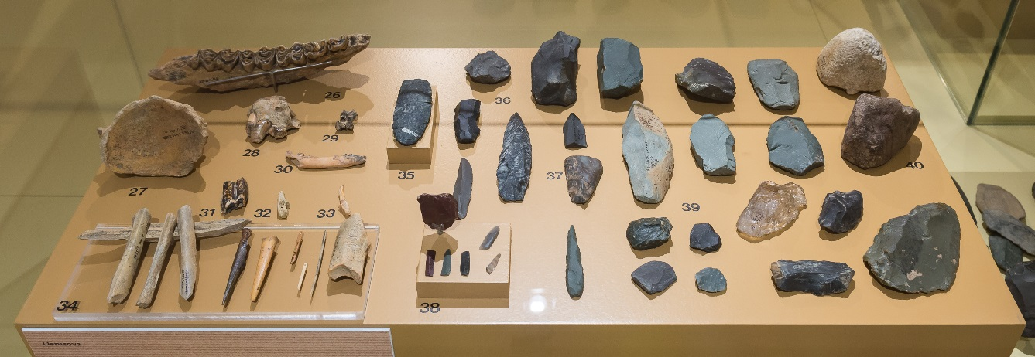
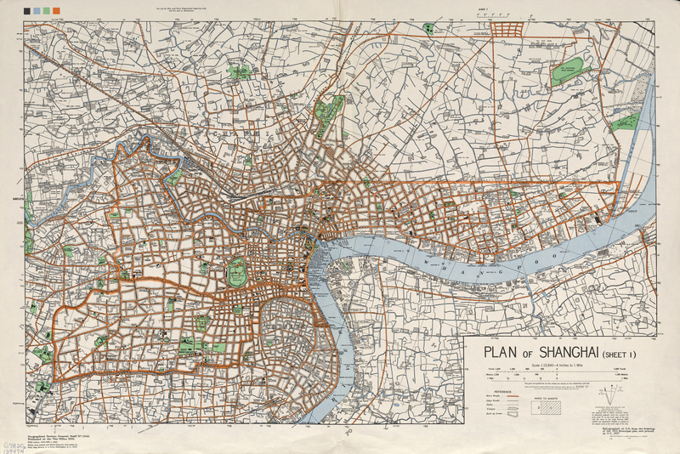
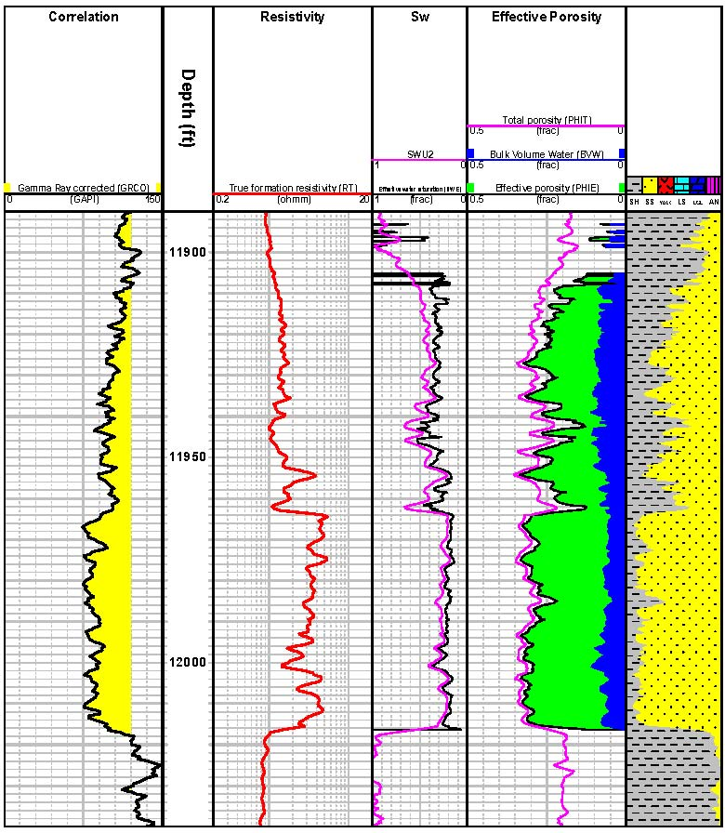
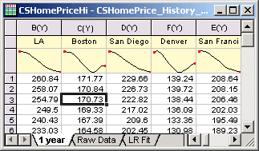
What is “data”?

Slide 54
Differs by Discipline
Natural/Physical Sciences
  Observational
  Experimental
  Simulation
  Compiled
Social Sciences
Qualitative
Quantitative
Humanities
Raw
Primary
Interpretive/Derived
2016, Jessica Trelogan, Managing Research Data, http://hdl.handle.net/2152/41279

Slide 55
Examples of Data
    “…materials generated or collected during the course of conducting research.” (National Endowment for the Humanities)
      Databases
      Recordings
      Geospatial coordinates
      Documentation
      Software code

Slide 56
Why bother with this?
Save time and money
Maximize your impact
Allow for reuse
Do better research
  And, it’s required!

Slide 57

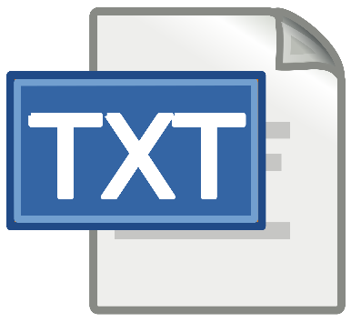

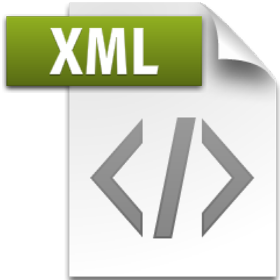

File Format Considerations
  Dataverse accepts any format
  Use what’s common in your discipline
  Non-proprietary, open standards
    Suggested formats:
      Comma-Separated Values (.csv)
      Plain Text (US-ASCII, UTF-8 (.txt)
      XML (.xml)
      JPEG (.jpg)
      PNG (.png)
      AIFF (.aif, .aiff)
      WAVE (.wav)
      AVI (uncompressed) (.avi)

Slide 58
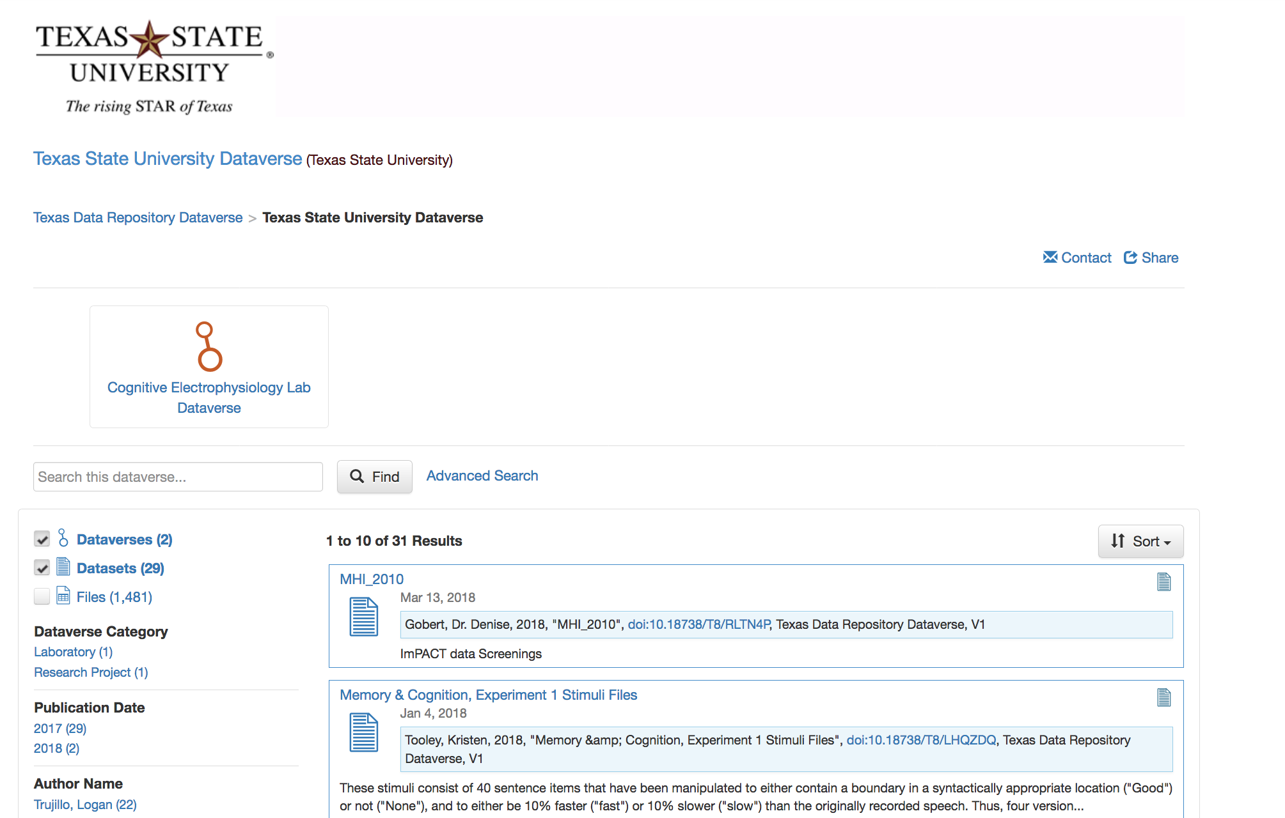
Finally, the moment you’ve all been waiting for…

Slide 59
TXST Dataverse Repository
  Benefits and Features
    Meeting funder mandates
    Permanent URL (doi)
    Organize and archive
    Increase citations and impact
      (receive credit for you work)
    Viewable statistics
https://digital.library.txstate.edu

Slide 60
Structure of Dataverse

Slide 61
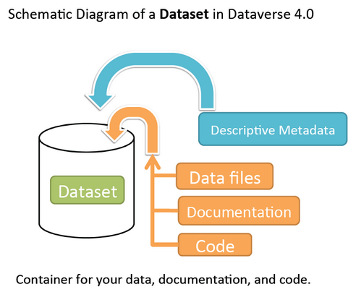

Slide 62
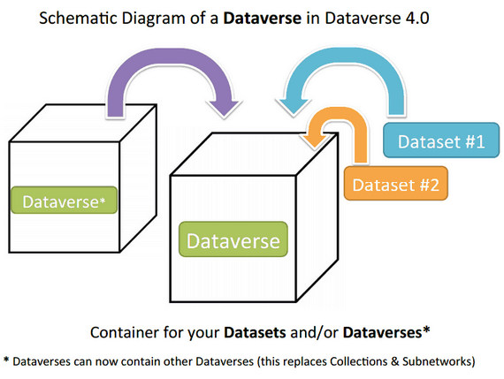

Slide 63
TXST Dataverse Repository
  Option 1:
    Deposit data directly into TXST Dataverse
  Option 2:
    Create a ‘dataverse’ inside the TXST Dataverse and deposit all your data
      (e.g., research project, grant, department, group, etc.)
https://digital.library.txstate.edu

Slide 65
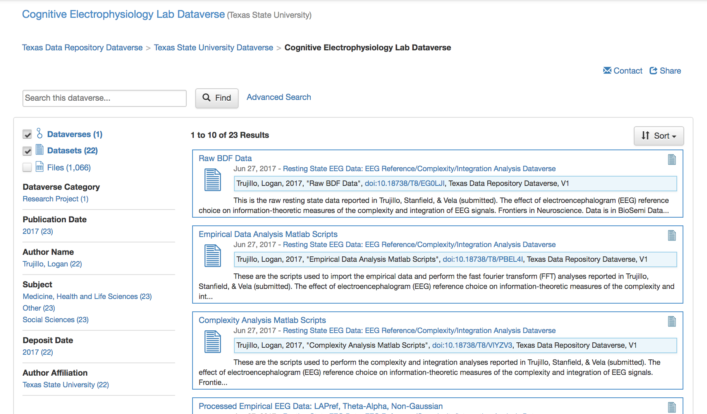

Slide 66
A Look Around Dataverse

Slide 67
TXST Dataverse Repository
https://dataverse.tdl.org/dataverse/txstate

Slide 68
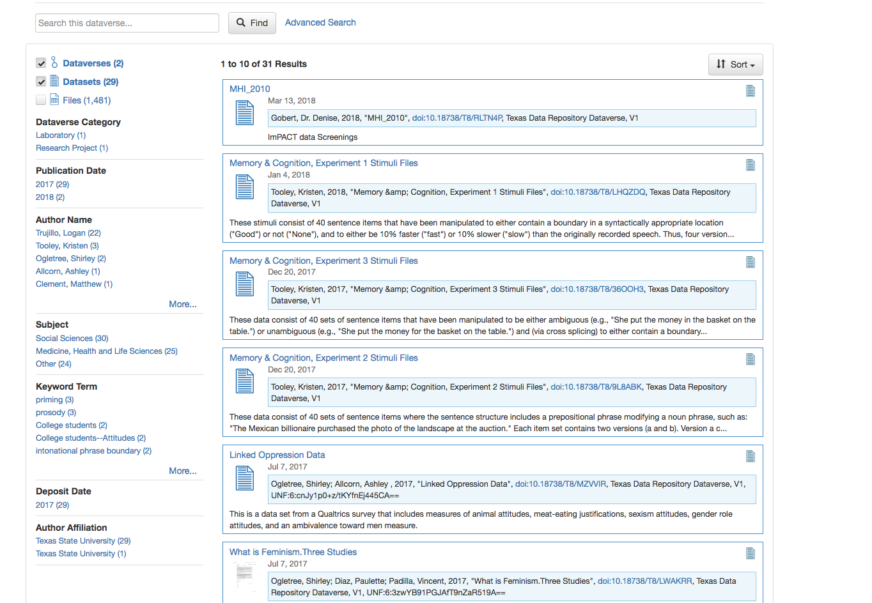

Slide 70
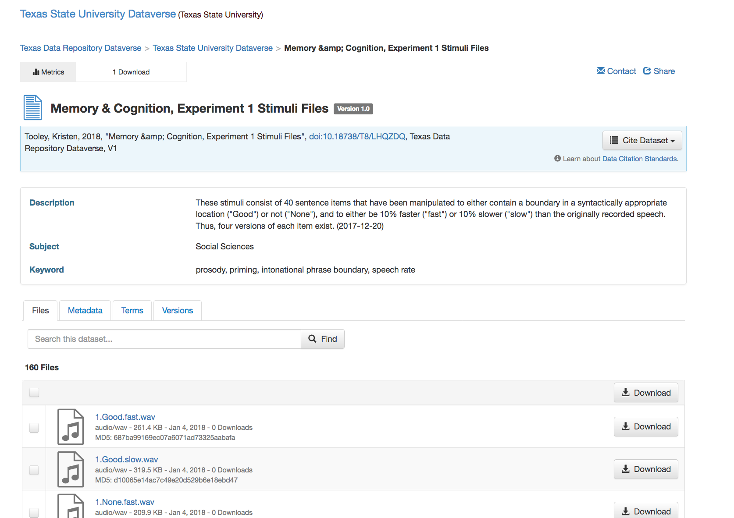

Slide 71
Submitting Your Data

Slide 72
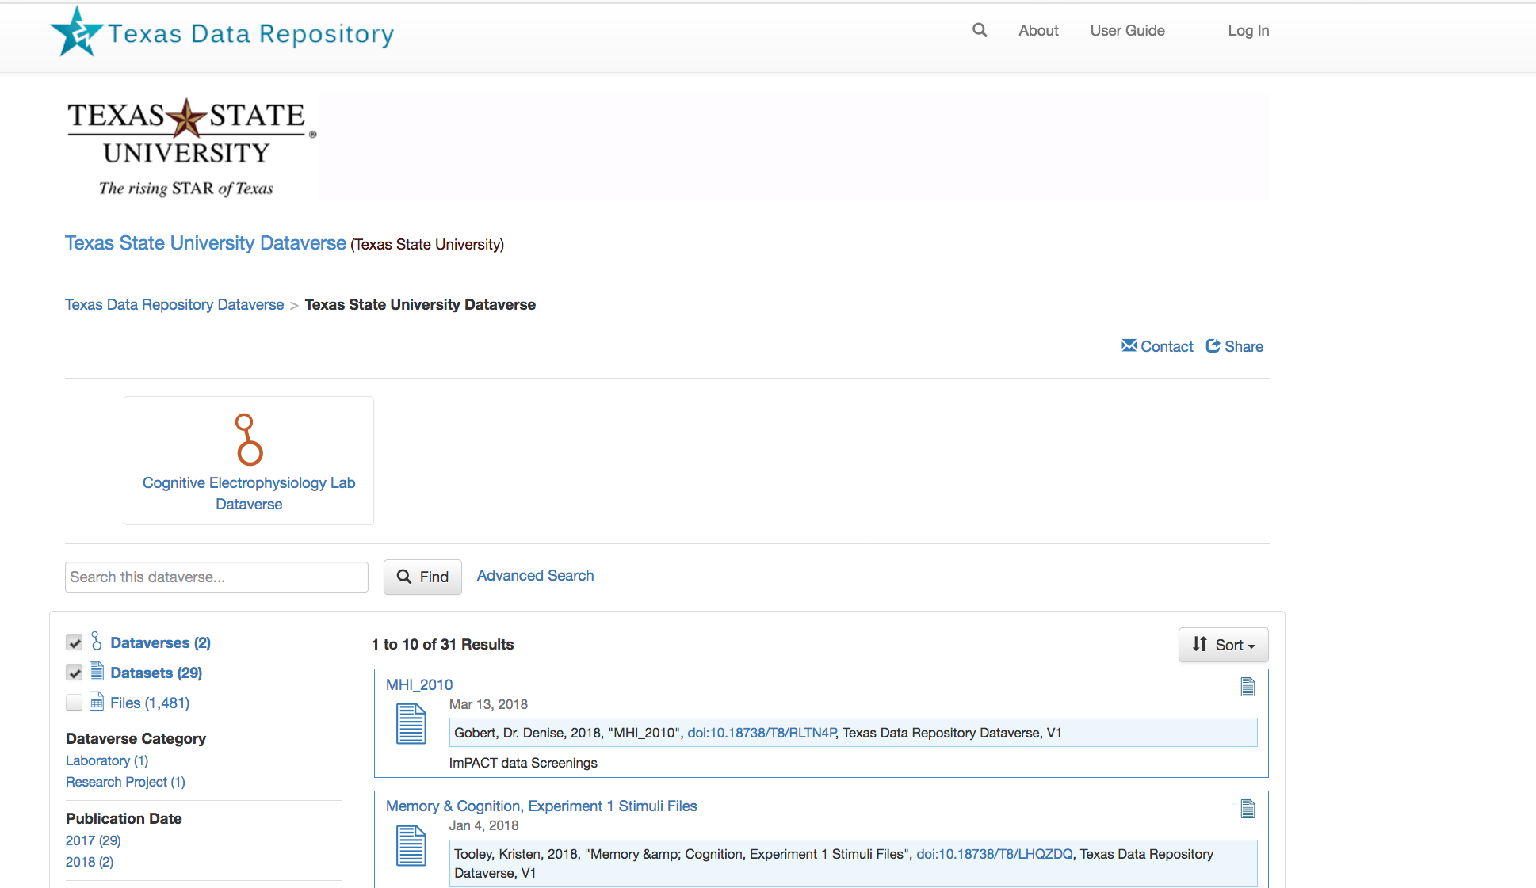

Slide 73
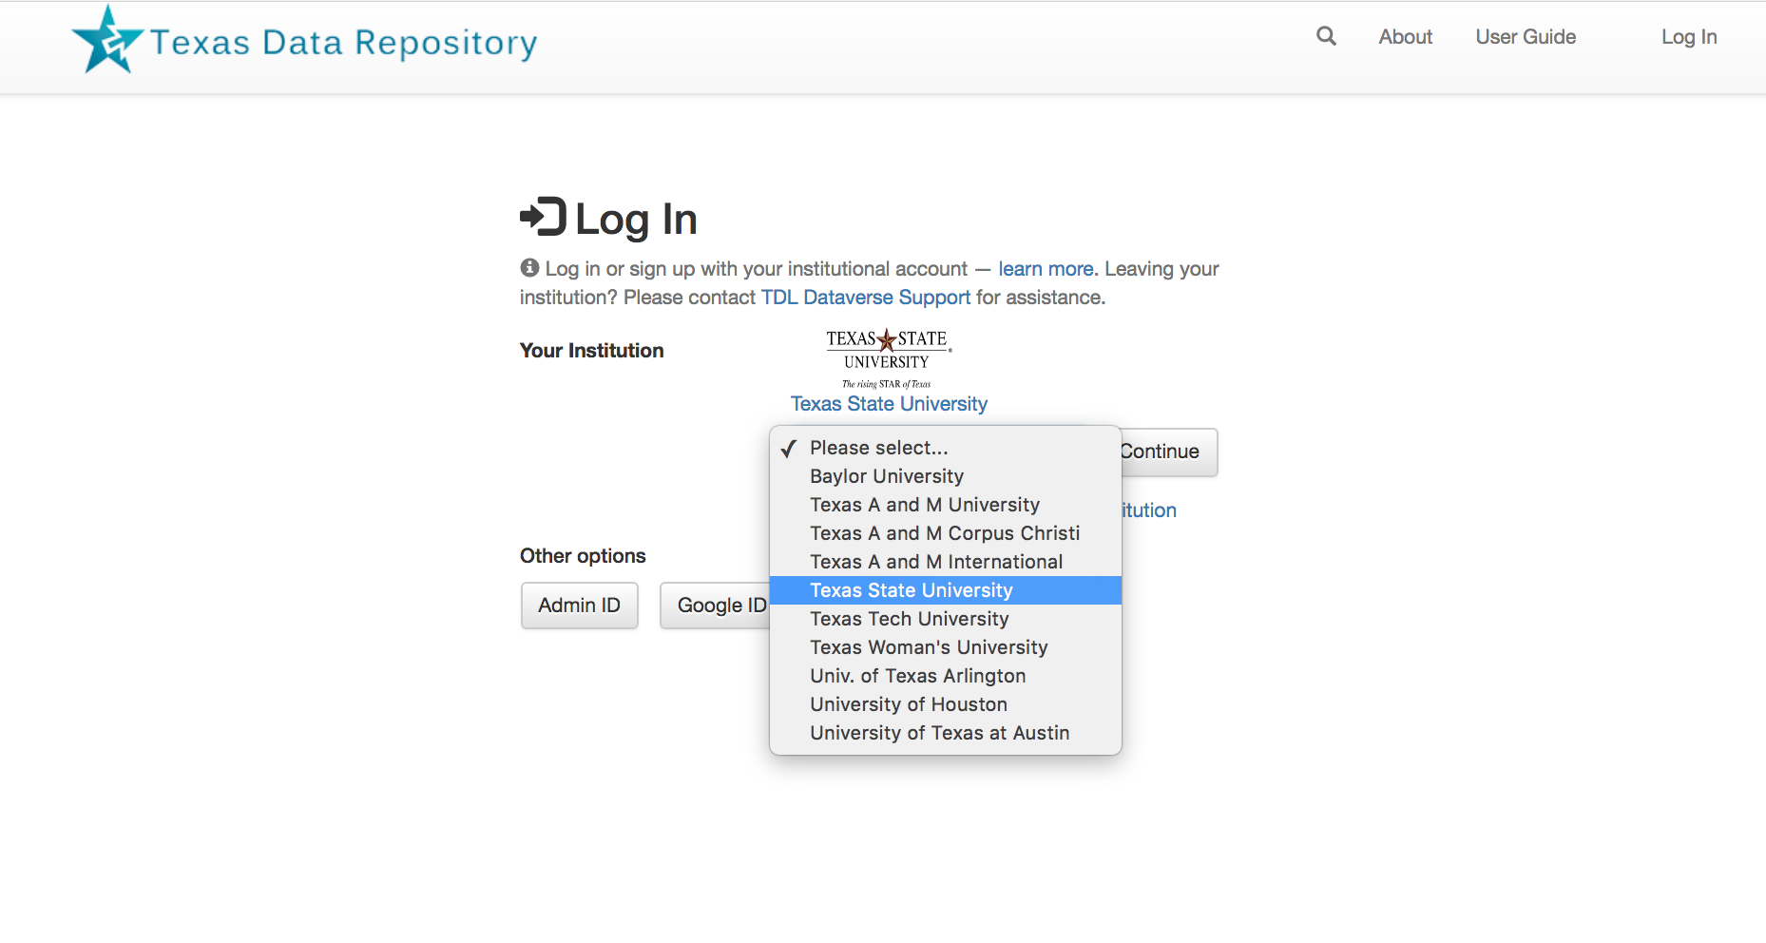

Slide 74
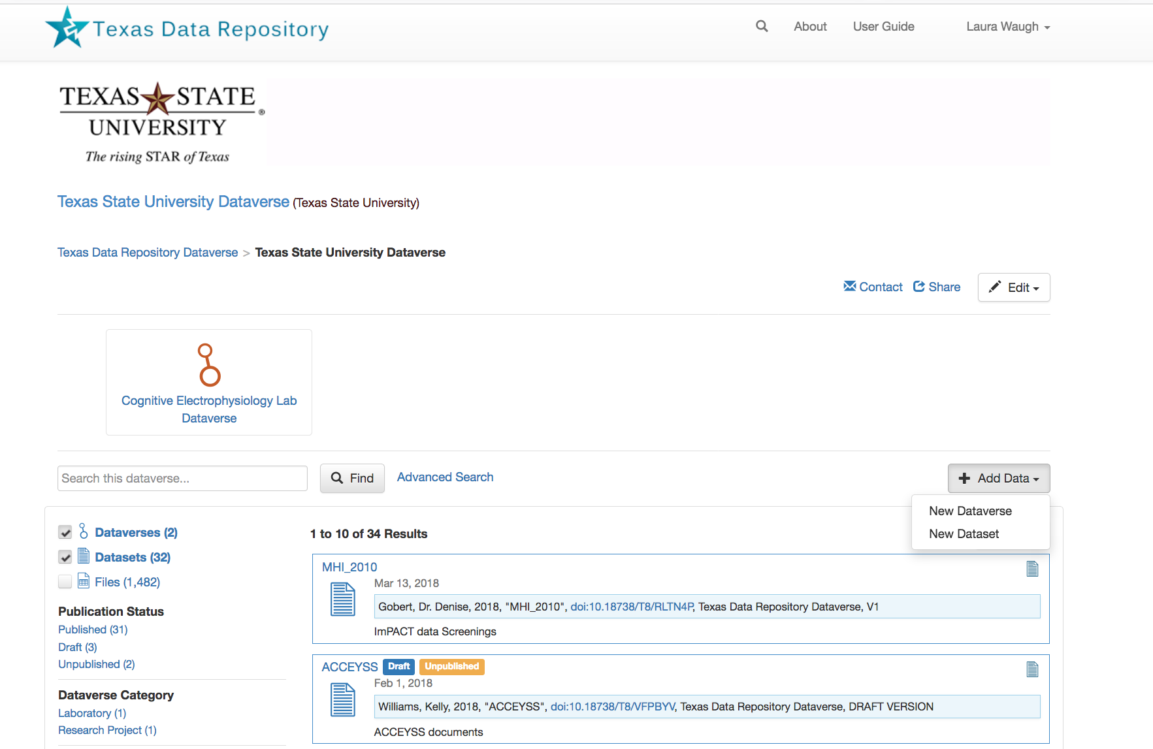

Slide 75
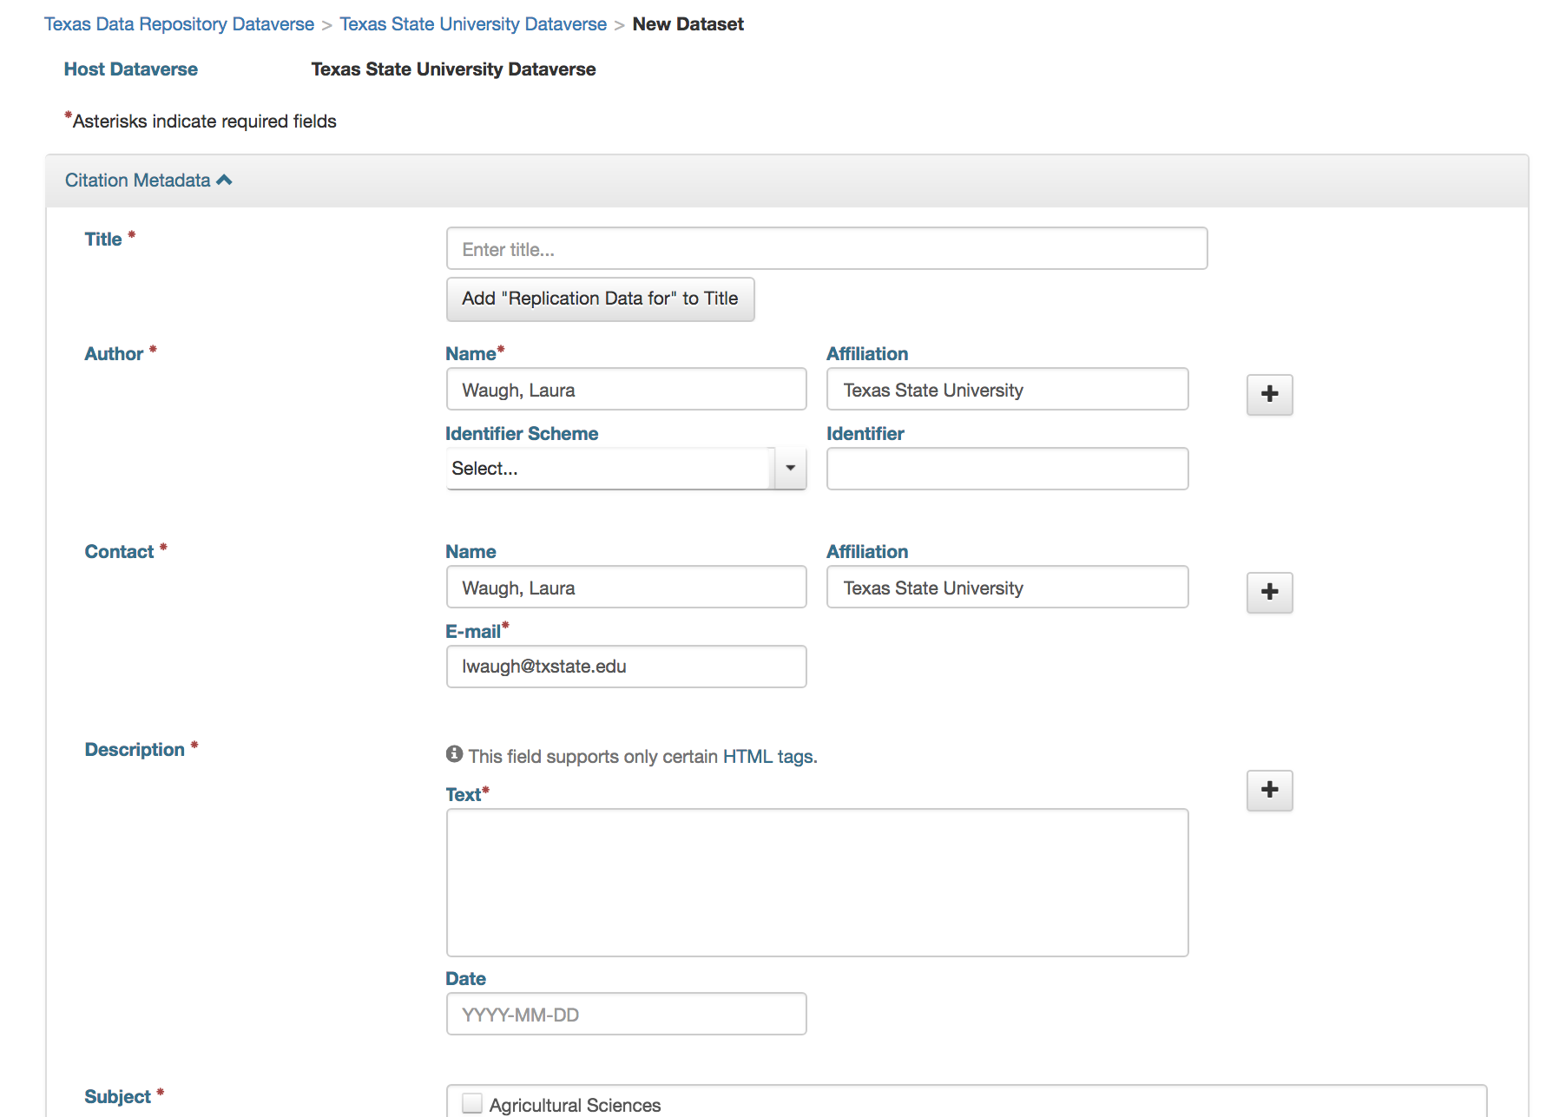

Slide 76
Describe Your Data
Ensure reusability
Metadata helps
Consider your Discipline
ReadMe (.txt) file

Slide 77
TXST Dataverse Repository
    Remains ’unpublished’ until you click “Publish”
    Can share unpublished data with colleagues
    User Guide with step-by-step instructions: http://data.tdl.org/user-guide/
https://digital.library.txstate.edu

Slide 78
Learn More:
From Office of the White House Chief Information Officer:
https://project-open-data.cio.gov/
Links to Federal Agency Open Mandates: http://www.library.cmu.edu/datapub/sc/publicaccess/policies/usgovfunders
ICPSR: What is data curation? https://www.youtube.com/watch?v=ZEkqF8cL2qQ
Find the Texas State University Dataverse on the library website under “Services to Faculty”: http://www.library.txstate.edu/services/faculty.html
Find Research Data information from the Office of Research and Sponsored Services at: http://www.txstate.edu/research/avpr/data_mgmt

Slide 79
Questions?
  Dianna Morganti
  diannamorganti@txstate.edu
  Laura Waugh
  lwaugh@txstate.edu

