Slide 1
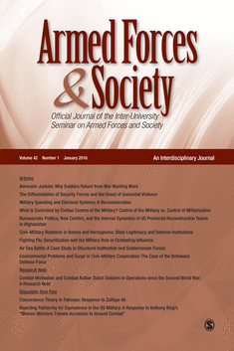
19-21 October, 2018
Academic Publishing in Military Studies:
Insights from an Experienced Editor
Patricia M. Shields
Texas State University
ps07@txstate.edu
Editor-in-Chief
Armed Forces & Society

Slide 2
Editorial Board Outreach

Slide 3

Military Studies Journals
Manuscript Review Process
Editors Perspective
Editors Desk
General Tips (content quality)
To Do -- Before submit
To Do – R&R
Keys to Success (personal)
Discoverability
Overview of Presentation

Slide 4
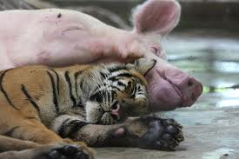
Where do Military Studies Journals
Fit in Academic Rankings?
Journal Citation Report

Slide 5
Previously Thompson Reuters
35% of all journals are part of
The JCR

Slide 6




Where are Military Journals Ranked

Slide 7

Impact Factor
measures the average
number of citations
to recent published articles
Number of times AF&S articles in 2016 & 2015 were
cited in JCR Journals
2 year (2017)
Impact Factor
=
Total number of articles in AF&S for 2016 & 2015
Problems with indicator

Slide 8
Rank | Journal | 5h-Index
1 | International Security | 33
2 | Security Dialogue | 30
3 | Studies in Conflict and Terrorism | 28
4 | Survival | 28
5 | Security Studies | 21
6 | Journal of Strategic Studies | 20
7 | Military Psychology | 20
8 | Armed Forces & Society | 20
9 | European Security | 19
10 | Defense and Peace Economics | 18
11 | International Peacekeeping | 17
12 | The RUSI Journal | 15
13 | Contemporary Security Policy | 15
14 | Parameters | 15
15 | Intelligence and National Security | 14
15 | Civil Wars | 13
17 | Small Wars and Insurgencies | 13
Military Studies Rankings
2018
h5-index
is the largest number h such that h articles published in 2013-2017 have at least h citations
As score of 10 would mean
10 articles published 2013-17 with 10 citations +

Slide 9
Rate wider exposure
of articles
Authors’ can take actions
to influence

Slide 10

Double Blind
Peer Review
Promotes Fairness in Process

Slide 11
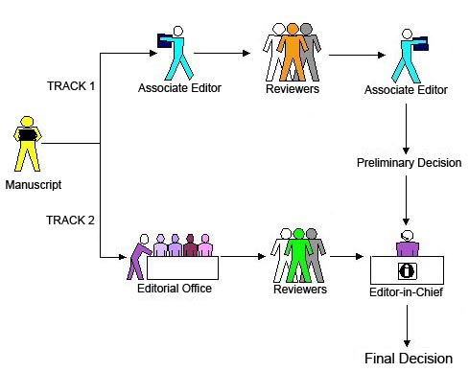
Editorial Process
(submission - publication)

Slide 12

Stage 1
Manuscript arrives
Editor’s Review
Reject 40- 60%
Find Reviewers

Slide 13

Stage 2
Send out for review
2-4 reviewers
Reviews in
Reviewers assessment

Slide 14


Stage 3
First Round Decision
Accept Very rare (1 in 500)
Reject
Revise and Resubmit
Persistence

Slide 15
Stage 4 +++
R&R decision, comments sent to author
Revised Manuscript and letter with explanation arrives
Re-review Re-review (could be 2 - 4 rounds)
Decision - Accept/Reject
If Accept publisher takes over

Slide 16
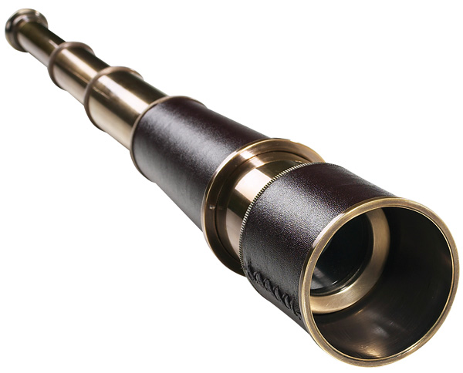


Editors Perspective
Scholars perspective

Slide 17

Steward or
Caretaker Role

Slide 18



Editor as Coach and Cop
Improve the manuscript
Make sure poor material gets caught

Slide 19

Most Precious Asset
Reviewer time

Slide 20
What is the citation potential?
Impact Factor

Slide 21

Tips Article Acceptance
Getting past the
Editors Desk

Slide 22

POOR FIT
Outside scope or mission of the journal

Slide 23
Audience --
Scholars/Policy Makers
International & Interdisciplinary
AVOID
Purely Military topics (strategy, tactics)
Purely International Relations Topics
If audience is military leadership of a particular country
Lots of country specific acronyms

Slide 24

Strong Abstract
Reviewer comment
Poor abstract
Poor paper

Slide 25
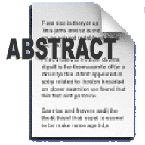
Include
Purpose
Method
Key findings
Take-away
Research Purpose
Method to achieve purpose
Key findings
Take-Away
Strong Writing
Avoid
Acronyms
Convoluted sentences
Obvious conclusion
(more research needed)

Slide 26

Introduction
Do not repeat abstract
Present big picture
Compelling case for research purpose/question
Clear statement of aims/purpose of pa
Big Picture
State purpose or aim early
Compelling Case for research question
Strongest Writing

Slide 27

Bibliography
Overall Quality
Cites to AF&S
Find Reviewers

Slide 28

Easy to Navigate
Clear logical subheadings
Tables – Stand alone quality

Slide 29

















Inadequate sample size
(7 interviews, 2 focus groups @
university Y)

Slide 30
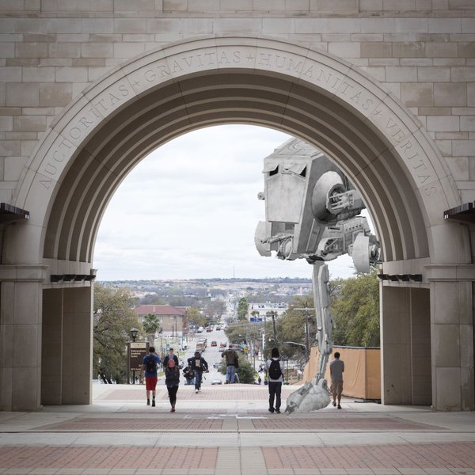
Quality Threshold
Poor Writing
Tired ideas
Lacks Coherence
Limited generalizability

Slide 31

To ensure meets quality threshold

Slide 32

Strong
External Validity
Broadly Defined
Survey Research
Case Studies multiple countries
Theoretical analytical generalizability

Slide 33

Enough Information
Imagine how to Replicate

Slide 34

State Hypotheses in testable form
Operationalization easy to find/judge
Does Hypothesis connect to research purpose/question?
Does the evidence collected test the hypothesis?

Slide 35
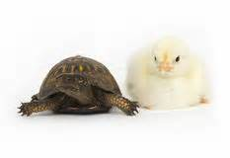
Do Data and Claims match?
Inappropriate generalization
Recognize Alternative Hypotheses

Slide 36

Before you send it out

Slide 37

Strategize the best fit journals
Find journal description, does it fit?
What is journal’s quality threshold?
Have they published articles on similar topics?
Preferred Methodology?
End with a plan and a
ranking of journals

Slide 38
Send to journals you cite!

Slide 39

Revise & Resubmit Decision

Slide 40
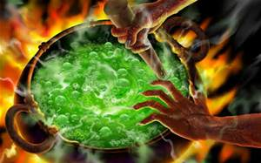
Get control of emotions

Slide 41

Open minded Creative Thinking

Slide 42

Revise & Resubmit
Explanation Letter
Organized
Thoughtful (not superficial)
Disagree OK
– good reason

Slide 43

Additional

Slide 44


Don’t take it personally (key test how you deal with first rejection)
Try again (use comments from reviewers)

Slide 45

Share your work widely – present at conferences
Conference Papers/Syllabi on Academia.edu, Institutional Repository, Research Gate

Slide 46

Cultivate Collaborators
No down side to “Good” co-author(s)

Slide 47


Two Personal Rules for
Successful Scholarship
The only good dissertation
is a completed dissertation.
2. Better in a library than a file cabinet.

Slide 48
Become an Active Reviewer
Familiar with behind the scenes
Hone critical review skills – apply to own work
Respect of the editor
Get a sense of what is a strong/weak paper
Active member of scholarly community

Slide 49
Shed the insider perspective
Consciously write for a larger audience
Limit unnecessary acronyms
Stand alone tables – easy skim
International & Interdisciplinary

Slide 50

Discoverability
Optimizing Article For Search Engines

Slide 51

EXTRA ATTENTION
Key Words
Abstract
Title

Slide 52





My Citations

Slide 53
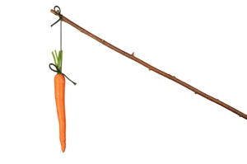
Incentives

Slide 54
Questions??

