Slide 1
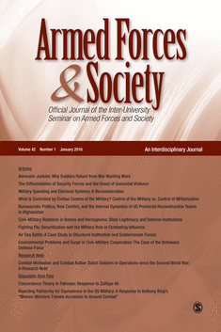
21-23 October, 2022
Scholarly Publishing in Military Sciences:
Insights from an Experienced Editor
Patricia M. Shields
Texas State University
ps07@txstate.edu
Editor-in-Chief
Armed Forces & Society

Slide 2
Editorial Board Outreach

Slide 3

Manuscript Review Process
Editors Perspective
Editors Desk
General Tips (content quality)
To Do -- Before submit
To Do – R&R
Keys to Success (personal)
Discoverability
Overview of Presentation

Slide 4


Double Blind
Peer Review
Promotes Fairness in Process

Slide 5
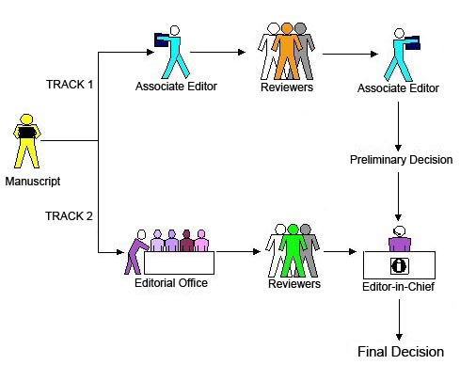
Editorial Process
(submission - publication)

Slide 6
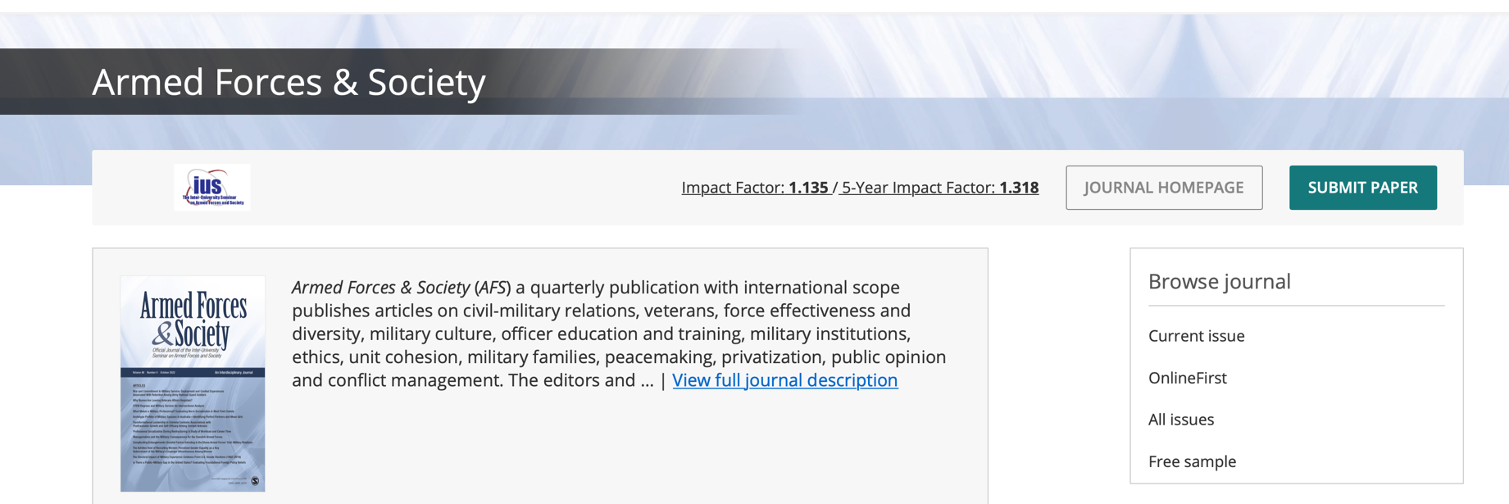
Stage 0 (Before submission)
Getting the Manuscript Ready for Review
Follow manuscript guidelines

Slide 7
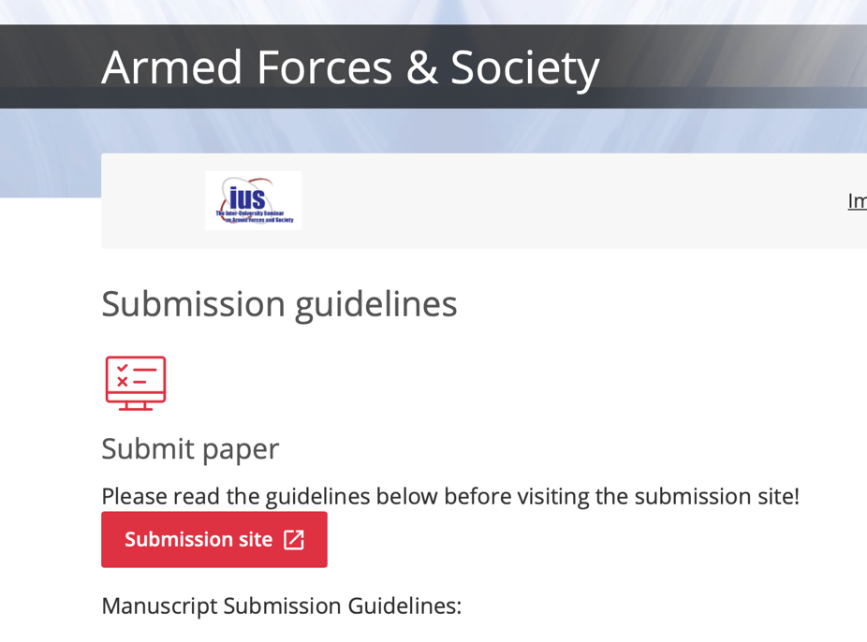
A few basics
APA 7.0 Style. (examples)
Endnotes
Anonymize
Figures/tables at end of paper
Return to Author to Fix

Slide 8


Stage 1
Manuscript arrives
Managing Editor Review
Editor’s Review
Reject 40- 60%
Find Reviewers

Slide 9

Stage 2
Send out for review
2-4 reviewers
Reviews in
Reviewers’ assessment

Slide 10

Stage 3
First Round Decision
Accept Very rare (1 in 500)
Reject
Revise and Resubmit

Slide 11
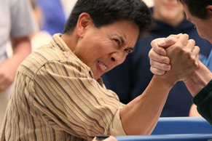
Stage 4 +++
R&R decision, comments sent to author
Revised Manuscript and letter with explanation arrives
Re-review Re-review (could be 2 - 4 rounds)
Decision - Accept/Reject
Sent to publisher for processing

Slide 12
Stage 5
Copyediting by SAGE
Author queries – Clarification/approval
Onlinefirst. (5-7 weeks)
Assigned to an
Issue (12 – 18 months)

Slide 13

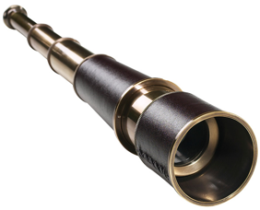


Editors Perspective
Scholars perspective

Slide 14


Steward or
Caretaker Role

Slide 15
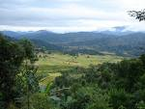


Editor as Coach and Cop
Improve the manuscript
Make sure poor material gets caught

Slide 16


Most Precious Asset
Reviewer time
More challenging to find reviewers

Slide 17

What is the citation potential?
Impact Factor

Slide 18
Impact Factor
measures the average
number of citations
to recent published articles
Number of times AF&S articles in 2020 & 2019 were
cited in JCR Journals
2 year (2021)
Impact Factor
=
1.135
Total number of articles in AF&S for 2020 & 2019
Problems with indicator

Slide 19


Tips Article Acceptance
Getting past the
Editors Desk

Slide 20

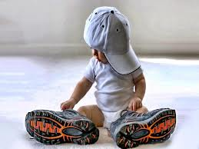
POOR FIT
Outside scope or mission of the journal

Slide 21
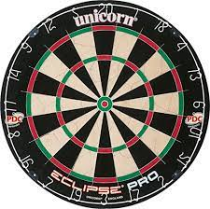
Bulls eye topics
civil-military relations
professionalism/leadership
veterans & reserves
military families
recruitment/retention
public opinion/popular culture
gender/race issues
peacekeeping
domestic use of military
civil/military cooperation
health/mental health
contracting
police/military interface
cohesion/readiness
society
military

Slide 22
Not Bullseye topic (far end of dartboard)
Need to make the case – fits the mission (implicit or explicit)
Look for new topics. Forest changes
“Dynamic intersection of Military & Society”
https://link.springer.com/referenceworkentry/10.1007/978-3-030-02866-4_31-1
Handbook of Military Science

Slide 23
Audience --
Scholars/Policy Makers
International & Interdisciplinary
Military scholars
AVOID
Purely Military topics (strategy, tactics)
Purely International Relations Topics
If audience is military leadership of a particular country
Narrowly tailored for a specific discipline
Lots of country or discipline specific acronyms

Slide 24

Strong Abstract
Gateway to reviewers
Gateway to readers and citations

Slide 25
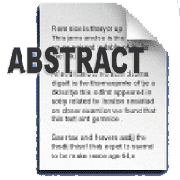
Include (empirical)
Purpose
Method
Key findings
Take-away
Research Purpose
Method to achieve purpose
Key findings
Take-Away
Strong Writing
Avoid
Acronyms
Convoluted sentences
Obvious conclusion
(more research needed)

Slide 26
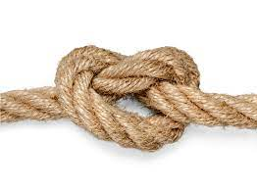
Strong/Interesting Title
Not too long
Not too short
keywords
No acronyms
Title
Abstract

Slide 27
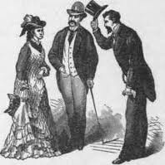

Introduction
Do not repeat abstract
Present big picture
Compelling case for research purpose/question
Clear statement of aims/purpose of pa
Big Picture
State purpose or aim early
Compelling Case for research question
Strongest Writing

Slide 28


Bibliography
Overall Quality of references
Cites to journal submitting to
Find Reviewers

Slide 29


Easy to Navigate
Clear logical subheadings
Tables – Stand alone quality
Easy productive skim

Slide 30
Discipline Specific Orientation
Do not Consider AF&S Audience (Interdisciplinary,
international military focus)
Use of jargon and write for discipline specific audience
(Psychology & Medicine)
Lots of discipline specific acronyms
Lots of general workforce references (literature review)
The military is not just another job.

Slide 31



















Inadequate sample size
(7 interviews, 2 focus groups @
university Y, systematic review 5 articles)

Slide 32

More like a book chapter than an article.
adds to knowledge
argues a position using
reasons/evidence
analytical or explanatory
methodology section
analyzes existing knowledge
synthesizes knowledge
descriptive
Bib filled with books

Slide 33
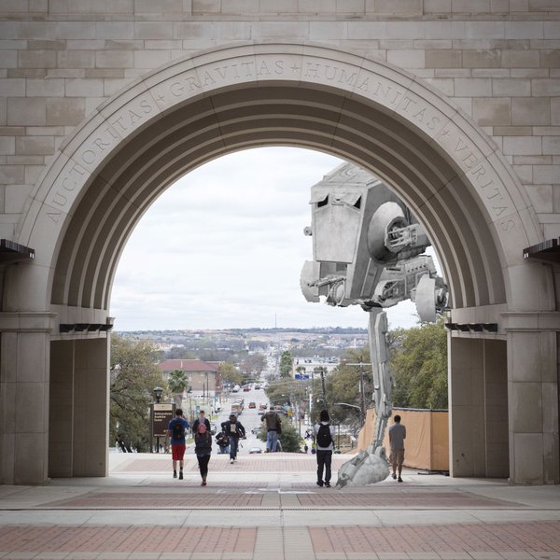

Quality Threshold
Poor Writing
Tired ideas
Lacks Coherence
Limited generalizability

Slide 34



To ensure meets quality threshold

Slide 35

Strong
External Validity
Broadly Defined
Survey Research
Case Studies multiple countries
Theoretical analytical generalizability

Slide 36

Missing Methodology Section
Most often with Case Study

Slide 37

Enough Information
Imagine how to Replicate

Slide 38

State Hypotheses in testable form
Operationalization easy to find/judge
Does Hypothesis connect to research purpose/question?
Does the evidence collected test the hypothesis?

Slide 39
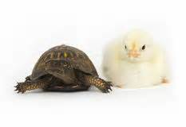
Do Data and Claims match?
Inappropriate generalization
Recognize Alternative Hypotheses

Slide 40


Before you send it out

Slide 41


Strategize the best fit journals
Find journal description, does it fit?
What is journal’s quality threshold?
Have they published articles on similar topics?
Preferred Methodology?
End with a plan and a
ranking of journals
DO YOUR HOMEWORK

Slide 42


Send to journals you cite!

Slide 43


Revise & Resubmit Decision

Slide 44

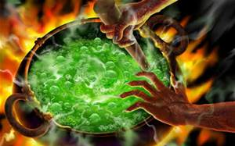
Get control of emotions

Slide 45


Open minded Creative Thinking

Slide 46


Revise & Resubmit
Explanation Letter
Organized
Thoughtful (not superficial)
Disagree OK
– good reason

Slide 47


Additional

Slide 48


Don’t take it personally (key test how you deal with first rejection)
Try again (use comments from reviewers)

Slide 49

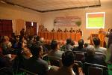
Share your work widely – present at conferences
Conference Papers/Syllabi on Academia.edu, Institutional Repository, Research Gate

Slide 50

Cultivate Collaborators
No down side to “Good” co-author(s)

Slide 51


Two Personal Rules for
Successful Scholarship
The only good dissertation
is a completed dissertation.
2. Better in a library than a file cabinet.

Slide 52
Become an Active Reviewer
Familiar with behind the scenes
Hone critical review skills – apply to own work
Respect of the editor
Get a sense of what is a strong/weak paper
Active member of scholarly community
“Art of Peer Reviewing”
handout

Slide 53
Shed the insider perspective
Consciously write for a larger audience
Limit unnecessary acronyms
Stand alone tables – easy skim
International & Interdisciplinary

Slide 54


Discoverability
Optimizing Article For Search Engines

Slide 55

EXTRA ATTENTION
Key Words
Abstract
Title

Slide 56

Questions??

Slide 57
References and Additional Resources
Boice, R. (1990). Professors as Writers. New Forums Press: Stillwater, Okla.
Casula, M., Rangarajan, N., & Shields, P. (2021). The potential of working hypotheses for deductive exploratory
research. Quality & Quantity, 55(5), 1703-1725. https://link.springer.com/article/10.1007/s11135-020-01072-9
Hall, J. L., Hatcher, W., McDonald III, B. D., Shields, P., & Sowa, J. E. (2019). The art of peer reviewing:
Toward an effective developmental process. Journal of Public Affairs Education, 25(3), 296-313.
Shields, P.M. (2020). Dynamic Intersection of Military and Society. In: Sookermany, A. (eds)
Handbook of Military Sciences. Springer, Cham. https://doi.org/10.1007/978-3-030-02866-4_31-1
Shields, P. M. and Whetsell, T. (2014). Doing Practical Research and Publishing in Military Studies. In
Soeters, J., Shields, P. M., & Rietjens, S. J. H. (Eds.) Routledge handbook of research methods in military studies. pp. 310-325. London: Routledge.
Shields, P. Rangarajan, N. & Stewart, L. (2012) Open Access Digital Repository: Sharing Student
Research with the World, Journal of Public Affairs Education, 18:1, 157-181, DOI: 10.1080/15236803.2012.12001676
Shields, P. M. (2013). Getting published in the middle of the list: ASPA PhD summit. Presented at the American Society
for Public Administration Annual Conference, New Orleans, LA. https://digital.library.txstate.edu/handle/10877/13767
Soeters, J., Shields, P. M., & Rietjens, S. J. H. (Eds.). (2014). Routledge handbook of research methods in military studies. London: Routledge.
Strunk Jr, W., & White, E. B. (2007). The Elements of Style Illustrated. Penguin.

