Slide 1


ASPA PhD Summit
Getting Published & Finding Coherence
Patricia M. Shields
Professor, Political Science
Texas State University
ps07@txstate.edu
Editor – in – Chief
Armed Forces & Society
International
Interdisciplinary
~ 40 years
March 16, 2014

Slide 2
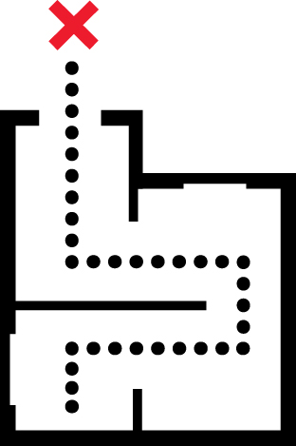

Plan for Presentation
Stages in manuscript processing
Editor’s Perspective
Tips for Article Acceptance
Article Coherence
Tips from the Playbook

Slide 3
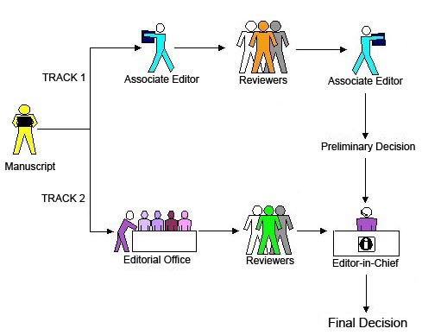
Editorial Process
(submission - publication)

Slide 4

Editorial Process
Manuscript arrives
Scholar One
Editor’s Review
Editor’s Reject 40% (Handout – criteria)
Find Reviewers
- look at bibliography
- Reviewer Data base
- Key words

Slide 5

Editorial Process (cont.)
Send out for review
2-4 reviewers
Reviews in
Send reminders
Reviewers assessment
Accept, Reject, Revise and Resubmit

Slide 6


Editorial Process
First Round Decision
Accept Very rare (1 in 50)
Reject (1 in 2)
Revise and Resubmit (most common)
Editor’s Comment
How to weigh reviewers’ comments
(Top scholar, graduate student)
Find additional problems
Persistence

Slide 7
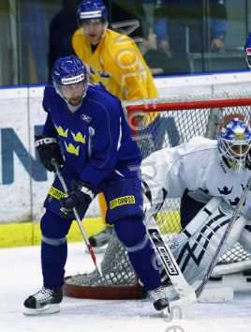
Editorial Process (cont.)
Revise and resubmit comments sent to author
Revised Manuscript and letter with explanation arrives - Re-review Re-review (could be 2 - 4 rounds)?
Decision - Accept/Reject
If Accept publisher takes over
Like a sports team - it often takes practice and more practice to achieve the goal.

Slide 8
Copyediting by Sage
Author queries – Clarification
On line first
Assigned to an
Issue

Slide 9


Tips for publishing
Editors Perspective
Scholars perspective

Slide 10


Editor as Coach and Cop
Improve the manuscript
Make sure poor material gets caught

Slide 11
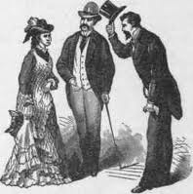

Tips Article Acceptance
(any journal)
Introduction
Easy to Skim

Slide 12
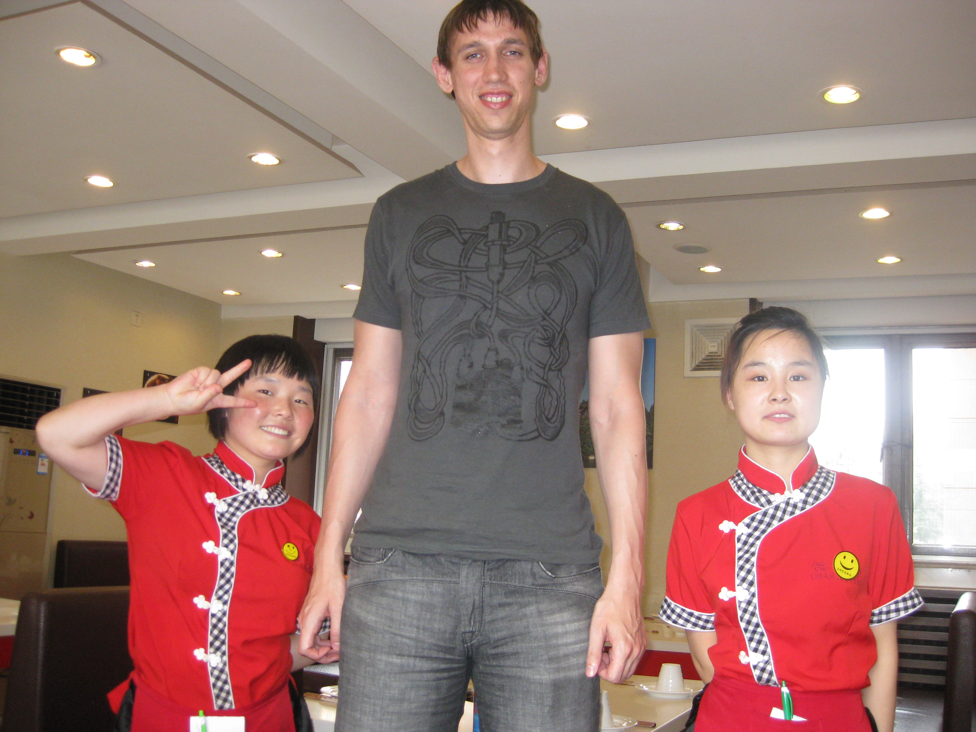
Tips Article Acceptance
good fit for journal
Cite the journal

Slide 13

















Tips for Article Acceptance
Adequate sample size
State Hypotheses in testable form

Slide 14

Additional Tips
Share your work widely – present at conferences
Develop cadre of research colleagues
Co-author(s)
Don’t take it personally (key test how you deal with first rejection)
Try again – use comments form reviewers

Slide 15

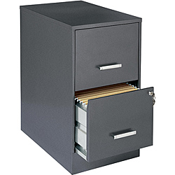
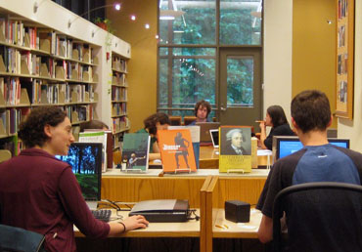
Two Personal Rules for
Successful Scholarship
The only good dissertation
is a completed dissertation.
2. Better in a library than a file cabinet.

Slide 16


Discoverability
Optimizing Article For Search Engines
Change in the way knowledge is being
generated and distributed.
In 20 years most knowledge will not be trapped in paper.
Correlation between downloads and citations

Slide 17

Tips from
Pay extra attention to writing the Abstract
Get the title right
Choose key words carefully

Slide 18
Articles Rejected for Lack of coherence
Purpose
Theory
Data Analysis
Method
Parts just not connected!

Slide 19
Steps in Research Process
Purpose
Theory
Data Analysis
Method
Conceptual
Frameworks
Role of Theory
Connections between Steps

Slide 20

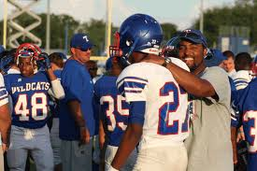




Notebook
Inspired
Football Player Students
Story

Slide 21

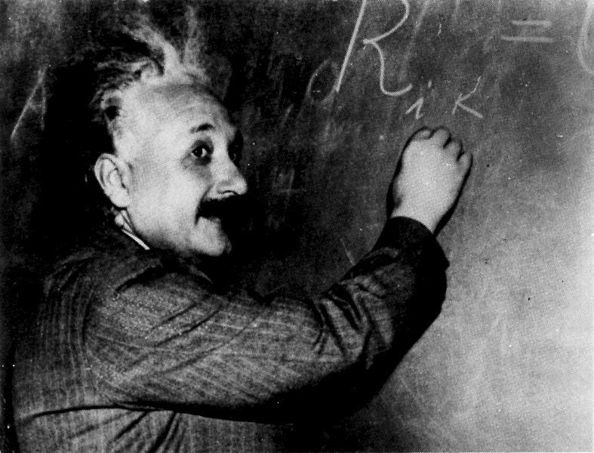
What is Theory?
“Theory can be defined as a coherent group of general
propositions or as a verified explanation accounting for known facts or phenomena (theory of relativity or gravity) Theories are used to explain reality or make predictions.” Johnson, 2010, p. 17

Slide 22

Theories apply at different
Policy Scales
Meta theory
Micro-economics
Where does your
dissertation fit in this scale?
Labor
economics
Hypotheses for
study
What factors explain wages
in local labor market?
Most fit here

Slide 23


Football Scale
Rules
Game Strategy
Individual play
Distinct and
interdependent
Moral and Science considerations

Slide 24

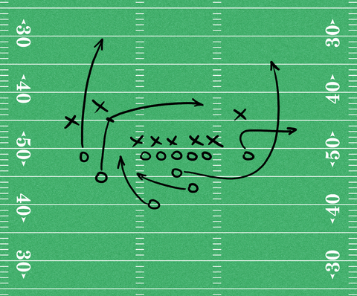
Plays are mental images/ideas that organize what players do on the ground in a particular situation
Plays do not make sense without
a purpose
Plays are a kind of close to the ground Theory
Like individual study

Slide 25
purpose
Long or short yardage
Play
ideas that organize player actions
How men move on ground
Results
Actual yardage gained
Movement of players on ground

Slide 26
Research Process Taking into account
Traditional Research notions of Theory
Research Purpose
Explanation
Theory -- Conceptual Framework
Hypotheses
Methodology
Data Collection Techniques
Statistics
Analyzing and organizing data
Conceptual framework – close to the data theory

Slide 27
Conceptual Framework:
Organization of ideas to
achieve a Purpose
Purpose
conceptual framework
Data Analysis
Method
Explanation
Hypotheses
Most common

Slide 28
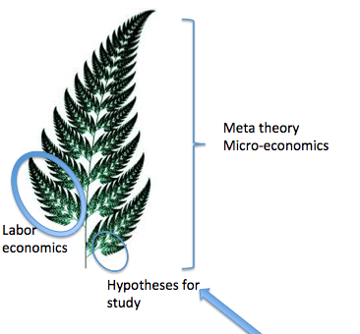

What Explains the level of Wages?
Explanation
What explains wages?
Hypotheses
Education
Intelligence
Job tenure
Theory
Conceptual
Framework
H1: As education increases wages increase
H2: As intelligence increases wages increase
H3: As job tenure increases wages increase

Slide 29
Explanation
What explains wages
Hypotheses
Education
Intelligence
Tenure
Method
Operationalize variables
Survey
Dependent variable – Wages (Hourly rate of pay)
Independent variables Education (years of school completed) H1
Intelligence (IQ score) H2
Tenure (months on the job) H3

Slide 30
Purpose
Explanation
(what explains wages)
Hypotheses
1: education
2: Intelligence
3: tenure
Method
Operationalize variables
Statistics
Statistics used to test H1; H2; H3 (Regression; Correlation..)
survey

Slide 31
PA has many types of purposes --
and Frameworks
Many Plays
Purposes
Explanation
Conceptual Frameworks
Hypotheses
Categories
Working Hypotheses
Models of operations research
Practical Ideal Type
Description
Exploration
Decision making
Gauging

Slide 32
Purpose | Conceptual framework | Method | Data Analysis
Explanation | Hypotheses | Survey Existing data Experimental design | Multivariate statistics Regression, t-tests, correlation, …
Description | Categories | Survey Content Analysis | Descriptive Statistics Mean, median, mode
Exploration | Working Hypotheses | Mostly Qualitative Case study, interviews, focus groups, direct observation… | Evidence analyzed by working Hypotheses
Decision Making | Models of operations research | Cost benefit analysis, cost effectiveness analysis, linear programing ……. | Depends on the technique used
Gauging | Practical ideal type | Mostly Qualitative Case study, interviews, focus groups, direct observation… | Evidence analyzed by criteria of practical ideal type

Slide 33
Purpose | Conceptual framework | Method | Data Analysis
Explanation | Hypotheses | Survey Existing data Experimental design | Multivariate statistics Regression, t-tests, correlation, …
Description | Categories | Survey Content Analysis | Descriptive Statistics Mean, median, mode
Exploration | Working Hypotheses | Mostly Qualitative Case study, interviews, focus groups, direct observation… | Anything goes Evidence analyzed by working Hypotheses
Decision Making | Models of operations research | Cost benefit analysis, cost effectiveness analysis, linear programing ……. | Depends on the technique used
Gauging | Practical ideal type | Mostly Qualitative Case study, interviews, focus groups, direct observation… | Evidence analyzed by practical ideal type category
Traditional
Methods Texts

Slide 34


Examples of Quality
Student Research
Award Winning (national, regional)
Cited (Journals, Books,
United Nations Reports, Dissertations,
Policy documents)
Widely Downloaded

Slide 35
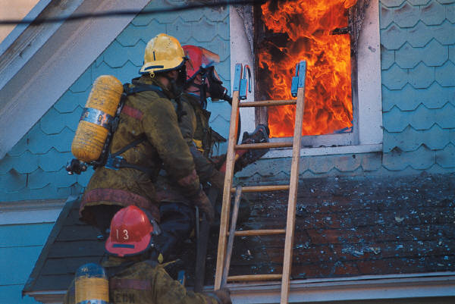

Handouts
What explains home fires?
College graduates attitudes
Toward high stakes testing.

Slide 36
Where do Conceptual
Frameworks come from??
Literature Review Chapter
Creativity Chapter
Like coach that creates
Plays
Learn Middle school
plays before big time.

